Slide 1

Seasonal Agriculture Performance Analysis
Student Name : Sneha Mahesh Vanjare
College Name : Bharati Vidyapeeth College of Engineering Kolhapur
AICTE STU ID : STU6a0d9a26e53d71779276326

Slide 2

PROBLEM STATEMENT
Agricultural activities are influenced by seasonal variations in environmental conditions, farming practices, resource availability and market conditions. As a result, agricultural performance may differ from one season to another. However, raw agricultural data does not clearly explain how agricultural performance changes across seasons or what patterns can be observed in different seasonal conditions. The problem is to analyze the given agricultural dataset and investigate seasonal differences in agricultural performance by identifying meaningful patterns, trends, relationships and variations within the available data.

Slide 3
Project Description Seasonal Agriculture Performance Analysis is a data analytics project focused on analyzing agricultural performance across different seasons, crops, and geographical regions. The project involves cleaning and preprocessing the agricultural dataset, performing exploratory data analysis, and identifying seasonal patterns in yield, production, revenue, cost, and profit. It also examines the relationship between environmental factors such as rainfall, temperature, and soil moisture and agricultural outcomes. Resource usage, including water, fertilizer, pesticides, and irrigation methods, is analyzed across seasons. Statistical techniques such as correlation analysis and ANOVA, along with visualizations using Python, Matplotlib, and Seaborn, are used to identify significant trends and variations. The project concludes with data-driven insights and recommendations to support better seasonal agricultural planning.

Slide 4

WHO ARE THE END USERS?
The end users of the Seasonal Agriculture Performance Analysis project include farmers, agricultural planners, agricultural departments, researchers, and policymakers.
Farmers can use the insights to understand seasonal changes in crop yield, resource usage, and profitability.
Agricultural planners and government departments can use the analysis for better seasonal planning and resource allocation.
Researchers can use the findings to study relationships between environmental conditions and agricultural performance, while policymakers can use the data-driven insights to support evidence-based agricultural decisions.

Slide 5

Technology Used
Python – For data analysis and processing.
Jupyter Lab– For developing and documenting the complete analysis.
Pandas – For data cleaning, manipulation, and analysis.
NumPy – For numerical operations and calculations.
Matplotlib – For creating data visualizations and charts.
Seaborn – For statistical visualizations and graphical analysis.
SciPy – For statistical analysis such as ANOVA and correlation.
Scikit-learn – For data preprocessing and performance-score analysis.

Slide 6
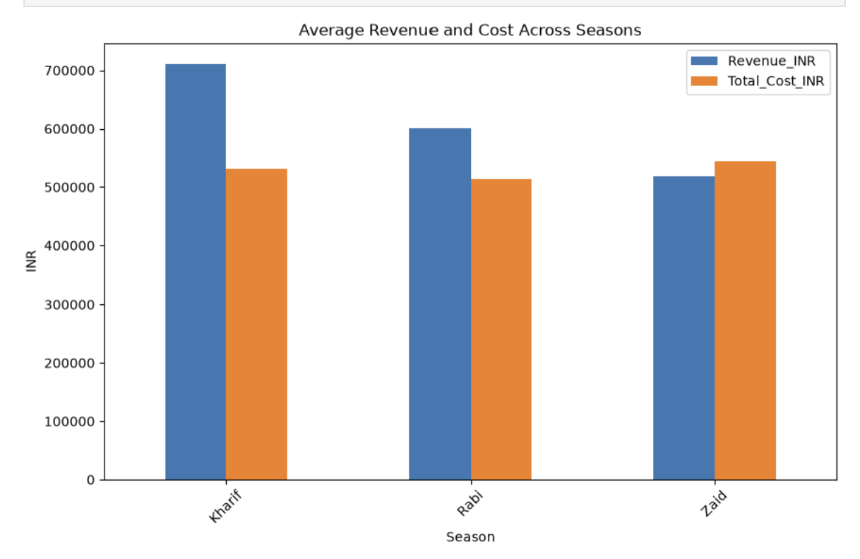
RESULTS
The chart compares the average revenue and total cost across different seasons. Kharif has the highest average revenue, while Zaid has the lowest revenue and its cost is higher than its revenue. Overall, the chart shows that revenue and cost vary across seasons, which helps identify the more economically favorable seasons.

Slide 7
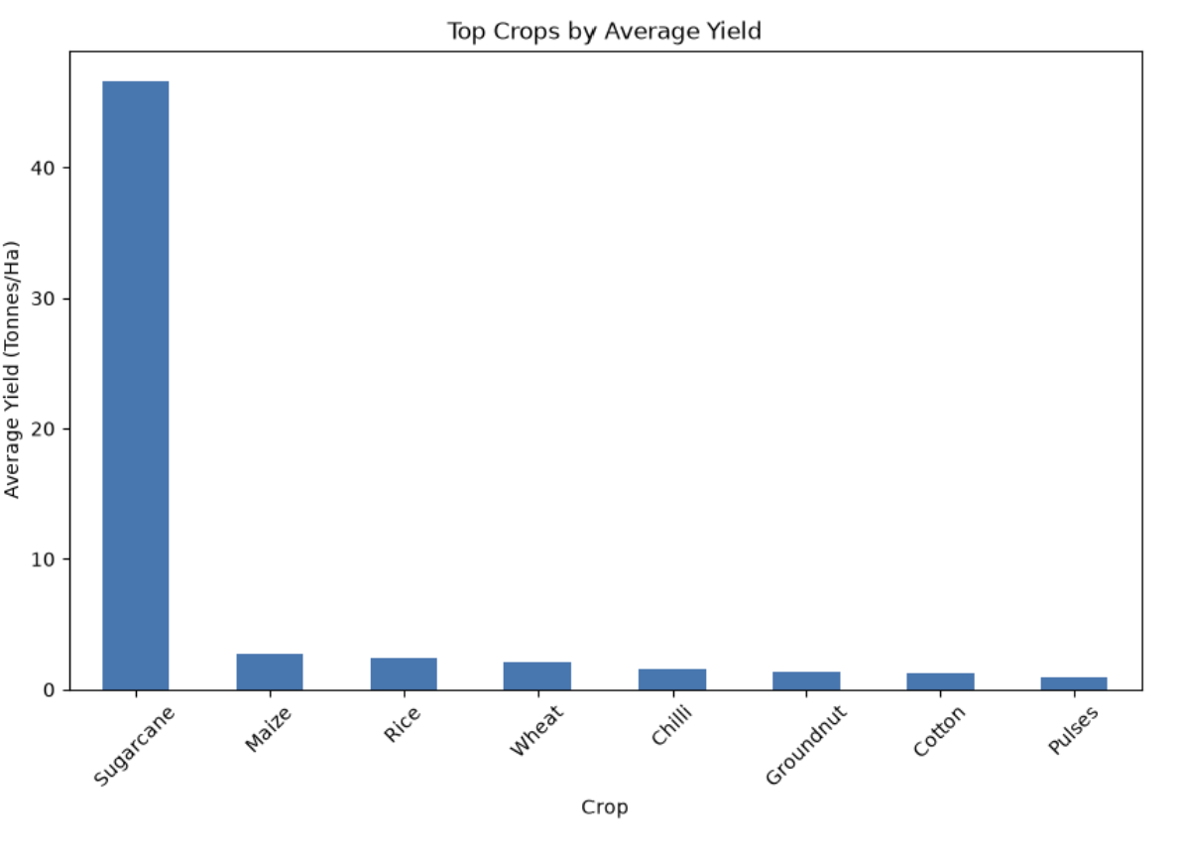
RESULTS
The analysis identifies the top-performing crops based on average yield. Sugarcane shows the highest average yield among the selected crops, while the other crops have comparatively lower yields. This analysis helps understand differences in crop productivity and can support better crop selection and seasonal agricultural planning.

Slide 8
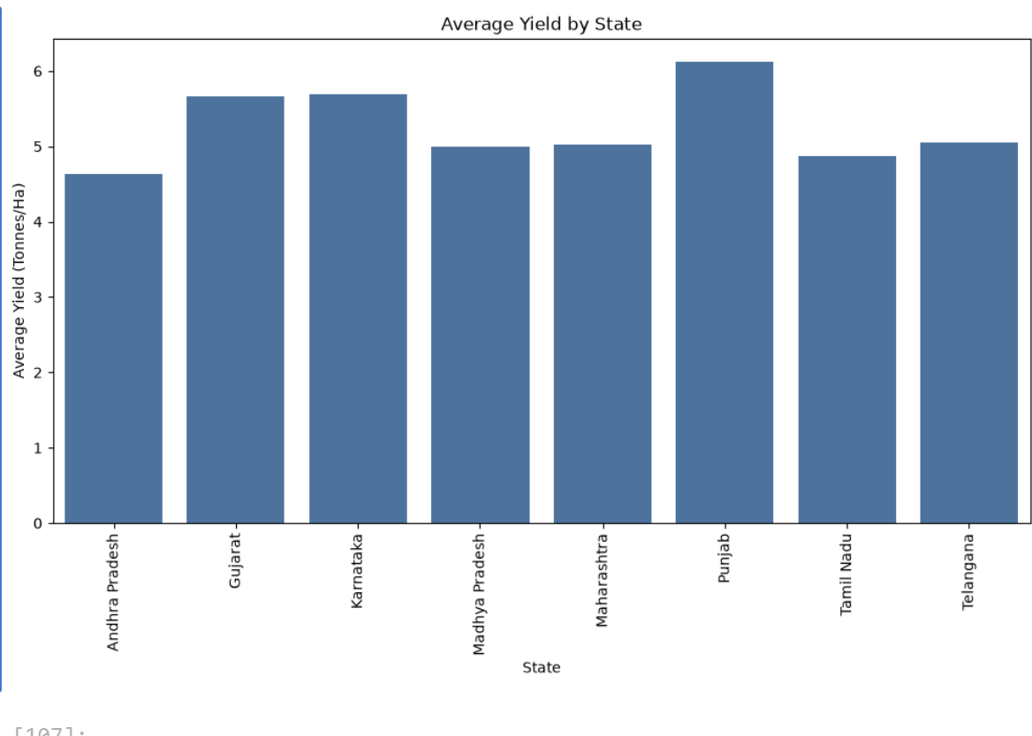
RESULTS
The state-wise analysis evaluates agricultural performance across different states based on yield, production, revenue, and profit. The average yield chart highlights differences in crop productivity between states. These regional variations provide useful insights into agricultural performance and can help identify states requiring further investigation or improved resource planning.

Slide 9
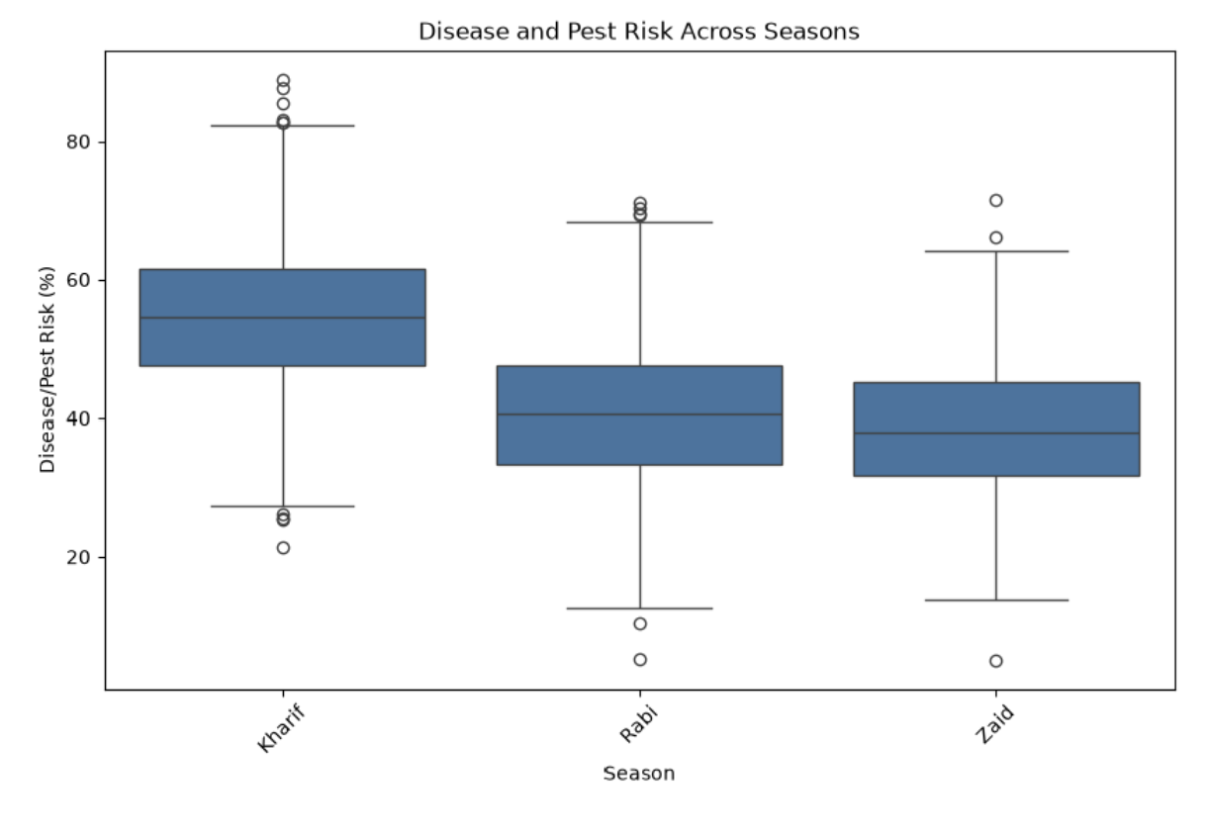
RESULTS
The boxplot shows that Kharif season has the highest disease and pest risk, while Rabi and Zaid have comparatively lower risk. The outliers indicate some unusually high or low risk values. This highlights the need for better pest and disease monitoring during high-risk seasons.

Slide 10
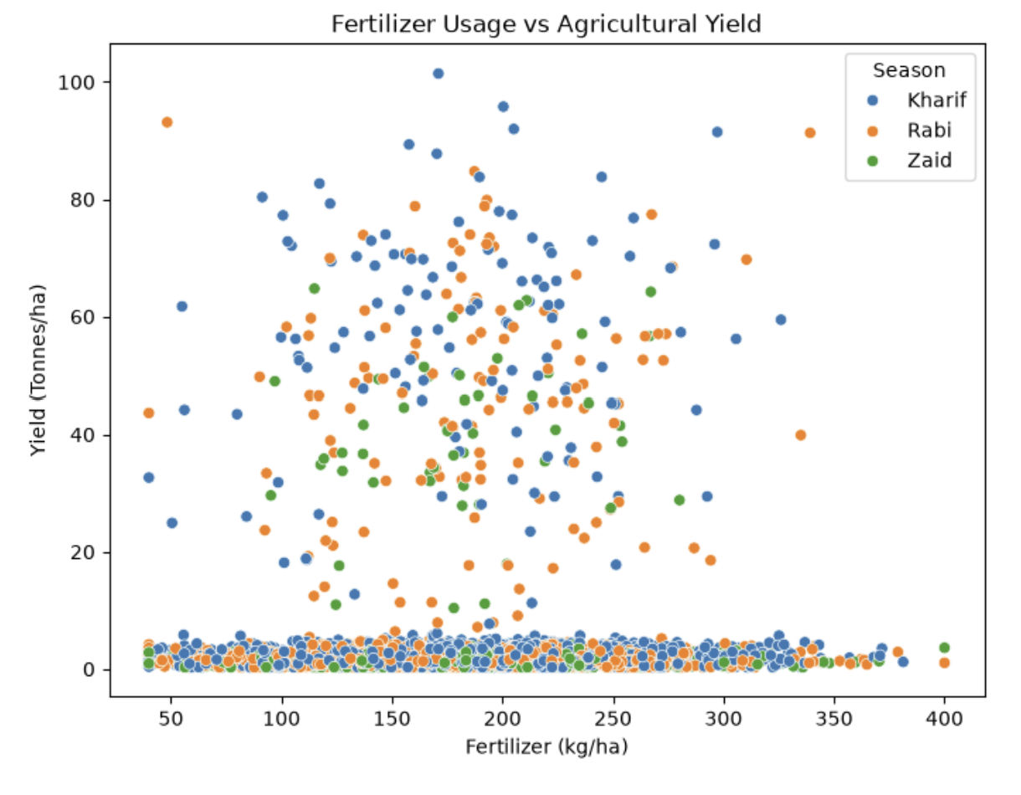
RESULTS
The scatter plot shows the relationship between fertilizer usage and crop yield across different seasons. The points are widely distributed, indicating that fertilizer usage does not have a simple direct relationship with yield. Kharif, Rabi, and Zaid show different yield patterns, suggesting that seasonal and other environmental factors may also influence agricultural productivity.

Slide 11
Future scope
Real-time weather integration can be added to analyze the impact of changing weather conditions on crop performance.
Crop yield prediction can be developed using Machine Learning models based on seasonal, environmental, and farming factors.
Disease and pest prediction can help farmers identify potential risks in advance.
Real-time market price analysis can be added to help farmers select more profitable crops.
Interactive dashboards can be developed using Power BI or similar tools for easier monitoring and decision-making.
Regional-level recommendations can be provided based on crop, season, soil, and resource conditions.
The system can be extended with historical and real-time agricultural data to improve seasonal planning and decision-making.

Slide 12
GitHub Link
https://github.com/snehavanjare2705-art/Seasonal-Agriculture-Performance.git

Slide 13
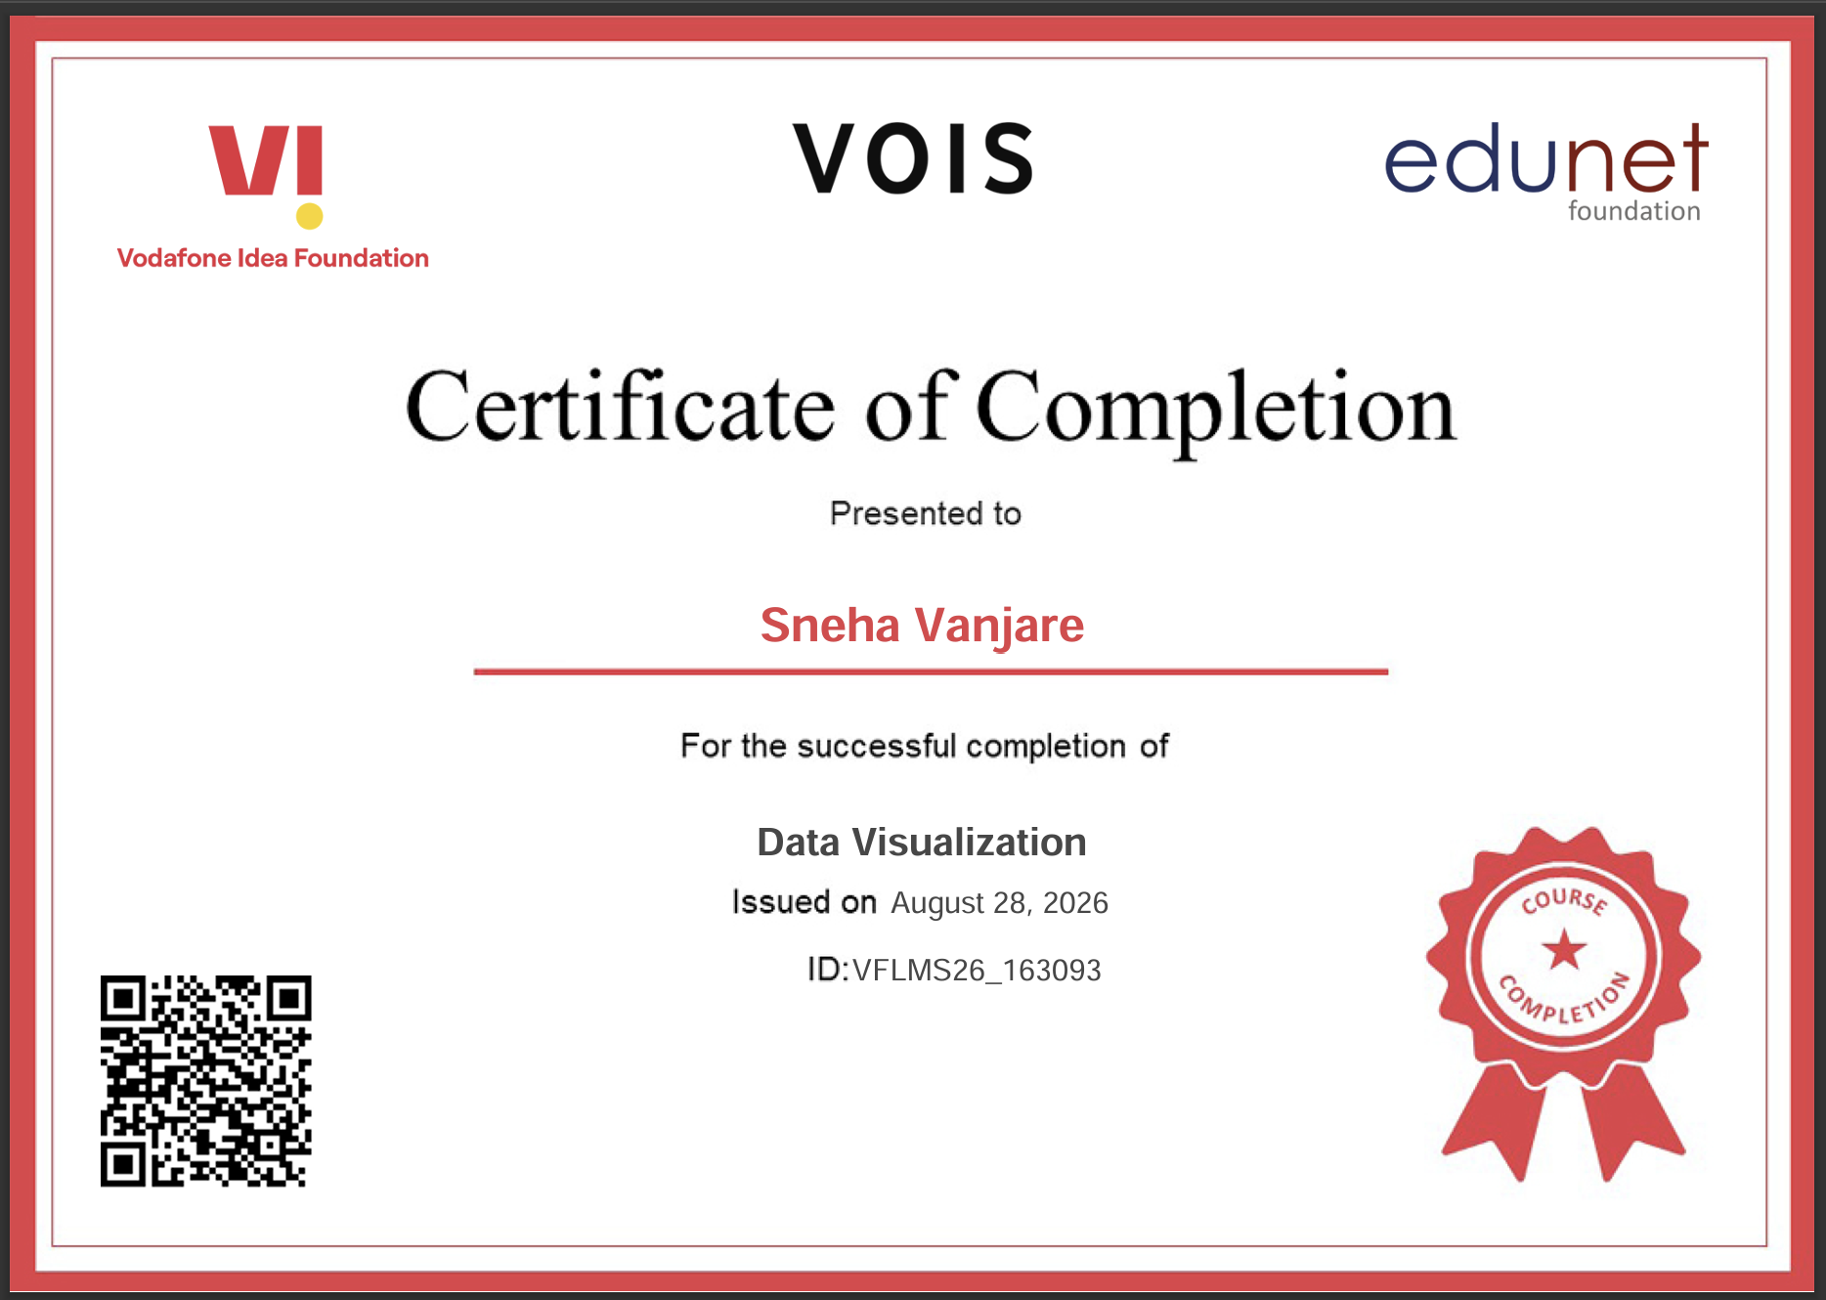
VOIS Course completion certificate - Course name- Data Visualization

Slide 14
Thank you
.
.

