Slide 1

AMCAT Data Analysis

Slide 2
About me
I’m Sneha[IN1241145], Completed M.C.A
As I am data enthusiastic .So I have been learning data science

Slide 3
Objective
As the salary is varying depending on various factors years of experience,Age,College tier,Specialization and other insights

Slide 4
Summary
The dataset contains around 40 independent variables and 4000 data points.We take salary as dependent variable and remaining variable

Slide 5
Data Cleaning
We are dropping columns like Unnamed: 0, ID,CollegeID,CollegeCityID
Replacing “-1” with “unknown” in Job city column
Replacing “present ” with “2015-12-31 in DOL
Changing data type of DOL,DOJ to date type

Slide 6
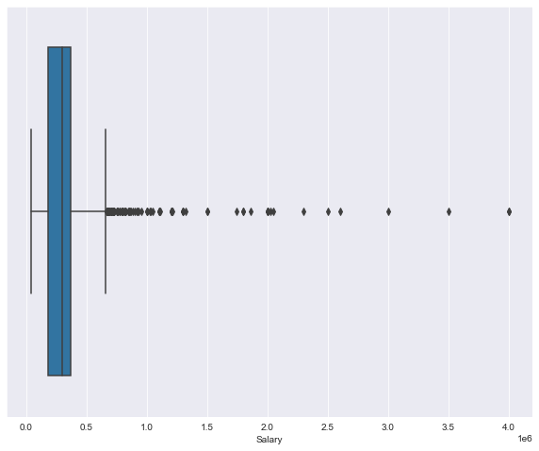
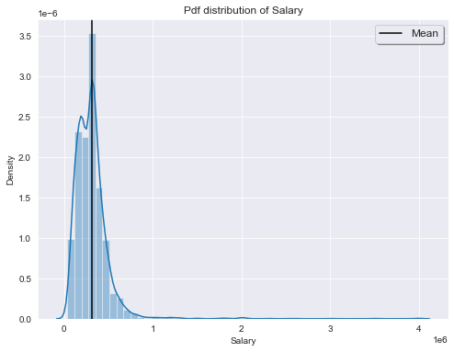
Univariante
It is pdf distribution of salary and it is right skewed salary has so many outliers

Slide 7
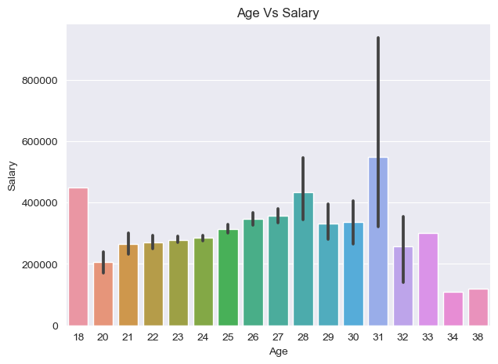
Bivariante
Age group of 31 and 30 had high salaries

Slide 8
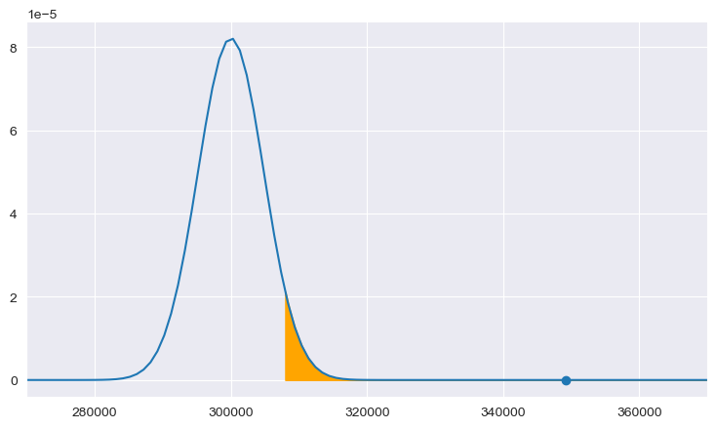
5. Research Question : Times of India article dated Jan 18, 2019 states that “After doing your Computer Science Engineering if you take up jobs as a Programming Analyst, Software Engineer, Hardware Engineer and Associate Engineer you can earn up to 2.5-3 lakhs as a fresh graduate.” Test this claim with the data given to you.
Here we are getting Reject Null Hypothesis means the salaries for freshers are getting average salaries 3.2L to 3.5L who had joined in computer science engineering took jobs in software engineer, programmer analyst and associate software engineer.
Based on the above statistics, this claim by times of India is False.

Slide 9

THANK YOU

