Slide 1
BOOK STORE WEBSITE USING HTML CSS AND JAVASCRIIPT
Mentor
Abha choubey
Presented by:
Sneha Yadav

Slide 2
Introduction
The Online Book Store Project provides interface to store book information . The user can add book data to the website with book name ,price, date of publishing, description of the book and author name. He can add books easily and delete the book they want this will help to manage books in a store it stores data in local storage with the help of JavaScript. This website is developed using html CSS and JavaScript.

Slide 3
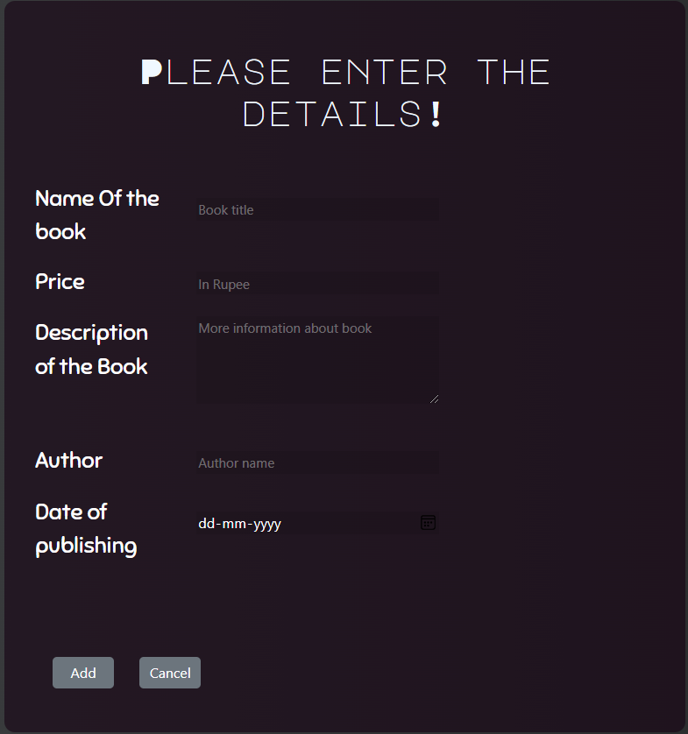
Working of the project
Add data -
Cancel button
ADD BUTTON

Slide 4
Woking of project
User can delete the book with delete button.
DELETE BUTTON

Slide 5
Working Block Diagram
Book Store
Java script arrays
Add book
View Book in the display
Delete book

Slide 6
Advantages and Disadvantages –
Advantages –
Less storage consuming.
Easy to use.
Easy to add and delete data
Attractive user interface.
Disadvantages –
Data is stored for the particular browser you are using.
Cannot update data.

Slide 7
Outcome
Using Online book store project the user can see the price list ,description and author of the book. The purpose of the project is to make a website that stores information about the book and it can be displayed . The added books will be displayed in tabular form and then user can check and see the book they want.

Slide 8
Thank you

