Slide 1
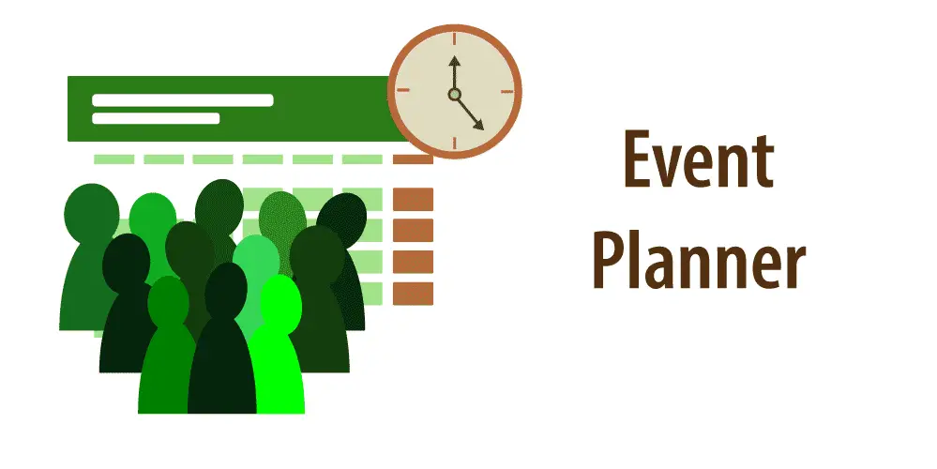
- TEAM FILO

Slide 2
Team Members
Snehitha Malireddy
Soumyashree Vainala
Mounish Kumar
Sakshi Shanbhag
_{Suchita Parira}
_{K. Sri Sravya}
_{Surya Teja Tekulapally}
Mouthika Sai Satya Karinki
Arunoday Bhattacharjee

Slide 3
Key Features
For Users :-
Registering for the portal
Creating new Event Plan Request
Viewing Quotations on the basis of the Quotations Generated
Respond to Quotations Generated and Accept and Reject them.
For Vendors:-
Create new Packages
Generate Quotations for a particular Event Plan Request

Slide 4
For Admins :-
Create New Vendors
View All existing Vendors
Activate and Deactivate Users Registered for the portal
Additional Features: -
Proper Validation of credentials for all types of actors(users, vendors and admins) to prevent unauthorized access to the systems.

Slide 5
USER JOURNEY

Slide 6

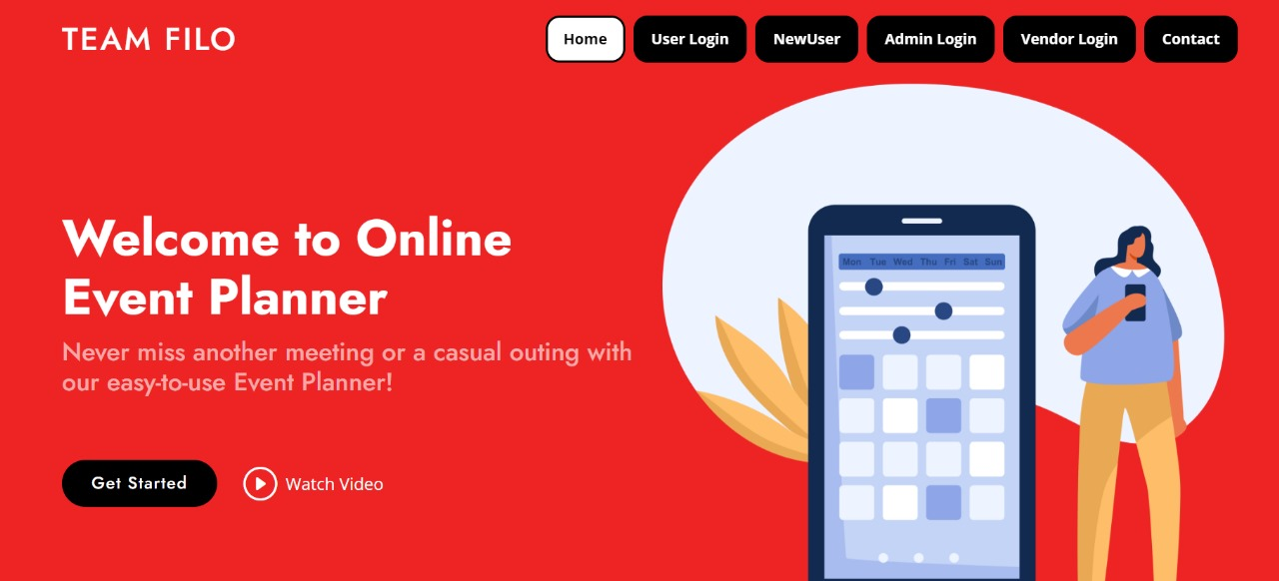
HOMEPAGE
ADMIN LOGIN VENDOR LOGIN USERLOGIN USERREGISTRATION

Slide 7
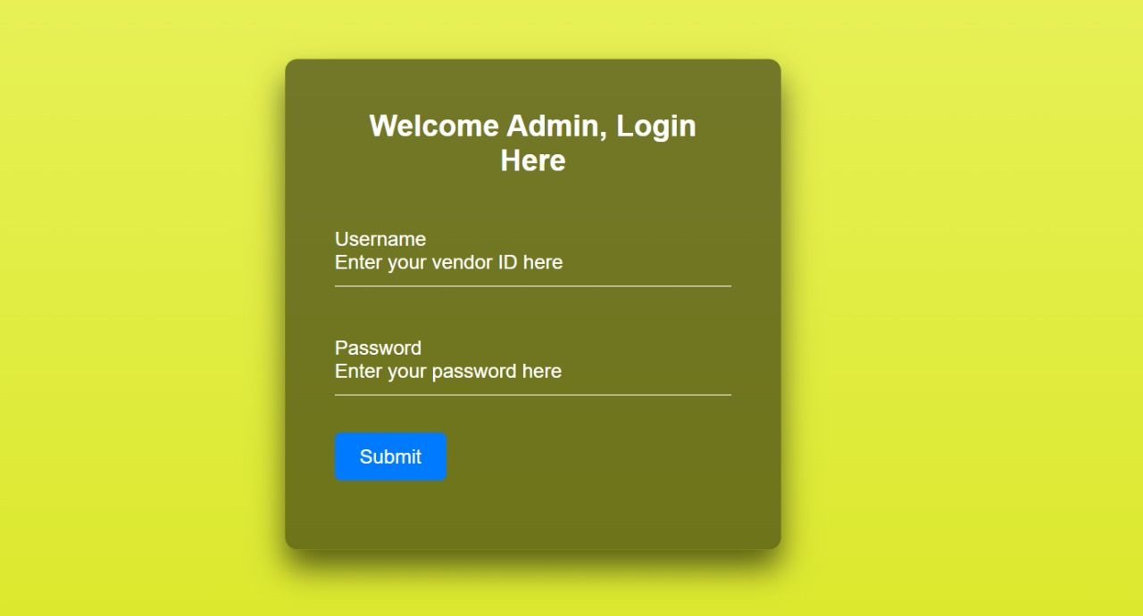
Admin Page
After successful login, Admin is directed to the admin homepage
Navigates to Admin Homepage , if the details entered are valid.

Slide 8
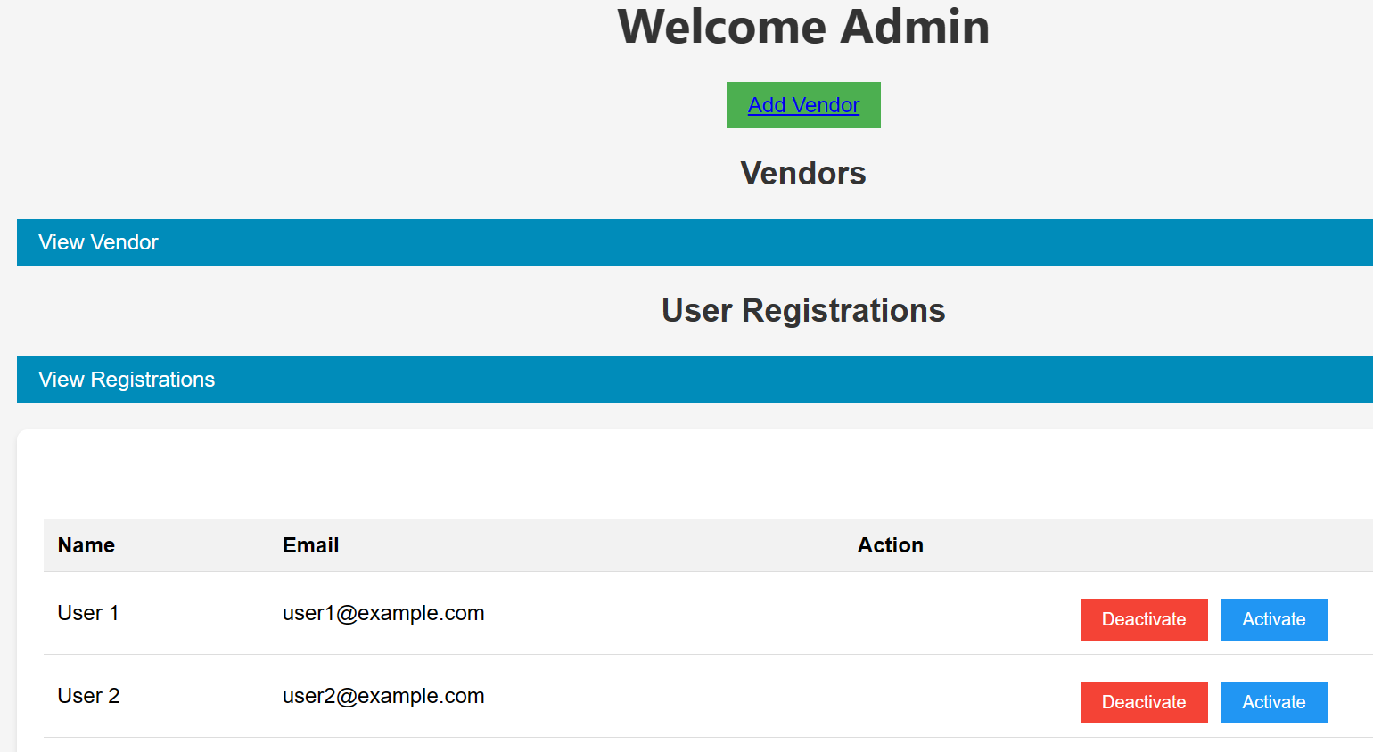
Admin Home Page
Navigates to Admin Homepage , if the details entered are valid.

Slide 9
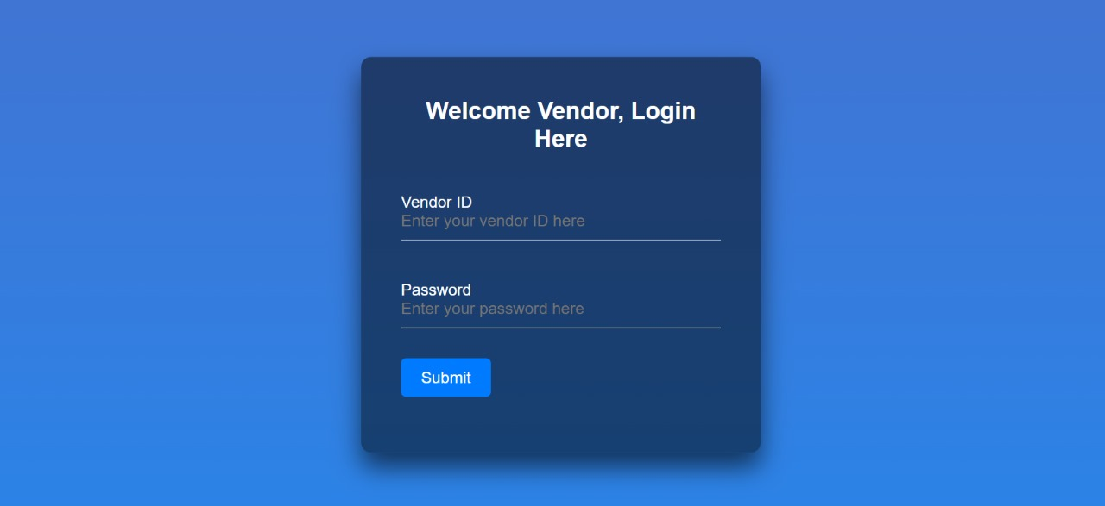
Vendor Login Page

Slide 10
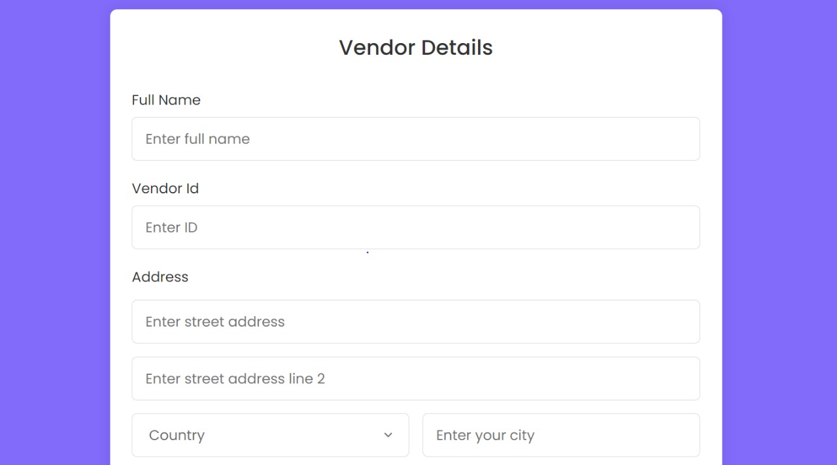
Add Vendor Page
Only Admin can add vendors
ONLY ADMIN
CAN ADD VENDOR

Slide 11
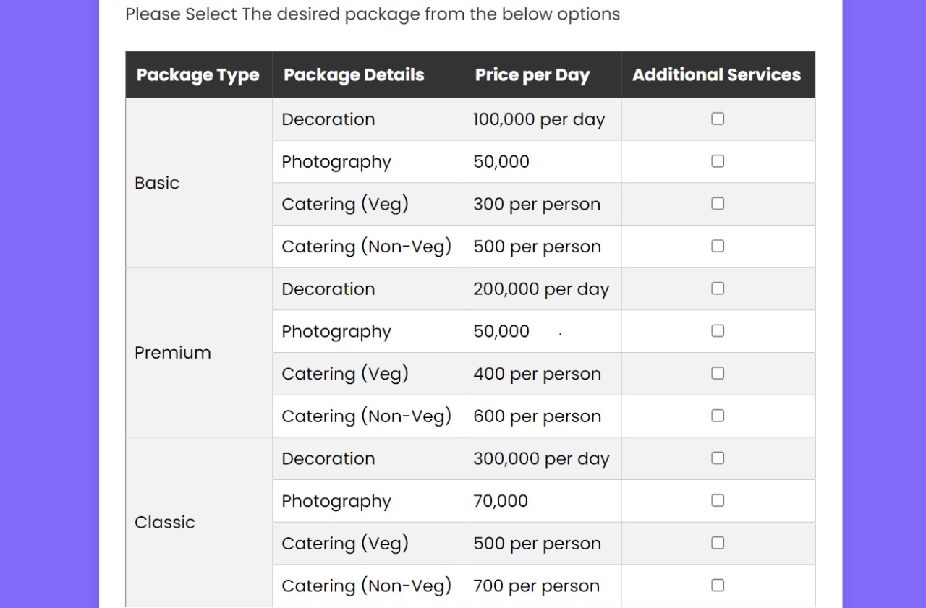
Add Vendor Page

Slide 12
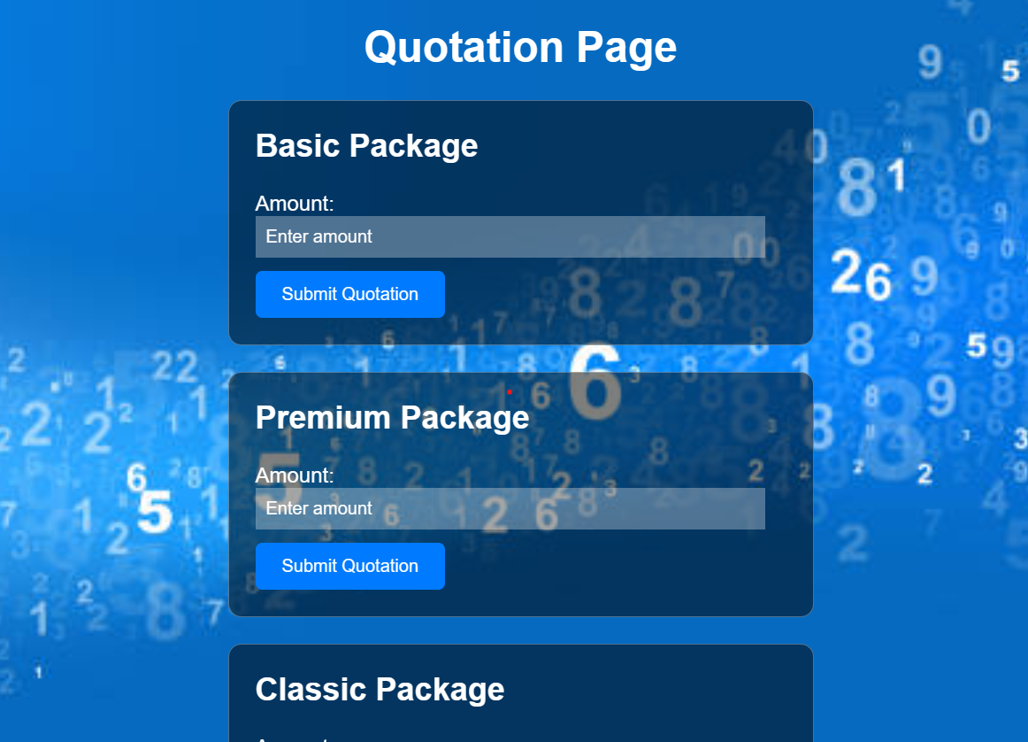
Vendor can view the User Requests in the Homepage.
Vendor gives quotations for the User Requests
There are 3 types of packages namely,
Basic
Premium
Classic

Slide 13
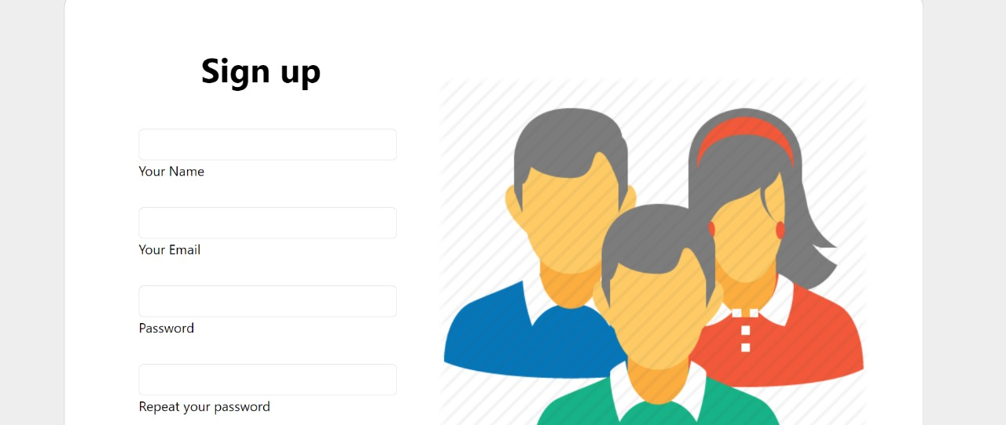
USER PAGE
User should register before logging in

Slide 14
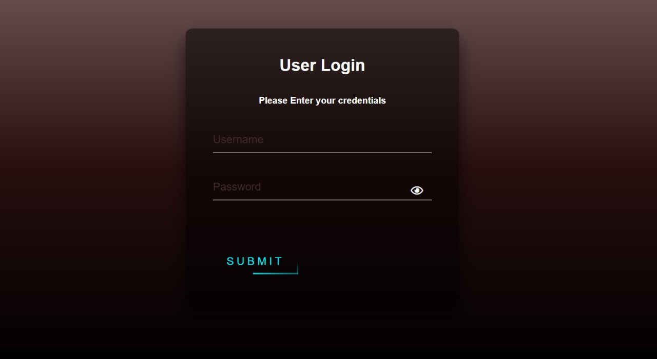
User Login Page

Slide 15
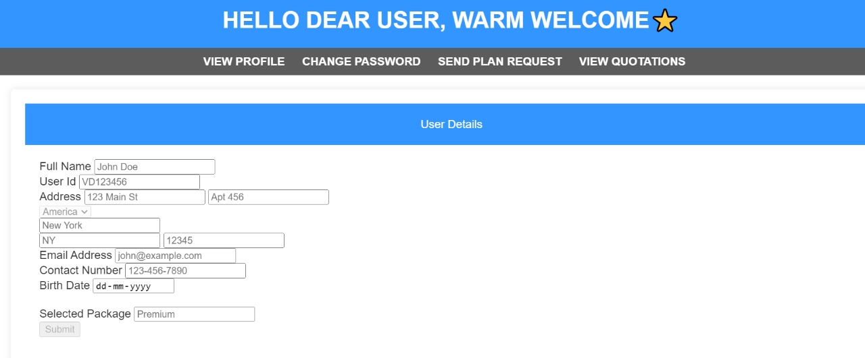
USER HOMEPAGE
User can send plan requests
User can View Quotations quoted by vendors and select the required one

Slide 16
Concepts Learned through the project
Front-end : -
Semantic HTML in order to make code readable
Using proper classes and ids to reuse styles as and when required
Using Bootstrap to make styling and grid development and design faster and easier
DOM manipulation using Javascript to Handle events and validation on user side’

Slide 17
Backend : -
Using of Layered architecture
Using interfaces in order to implement contract
Using OOPs principles like polymorphism to make methods reusable with multiple types.
Using Generic Type to ensure type safety
Handling and Throwing Exception

Slide 18








Tools Used in the Project: -

Slide 19
THANKYOU
STAY TUNED FOR THE UPCOMING EVENTS

