Slide 1


INFOSYS SPRINGBOARD MILESTONE-3
TEAM-C

Slide 2
Problem Statement
Manual receipt management problems
• Time consuming data entry • High chances of human error • Difficult to track expenses • Poor financial visibility • Hard to organize large numbers of receipts

Slide 3
Solution Overview
Our Solution: Receipt & Invoice Digitizer
• Upload receipts or invoices • Extract text using OCR • Automatically identify important data • Store data in structured database • Provide analytics and expense insights

Slide 4
System Architecture
Main System Components
User Interface (Upload + Dashboard)
OCR Engine
Data Processing & Extraction
Database Storage
Analytics Dashboard
Admin Management System

Slide 5
User Authentication Module
Secure user login system • Email and password authentication • Google login support • Admin login option • Access control for users and admins

Slide 6
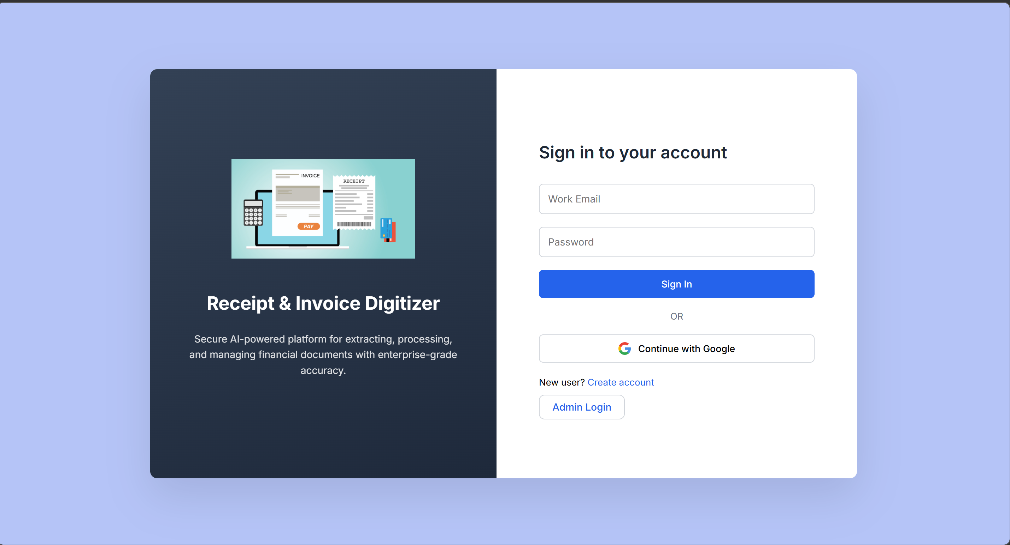
Login Page
Secure login system
Email and password authentication
Google sign-in option
Access to both user and admin portals

Slide 7
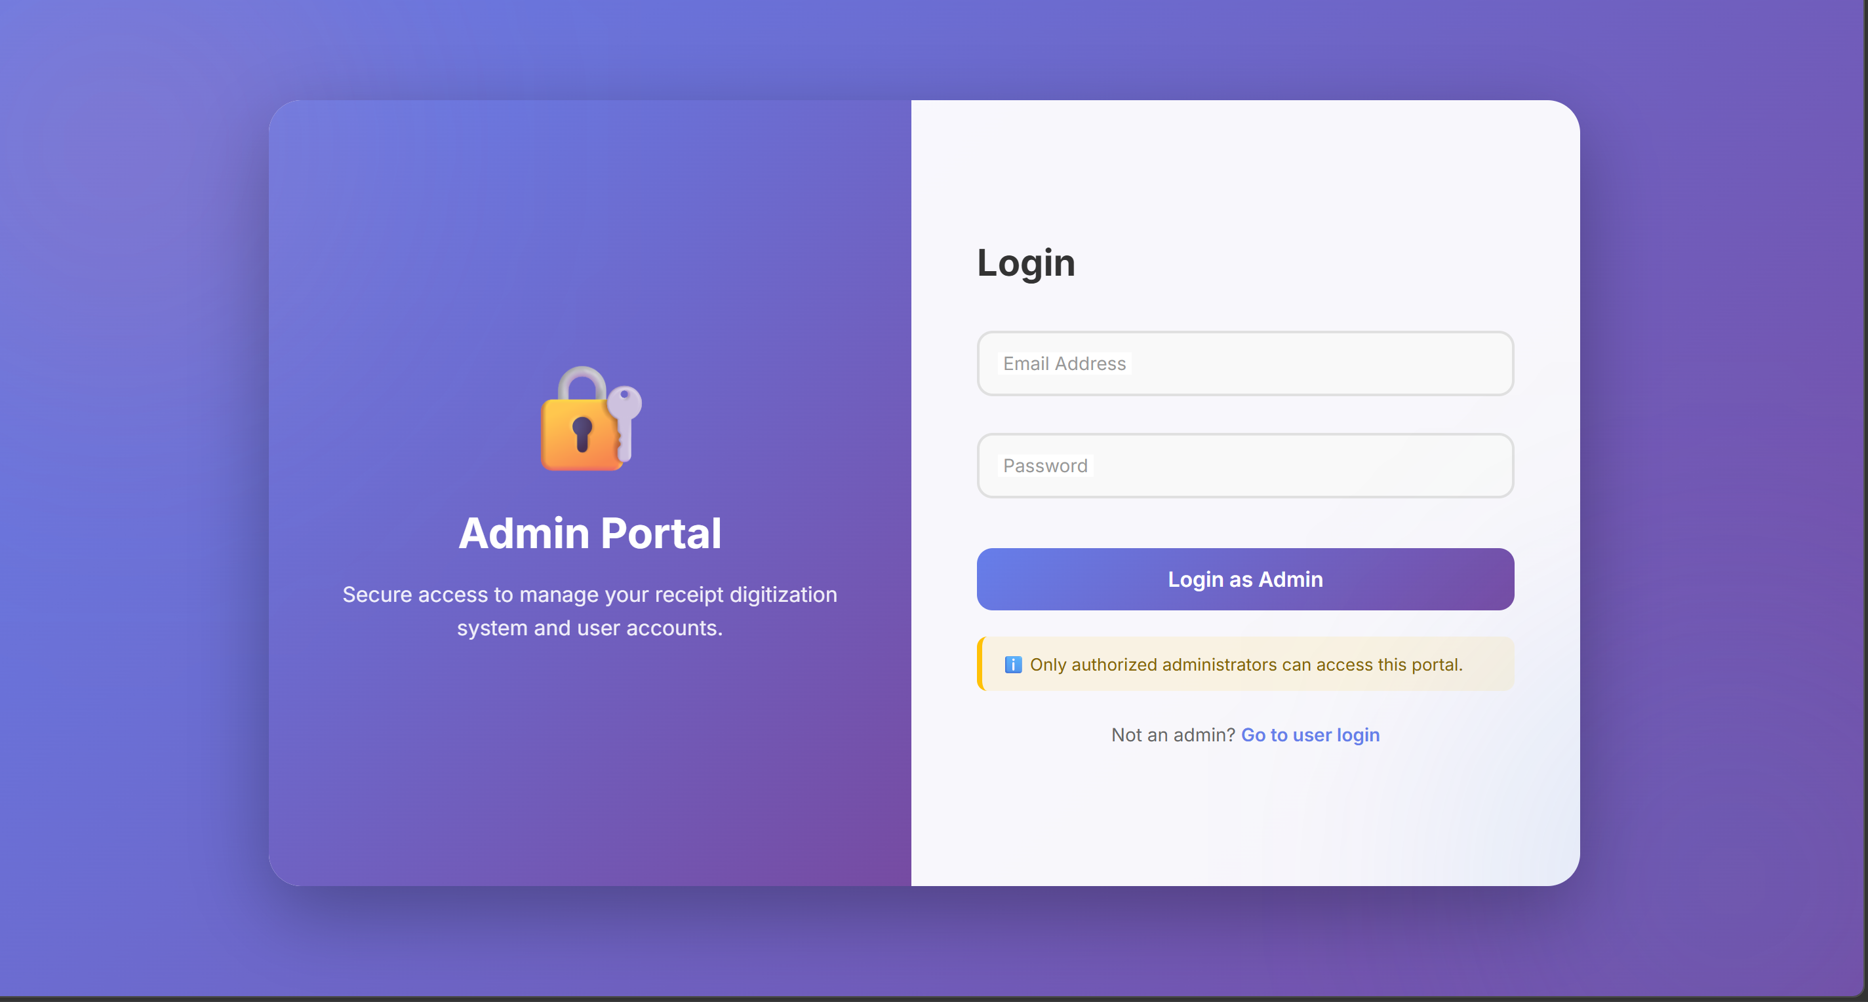
Admin Login Page
Dedicated admin login page
Secure administrator authentication
Restricted access for authorized admins only
Manages system operations

Slide 8
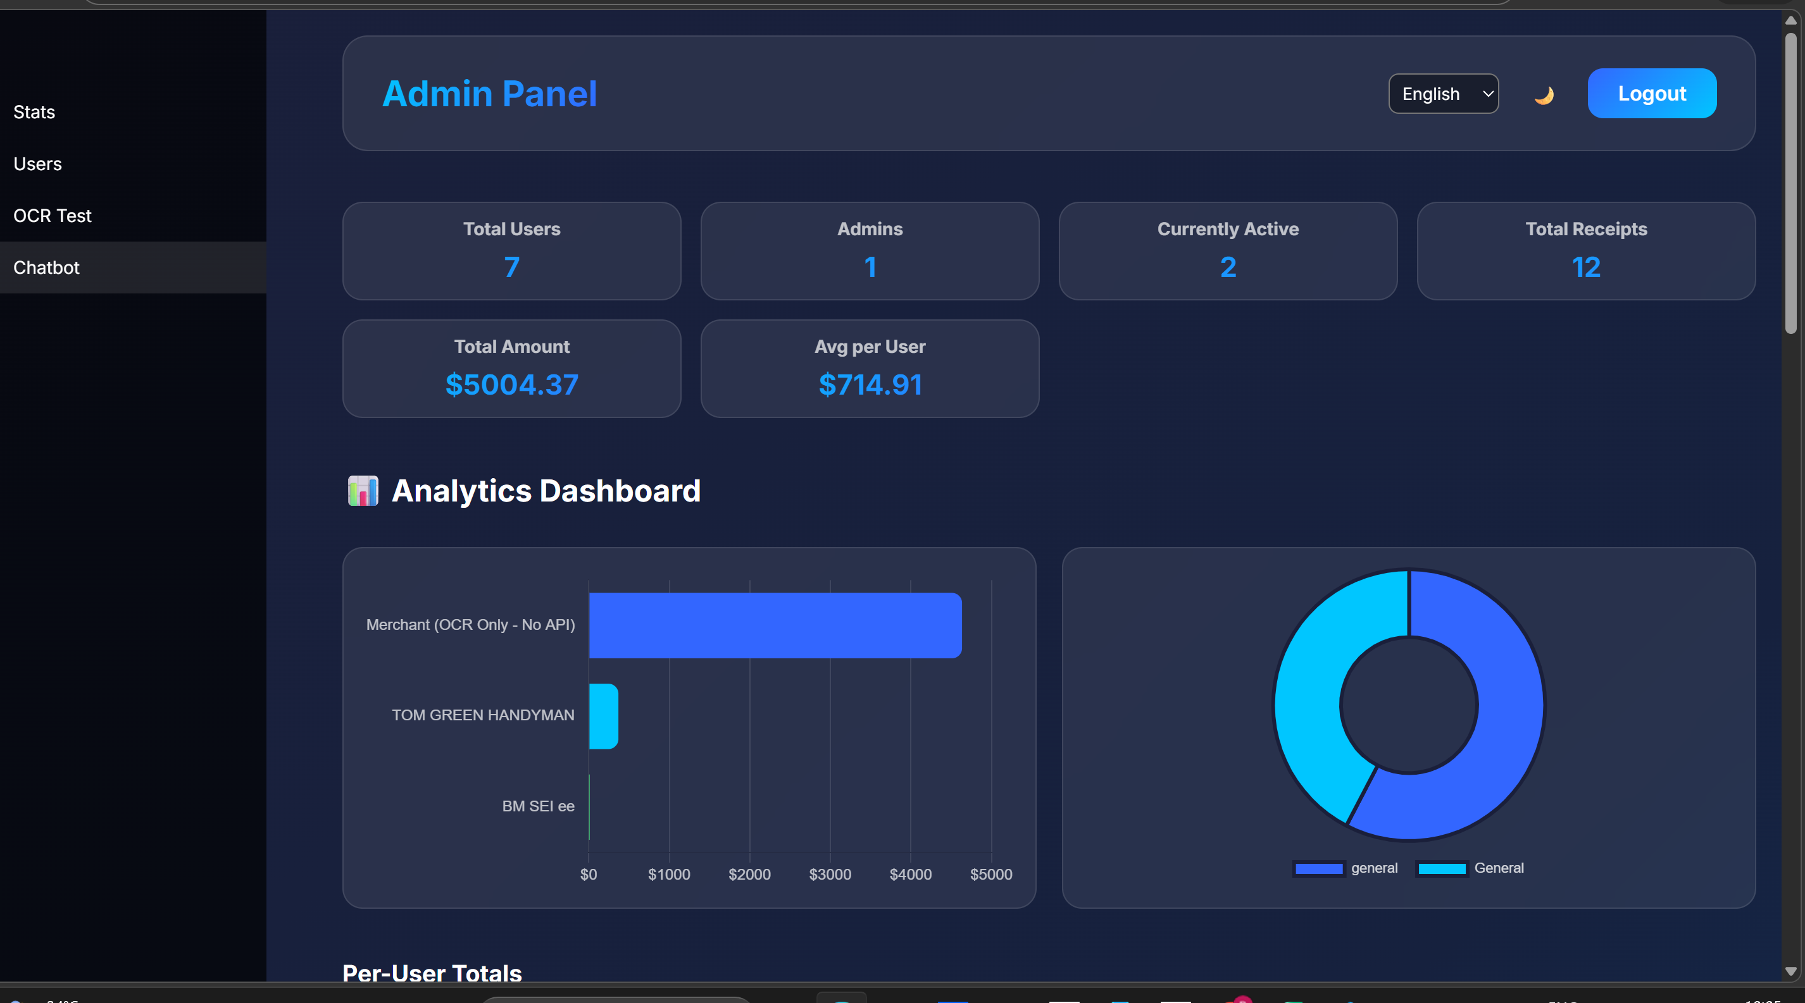
Admin Dashboard
Features:
Total number of users
Total receipts processed
Active users monitoring
Total transaction amount
Average spending per user
Admin Controls
Promote users to admin
Demote admins
View user activities

Slide 9
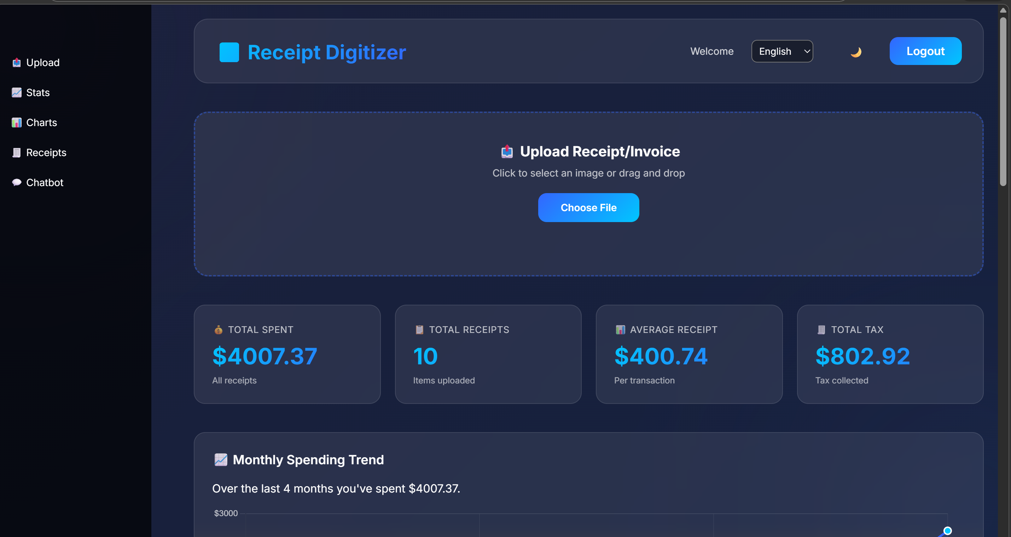
User Dashboard
Features:
Upload receipt or invoice
Drag and drop image upload
Automatic OCR processing
Instant data extraction
Key Metrics
Total amount spent
Total receipts uploaded
Average receipt value
Total tax collected

Slide 10
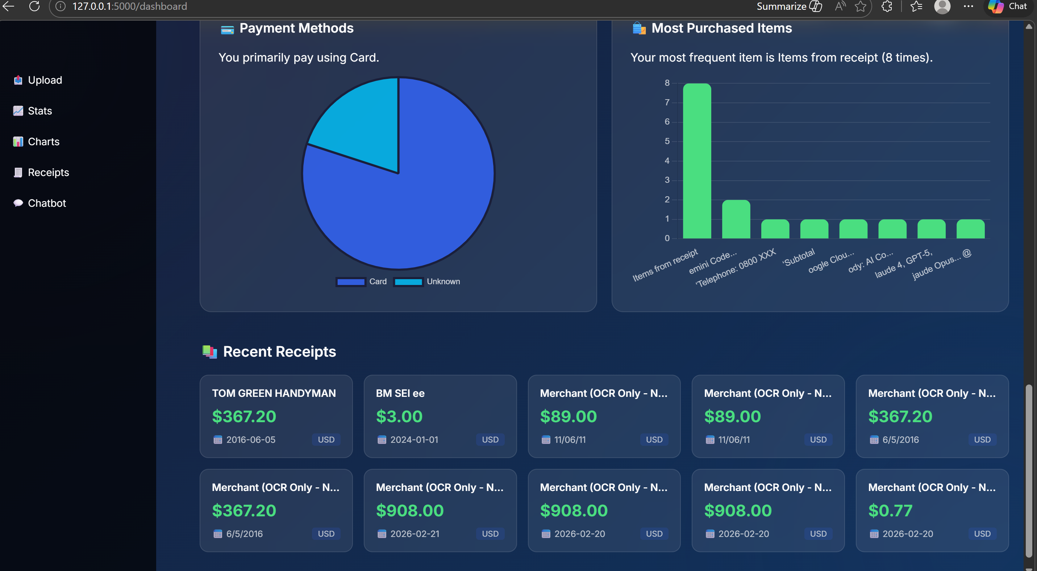
Analytics & Insights
The system provides visual insights such as:
Monthly spending trends
Most purchased items
Top merchants
Spending by category
Payment method analysis

Slide 11
Technologies Used
Technologies Used
Frontend
HTML
CSS
JavaScript
Backend
Python
Flask
AI Processing
OCR Engine (Tesseract)
Database
SQLite / MySQL

Slide 12
Conclusion
The Receipt & Invoice Digitizer simplifies financial document management by automatically extracting key information from receipts and invoices using OCR technology. The system reduces manual effort, improves accuracy, and organizes financial records efficiently. Through user and admin dashboards, it provides clear insights into spending patterns, transaction history, and system usage. Overall, this platform helps users manage receipts digitally while enabling administrators to monitor and manage the system effectively.

Slide 13
THANK YOU
TEAM-C

