Slide 1
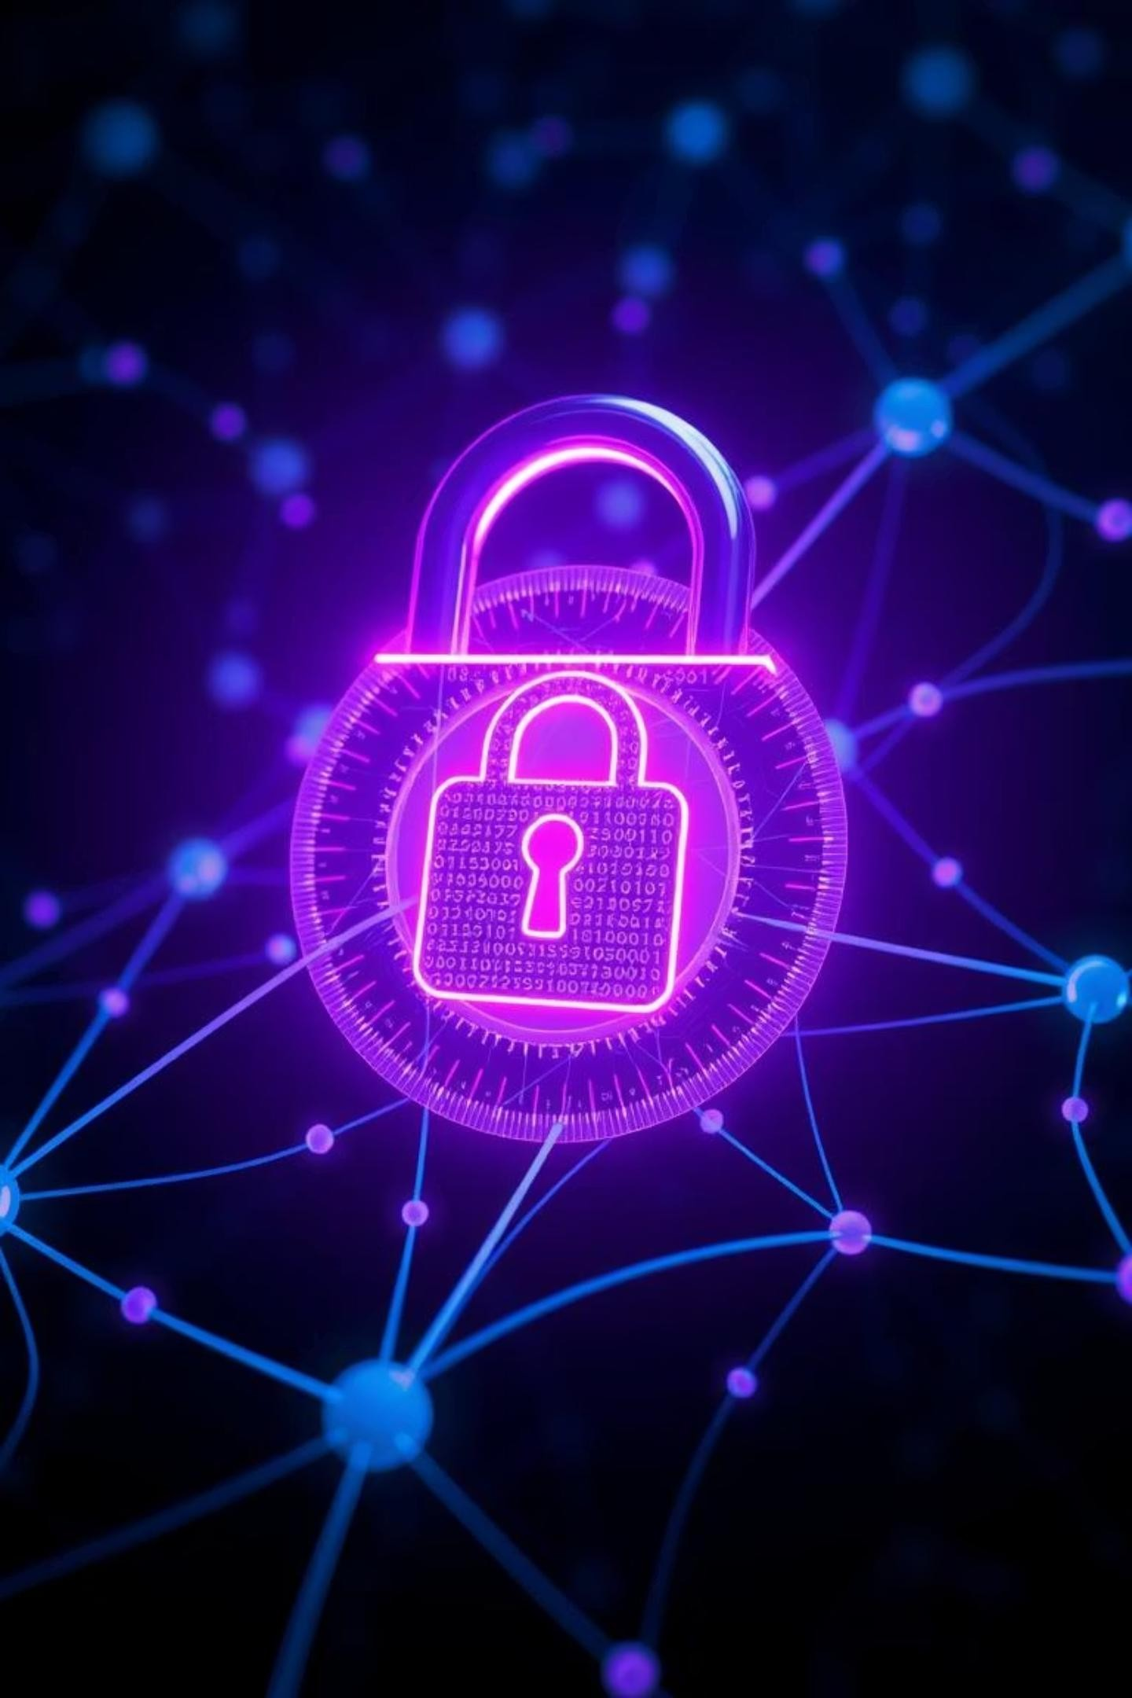

Phishing Awareness
Training: Protect Yourself Online
Phishing remains the number one cyber threat globally, with over 90% of all cyberattacks initiating from these deceptive attempts. In 2022 alone, Business Email Compromise (BEC) scams led to staggering global losses of
$2.7 billion, as reported by the FBI IC3. Understanding and recognizing these
threats is your first line of defense.
by Snehith Sudulaguntla

Slide 2
Recognizing Phishing Emails
Urgent/Threatening Language
"Account will be suspended immediately!" These emails create panic to bypass rational thought.
Generic Greetings
"Dear Customer," instead of your name. Legitimate companies personalize communications.
Suspicious Sender
Unfamiliar email addresses, like support@amaz0n.com, indicate a fraudulent source.
Bad Grammar/Typos
Unprofessional language and numerous spelling errors are
classic red flags.
Unexpected Attachments/Links
Beware of .zip or .exe files, or any links from unknown or
suspicious senders.

Slide 3
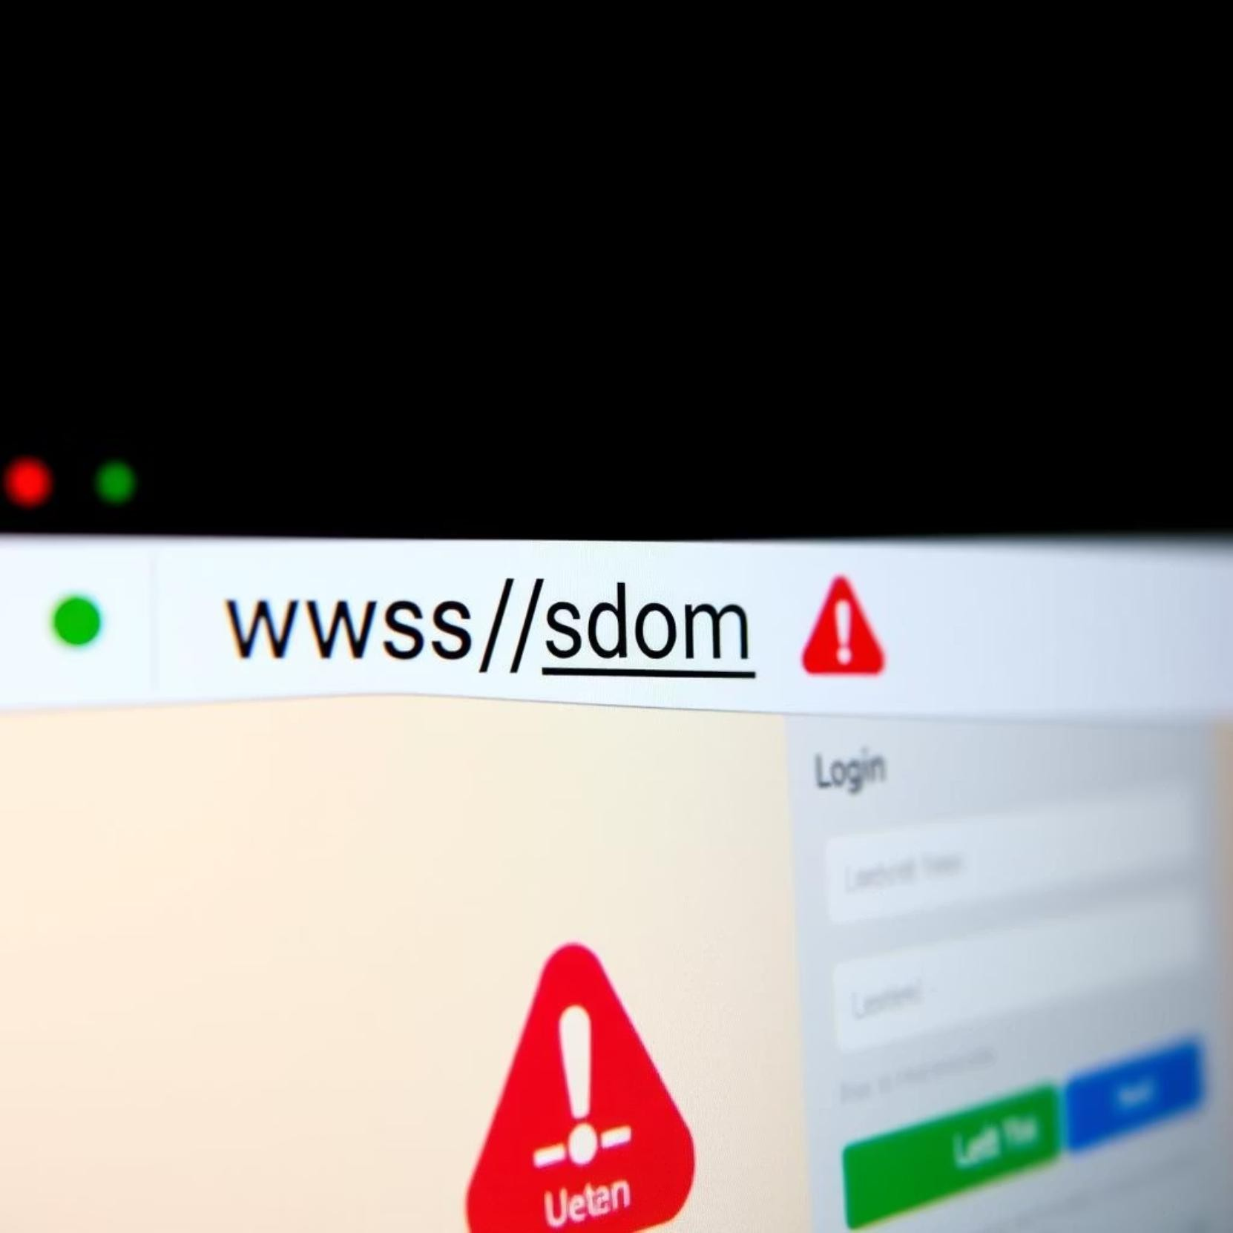
Identifying Fake Websites
Inspect the URL: Look for subtle misspellings (e.g., paypaI.com) or strange characters in the address bar. A genuine website will have a clean, familiar URL.
HTTPS vs. HTTP: Always verify that the site uses HTTPS and displays a padlock icon in the browser, indicating a secure, encrypted connection.
Poor Quality Design: Blurry logos, inconsistent fonts, and a generally unprofessional layout are strong indicators of a fraudulent site.
Unexpected Pop-ups: Be wary of sites that immediately request sensitive information via unexpected pop-ups upon arrival.
Lack of Contact Info: Legitimate businesses provide clear contact details like a physical address and phone number, which are often missing on fake sites.

Slide 4

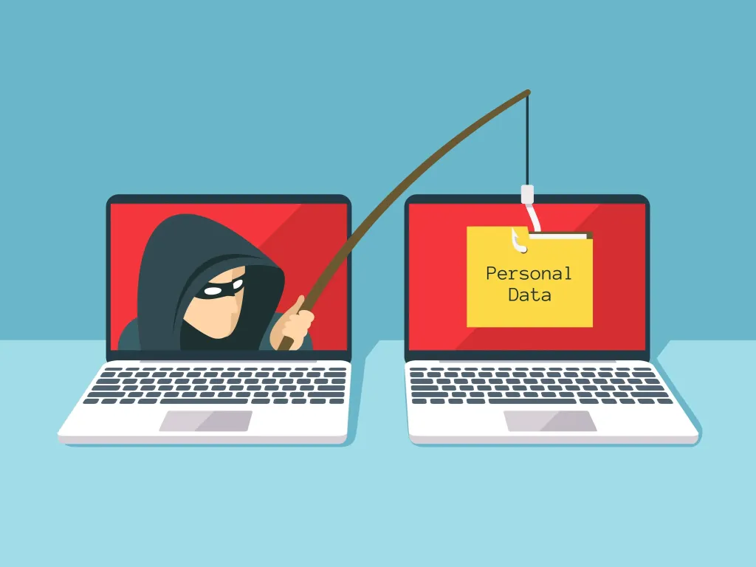
Understanding Social Engineering Tactics
Urgency
"Act now or lose access!" to create panic and bypass rational thinking.
Fear
"Your account is compromised!" preying on anxiety to pressure quick action.
Authority
Impersonating a CEO, IRS, or IT support to demand compliance without question.
Curiosity
"Check out these photos!" to entice clicks by exploiting natural human intrigue.
Scarcity
"Limited time offer!" to pressure quick, unconsidered decisions.

Slide 5
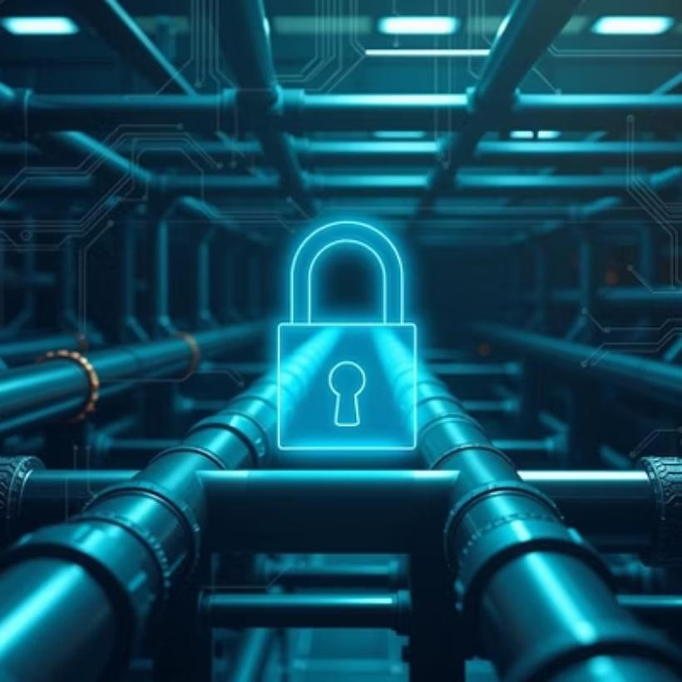

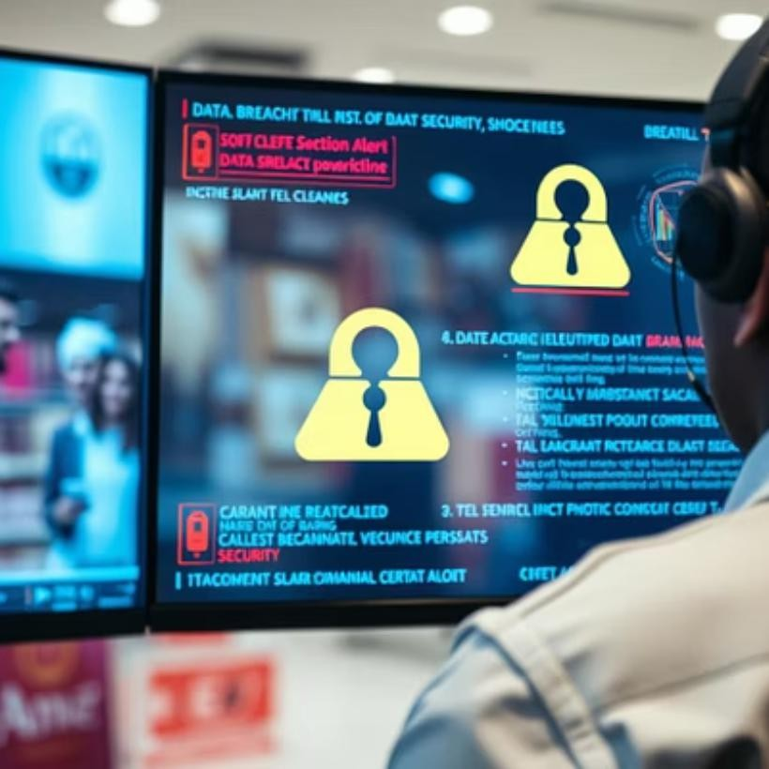
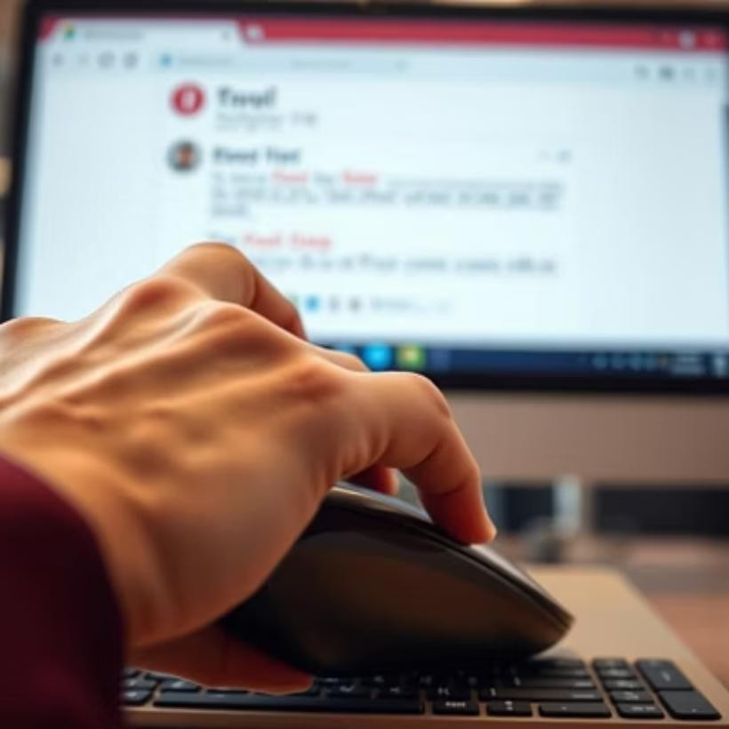
Real-World Phishing Examples
Phishing isn't just theory; it's the root cause of some of the most significant cyber incidents in recent history.

Slide 6
Best Practices: How to Avoid Falling Victim
1
Stop, Look, Think
Pause and critically examine any email, link, or attachment before interacting with it.
2
Verify Sender
Always contact the sender directly using a known, legitimate contact method—not by replying to the suspicious email.
3
Hover Over Links
Before clicking, hover your mouse over a link to preview the URL and spot any malicious addresses. On mobile, long-press to see the full URL.
4
Use Multi-Factor Authentication (MFA)
Enable MFA whenever possible. It blocks over 99.9% of automated cyberattacks, even if your password is compromised.
5
Strong, Unique Passwords
Create complex, unique passwords for all your accounts, ideally using a reliable password manager.
6
Report Suspicious Activity
If you suspect a phishing attempt, forward the email immediately to your IT or security team and then delete it.

Slide 7
Test Your Knowledge: Interactive Quiz
Scenario 1: Identify the phishing email from three given examples, explaining the red flags present.
Scenario 2: Examine several URLs and spot the one that leads to a fake website, detailing the deceptive elements.
Scenario 3: A suspicious email asks for your password. Choose the best course of action: reply, delete, or report and delete?
Question: What is the primary goal of social engineering tactics in the context of phishing?

Slide 8
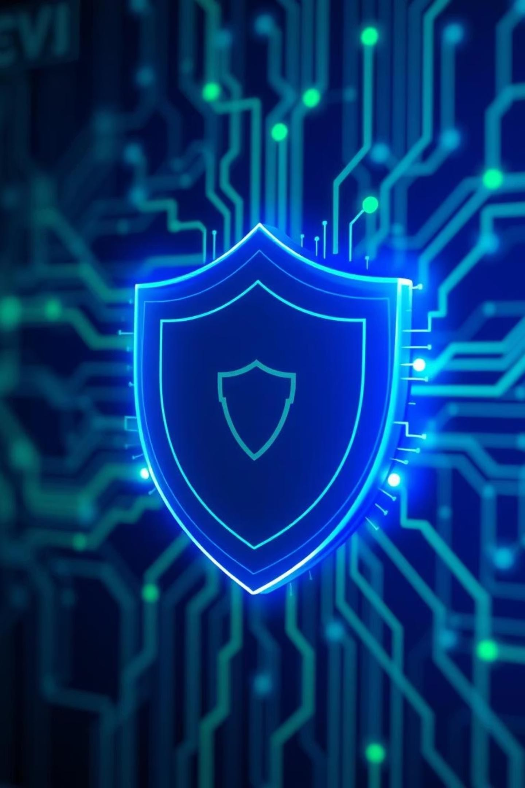
Conclusion: Stay Vigilant, Stay Secure
Phishing is a constant, evolving threat in our digital landscape. Your heightened awareness and proactive actions are the strongest defense against these sophisticated attacks. Remember, every suspicious email or link you identify and report helps protect not just yourself, but our entire organization.
Stay vigilant, question everything that seems unusual, and always prioritize security. Together, we can build a resilient defense against cyber threats.

