Slide 1
ApexPlanet Sales Analysis
Data Storytelling & Statistical Validation
Presented by: Chinni Snehitha ApexPlanet Internship — Task 4

Slide 2
Business Objective
Analyze overall sales performance using customer, product, category, and city-level data.
Identify the major revenue and order drivers.
Understand customer and monthly sales patterns.
Use statistical testing to validate an important business finding.
Key Question:
What factors are driving sales performance, and what actions can help improve business growth?

Slide 3
Dataset Overview
Total Orders Total Customers Total Products Total Categories
1,000
947
6
5
Data Coverage
Customer: Customer ID, Name, Age, Gender
Location: City
Product: Product, Category
Sales: Quantity, Unit Price, Total Sales
Date: Order Date
The dataset contains 1,000 sales transactions covering customers, products, categories, cities, and sales values.

Slide 4
Overall Sales Performance
Total Revenue Total Orders Total Customers Average Order Value
₹13,93,99,439.65
1,000
947
₹1,39,399.44
Key Performance Findings
Electronics - generated the highest category revenue.
Laptop - was the highest-revenue product.
Patna - recorded the highest city-wise sales.
Electronics - had the highest number of orders.

Slide 5
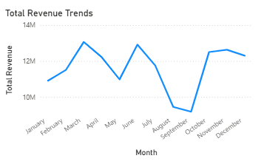
Sales Trends & Business Insights
Key Insights
1. Monthly Revenue
Revenue fluctuates across the months.
The highest monthly revenue occurs around March and June.
2. Category Performance
Electronics is the strongest revenue-generating category.
Fashion has the lowest category revenue among the five categories.
3. Product Performance
Laptop has the highest product revenue.
Shoes has the lowest product revenue.
Business Implication
Focus inventory, promotions, and marketing efforts on high-performing products and categories while investigating opportunities to improve lower-performing segments.

Slide 6
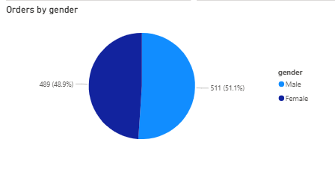
Customer Analysis
Customer Insights
Gender Distribution
Male customers: 511 (51%)
Female customers: 489 (49%)
The customer base is relatively balanced by gender.
Average Sales by Gender
Male average sales: ₹1,41,807.34
Female average sales: ₹1,36,883.21
Male average sales are slightly higher than female average sales.
Statistical Validation
T-statistic: 0.6826
P-value: 0.4950
Significance level: 0.05
95% Confidence Interval: −₹9,231.58 to ₹19,079.85
Since the p-value (0.4950) is greater than 0.05, there is no statistically significant difference between male and female average sales.

Slide 7
Hypothesis Testing — Business Conclusion
Business Interpretation
Gender should not be treated as a strong standalone factor for sales targeting because the observed difference in average sales is not statistically significant.
Hypotheses
Null Hypothesis (H₀) There is no significant difference in average sales between male and female customers.
Alternative Hypothesis (H₁) There is a significant difference in average sales between male and female customers.
Test Result
Test Used: Independent Two-Sample T-Test
Significance Level: 0.05
P-value: 0.4950
Decision: Fail to reject H₀
Result: Not statistically significant

Slide 8
Key Business Recommendations
1. Strengthen Electronics
Electronics is the highest-revenue category and should receive strong inventory and promotional support.
2. Promote High-Performing Products
Laptop is the leading product by revenue. Maintain adequate inventory and consider targeted promotions.
3. Focus on High-Performing Cities
Patna recorded the highest city-wise sales. Analyse successful strategies in high-performing cities and replicate them where appropriate.
4. Use Multi-Factor Customer Segmentation
Gender alone is not a statistically significant differentiator in average sales. Customer targeting should therefore consider other factors such as product preference, city, purchase behaviour, and order value.
Expected Business Impact
Better inventory planning, targeted marketing, stronger regional strategies, and more data-driven customer segmentation.

Slide 9
Conclusion & Call to Action
Key Findings
Total revenue reached ₹13.94 crore from 1,000 orders.
Electronics was the strongest revenue-generating category.
Laptop was the leading product by revenue.
Patna recorded the highest city-wise sales.
Male and female customers showed similar average sales, with no statistically significant difference.
Business Action Plan
1. Prioritize high-performing products and categories. 2. Strengthen strategies in high-performing cities. 3. Improve lower-performing products and categories through targeted promotions. 4. Use multiple customer attributes rather than gender alone for segmentation.
Final Takeaway
Data-driven decisions should focus on revenue drivers, customer behaviour, product performance, and regional opportunities rather than relying on a single customer characteristic.

