Slide 1
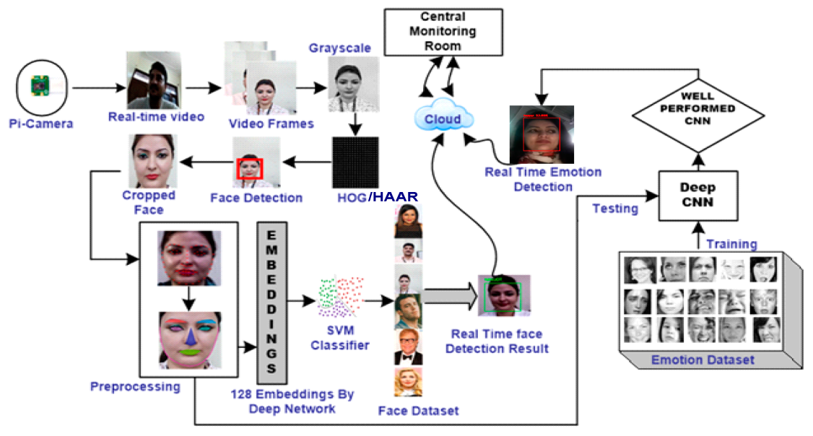
REAL-TIME FACIAL EMOTION
RECOGNITION USING DEEP LEARNING
Guide:
Mr.B.Tulasi Dasu
IOMP Supervisor:
Mrs.U.Chaitanya
IOMP ID:25-18
B.SNEHITHA-22261A1211
K.PRADEEP REDDY-22261A1230

Slide 2
OUTLINE
ABSTRACT
INTRODUCTION
EXISTING SYSTEM
LITERATURE SURVERY
PROBLEM STATEMENT
REQUIREMENTS
PROPOSED SYSTEM
OBJECTIVES
MODULES DESCRIPTION
METHODOLOGIES
DESIGN ARCHITECTURE&UML DIAGRAMS
APPLICATIONS
REFERENCES

Slide 3
ABSTRACT
This project detects human emotions in real-time using facial expressions.
A camera captures the face, and deep learning models analyze expressions to identify emotions like happiness, sadness, anger, and surprise.
The system is useful in mental health monitoring, AI assistants, customer service, and security applications.
It helps machines understand human emotions and improve human-computer interactions.
Useful in mental health monitoring, AI assistants, customer service, and security.
Uses OpenCV for face detection and DeepFace for emotion recognition.

Slide 4
INTRODUCTION
Emotion detection is an important area in artificial intelligence that helps machines understand human feelings.
The system uses computer vision and deep learning models to process real-time data from cameras .
Facial expressions are detected using Convolutional Neural Networks (CNNs) Real-time processing ensures fast and accurate emotion recognition, improving human-computer interaction.
Deepface framework is used for feature extraction and classification.
Haar Cascade Classifier (OpenCV) is used for face detection.

Slide 5
EXISTING SYSTEM
Most existing emotion recognition systems rely on manual annotation or traditional machine learning models that require handcrafted features.
These methods lack real-time processing capabilities and are often limited to basic emotions like happy, sad, and angry.
Systems using rule based or statistical approaches have low accurary when dealing with variations in lighting,facial occlusions and different expressions.
Many applications are limited to static images and making them unsuitable for real time video analysis.

Slide 6
LITERATURE SURVEY
S.NO | AUTHOR NAMES,YEAR OF PUBLICATION | JOURNAL OR CONFERENCE NAME AND PUBLISHER NAME | METHODOLOGY/ ALGORITHM / TECHNIQUES USED | MERITS | DEMERITS | RESEARCH GAPS
1 | M. A. Ozdemir, B. Elagoz, A. Alaybeyoglu, R. Sadighzadeh and A. Akan (2020) | 2020 Medical Technologies Congress (TIPTEKNO), Izmir, Turkey | CNN Architecture for facial emotion recognition | High accuracy in emotion detection, efficient feature extraction | Requires large datasets for training, computationally expensive | Limited generalizability to diverse datasets, lack of real-time optimization
2 | D. Joshi, A. Dhok, A. Khandelwal, S. Kulkarni and S. Mangrulkar (2021) | 2021 International Conference on | Real Time Emotion Analysis (RTEA) | Provides real-time emotion classification. | Limited dataset coverage. | Needs better generalization on diverse demographics
3 | T. Winyangkun, N. Vanitchanant, V. Chouvatut and B. Panyangam (2023) | 15th International Conference on Knowledge and Smart Technology (KST), Phuket, Thailand | Real-Time Detection and Classification of Facial Emotions | Accurate classification, lightweight model for real-time applications | Performance degrades in low-light conditions, high sensitivity to noise | Lacks multi-modal emotion recognition integration

Slide 7
S.NO | AUTHOR NAMES,YEAR OF PUBLICATION | JOURNAL OR CONFERENCE NAME AND PUBLISHER NAME | METHODOLOGY/ ALGORITHM / TECHNIQUES USED | MERITS | DEMERITS | RESEARCH GAPS
4 | M. Bhanupriya, N. Kirubakaran and P. Jegadeeshwari (2023) | International Conference on Data Science, Agents & Artificial Intelligence (ICDSAAI), Chennai, India | EmotionTracker: Real-time Facial Emotion Detection with OpenCV and DeepFace | Combines traditional image processing with deep learning for enhanced detection | Less effective for complex emotions, limited emotion categories | Expansion to a broader range of emotions and real-world scenarios needed
5 | Barhoumi, C., BenAyed, Y. (2025) | Artificial Intelligence Review 58 | Deep learning and data augmentation for real-time face emotion recognition | Enhances recognition performance, improves model robustness with augmented data | Increased computational requirements, potential overfitting issues | Needs more real-world testing for practical implementation

Slide 8
PROBLEM STATEMENT
In today’s world, understanding human emotions is essential for enhancing human-computer interaction, mental health monitoring, and behavior analysis. Traditional systems lack the capability to recognize emotional states in real-time and require manual intervention or delayed processing. Moreover, recognizing emotions from facial expressions becomes challenging due to variations in lighting, head pose, occlusions, and individual facial features.
Therefore, there is a need for an automated, real-time facial emotion recognition system that can accurately detect and classify human emotions from facial expressions using advanced deep learning techniques. This system should be capable of processing live video or images efficiently and recognizing multiple emotions with high accuracy.

Slide 9
REQUIREMENTS
SOFTWARE:
Operating System: Windows 10/11
Programming Language: Python 3. 9
Libraries :OpenCV (for face detection)
TensorFlow/Keras (for deep learning models)
NumPy & Pandas (for data handling)
IDE/Code Editor: VS Code
HARDWARE:
Processor: Intel i5/i7
Camera: HD Webcam (for facial expression analysis)

Slide 10
PROPOSED SYSTEM
A deep learning-based model capable of recognizing 20+ emotions in real-time.
Processes live video streams or images and classifies emotions instantly.
Uses Convolutional Neural Networks(CNNs) and transfer learning to improve accuracy
Integrates OpenCV and DeepFace for facial detection and analysis.
The system is optimized for high-speed performance with low latency,making it suitable for the real world applications.

Slide 11
OBJECTIVES
To Develop an AI-powered emotion recognition system.
To Enhance real-time processing speed using optimized deep learning models.
To Detect and classify 20+ facial emotions accurately.
To Improve accuracy & robustness under different lighting conditions and occlusions.
To Create a user-friendly interface for easy integration into real-world applications.

Slide 12
MODULES DESCRIPTION
Face Detection Module – Detects human faces using OpenCV/DeepFace
Preprocessing Module – Normalizes, resizes, and enhances images for better recognition.
Feature Extraction Module – Extracts facial landmarks and deep learning-based features.
Emotion Classification Module – Uses a trained CNN model to classify emotions.
Output & Visualization Module – Displays results in a web-based UI with real-time updates.

Slide 13
METHODOLOGIES
Capture input image/video frame.
Apply OpenCV for face detection.
Resize and normalize the image.
Feed the processed image into the CNN model.
Predict the emotion label using Softmax activation.
Display the detected emotion in real-time.

Slide 14
DESIGN ARCHITECTURE
Input Layer
Preprocessing Layer
Face detection
Image resizing and normalization
CNN Model
Output Layer
Detected emotion

Slide 15
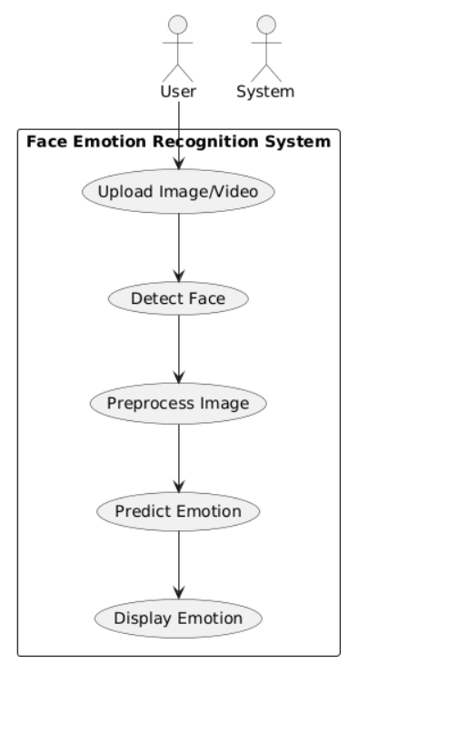
UML DIAGRAMS
USE CASE DIAGRAM

Slide 16
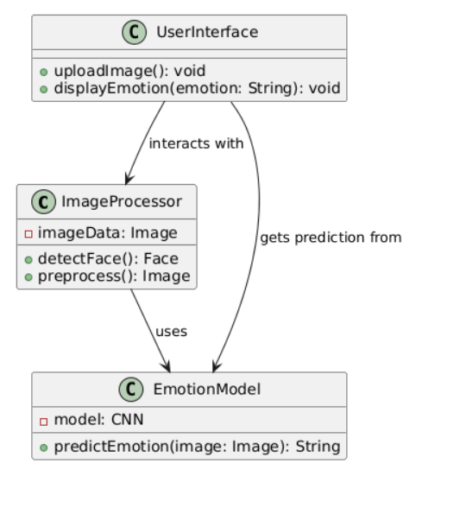
CLASS DIAGRAM

Slide 17
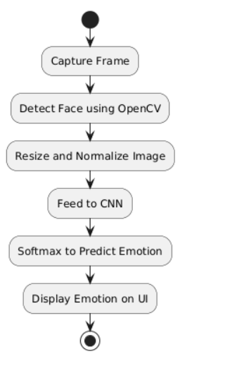
ACTIVITY DIAGRAM

Slide 18
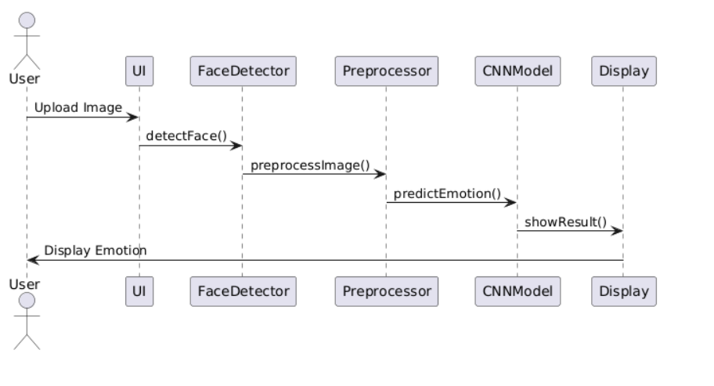
SEQUENCE DIAGRAM

Slide 19
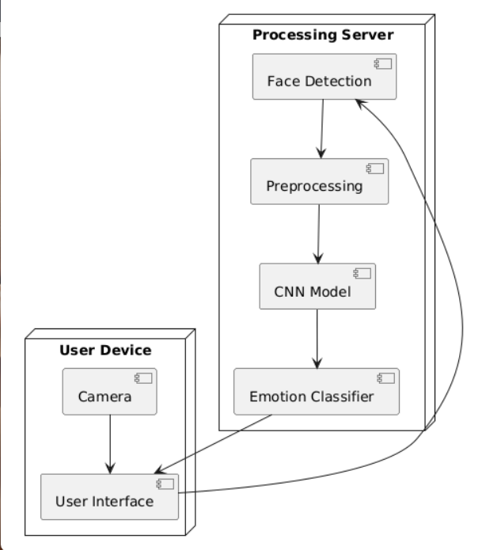
DEPLOYMENT DIAGRAM

Slide 20
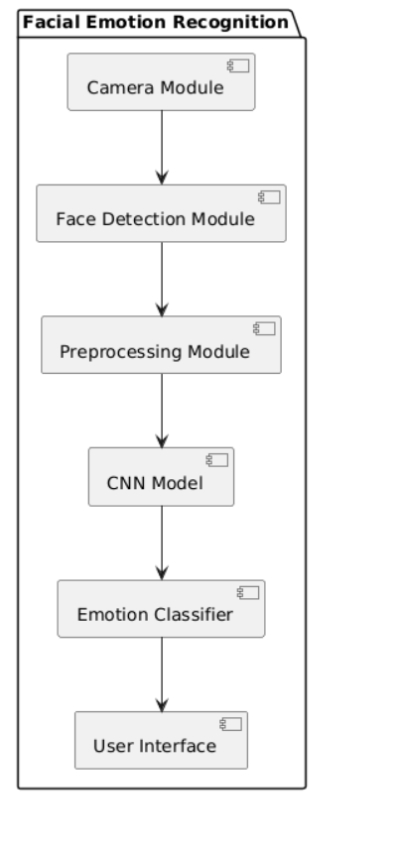
COMPONENT DIAGRAM

Slide 21
APPLICATIONS
Mental Health Monitoring – Helps therapists analyze emotional patterns.
Human-Computer Interaction (HCI) – Enhances AI assistants, chatbots, and VR applications.
Security & Surveillance – Detects unusual emotional states for crime prevention.
E-Learning Platforms-Monitors Student engagement in studies based on facial expressions

Slide 22
REFERENCES
[1] M. A. Ozdemir, B. Elagoz, A. Alaybeyoglu, R. Sadighzadeh and A. Akan, "Real Time Emotion Recognition from Facial Expressions Using CNN Architecture," 2020 Medical Technologies Congress (TIPTEKNO),Izmir, Turkey, 2020, pp. 1-4, doi: 10.1109/TIPTEKNO.2020.8895215
[2] D. Joshi, A. Dhok, A. Khandelwal, S. Kulkarni and S. Mangrulkar, "Real Time Emotion Analysis (RTEA)," 2021 International Conference on Artificial Intelligence and Machine Vision (AIMV), Gandhinagar, India, 2021, pp. 1-5, doi: 10.1109/AIMV53313.2021.9670908
[3] T. Winyangkun, N. Vanitchanant, V. Chouvatut and B. Panyangam, "Real-Time Detection and Classification of Facial Emotions," 2023 15th International Conference on Knowledge and Smart Technology (KST), Phuket, Thailand, 2023, pp. 1-6, doi: 10.1109/KST57286.2023.10086866.
[4] M. Bhanupriya, N. Kirubakaran and P. Jegadeeshwari, "EmotionTracker: Real-time Facial Emotion Detection with OpenCV and DeepFace," 2023 International Conference on Data Science, Agents & Artificial Intelligence (ICDSAAI), Chennai, India, 2023, pp. 1-4, doi: 10.1109/ICDSAAI59313.2023.10452452.
[5] Barhoumi, C., BenAyed, Y. Real-time face emotion recognition using deep learning and data augmentation. Artif Intell Rev 58, 49 (2025).

Slide 23
THANK YOU!!

