Slide 1
ENTERTAINMENT MANAGEMENT SYSTEM TEAM-44 2100030086 2100030130 2100030221

Slide 2
ENTERTAINMENT MANAGEMENT SYSTEM: Entertainment Management Software is one-of-a-kind software in which you can simultaneously book and manage your event, band, catering service, and venue. As an entertainment provider, you are well aware of the myriad of things you need to keep in mind to organize the perfect event, and that’s where our software can provide organization for all your tasks. Some of the important features -> Document storage & management -> accounts receivable & payable management -> bill storage and management for your entire company -> e-mail management -> create timelines

Slide 3
Survey links: https://docs.google.com/forms/d/1ae5vNu_f8bjQ3r4J5fBqwhZp3GGnG0FG4uRsegi8Uho/edit https://docs.google.com/forms/d/e/1FAIpQLSf5sOVW8nrdBeeAZIHG9y-kVYMzidbgVpTMi5rfJbXNYFCoEg/viewform?usp=sf_link

Slide 4
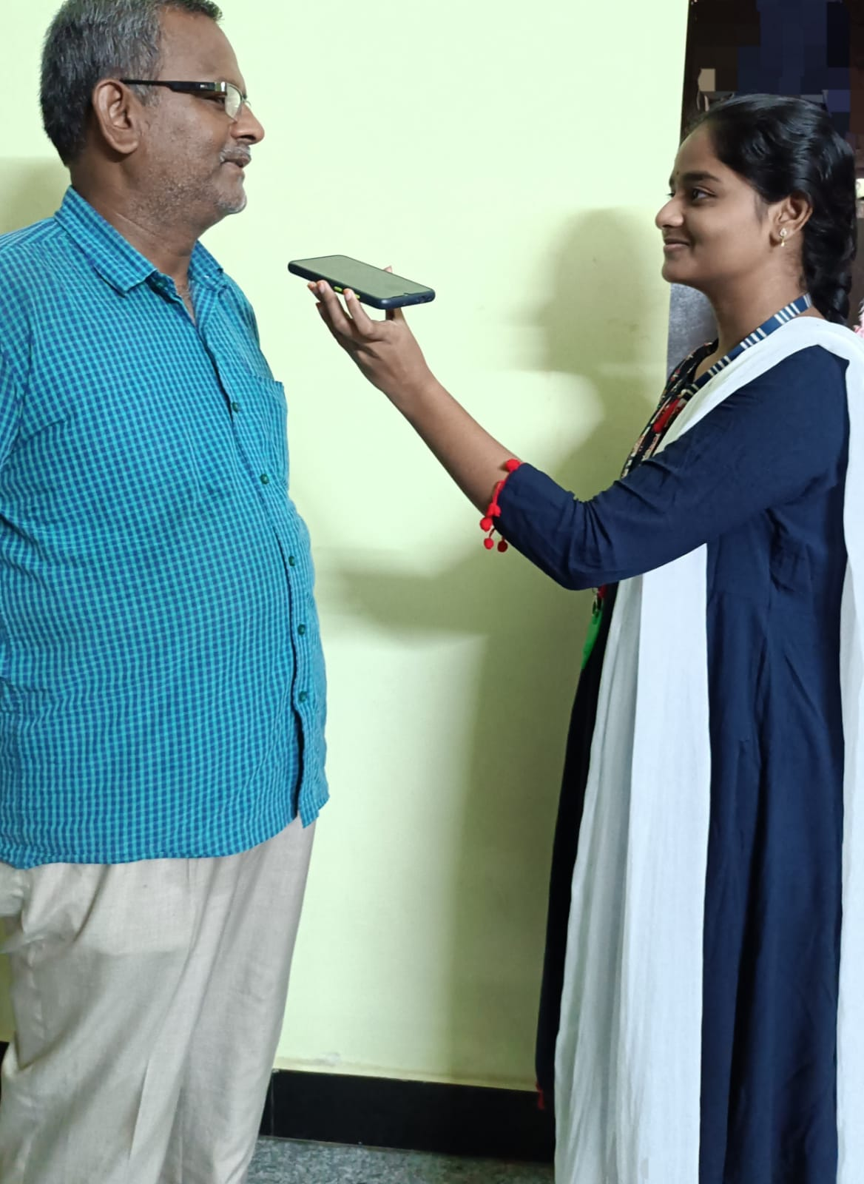
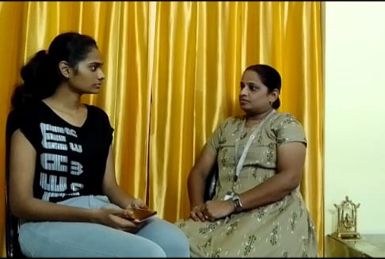
Survey photos

Slide 5
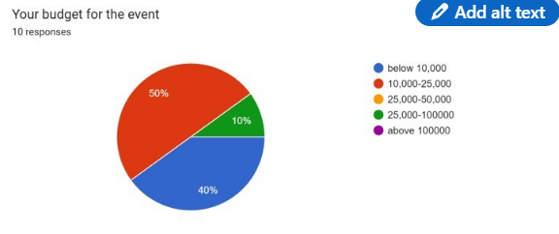
Survey analysis:

Slide 6
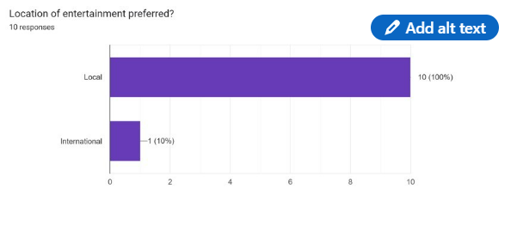

Slide 7
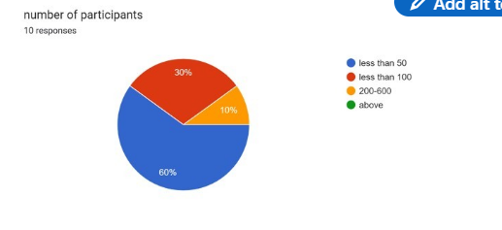

Slide 8
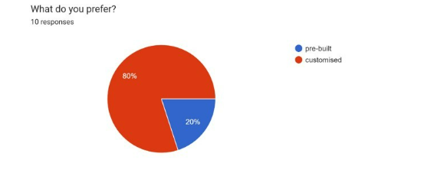

Slide 9
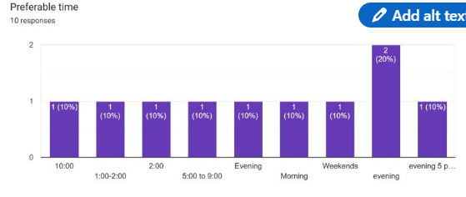

Slide 10
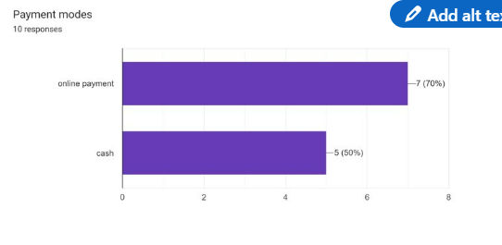

Slide 11
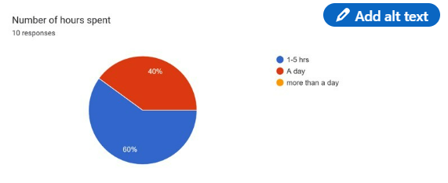

Slide 12
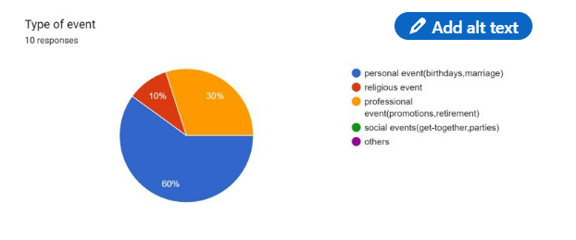

Slide 13
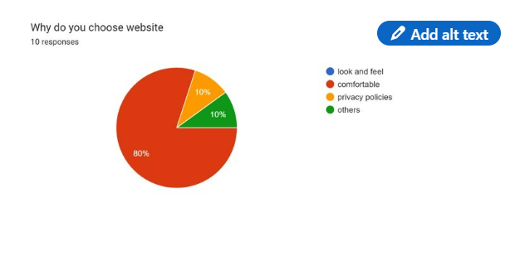

Slide 14
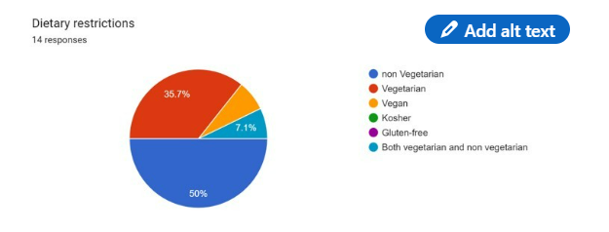

Slide 15
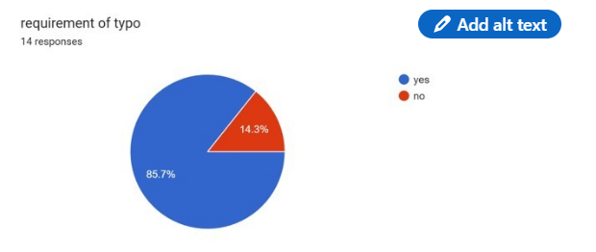

Slide 16
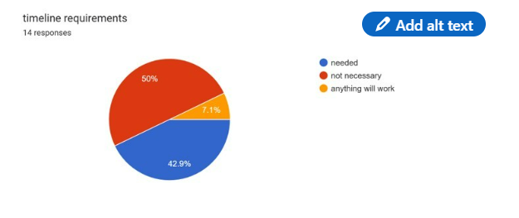

Slide 17

PERSONA:
AADYA-Business Women
Age: 45
Gender: Female
Event: Product Launching
Habits: Interacting with Team & Team gathering.
Influences: Mother
Short-Term Goals: Becoming a successful enterpriser

Slide 18

Neha-House Wise
Age: 32
Gender: Female
Event: son’s marriage
Habits: Reading stories about successful persons.
Influences: Mother
Short Term Goals: Becoming self-independent. Becoming inspirational to her children.

Slide 19

Anupama-music director
Age: 40
Gender: Female
Event: audio launch
Habits: Creating new music albums.
Influences: Father
Short Term Goals: Becoming a great & popular music director.

Slide 20
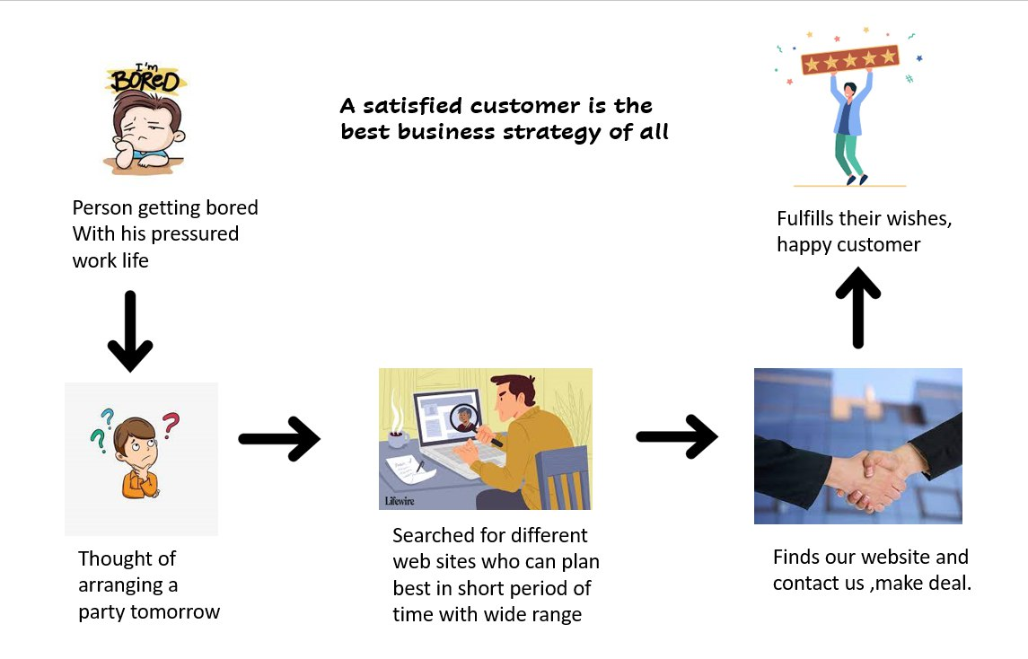
Customer journey map:

Slide 21
LINKEDIN ARTICLE
https://www.linkedin.com/posts/snehitha-kanagala-13a822216_sdp1-activity-6974370920085827585-zBdk?utm_source=share&utm_medium=member_desktop

