Slide 1
Prepping your data with Tableau Prep Builder
Snehith Allamraju

Slide 2

About myself
Snehith Allamraju Global Business Intelligence Manager @ Nobel Biocare, Danaher Dental Platform
12 years of experience in the Business Intelligence and Analytics domains
Experience working with data warehousing, ERP, CRM visualization and analytics tools across SAP, Oracle, Microsoft stacks and Tableau
Certified SAP BI, Tableau Desktop Specialist and Azure Data Scientist

Slide 3
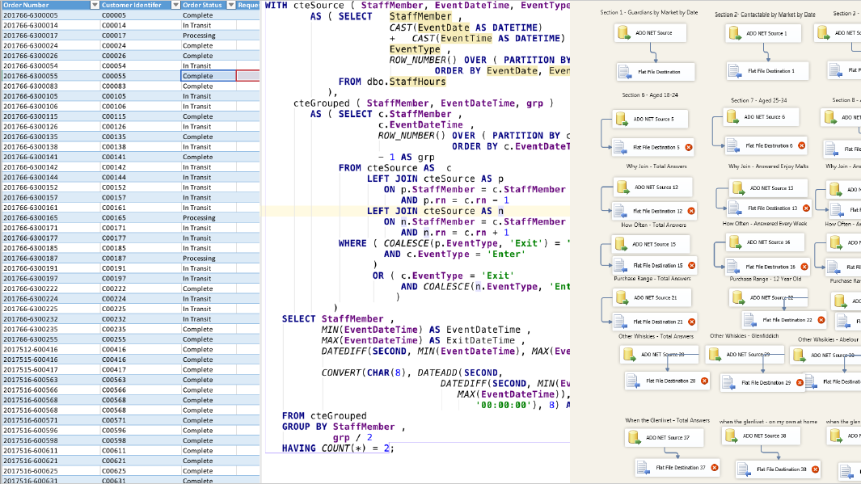

Slide 4
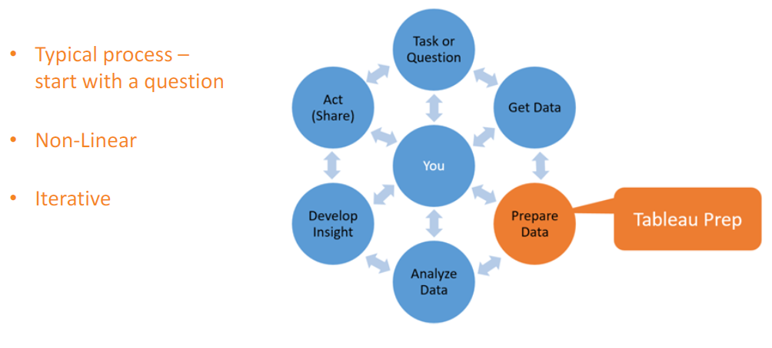
Data Preperation and Analytic Cycle
https://tc18.tableau.com/sites/default/files/session/assets/KinstlerDeBeySantamaria_TC18_PPT_forAttendees.pdf

Slide 5
Time consumed around data preparation of the overall time of an analytics project” - Experts
80%

Slide 6
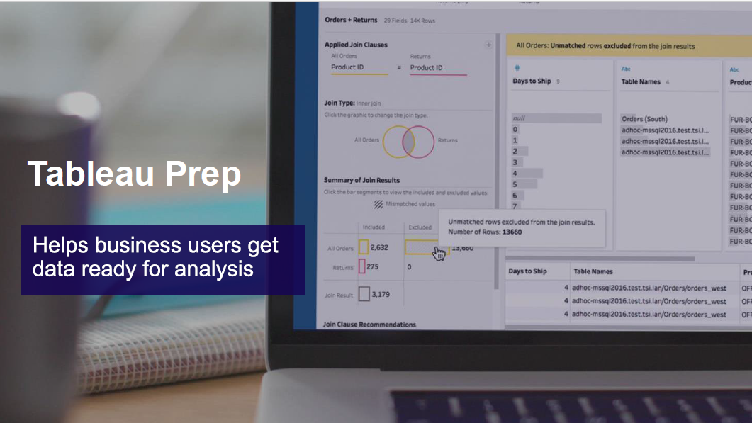

Slide 7
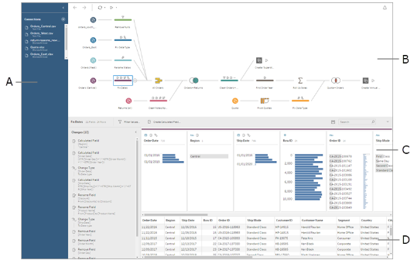
Tableau Prep Builder Workspace
The Tableau Prep Builder workspace consists of the following areas designed to help you interact with and explore your data
Connections pane (A) shows the databases and files you are connected to
Flow pane (B): A visual representation of your operation steps as you prepare your data.
Profile pane (C): A summary of each field in your data sample. See the shape of your data and quickly find outliers and nulls.
Data grid (D): The row level detail for your data. You can filter, keep only, and exclude individual field values in this grid
Change pane (E): Keeps track of any changes you make, in the order you make them
E
You work with Flows in Tableau Prep Builder

Slide 8





Tableau Prep Builder Core functionalities
Connect
Examine and Filter
Clean and Shape
Combine : Join or Union
Preview and Share
You can use these options to build your flow :
Add Branch
Add Insert step
Add aggregate
Add output
Add pivot
Add join
Add union

Slide 9
Connect
Examine and Filter
You start a new flow by connecting to your data
Understand the Composition of your Data
Start or open a flow
“Add Connection”
Variety of connectors
Hyper
Custom SQL queries
Files
Refresh Data
Data Interpreter
Union Files/Tables
Search
Files
Matching Pattern (xxx*)
Data Sampling
Change Data types/Names/Filters
See Distributions of your dataset fields or unique values
Sorting values in fields
Highlight identical values
Search
Filter
Wildcard matches
Null values
Calculation

Slide 10
Clean and Shape
Combine : Join or Union
Edit, transform and aggregate your data
Understand the Composition of your Data
Filter
Split Values / Merge
Add / Remove/ Rename Columns
Create Calculated fields / Remove Fields
Group and Replace
Pivot
Clean
Uppercase/ Lowercase
Punctuation
Trim Spaces
Recommendations
Fuzzy Match !!
Pronunciation
Spelling
Common characters
Joins
Table relationships : Join Clauses and Join types
Recommendations for joins
Auto detect keys
Unions
Inspect results
Merge fields
Flow actions
Color Scheme
Description
Renaming Steps
View all step by step changes

Slide 11
Preview and Share
For further analysis
Add Output
Save workflow
Hyper
CSV
tde
Preview results
In Tableau desktop
Create and publish data extracts and data sources
Execute the Flow and see the magic of Tableau prep builder on your way to Clean, prepared data!

Slide 12
Resources
Tableau Online Help for Tableau Prep
Free training videos
Start with the five fundamentals
https://www.tableau.com/about/blog/2018/7/master-tableau-prep-list-learning-resources-92064
https://www.tableau.com/about/blog/2019/9/tips-and-tricks-filtering-your-data-tableau-prep-builder
Preppin’ data Project : Weekly Dataset and Solution @ https://preppindata.blogspot.com/ #PreppinData organized by Carl Allchin and Jonathan Allenby
A weekly project designed to get people hands-on with data preparation.
Each week a set of data is released along with a series of requirements and end-goal of how the data needs to be prepared.
During the week, participants share and discuss their ways of tackling the problem and the following week, a possible solution is released.
These projects explore various facets of data preparation and aim to not only provide realistic examples of data preparation problems, but also keep participants on the cutting edge of Tableau Prep Builder releases by highlighting new or interesting features.

Slide 13
Thank You

