Slide 1
VerityWrite AI
STIFF
Furthermore, the candidate demonstrated proficiency in Python. It is important to note that the candidate scored 82/100.
Make AI sound natural. Keep every fact intact.
NATURAL, FACTS KEPT
Team Hackprime | Project update
The candidate is strong in Python and scored 82/100.
Google Student Club Welcome Hackathon 2026
Problem Statement 2: AI Humanization and Natural Language Refinement
Checked: Python, 82/100
Notes:
Member 1 says: Hi everyone, we're Team Hackprime. Our project is VerityWrite AI. It takes stiff, robotic AI text and makes it sound natural, and it proves that no facts were changed along the way.

Slide 2
What we'll cover
1
The problem and how it works
Member 1
Why stiff AI text is a risk, and the steps we follow
2
What we've built
Member 2
The features, voice and screenshots, readability scores, and a live check
3
How we match the brief
Member 3
What's done and what's still open
4
What's left and what's next
Member 4
What we'll finish, and extras to stand out
5
Results, limits and our team
Member 5
Our test results and who did what
Notes:
Five parts, one for each of us. Swap 'Member 1 to 5' for your real names.

Slide 3



Why stiff AI text is a problem
It sounds stiff
OUR IDEA
Same openers again and again, and filler like 'It is important to note that'.
Sound more human, but never change the facts. And show the proof.
Rewrites can change facts
A score, a date or a name can quietly change when AI rewrites text.
You can't see the proof
We rewrite first, then check the result before anyone sees it.
You get smooth text, but nothing shows the meaning stayed the same.
Notes:
Three problems: the text sounds stiff, a rewrite can change facts without anyone noticing, and nobody can see proof. Our idea is simple: rewrite, then check.

Slide 4








How it works
1. Add text
2. Lock facts
3. Check style
4. Rewrite
5. Verify
6. Show proof
Type, speak or upload a screenshot, then pick type and tone
Lock names, dates, scores and key terms
Find stiff or repeated phrasing
AI rewrites it so it sounds natural
Check every locked fact is still there
Show PASS, REVIEW or BLOCKED with proof
Code + AI
Our code
Our code
Gemini AI
Code + AI
Our code
If a check fails, we try again. If it still fails, we block it and never call it approved.
If the AI is unavailable, a simple backup rewriter keeps the app working. Fact checks still run.
Notes:
Walk through left to right. Be clear that Gemini is used for the rewrite step, the optional judge, and the optional voice and screenshot reading. Listening uses an online text-to-speech service. Everything else is our own code, so it is easy to explain and test. It's a fixed set of steps, not an AI agent.

Slide 5



What we've built
Working
Working
Working
Fact lock
Style detector
Tone control
Finds names, dates, times, scores and tech terms, and keeps them safe.
Gives a 0 to 100 'robotic' score and highlights stiff or repeated phrases.
5 content types and 3 tone levels, plus your own voice notes.
Working
Working
Working
Fact checker
Skip check
Results screen
Spots missing, changed or made-up facts and gives a clear verdict.
If the text already sounds natural, we leave it alone.
Side-by-side view, word-level changes, editable text and a test panel.
Notes:
Six features that already work. Be ready to show the app live: load the recruiter sample, click Humanize, then use the 'Break it on purpose' panel.

Slide 6
It rewrites, and it catches mistakes
BEFORE: stiff
AFTER: natural, facts kept
The candidate, Asha Rao, scored 82/100 in Python and 74/100 in SQL on 8 October 2026. The candidate demonstrated a good understanding of Python fundamentals but needs further assessment in SQL query optimization. The candidate is recommended for a second technical interview.
Asha Rao scored 82/100 in Python and 74/100 in SQL on 8 October 2026. Python fundamentals are solid, but SQL query optimization needs further assessment. A second technical interview is recommended.
Facts kept:
Asha Rao
82/100
74/100
8 October 2026
Python
SQL
The before and after is an example of what we aim for. The test below shows how the app really behaves.
Test: we change 82/100 to 92/100 in the rewrite
Result: BLOCKED. The app says '82/100' became '92/100' and won't approve it.
Notes:
Replace the before/after text with a real screenshot from your app if you can. Then do the live test: open 'Break it on purpose' and click 'Change a number'. The app also catches a dropped date, a swapped tech term and an invented achievement with a number in it.

Slide 7






New: voice, screenshots and readability
Test live
Test live
Test live
Voice input
Listen aloud
Screenshot reader
Record your text. It is typed out so you can edit it, then rewritten.
Hear any rewrite, or the text from a screenshot, read out loud.
Pulls the text out of an image, or explains what it shows in plain words.
Test live
Working
Working
Screenshot to rewrite
Readability scores
Export and copy
Send what was read from a screenshot straight into the fact lock and rewrite.
Six standard formulas and an overall score, with before and after for each.
Download the scores as a CSV file, or copy them all as text.
Notes:
New since the last update: speak your text, listen to the rewrite, upload a screenshot, and readability scores. Be honest about the status. Voice input and screenshot reading use Gemini, and listening uses an online text-to-speech service, so they need a key and internet. We tested them with stand-ins, not live, so run each once on the real app before presenting. Readability scores and export are fully working and run offline.

Slide 8
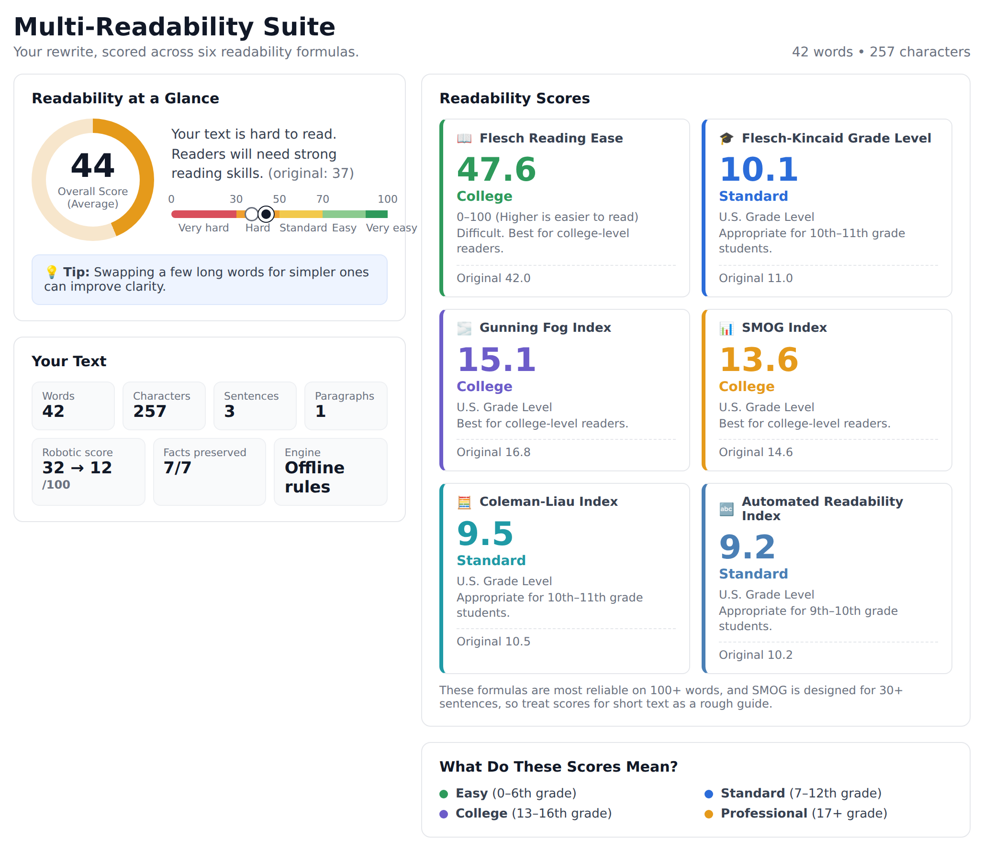
Readability scores for every rewrite
6
readability formulas, each shown before and after
0–100
overall score, from Very hard to Very easy
CSV
download every score, or copy them as text
These scores show how easy the text is to read. They do not check the facts. The fact checker does that.
Real output from our app on the recruiter example. It is a short text, so the scores are a rough guide.
Notes:
This is a real screenshot of our app on the recruiter example. Six standard formulas, an overall 0 to 100 score, and the original score on every card so the audience can see what changed. Say clearly that readability is about how easy text is to read, not whether it is true. Short texts give rough scores. The Export button downloads a CSV and Copy all scores copies plain text.

Slide 9
How we match the brief
What the brief asks | Status | In plain words
Find stiff, robotic language | Done | Spots stiff, repeated and templated phrases
Match tone to the context | Done | 5 content types and 3 tone levels
Keep names, scores, dates, terms | Done | Our code checks them every time
Check before showing the result | Done | Labelled PASS, REVIEW or BLOCKED
Keep the meaning | Mostly | The AI judge helps check meaning
No made-up facts | Mostly | Fake numbers caught; other claims need a person
Same voice across messages | Mostly | Voice notes work; a batch check is next
State the intent | To do | We keep the facts but don't state the intent yet
Prove it with tests | Mostly | Fact tests done; meaning and tone tests next
Live public website | To do | Deploy it and test the link
Notes:
This is our honest self-check against what the brief asks. Done means built and tested. Mostly means it works but has a known weakness. To do means we still need to finish it. Update the last row once the live link works.

Slide 10
What's left to finish
Must do
Show the intent
Member 2
AI states what the text is trying to say, and we check the rewrite still says it.
Must do
Check a set of messages
Member 4
Rewrite related messages together and score how consistent they sound.
Must do
Test meaning, tone, voice and screenshots
Member 5
Run tests with Gemini, try voice and screenshots live, and add meaning and tone checks.
Must do
Publish the live link
Member 1
Deploy it, then test on a phone and another network.
Nice to have
Catch made-up claims
Member 3
Compare the claims in each sentence, not just numbers and names.
Nice to have
Ask real people
Member 5
Have 10 people rate how natural and accurate the rewrites feel.
Notes:
The 'Must do' items close gaps against the brief or the mandatory rules. 'Nice to have' items make it more trustworthy. Owners are suggestions, so change them to fit your team.

Slide 11




Extra features to stand out
Idea
Idea
Idea
PII shield
Explain each change
Risk heatmap
Hides names and phone numbers from the AI, then puts them back.
Shows why a sentence was changed, in plain words.
Colors sentences by how likely their meaning changed, so reviewers look there first.
Idea
Idea
Idea
Voice profiles
Review log
Email add-on
Save a team's writing style so every message sounds alike.
Recruiters approve or reject each rewrite, and we keep a record.
Use it right inside Gmail, without copy and paste.
Notes:
These go beyond the brief. They're ideas, not built yet, so don't present them as finished. The PII shield and the review log fit the judging points on privacy and responsible AI. Pick the one or two you can realistically finish.

Slide 12
Test results so far
9/9
rewrites kept every key fact
3/3
natural texts were left alone
38/38
faked mistakes were caught
Next we'll also test meaning, tone and consistency, and ask real people.
From our 12 sample texts, run without Gemini. The robotic score is our own rough measure, not a person's opinion. We'll update this with Gemini results.
Notes:
These numbers come from running our test script without Gemini. Re-run 'python eval/run_eval.py' with your Gemini key and replace the chart values and the three big numbers with your real results. Never say the system can't make mistakes.

Slide 13
Who did what
Who
What they did
What's next
Member 1
Set up GitHub, connected the parts, added retry and backup, connected Gemini
Publish the live link
Team lead
Member 2
Wrote the rewrite instructions for each content type and tone, and the AI judge
Add the intent step
AI and prompts
Member 3
Built the fact finder and the detector for stiff phrases
Catch made-up claims
Finding facts
Member 4
Built the app: highlights, side-by-side view, editable text, test panel
Batch mode and mobile layout
App screens
Member 5
Wrote the checker rules, 25 tests, the evaluation, README and slides
Run the tests with Gemini
Testing and docs
Notes:
Each person says their own line in their own words. IMPORTANT: replace 'Member 1 to 5' with real names and change each line to match what that person really did. These lines follow the planned roles, not a record of who did what.

Slide 14

Staying responsible, and our limits
How we keep people in charge
What it can't do yet
We show the evidence, and a person makes the call
Anything doubtful is marked REVIEW or BLOCKED
We only use made-up data, because voice and images go to Gemini
API keys stay out of GitHub
You can edit the text and it's re-checked instantly
It can miss some names
Made-up claims with no numbers or names rely on the AI judge
The AI judge can be wrong too
The backup rewriter is basic
Voice and screenshots can be misread, so check the text first
Our robotic score and readability scores are rough guides
Notes:
The brief wants us to separate what we observed from what we conclude, show uncertainty, and keep a human in the loop. Being open about limits earns more trust than overclaiming.

Slide 15
What's left
1
Publish it
Get the live link working, test voice and screenshots on it, and practise the demo
2
Fill the gaps
Intent, consistency across messages, and tests for meaning and tone
3
Add the extras
Privacy shield, change explanations and a review log
Questions? We'd love your feedback.
Notes:
Member 1 closes: we've built most of it, we know exactly what's left, and we have a few extras that could make it stand out. Thank you, we'd love your feedback.

