Slide 1
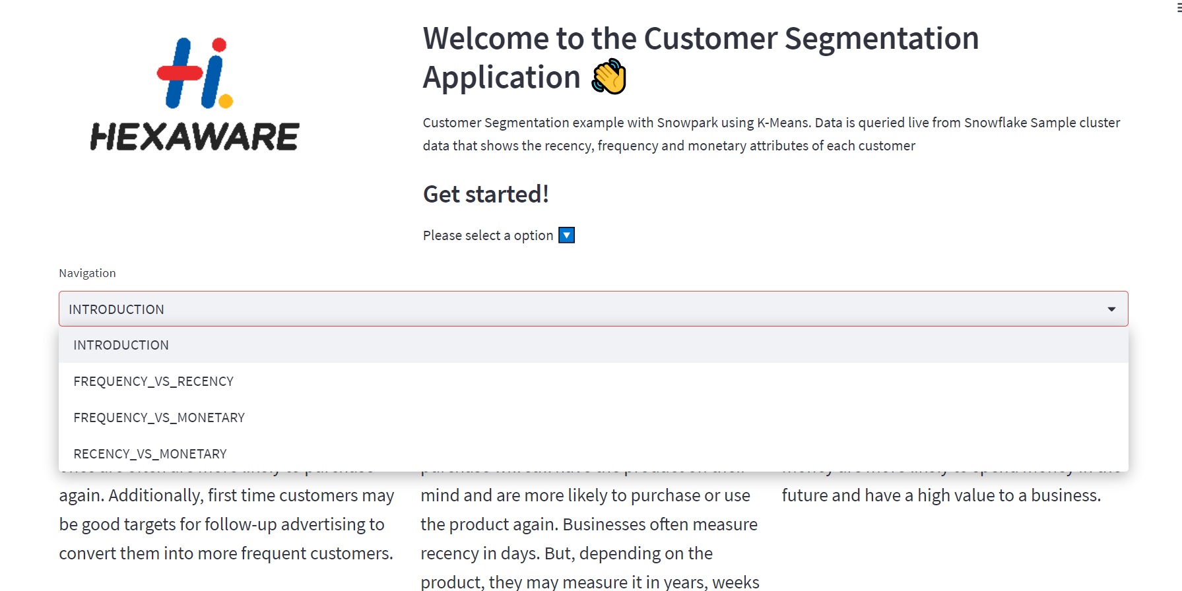
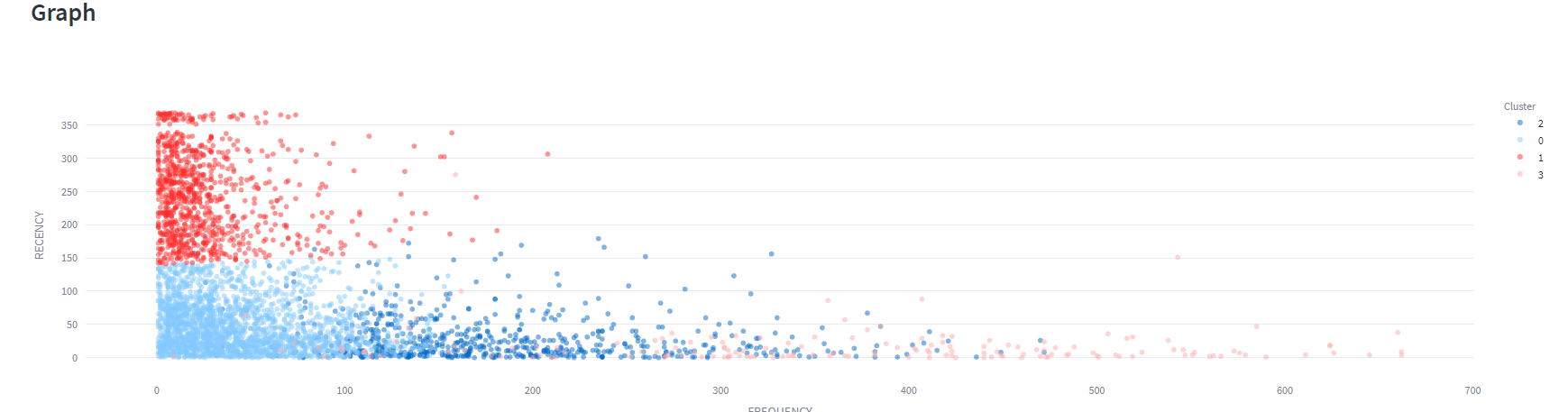
Building Interactive Data App – Snowpark & Streamlit
Problem Statement:
Components for the Demo:
Create a data application using Streamlit to segment customers based on their purchasing behavior using the RFM (Recency, Frequency, Monetary) model.
Snowflake
Snowpark & Jupyter Notebook
Streamlit App
Data Preparation :Recency ,Frequency and Monetary values aggregated .
Model Experimentation(K-Means)
Designing application
Establishing Snowflake connection
Building Filters
Projecting insights
Dataset: POS data from Online Retailer.(Source:Kaggle)
Loading Dataset from Snowsql .
Clustering model deployed as a snowflake stored procedure.

