Slide 1
NILM Energy Disaggregation Project
By: Snehit Jain | IIT Mandi | Roll No: IITMCS_2406121

Slide 2
Abstract
This project develops a machine learning system to predict appliance ON/OFF states from aggregate energy data. Synthetic data is used for testing. Future LLM integration can generate natural language summaries.

Slide 3
Introduction & Dataset
NILM identifies appliance-level energy usage without individual sensors. Datasets: iAWE and synthetic. Features: hour, minute, dayofweek, rolling mean/std.

Slide 4
Appliance | Accuracy | Precision | Recall | F1 Score
Fridge | 0.85 | 0.86 | 0.90 | 0.88
Ac | 0.84 | 0.89 | 0.84 | 0.87
Washing_machine | 0.88 | 0.90 | 0.89 | 0.90

Slide 5
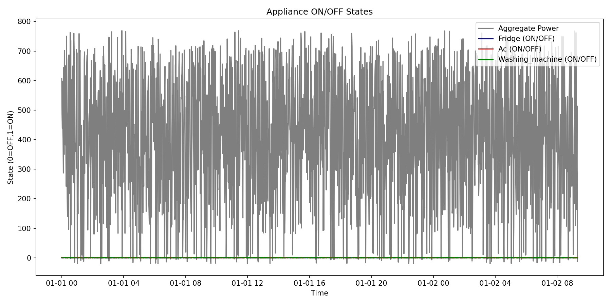

Slide 6
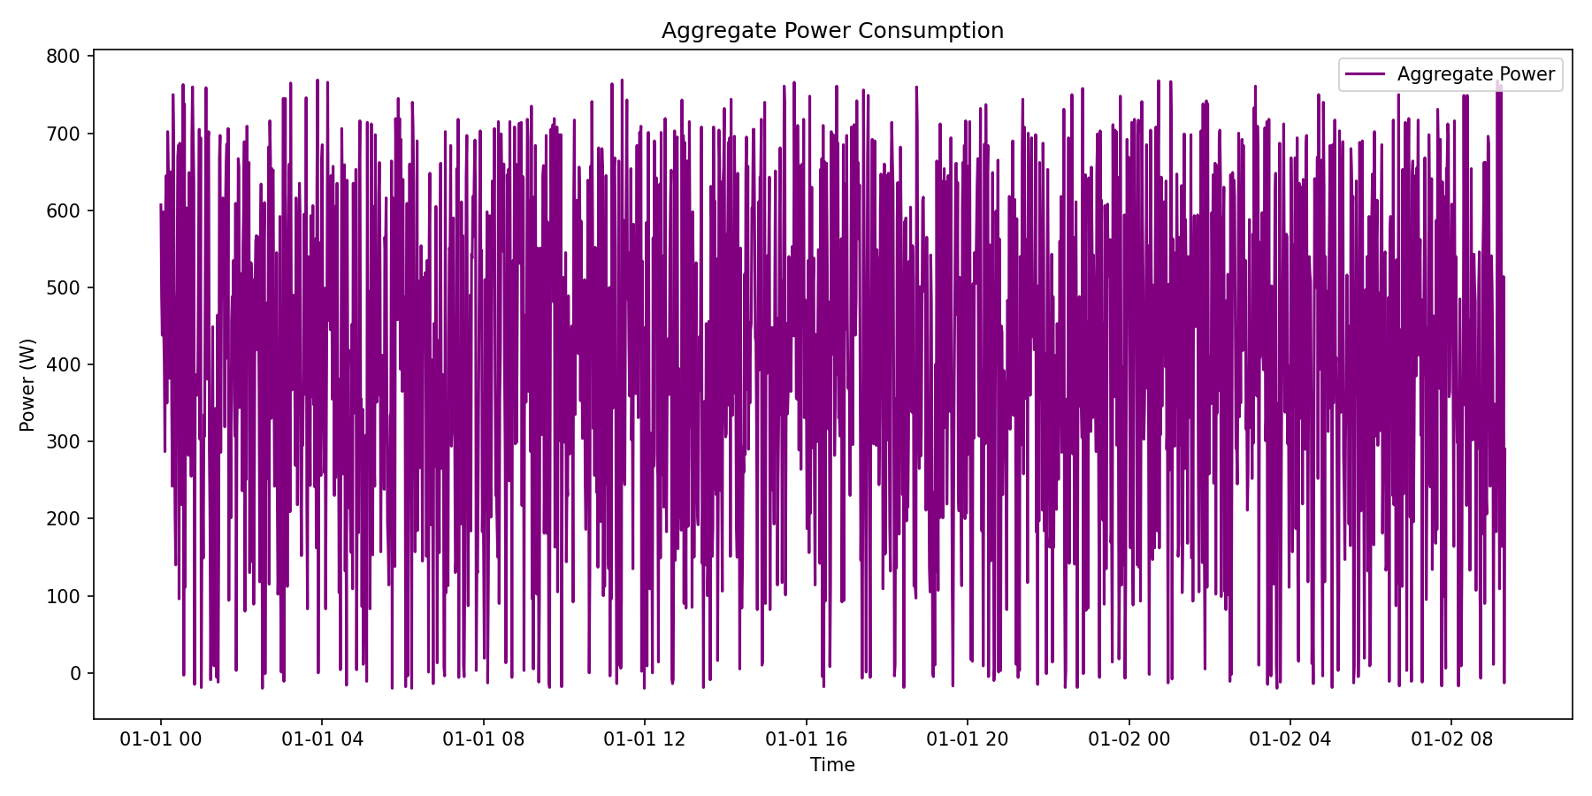

Slide 7
Conclusion & Future Work
Energy disaggregation successful.
Future: Integrate LLMs for automated natural language summaries.

