Slide 1

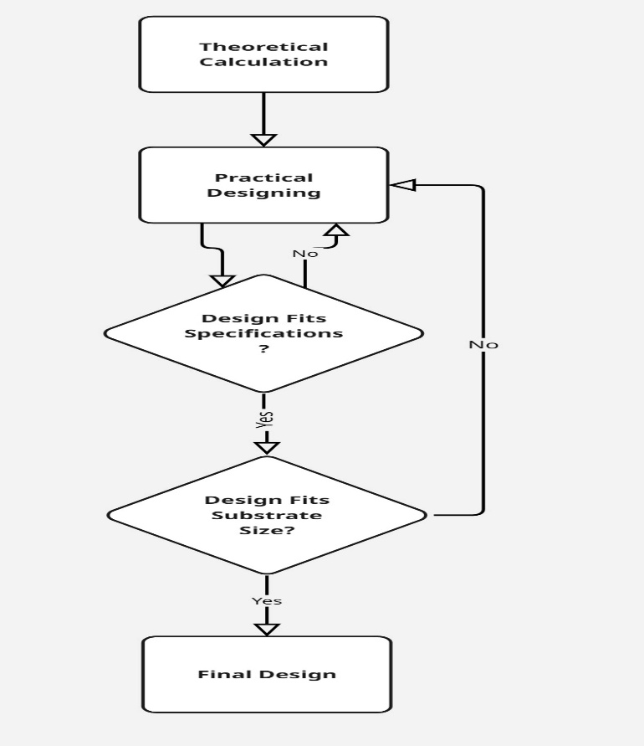
Design & Development of Compact Low pass and Band pass Filters for Microwave Receivers Applications
SRTD-RTMG-MISA
Name: Sneh Ashish Shah
Designation: Researcher
Institution: Institute of Technology, Nirma University
Guide: Sri. Vinit Kumar
Contact e-mail: vinitkumar@sac.isro.gov.in
PHOTO
MAJOR OBJECTIVES:
Design of a Micro strip Low Pass filter with Cut-off at 2.475 GHz
Insertion Loss < 3dB, 0.5 dB Bandwidth of 2.475 GHz, 1dB Bandwidth of 2.5 GHz, Return Loss > 15 dB
Stopband Rejection > 20 dBc (2.750 – 10.125 GHz), Image Rejection > 30 dBc (7.725 – 10.125 GHz)
Design size to be limited within ¾-inch x ¾-inch area substrate
15 MAY 2025 to
23 JULY 2025
METHODOLOGY FLOW CHART:
RESULTS/MAJOR FINDINGS:
Insertion loss of < 3dB and Return loss of > 15 dB is maintained all over the passband.
Open Stub topology causes creation of harmonics beyond the passband which is suppressed by another Low Pass filter with a 3 dB cut-off point of 3.500 GHz
The complete LPF is integrated into a single substrate of area ¾-inch x ¾-inch to achieve the desired performance.
The combined design provides the following results over the complete band of DC – 17.250 GHz:
Subsystem : HSU-IFBE-Ch1
Insertion Loss : < 3 dB
Return Loss : > 15 dB
0.5 dB Bandwidth : 0 - 2.475 GHz
1 dB Bandwidth : 0 - 2.500 GHz
Stopband Rejection : > 20 dBc
Image Rejection : > 30dBc
CONCLUSION:
The designed filter satisfies the given specification constraint within the complete frequency range of DC – 17.250 GHz.

