Slide 1




SUMMER INTERNSHIP 2025 - FINAL REVIEW
Design and Fabrication of RF Band pass and Low pass Filters for Space Applications
15 MAY - 23 JULY 2025
EXTERNAL GUIDE: SRI VINIT KUMAR SCI/ENGR-SG @SAC – ISRO
INTERNAL GUIDE: DR. MANISHA UPADHYAY
EFFORTS BY: SNEH SHAH (22BEC121)
1

Slide 2
Index
Key Terms
Introduction
Design Specifications
Design Challenges
Literature Survey
Methodology
Calculations
Schematic Design
Layout Design
Simulation/EM Simulation/Co- Simulation
Final Results
Conclusion
Key Learnings
Future Scope
References
2

Slide 3
Key Terms
RF – Radio Frequency
LPF – Low Pass Filter
BPF – Band Pass Filter
BW – Bandwidth
L and C – Inductor and Capacitor
Schematic
Layout
Simulation (EM/Co)
Substrate
Fabrication
3

Slide 4
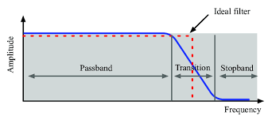
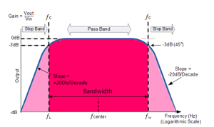
Introduction
Filters play a fundamental role in the design of communication systems by selectively allowing signals within a specified frequency range to pass through while blocking unwanted frequencies.
Among various types of filters, Low Pass Filters (LPF) and Band Pass Filters (BPF) are crucial in RF (Radio Frequency) and microwave applications, where they are used to isolate desired frequency bands from the surrounding noise and interference.
Figure 1. : Ideal vs Practical LPF [9]
Figure 2. : Ideal vs Practical BPF [10]
4

Slide 5
Introduction
A filter is a two-port network used to control the frequency response of a certain point in an RF or microwave system by providing transmission at frequencies within the passband of the filter and attenuation in the stopband of the filter[6].
Typical filter responses include low-pass, high-pass, band pass, and band-reject characteristics.
Applications can be found in virtually any type of RF or microwave communication, radar, or test and measurement system.
Different types of filter prototypes exist within the types of filters which include Butterworth, Chebyshev, Elliptic, Gaussian, Bessel, etc.
The basic methodology any filter design process includes starting with a Low Pass Protoype then further we convert or transform them to different response that are desired.
5

Slide 6
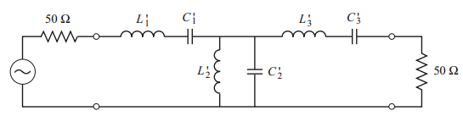
Design Specifications (BPF)
Band Pass Filter (BPF)
Center Frequency : 312.5 MHz
Bandwidth (BW):
0.5 dB → ± 50 MHz
1 dB → ± 60 MHz
Rejection :
At ± 125 MHz
Greater than >20dBc
Filter Order, N = 3
Q-Factor = 25
Use Lumped Elements only
Butterworth / Maximally Flat Response
Use practical values of Inductor(L) and Capacitor(C)
Figure 3. : Basic Circuit for 3rd Order BPF [6]
6

Slide 7
Design Challenges (BPF)
Sharp Roll-Off
→ Difficult to achieve in Low Order filters
Very less components
→ In order to reduce area as much as possible
Q-Factor
→ This parameters helps us include parasitics in our simulations
Using practical values of L and C
→ Readily available in market
For the design of the Band Pass Filter using Lumped Elements much literature review was not required. Only referred materials were the textbooks mentioned in [6] and [7].
Some websites were also referred, just get an idea about how filters look after being fabricated and what their physical sizes are.
7

Slide 8
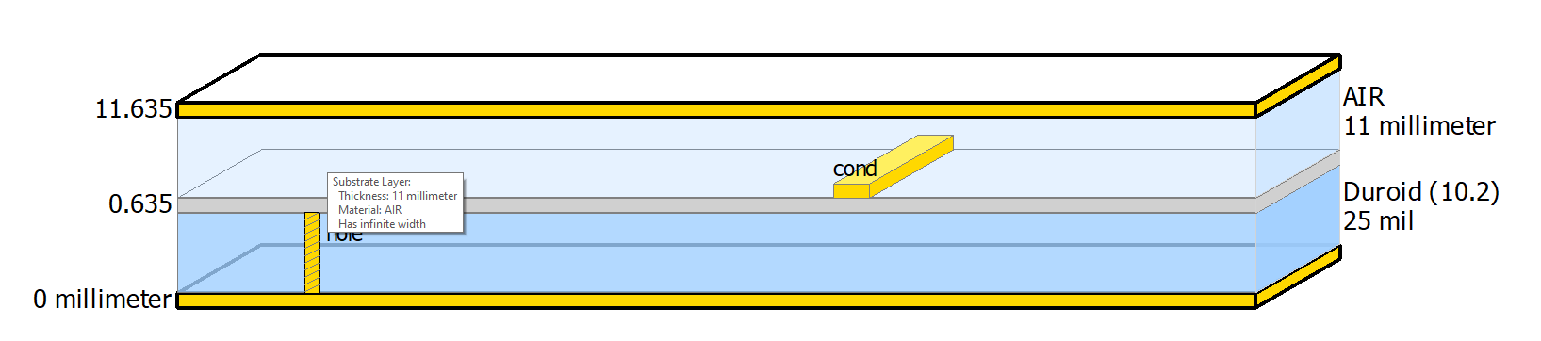
Methodology (BPF)
The design is implemented on an Duroid 6010 substrate, which is a commonly used material in RF and microwave circuits due to its excellent electrical and mechanical properties [8]. Below mentioned are some of the key substrate parameters:
Substrate Height (H): 25 mils (0.635 mm)
Relative Dielectric Constant (ε_{r}): 10.2
Loss Tangent (Tan D): 0.002
Conductor Material: Gold (Au)
Conductor Thickness (T): 17 um
Conductivity: 4.1E+7 S/m
Upper Housing Height (Hu): 11 mm
Substrate Area: ¾ - inch x ¾ - inch - (≈ 19 mm x 19 mm)
Duroid 6010 is selected as the dielectric substrate for its high permittivity (ε_{r} = 10.2), which enables miniaturization of the resonator structures and helps achieve compact layout within the given area constraint of ¾ - inch × ¾ - inch. Its low loss tangent (0.002) is ideal for microwave frequencies, contributing to low insertion loss and improved quality factor (Q).
8
Figure 4. : Substrate structure used for BPF

Slide 9
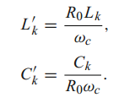
Methodology (BPF)
Further, we use the g-values table from [], to calculate the values of L and C. The formulae for the same are given below.
Figure 5. : Formulas for calculating values of L and C [6]
Here, L_{k} and C_{k} take values from g-values and finally we get the values of Inductances and Capacitances in nH and pF respectively.
Further, we create a Schematic followed by Layout or directly start with a layout. Accordingly, we perform tuning operations for enhancing the response and run EM simulations with various physical parameters to get the most accurate response of the filter.
Here, we work with Co-Simulations. Finally, the layout is ready for fabrication after exporting “. gds” file.
9

Slide 10
Calculations (BPF)
The below tables show the various values for calculations of different types of filter design that were tried.
i | L (nH) | C (pF)
1 | 56.58 | 4.58
2 | 5.729 | 45.27
3 | 56.58 | 4.58
4 | 9.75 | 36.3s
i | L (nH) | C (pF)
1 | 65.5 | 4.155
2 | 8.6315 | 30
3 | 65.5 | 4.155
4 | 18 | 18
5 | 14.9235 | 19.5
6 | 10.8 | 18
i | L (nH) | C (pF)
1 | 65.5 | 3.0695
2 | 10.353 | 23.4
3 | 65.5 | 3.0695
4 | 14.58 | 69.97
Table 1. : 3rd Order BPF Filter with an m-derived section
Table 3. : 3rd Order BPF Filter with an m-derived section
Table 2. : 4th Order BPF Filter with 2 m-derived sections
10

Slide 11
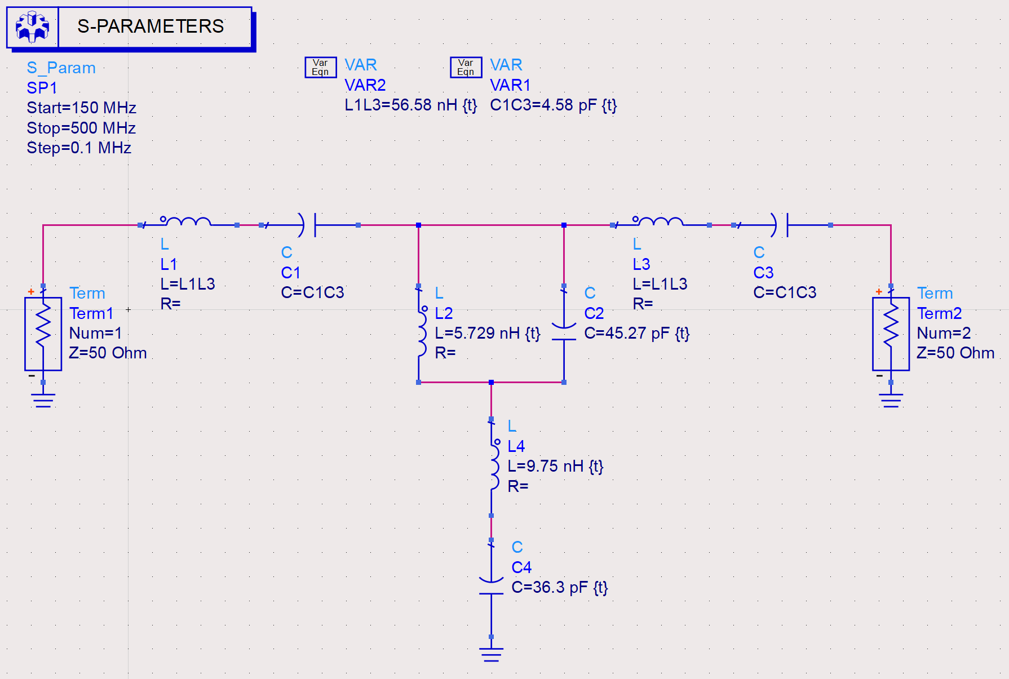
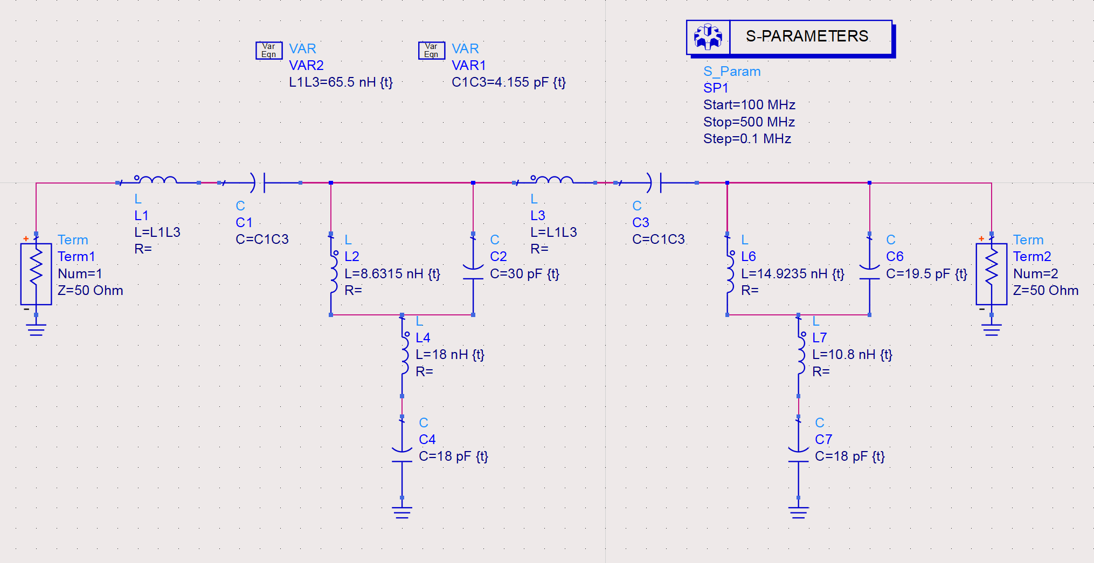
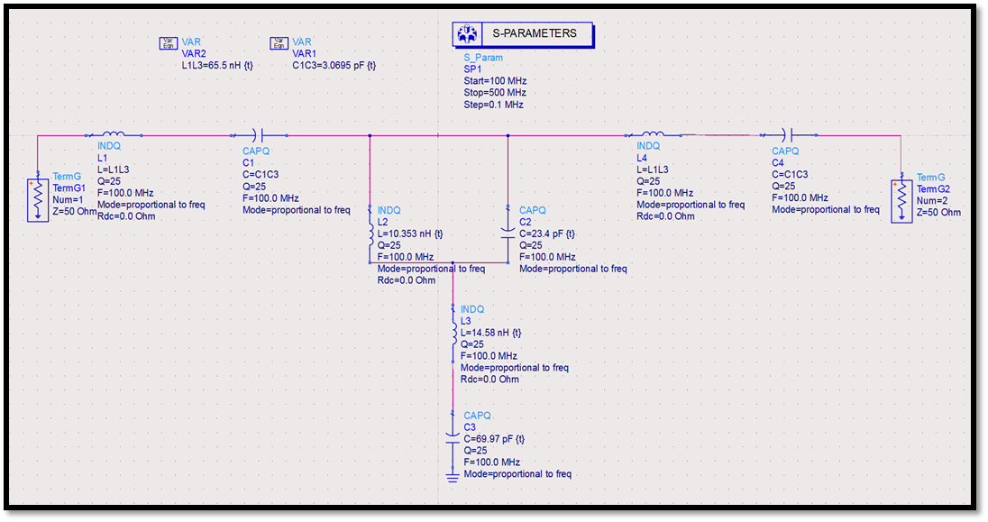
Schematic Design (BPF)
The below figures shows the types of schematics that were designed to obtain the desired response.
Figure 6. : 3rd Order BPF Filter with an m-derived section
Figure 7. : 4th Order BPF Filter with 2 m-derived sections
11
Figure 8. : 3rd Order BPF Filter with an m-derived section (with Actual Values and parasitics)

Slide 12
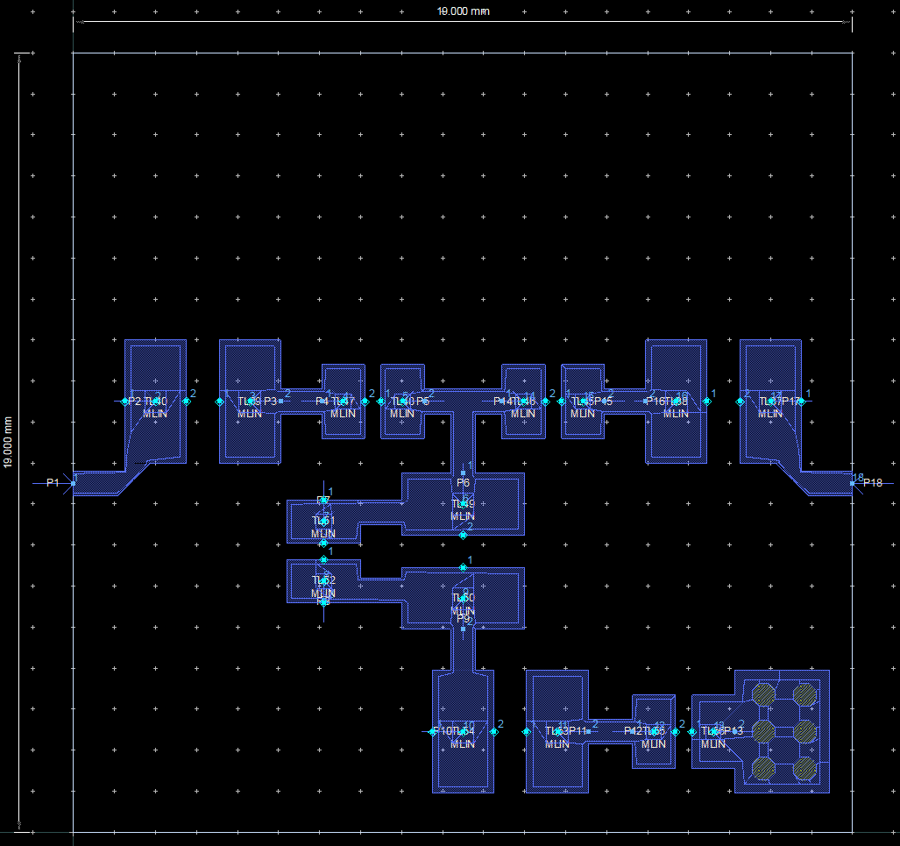
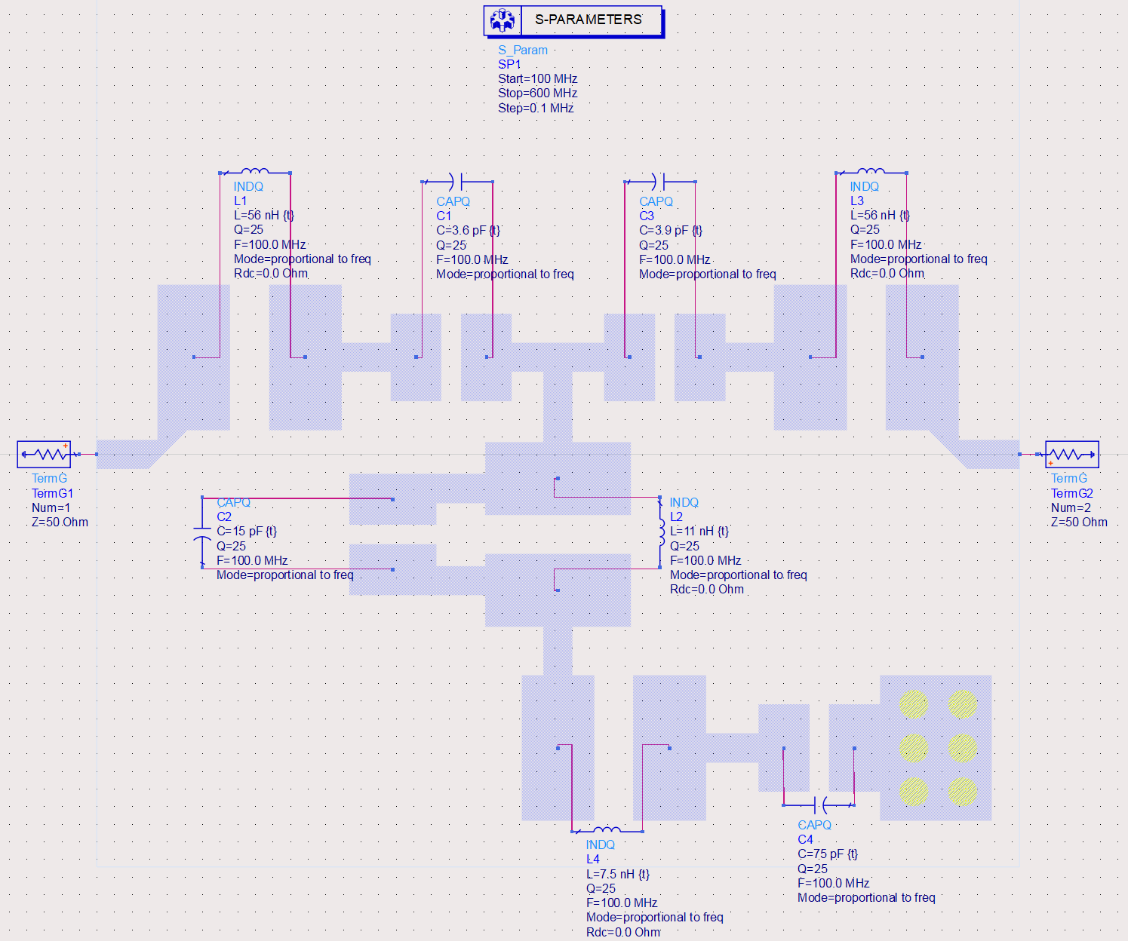
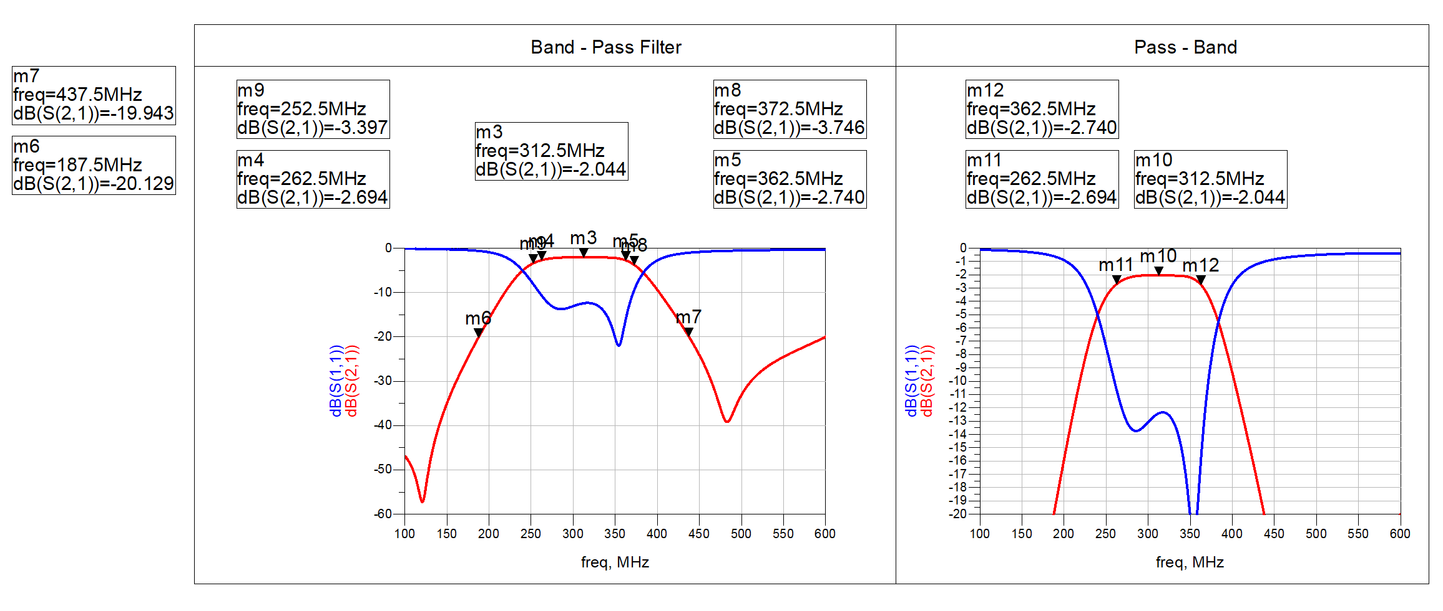
Final Results (BPF)
The below consists of Layout for Fabrication, Co-simulation of the Circuit and it Response.
Figure 12. : 3rd Order BPF Layout (To be fabricated)
Figure 13. : 3rd Order BPF Filter Co-Simulation View
12
Figure 14. : 3rd Order BPF Filter with an m-derived section (with Actual Values and parasitics)

Slide 13
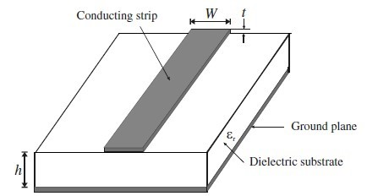
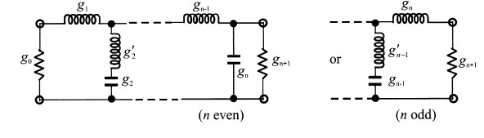
Design Specifications (LPF)
Low Pass Filter using Microstrip Line in ADS
Given Specifications
Subsystem → HSU-IFBE-Ch1
0.5dB BW → 0.075 – 2.475 GHz
1dB BW → 0.050 – 2.5 GHz
Stopband → 2.750 – 17.25 GHz with >20dBc Rejection
Image Rejection → 7.725 – 10.125 GHz with >30dBc Rejection
Insertion Loss <3dB
Return Loss → Better than 15dB
Figure 15.: Circuit for n^{th} Order LPF [7]
13

Slide 14
Design Challenges (LPF)
Achieving wide stopband rejection up to 17.25 GHz with >20 dB attenuation.
Achieving >30 dB image rejection in the 7.725–10.125 GHz range
Maintaining low insertion loss (<3 dB) over the wide 0.05–2.5 GHz passband.
Total filter structure exceeded target layout area of ¾×¾ inch².
Also, follow the rules for fabrication process.
14

Slide 15
Literature Survey (LPF)
In a previous work [1], a novel low-pass filter using spiral compact microstrip resonant structure for size reduction and broad pass-band is presented. The proposed low-pass filter is designed, fabricated and tested. The insertion loss of the filter is less than 0.1dB in the frequency range from DC to 3.5 GHz.
In another work [2], A lowpass filter with wideband stopband is developed using microstrip line and proposed in this paper. It consists of shunt stepped-impedance open-circuited stubs and unit elements. The electrical length of the open-circuited stubs is chosen to be twice the length of the unit elements at a specific frequency.
Work [3] presents design, implementation and performance evaluation of a 2.8 GHz low-pass filter using microstrip resonator. The 3D planar electromagnetic simulator ADS Momentum is used for the layout design and the performance characterization. This filter has a Chebyshev response with 0.02 dB of ripple and a cutoff frequency located at 2.8 GHz.
15

Slide 16
Literature Survey (LPF)
In work [4] a compact microstrip low-pass filter (LPF) using T-shaped resonator with wide stopband is presented. The proposed LPF has capability to remove the eighth harmonic and a low insertion loss of 0.12 dB.
Work [5] presents a novel lowpass filter (LPF) structure which consists of a section of high-impedance microstrip line (HIML) with a pair of radial stubs (RSs) loaded at its center and a pair of stepped-impedance open stubs (SIOSs) loaded on both ends of HIML.
16

Slide 17
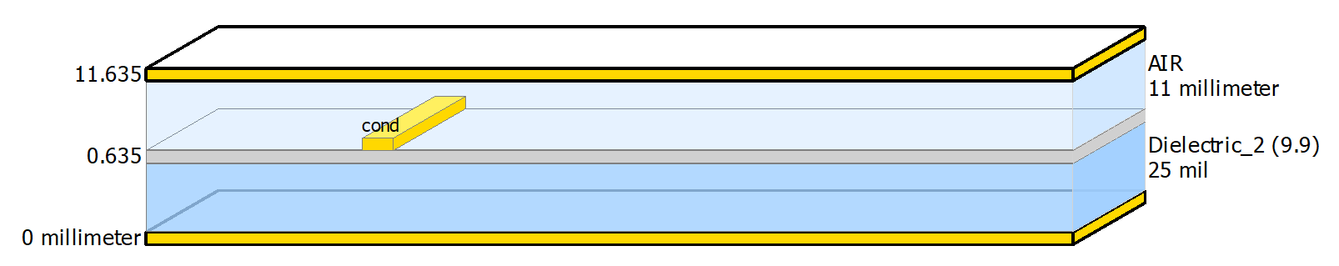
Methodology (LPF)
The design is implemented on an Alumina (Al₂O₃) substrate, which is a commonly used ceramic material in RF and microwave circuits due to its excellent electrical and mechanical properties []. Below mentioned are some of the key substrate parameters:
Substrate Height (H): 25 mils (0.635 mm)
Relative Dielectric Constant (ε_{r}): 9.9
Loss Tangent (Tan D): 0.007
Conductor Material: Gold (Au)
Conductor Thickness (T): 8 um
Conductivity: 4.1E+7 S/m
Upper Housing Height (Hu): 11 mm
Substrate Area: ¾ - inch x ¾ - inch - (≈ 19 mm x 19 mm)
Alumina is selected as the dielectric substrate for its high permittivity (ε_{r} = 9.9), which enables miniaturization of the resonator structures and helps achieve compact layout within the given area constraint of ¾ - inch × ¾ - inch. Its low loss tangent (0.007) is ideal for microwave frequencies, contributing to low insertion loss and improved quality factor (Q).
17
Figure 16. : Substrate structure used for LPF

Slide 18

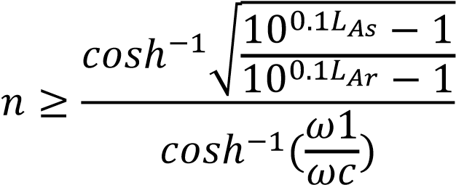
Methodology (LPF)
Further, we use the g-values table from [], to calculate the values of L and C. The formulae for the same are given below.
Figure 17. : Formulas for calculating values for LPF [7]
Here, L_{k} and C_{k} take values from g-values and finally we get the values of Inductances and Capacitances in nH and pF respectively.
Now, we use the Richards Transformation to convert these lumped elements values to microstrip line values consisting of Ws and Ls.
From the above formula, we get ɵ or bl, which is the electrical length. Finally, we use the LineCalc tool from ADS to calculate the physical widths and lengths. We can also calculate the W, L manually but the software gives us more accurate parameters and considers some more conditions which we usually ignore.
Further, we create a Schematic followed by Layout or directly start with a layout. Accordingly, we perform tuning operations for enhancing the response and run EM simulations with various physical parameters to get the most accurate response of the filter.
Here, we work with EM-Simulations. Finally, the layout is ready for fabrication after exporting “. gds” file.
18

Slide 19
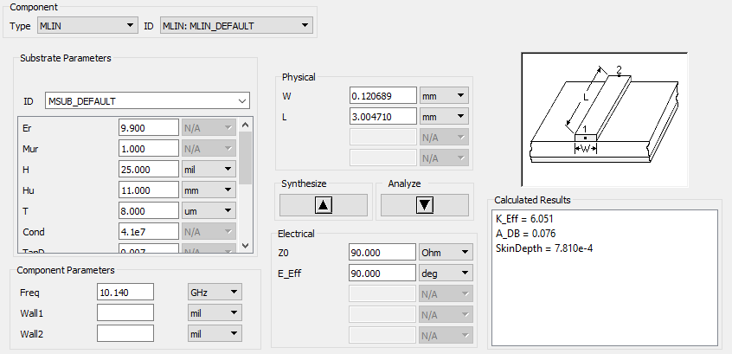

Calculations (LPF)
The below is the example of using the LineCalc tool in ADS. Detailed calculations cannot be shown here. Also, in this design earlier schematics were used now at this stage directly we go on with layouts.
Not all layouts have been shown next. Refer to the report for all the designs.
Figure 18. : Line Calc Tool to calculate physical L and W
Figure 19. : More Formulas for calculating values for LPF [7]
19

Slide 20
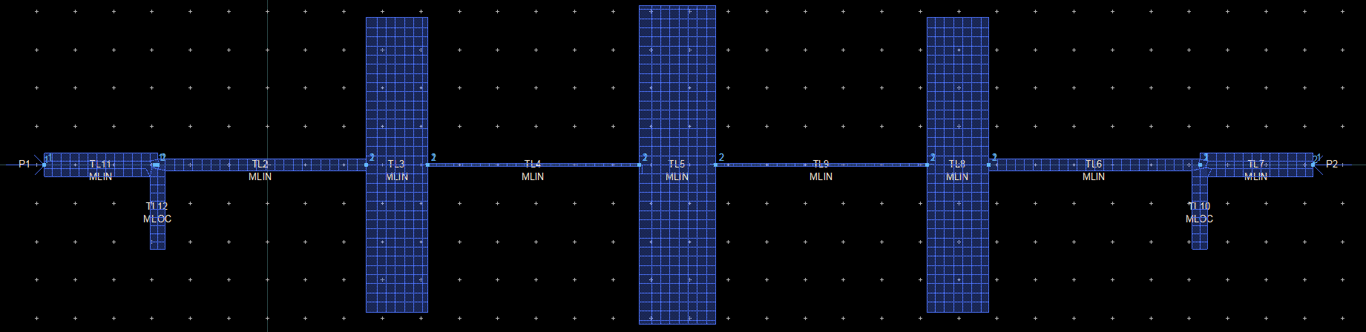
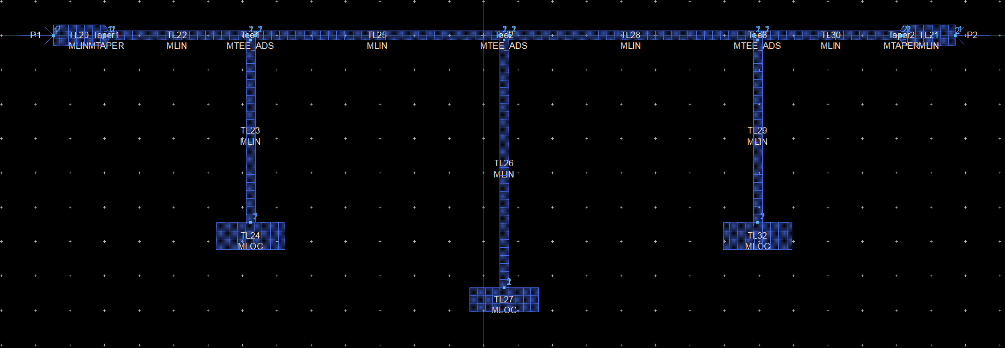
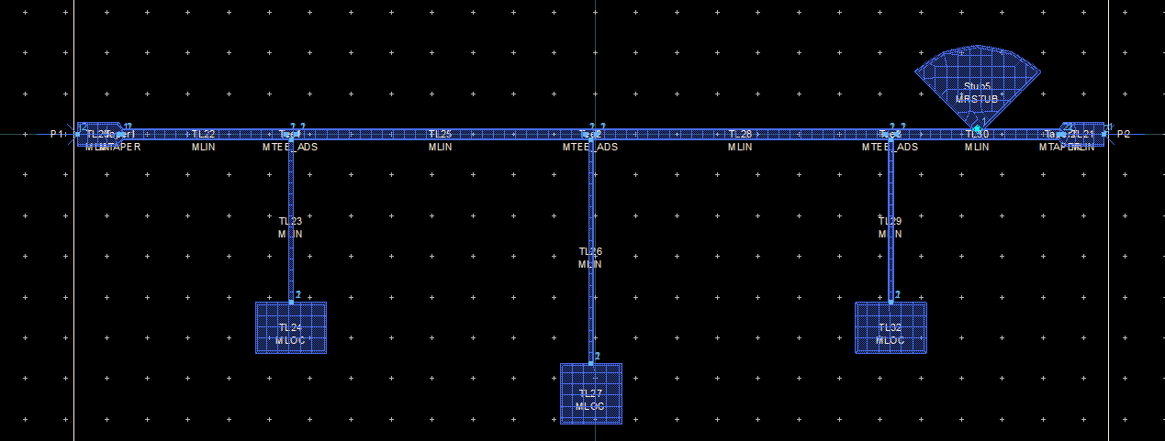
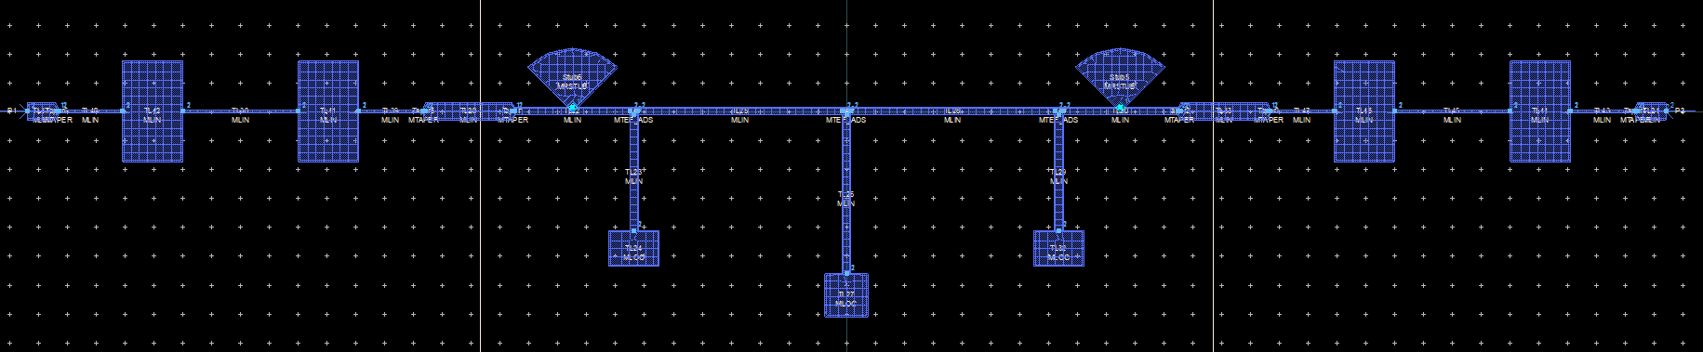
Layout Design (LPF)
The below figures shows the types of layouts that were designed to obtain the desired response.
Figure 20. : Layout for the 7th Order Stepped Impedance Filter
Figure 21. : Layout for the 7th Order LC Open Stub Filter
Figure 23. : Layout for the 7th Order Filter + 5th Order LPF with Radial Stubs
20
Figure 22. : Layout for the 7th Order Filter with Radial Stubs

Slide 21
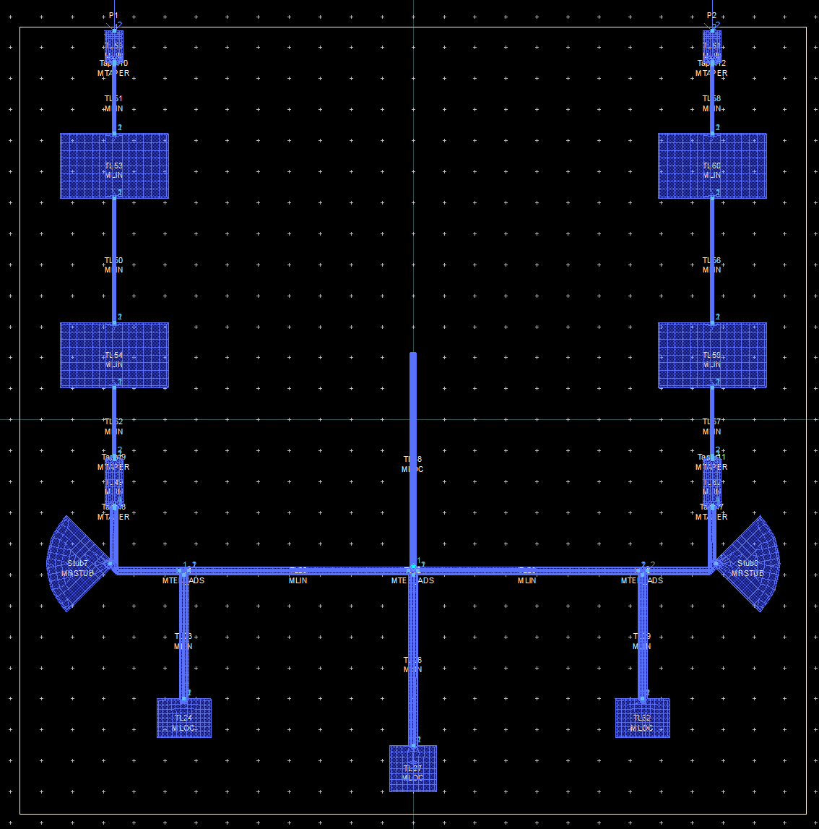
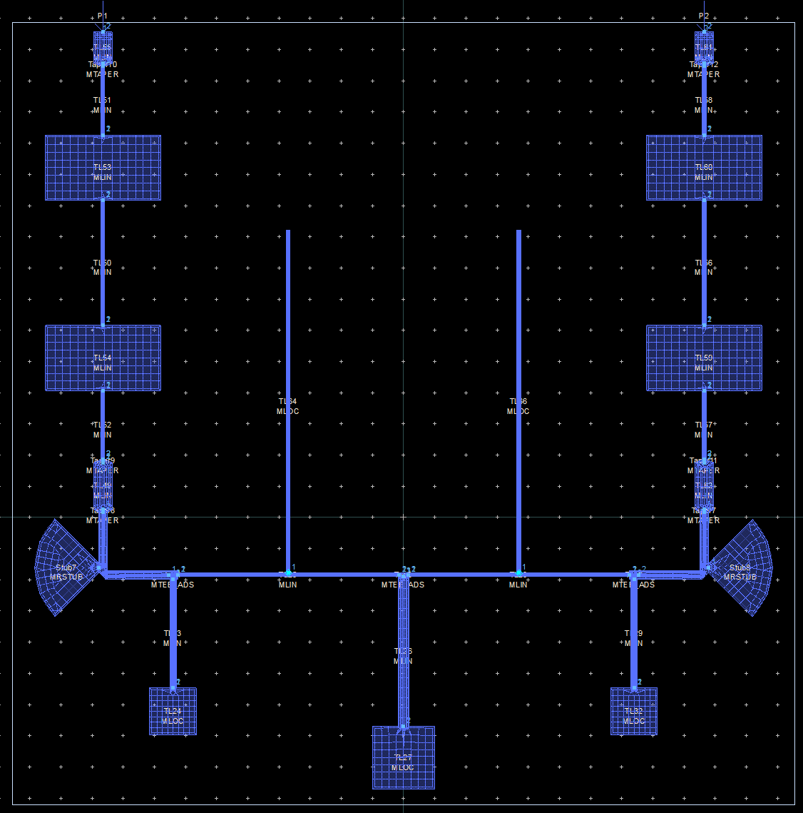
Layout Design (LPF)
The below figures shows the types of layouts that were designed to obtain the desired response.
Figure 24. : Layout of LPF + LPF fitted in 1 inch x 1 inch
Figure 25. : Layout of LPF + LPF fitted in 1 inch x 1 inch with increased order
21

Slide 22
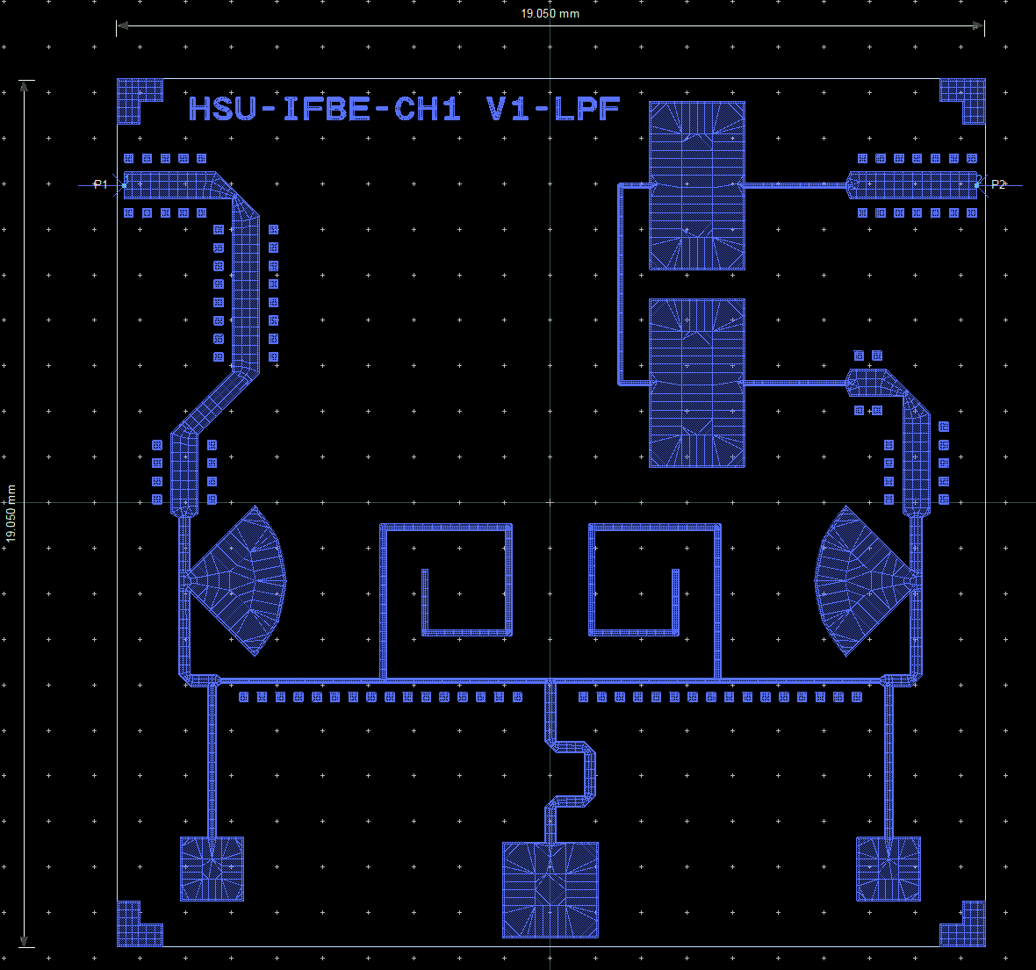
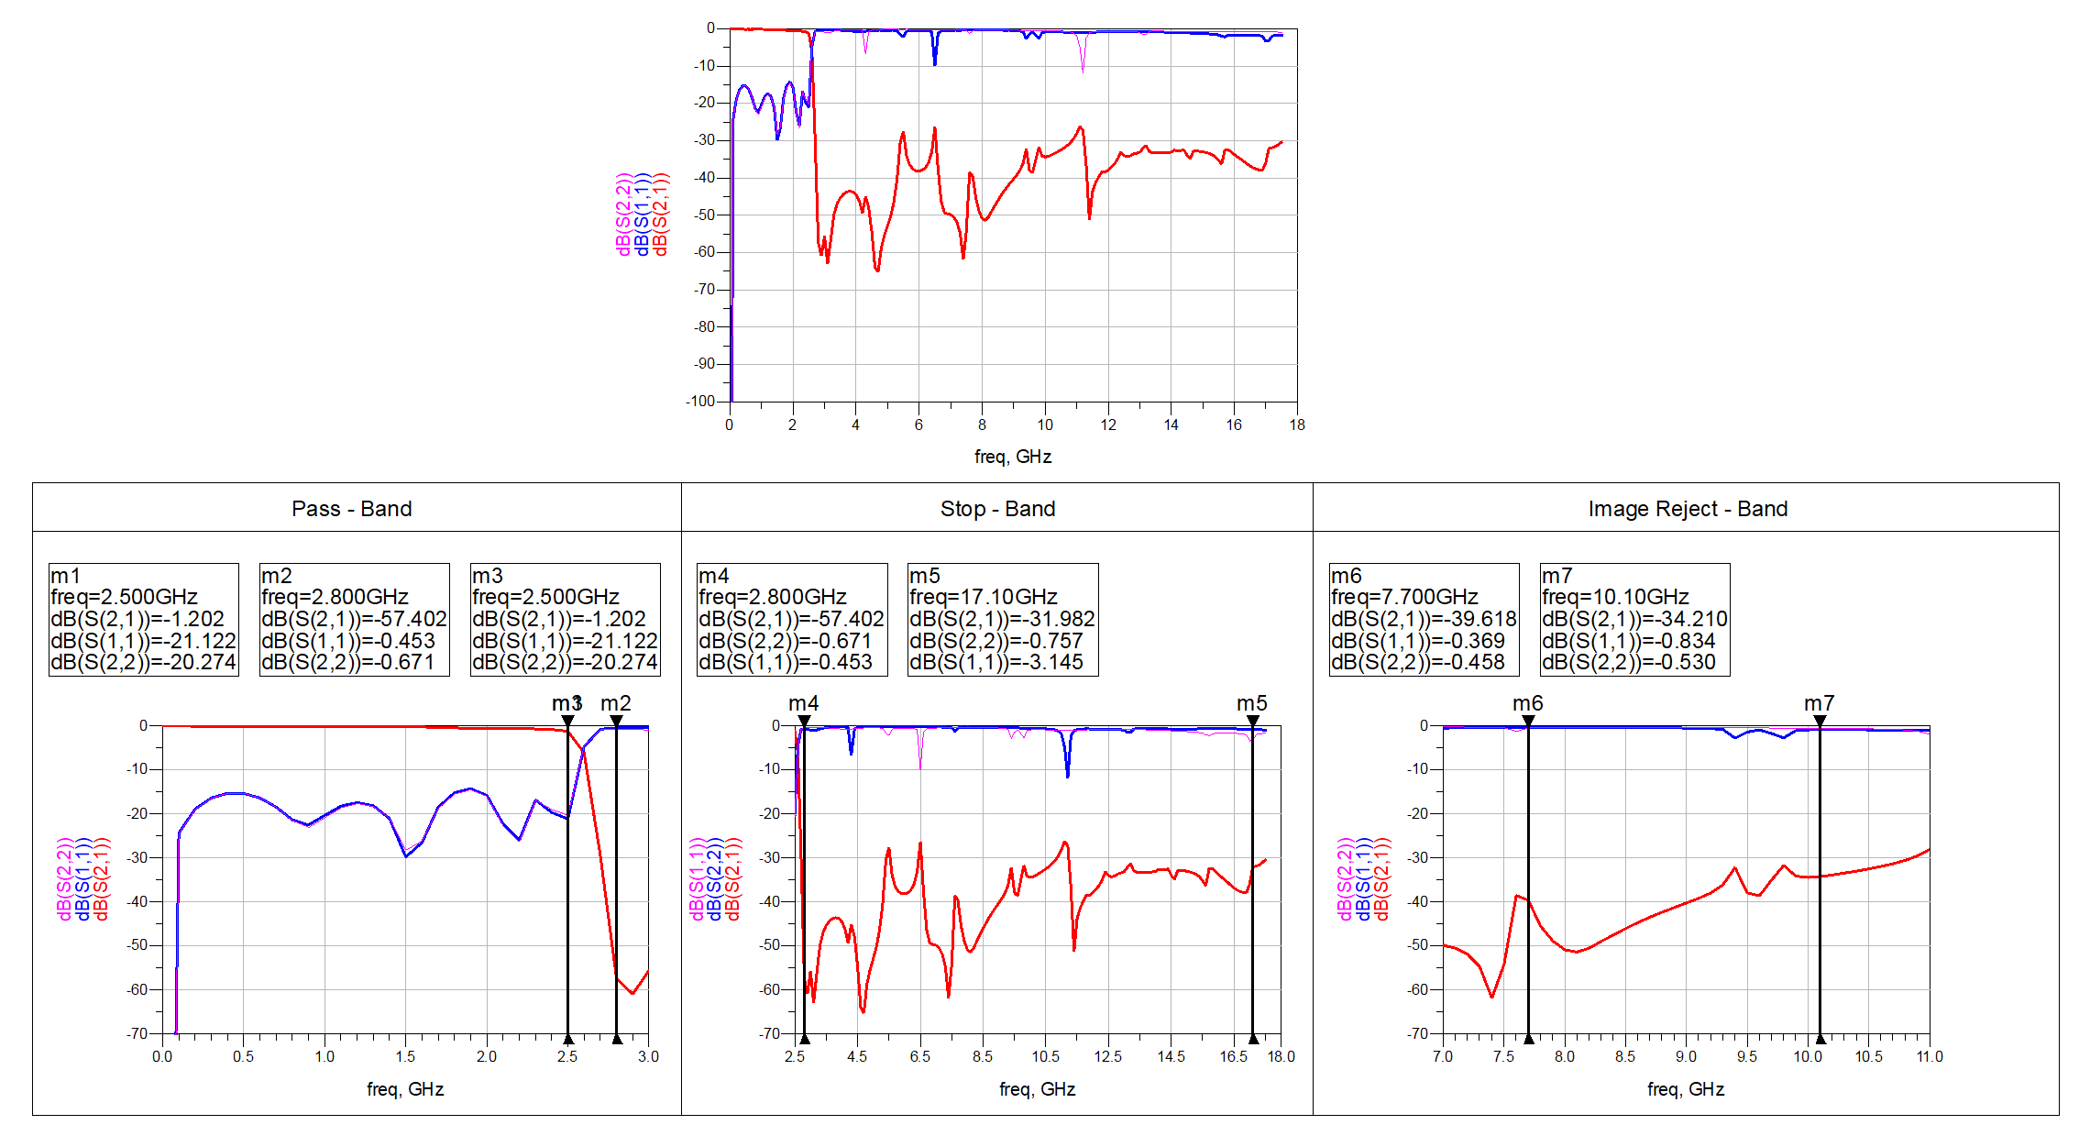
Final Results (LPF)
The below consists of Layout for Fabrication, EM-simulation of the Circuit.
Figure 26. : Final LPF+LPF Layout (To be fabricated)
Figure 27. : Final Simulation Results
22

Slide 23
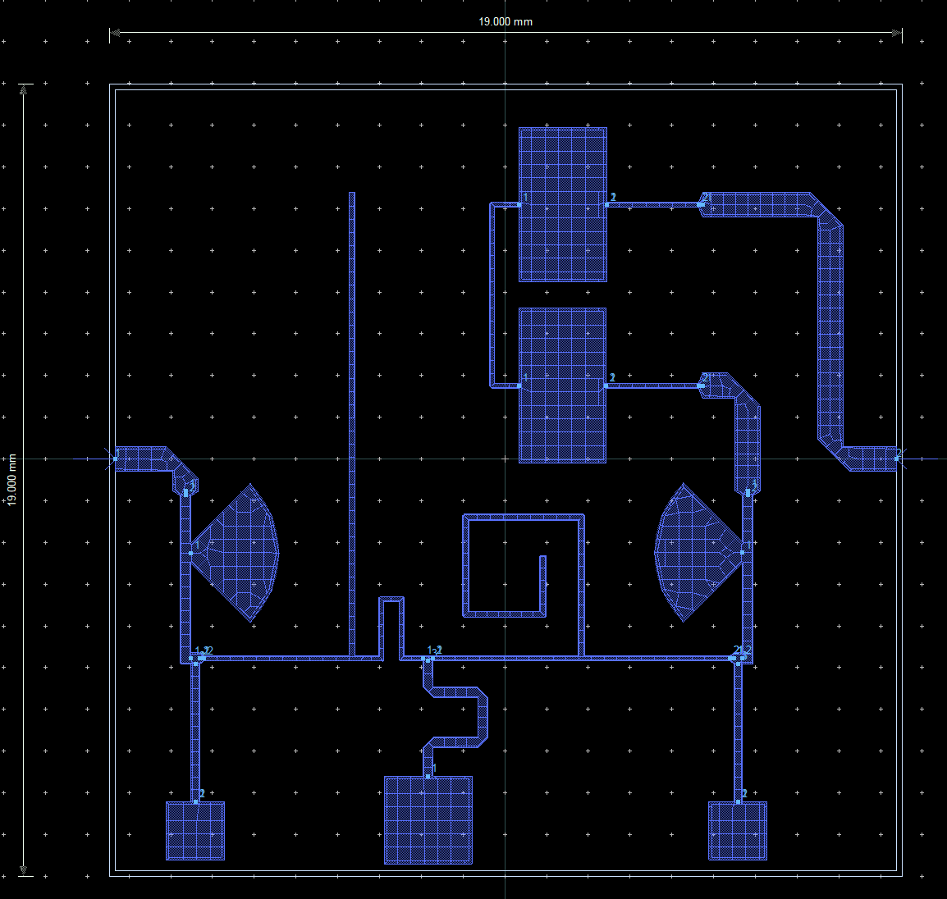
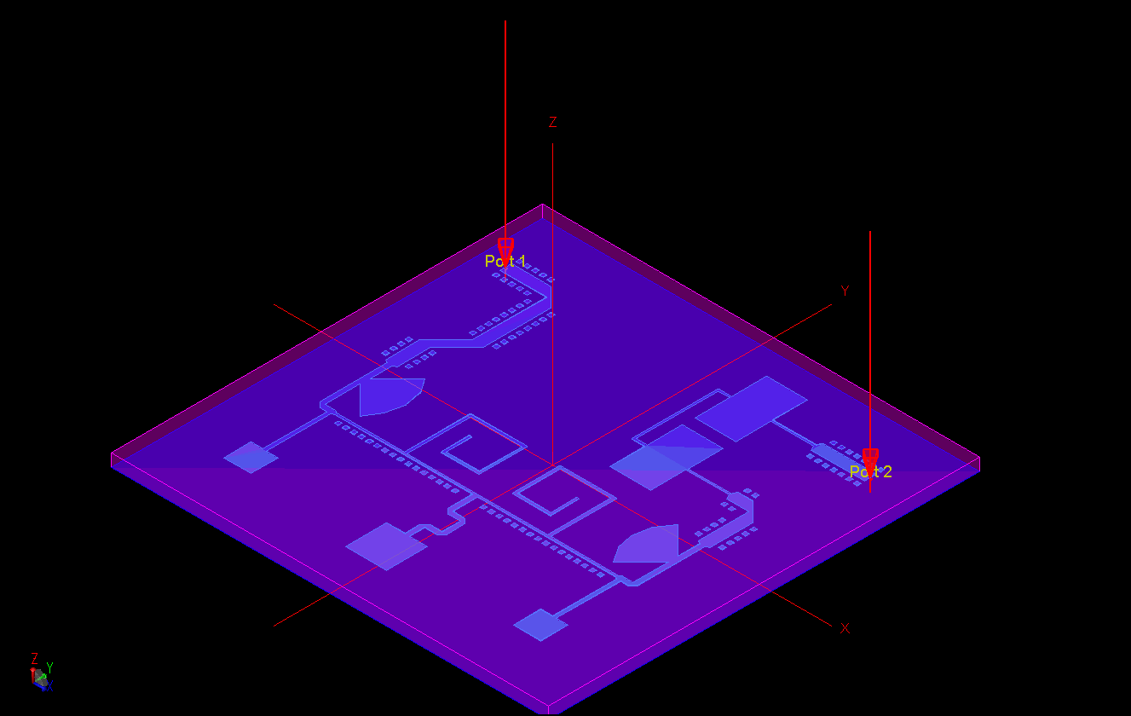
Final Results (LPF)
The below consists of a v2 Layout (under progress) for Fabrication, EM-simulation of the Circuit.
Figure 27. : v2 Final LPF+LPF Layout (To be fabricated)
Figure 27. : 3D View for v1 Final LPF Design
23

Slide 24
Conclusion
Final design consists of a 3rd order LC Band Pass Filter satisfying the specifications. It also meets the desired specifications and fits in the area of ¾ inch x ¾ inch.
The design for micro strip Low Pass Filter also matches the specifications given and has been fitted in an area of ¾ inch x ¾ inch also.
Both the filters are nearly ready for fabrication stage and afterwards we will be comparing the filters practical and simulated results.
24

Slide 25
Key Learnings and Future Scope
The major learning include knowledge gain in the domain of RF and Microwave. Explored the facilities available with SAC-ISRO and how people work their. Also, major change in the mind-set to make things perfect and very accurate as required by the Space industry.
The micro strip LPF can still be optimized in size as well as ports placed at centre that is being carried out in the v2 Layout.
Further, after both the filters are fabricated, we will test their response in Vector Network Analyser (VNA) and verify the Simulated and Practically obtained results for the both the filters.
The other areas to be explored includes Mixers, Amplifiers, etc.
25

Slide 26
References
Song, Mei-jing, and Jiu-sheng Li. "A compact microstrip lowpass filter using spiral resonant structure." 2011 4th IEEE International Symposium on Microwave, Antenna, Propagation and EMC Technologies for Wireless Communications. IEEE, 2011.
Alyahya, Meshaal, et al. "Compact microstrip lowpass filter with ultra-wide rejection-band." 2017 International Conference on Wireless Technologies, Embedded and Intelligent Systems (WITS). IEEE, 2017.
Ahmad, Jameel, et al. "Design and Fabrication of a Low-Pass Filter based on a Microstrip Resonator for Microwave Applications." 2021 International Conference on Electrical, Computer, Communications and Mechatronics Engineering (ICECCME). IEEE, 2021.
Sheikhi, Akram, Abbas Alipour, and Abdolali Abdipour. "Design of compact wide stopband microstrip low-pass filter using T-shaped resonator." IEEE Microwave and Wireless Components Letters 27.2 (2017): 111-113.
Xu, Jin, et al. "Design of miniaturized microstrip LPF and wideband BPF with ultra-wide stopband." IEEE Microwave and wireless components letters 23.8 (2013): 397-399.
26

Slide 27
References
Jia-Sheng Hong, M.J.Lancaster. “Microstrip Filters for RF/Microwave Applications”.
David M. Pozar. “Microwave Engineering”, 4th Edition.
T.C Edwards, M.B Steer. “Foundations of Interconnect and Microstrip Design”, 3rd Edition.
S. K. Mitra and S. K. Samanta, "A Review of Digital Filtering Techniques for Electrocardiogram Signal Processing," *Int. J. Eng. Adv. Technol.*, vol. 9, no. 4, pp. 224–229, Apr. 2020.
"Band Pass Filter," GeeksforGeeks, Apr. 8, 2024. [Online]. Available: https://www.geeksforgeeks.org/electronics-engineering/band-pass-filter/
27

Slide 28
THANK YOU
28

