Slide 1

HR_ANALYTICS
SNEKHA j

Slide 2
OUTLINE
INTRODUCTION
METHODOLOGY
TOOLS USED
RESULT
CONCLUSIONS

Slide 3
INTRODUCTION
This HR analytics project focuses on analyzing employee attrition using a structured dataset containing detailed records of over 1,400 employees. The dataset includes attributes such as age, department, job role, years at the company, job satisfaction, and whether the employee has left the organization. The goal of the project is to identify patterns and key factors contributing to attrition. Through Excel-based data cleaning, filtering and visualizations, insights are drawn to assist HR departments in making data-driven decisions to reduce turnover and improve retention strategies.

Slide 4
METHODOLOGY
MYSQL
POWER
BI
GITHUB

Slide 5
TOOLS USED
MYSQL WORKBENCH
POWER QUERY
POWER BI

Slide 6
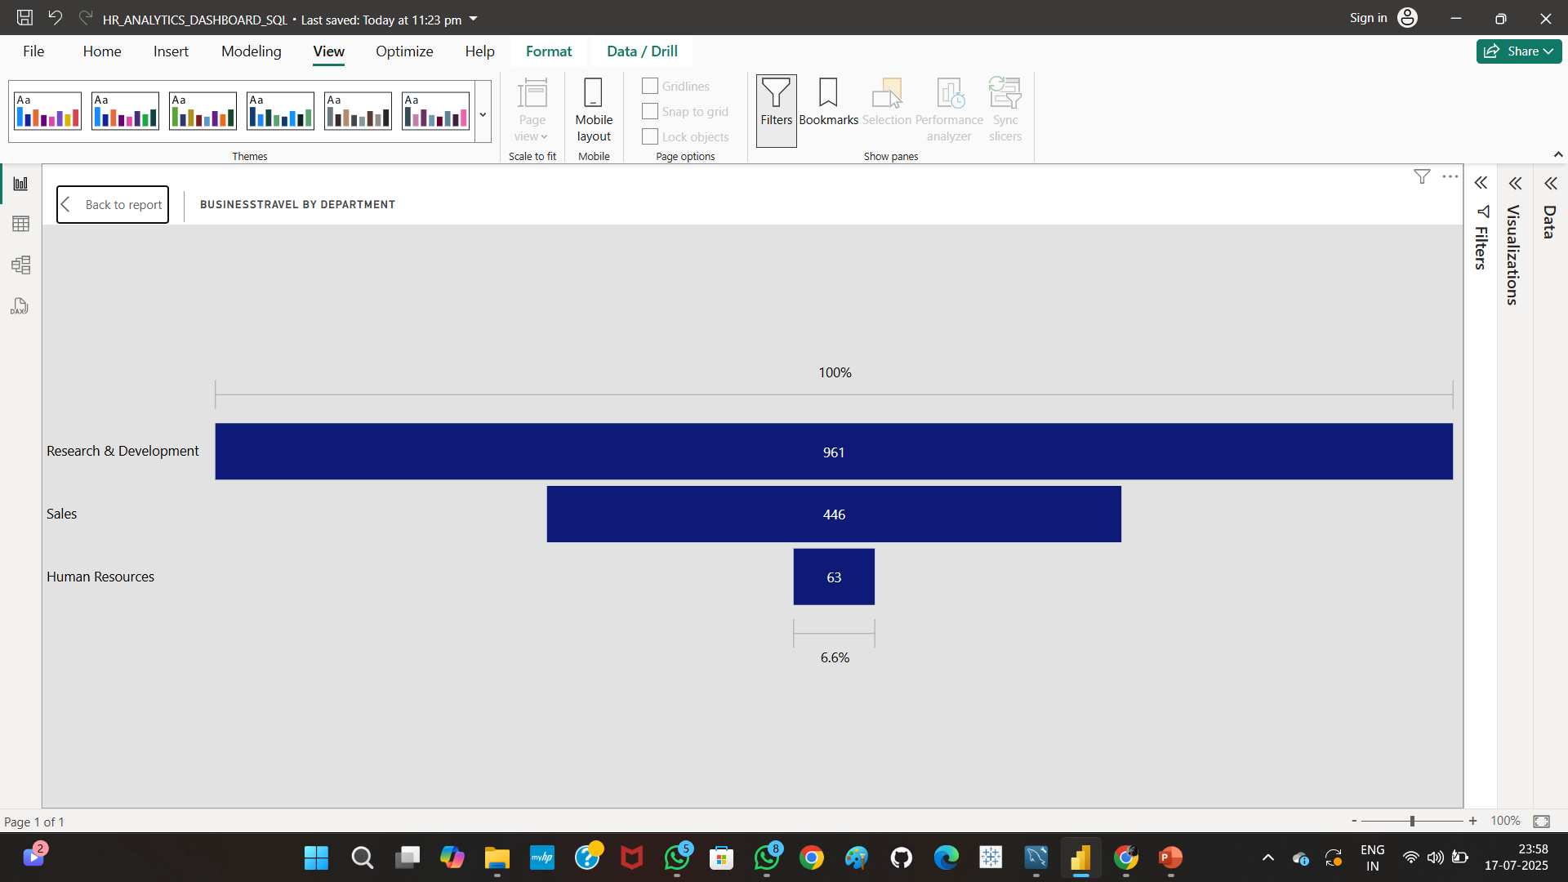
RESULT
Business Travel by Department
This horizontal bar chart shows how many employees travel for business across departments.
Research & Development has the highest number of business travelers (961), followed by Sales (446), and Human Resources (63). This insight helps understand departmental demands for travel, which may affect job stress, work-life balance, or attrition risk.

Slide 7
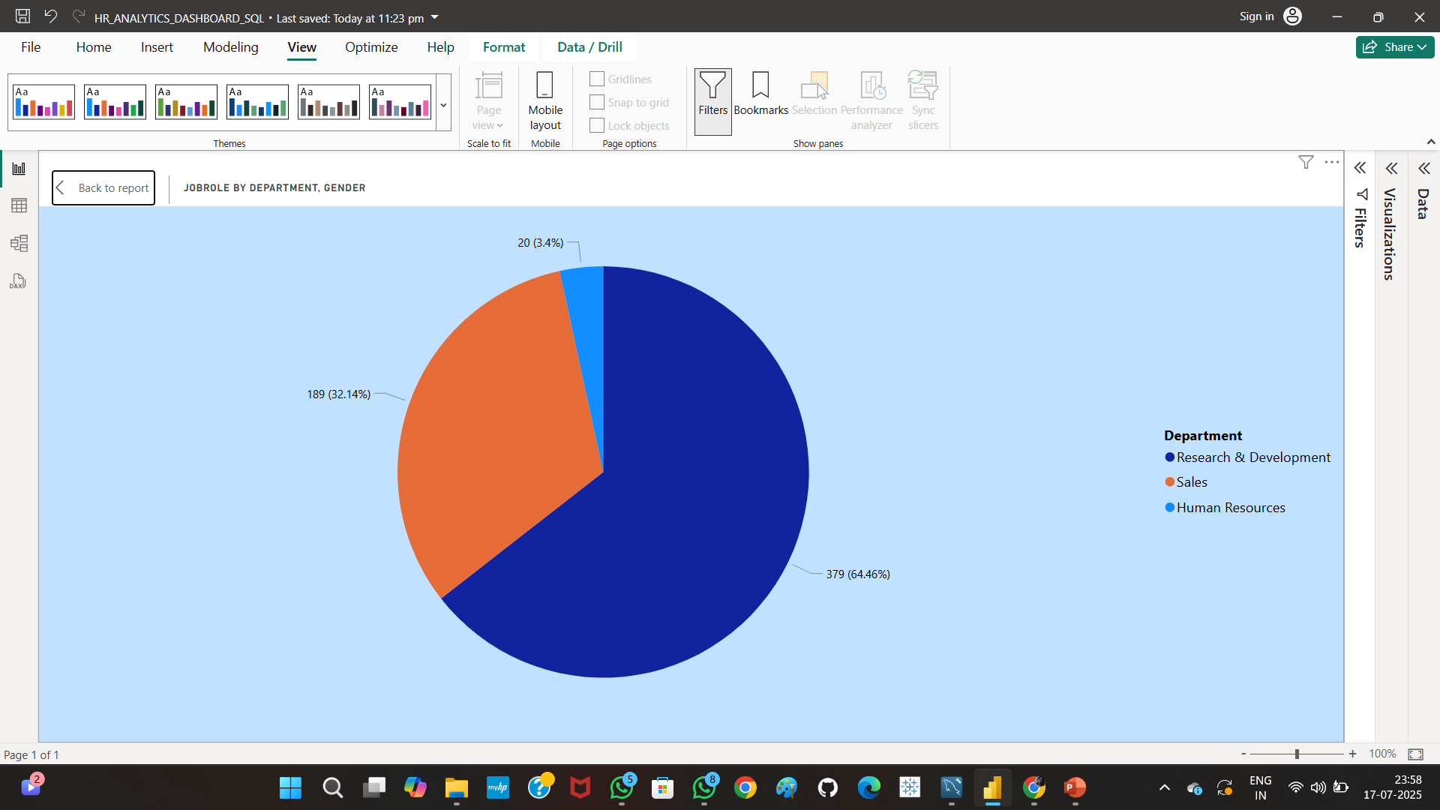
2. Job Role by Department & Gender
The pie chart displays the gender distribution across departments. Research & Development dominates with 64.46%, followed by Sales (32.14%) and Human Resources (3.4%). This visualization helps in assessing diversity and potential gender gaps in job roles within departments.

Slide 8
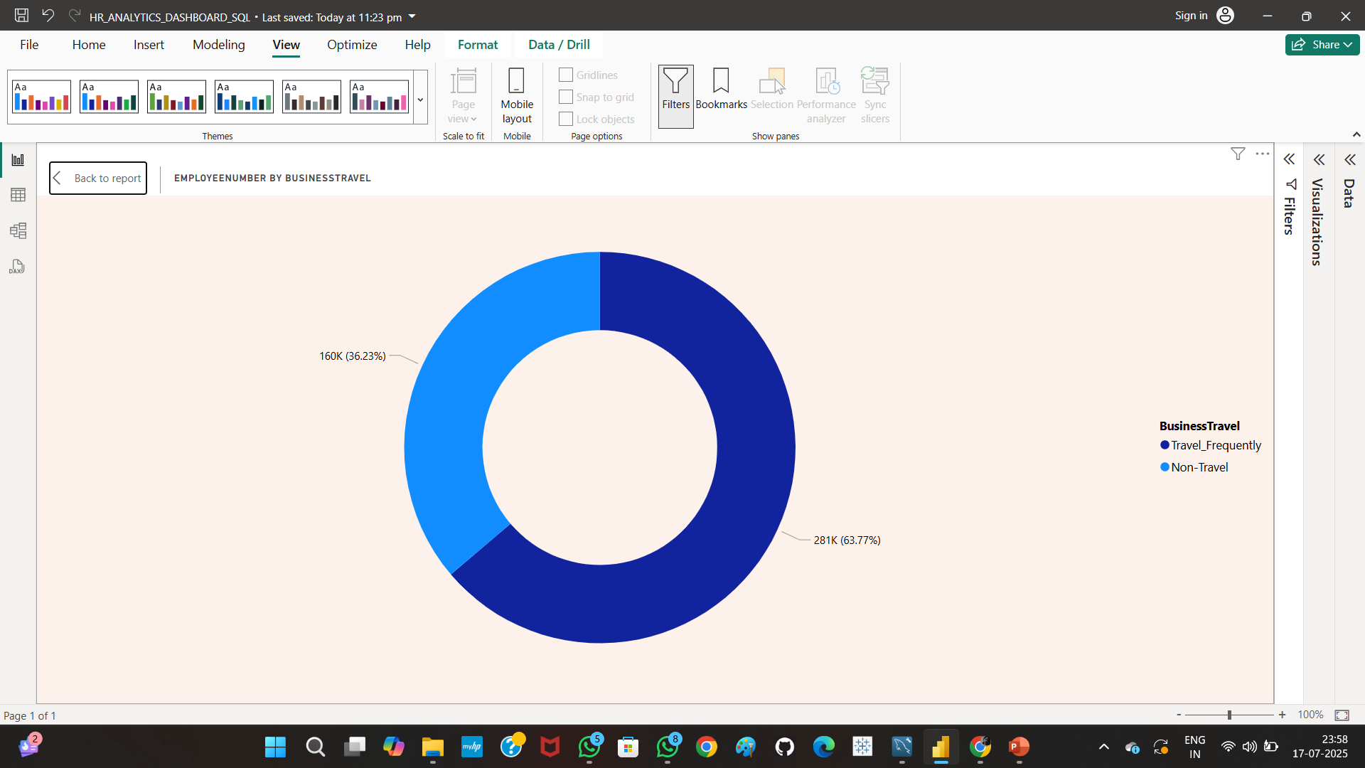
3. Employee Count by Business Travel Frequency
This donut chart shows that 63.77% of employees travel frequently for business, while 36.23% do not. It highlights the travel load among employees, which can relate to performance, burnout, or attrition trends in the organization.

Slide 9
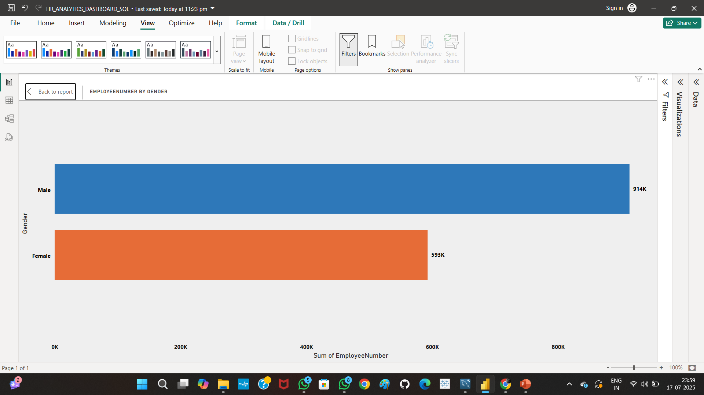
4. Employee Count by Gender
This bar chart compares employee distribution by gender. Males (914K) outnumber females (593K), indicating a gender imbalance. Such visualizations help HR assess diversity, inclusion, and hiring practices, and plan for a more balanced workforce.

Slide 10
CONCLUSION
From the Excel-based analysis, we discovered that employee attrition is influenced by multiple factors such as job satisfaction, monthly income, overtime, years at the company, and work-life balance. Employees with long working hours and low job satisfaction showed higher rates of leaving. The insights gained from this project can help HR teams take proactive steps such as improving workplace culture, reviewing compensation strategies, and implementing retention programs. Overall, this project highlights the power of Excel in uncovering actionable insights and emphasizes the importance of data-driven decision-making in human resource management.

Slide 11
THANK YOU
SNEKHA J
snekhajeyachandran1206@gmail.com

