Slide 1


Trivial File Transfer Protocol
Presented by-
Batch: System CPP Linux System Programming July 05th Batch_SPRINT_Group02
Snekha S (Id:46252697)
Umamageshwari N (Id:46252623)
Maadhesh M (Id:46252640)
Priya Kumari (Id:46252339)

Slide 2
Agenda
Overview
High Level Design
Requirements
Sample Code Snippets
Challenges faces & how it addressed
Experience Gained
Demo
Individual Contribution

Slide 3

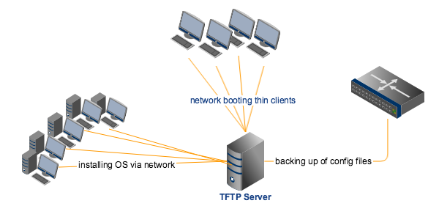
Overview
TFTP is a simple protocol to transfer files, and therefore was named the Trivial File Transfer Protocol or TFTP
The scope of the project is to provide implementation of TFTP Service (UDP based) involving a client and a server. The server handles the client's ftp request and performs file download after validation. Server may optionally handle multiple client ftp requests simultaneously. The protocol implemented shall follow the RFC1350 specification. This project is based on C++ and socket programming to transfer files.

Slide 4
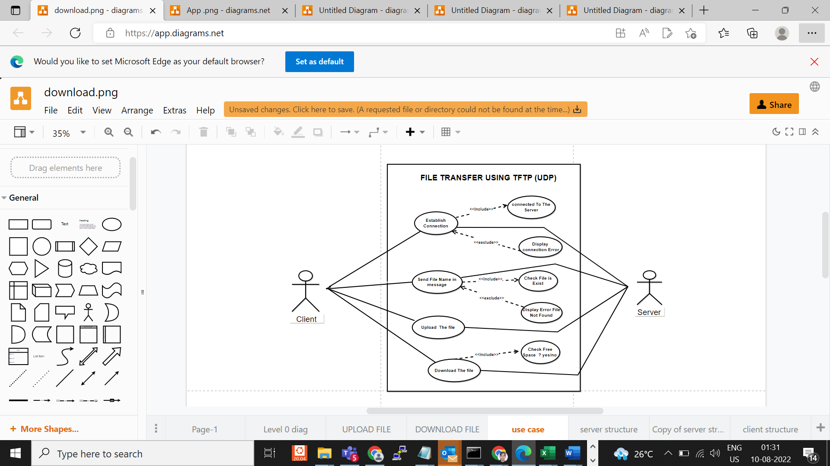
High Level Diagrams: Use-Case Diagram

Slide 5
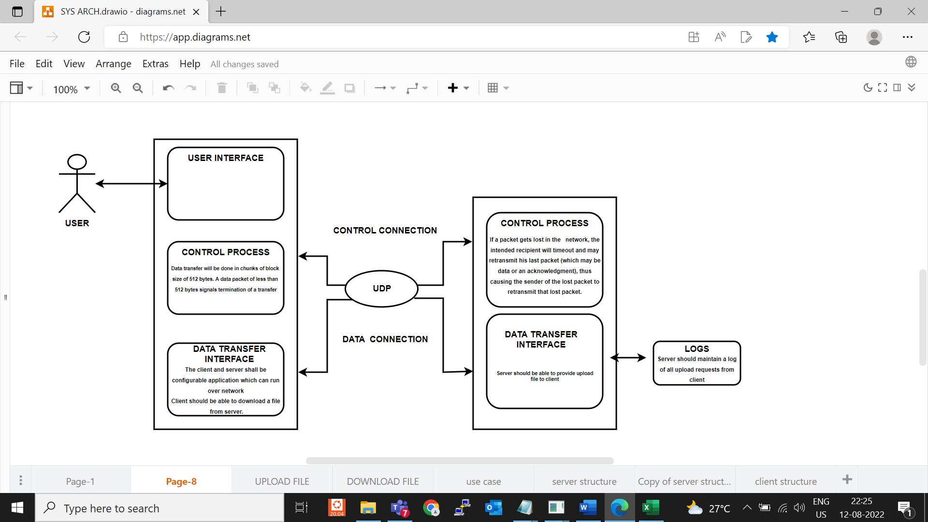
System Architecture

Slide 6
Requirements
Client
Server
Establish connection
Should be able to download file
Data transfer will be done in chunk of block size of 512 bytes
Errors should be handled.
Server should be able to upload file.
Should maintain log of all upload request.
Server will be iterative server to handle multiple clients.

Slide 7
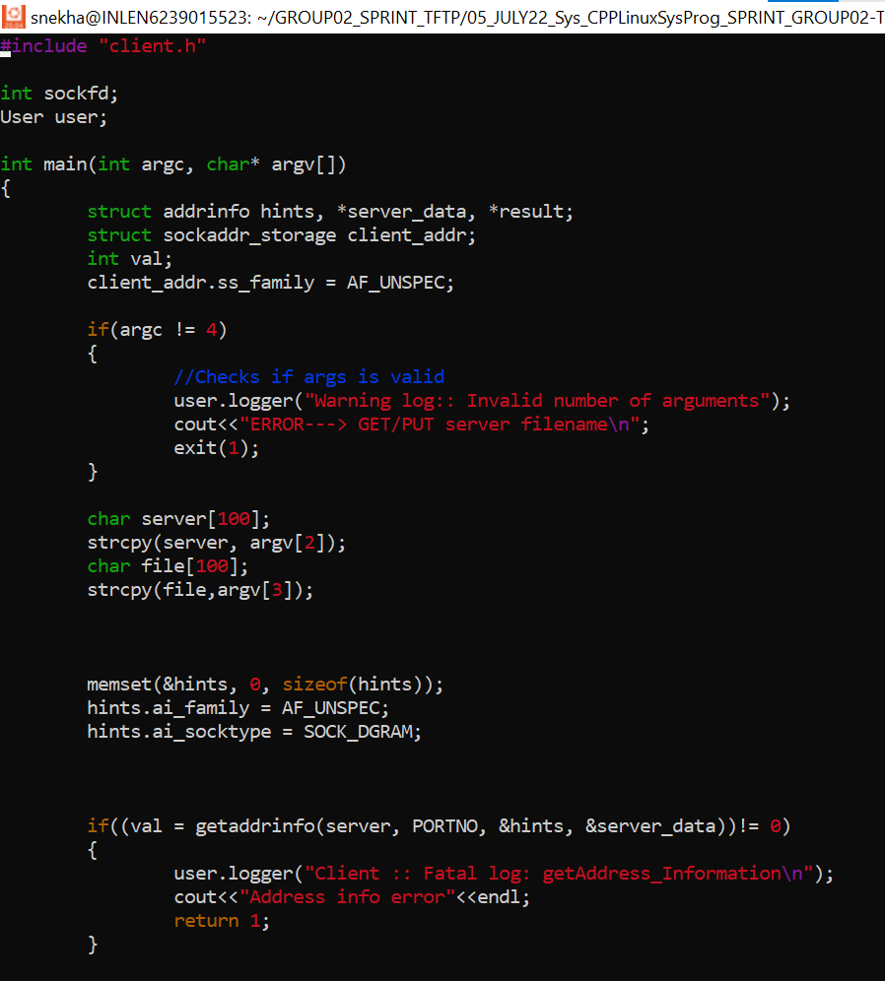
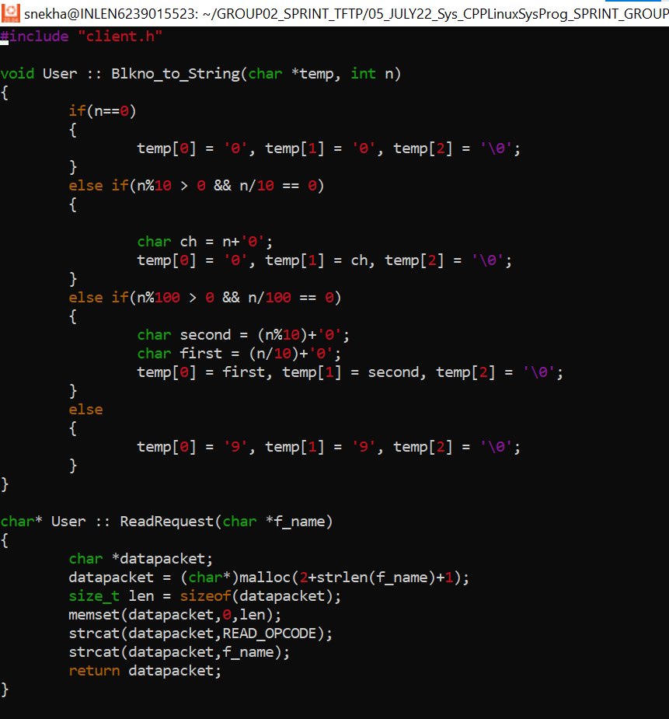
Sample Code Snippets

Slide 8
Challenges faced & how it addressed
Challenges faced
Solution
Managing the deadlines
Scope Management
Project Management
development
Proper time estimation
Project review at each steps
Preparing daily MOM’s
Detailed scope management plan
proper risk management strategies
Finding out right tools needed for project
Proper time estimation
Identifying any and all potential risks

Slide 9
Experienced Gained
Managing the project team
Time Management
Risk Management
Steps involved in project development
Importance of communication within a team

Slide 10
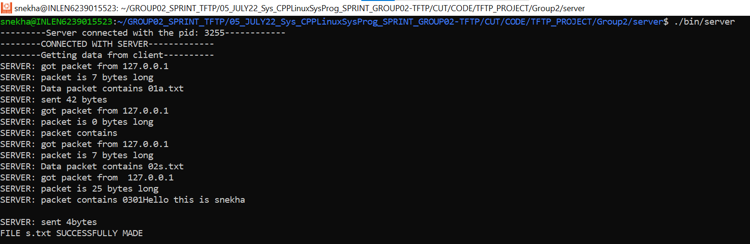
Demo: Server

Slide 11
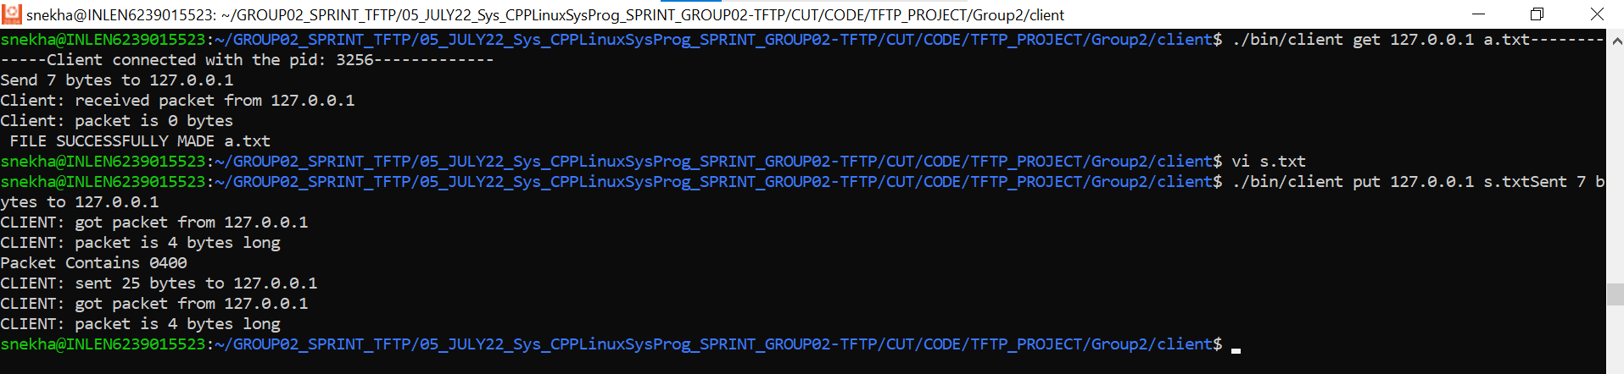
Demo: Client

Slide 12
Individual Contribution
Snekha S
Modified and prepared all final document.
Coding done for client and merge the code
Prepared project ppt.
Made the final design and SRS document.
Maadhesh M
Prepared flow chart for design document
Coding done for packetization
Prepared draft for design document.
Umamageshwari N
UT IT test cases
Coding done for server side
Prepared Use case diagram, System architecture and sequential diagram for design document.
Priya Kumari
Prepared draft for SRS
Coding done for error handling
Updating MOM

Slide 13

Thank you

