Slide 1
Movies for Microsoft
Simran Nepaul
Zach Paul

Slide 2
Microsoft Wants a Movie Studio
-What types of movies would be best to produce?
Action? Thriller?
When is the best time to release a film?
Summer, spring?
How much will it cost?
Notes:
We want to know what movies we want to make. Does the genre matter? Does the release date matter? Does the amount of money put into the film matter? How many movies should we make? How do we determine what makes a film successful? For our purposes, we know that the answer to that last question. It’s whatever makes the most money.

Slide 3
Business Value
How will this add value to the company?
Profit
Name brand recognition
Notes:
Having a successful movie studio will add some things to the microsoft portfolio. Most importantly, profit. A successful movie studio will bring in money.
The other thing is recognition. Just like Marvel and Disney’s names come out when thinking of successful studios. We want our name to also be on that list of “good” studios.

Slide 4
Methodology
Sorted movies by genre and release date
Only looked at movies from the last 30 years
Determined profitability and cost for each genre of film
Looked at the best release month for each genre
Looked at production values to profit for each genre
Notes:
We wanted to see how each genre of movie fared when only compared against itself to see what genre typically results in a movie that creates profit.
We looked at when each genre is released and what seasons or months it does best in.
We also wanted to look at each genre and see how much it costs in general to make a movie of that type.

Slide 5
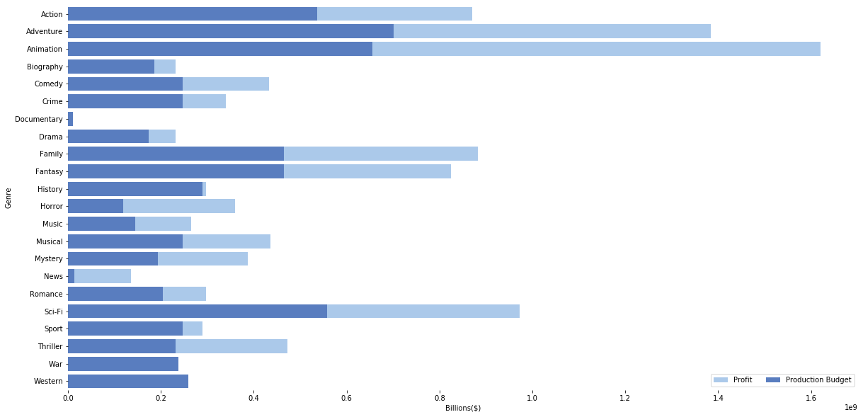
Each Genre and its Profitability
Notes:
Animation films are the clear winner. They don’t cost very much compared to their median profitability. Action, adventure, family, fantasy, horror, and sci-fi all also have a pretty good chance for being profitable.
History, documentaries, crime, western, sport are not. War movies do not tend to do well in general, but they seem to do very well in July.
News films seem to have a very large return on investment but that return is still so small compared to what the other films are doing. A news film would be best used as a supplementary film to a different, more profitable movie.

Slide 6
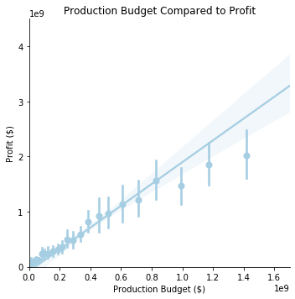
How Much Money to Spend?
Higher production budgets tend to bring in more profit
~$400 million as a general rule for
producing a movie
Notes:
Higher production budgets trend towards being more profitable, but the “sweet” spot seems to be around 400million production budget in general.

Slide 7

Action Movies in a Year
Notes:
Action movies do best in the summer, but also do well in the winter.

Slide 8

Animation Movies in a Year
Notes:
Animation films do very well in the late spring, early summer.

Slide 9

Adventure Movies in a Year
Notes:
Similar to action movies, adventure films follow the same trend. They do best in the summer, but also do well in the winter as well.

Slide 10
Final Recommendations
1 Animation Film released in May for $200 million for ~$250million profit
1 Action film released in July for $400 million for ~$400million profit
1 Adventure film released in November for $400 million for ~200million profit
Total: 1.0billion investment
1.85billion gross
850 million profit.
Notes:
We want to spread out our releases so that they’re not all happening in the same season. We don’t want our own movies to be competing with each other.
Animation films do well near the springtime. We want to make an animation film since they tend to be safe.
Action films do well in the summer. We want to release an action film here because they’re the most profitable type of movie to make at this time
Adventure films don’t do as well in the winter, but we shouldn’t have all our movie release at the same time. This movie will likely make less money than it would in the summer, but should still manage to turn a profit.

Slide 11
Future Work
In the future we would like to explore the individuals responsible for making movies
Actors, writers, and directors
Who are the most profitable people for each genre
We would also like to look at which genres do better worldwide
Finally, what combinations of genres do well
What combinations do better than their individual parts
Notes:
We want to look more deeply into the personnel involved in making movies. I believe that some genres that are represented as doing poorly could be incredibly profitable so long as the right people are working on the film.
There’s also the worldwide market that we didn’t consider. We didn’t differentiate between worldwide and domestic markets too much, and some types of films could do better or worse depending on where they are marketed towards.
Finally we only looked at each genre as an individual, but most movies are represented by more than one genre. We should consider multi-genre films as a future target to look into.

Slide 12
Thank You!
Notes:
Thanks for listening to us, we hope that this presentation provided some insight towards the profitability of movies.

