Slide 1

Raptor : Scalable Rule Placement over Multiple Path in Software Defined Networks
Pravein Govindan Kannan, Chan Mun Choon, Richard T.B.Ma and Ee-Chien Chang
Notes:
Hello Everyone, I will be presenting Raptor, a scalable rule placement scheme for multi-path/dynamic traffic in software defined networks.

Slide 2

Software Defined Networking
Network Policies
Access Control (ACL)
Traffic Measurement
Rate Limiting
Traffic Engineering
App1
App2
App n
SDN Controller
OpenFlow
Forwarding
Forwarding
Forwarding
Forwarding
Raptor
Notes:
In Software Defined Networking, Switches implement forwarding, and controller configures the entire network by implementing Network policies.
Benefit of this being, the controller gets a complete view of the network, and can operate network policies considering the entire network as a single switch.
Network policies could typically be :
Access control, which limits the communication for certain traffic.
Traffic measurements.
Rate limiting on the traffic throughput
And certain types of traffic engineering.

Slide 3
Network Policies translation to Switches
PRIORITY
MAC SRC
MAC DST
IP SRC
IP DST
TCP Dport
TCP SPort
VLAN ID
...
ACTION
Rule Matching
Action
Raptor
Notes:
The network policies are implemented by rules in the switches, which match on the headers and take the corresponding actions.
For any incoming packet to a switch, it has to be matched with all the rules, and takes the action of it’s corresponding matched rule.

Slide 4
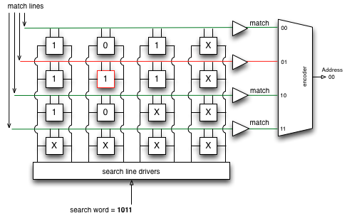
Network Policies to Switches
Where is the Flow tables (rules) Stored?
TCAM
Expensive
Power-Hungry (~60%)
Few thousand Entries (1K-10K)
Increasing demands for individual policies(per-flow)
Rule placement is crucial to scale!!
Raptor
Notes:
These rules are stored in a high speed look-up memory knows as TCAM(Ternany content addressable memory)
which does the entire search operation in a single lookup,
However, it is very expensive, power hungry, and limited to few thousand entries in the switches.
And, with increasing demands for per-flow policies in virtualized data-centers,
rule placement is very crucial in-order to support the increasing demands.

Slide 5
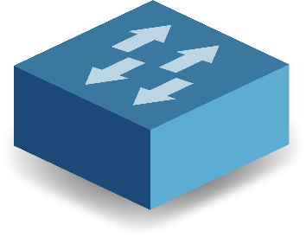
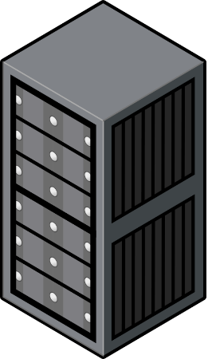
Rule Placement Scenarios
S3
S6
ID | Source | Destination | Action
1 | H1(00) and tcp-port:80 | H3(10) and tcp-port:80 | Drop
2 | H2(01) | H3,H4(1*) and tcp-port:443 | Drop
3 | All(*) | H4(11) | Counter
4 | All(*) | All(*) and tcp-port :22 | Drop
H1 (00)
H3 (10)
S1
S5
S4
S7
H2 (01)
H4 (11)
S2
Notes:
Now, I will illustrate rule placement considering the following 4 rules to be placed on the network with 4 hosts H1,H2, H3 and H4.
Basically, the rules have the match criterion (in source and destination) and the action to be taken.

Slide 6
Placement of Rules at Ingress
S3
S6
ID | Source | Destination | Action
1 | H1(00) and tcp-port:80 | H3(10) and tcp-port:80 | Drop
2 | H2(01) | H3,H4(1*) and tcp-port:443 | Drop
3 | All(*) | H4(11) | Counter
4 | All(*) | All(*) and tcp-port :22 | Drop
H1 (00)
H3 (10)
S1
S5
S4
S7
H2 (01)
H4 (11)
S2
Notes:
Now, I will illustrate rule placement considering the following 4 rules to be placed on the network with 4 hosts H1,H2, H3 and H4.
Basically, the rules have the match criterion (in source and destination) and the action to be taken.

Slide 7
Placement of Rules at Ingress
S3
S6
ID | Source | Destination | Action
1 | H1(00) and tcp-port:80 | H3(10) and tcp-port:80 | Drop
2 | H2(01) | H3,H4(1*) and tcp-port:443 | Drop
3 | All(*) | H4(11) | Counter
4 | All(*) | All(*) and tcp-port :22 | Drop
H1 (00)
H3 (10)
1
S1
S5
S4
S7
H2 (01)
H4 (11)
S2
Notes:
Lets, consider the default placement implemented by SDN Controllers, where rules are placed on the ingress of the network, where it applies to.
Rule 1, since it applies to traffic between H1 and H3, It is placed in Switch S1.

Slide 8
Placement of Rules at Ingress
S3
S6
ID | Source | Destination | Action
1 | H1(00) and tcp-port:80 | H3(10) and tcp-port:80 | Drop
2 | H2(01) | H3,H4(1*) and tcp-port:443 | Drop
3 | All(*) | H4(11) | Counter
4 | All(*) | All(*) and tcp-port :22 | Drop
H1 (00)
H3 (10)
1
S1
S5
S4
S7
H2 (01)
2
H4 (11)
S2
Notes:
Consider Rule 2, which applied between H2, and H3/H4. Hence, this rule will be placed in Switch S2, which is ingress switch of this packet path.

Slide 9
Placement of Rules at Ingress
3
S3
S6
ID | Source | Destination | Action
1 | H1(00) and tcp-port:80 | H3(10) and tcp-port:80 | Drop
2 | H2(01) | H3,H4(1*) and tcp-port:443 | Drop
3 | All(*) | H4(11) | Counter
4 | All(*) | All(*) and tcp-port :22 | Drop
H1 (00)
H3 (10)
1
3
S1
S5
S4
S7
H2 (01)
2
3
H4 (11)
S2
Notes:
Consider Rule 3, which applies to traffic originating from all hosts to destination H4. Hence, this rule is applied to all the ingress switches S1, S2, S6.

Slide 10
Placement of Rules at Ingress
3
4
S3
S6
ID | Source | Destination | Action
1 | H1(00) and tcp-port:80 | H3(10) and tcp-port:80 | Drop
2 | H2(01) | H3,H4(1*) and tcp-port:443 | Drop
3 | All(*) | H4(11) | Counter
4 | All(*) | All(*) and tcp-port :22 | Drop
H1 (00)
H3 (10)
1
3
4
S1
S5
4
S4
S7
H2 (01)
2
3
4
H4 (11)
S2
Problem :
No. of Rules limited to Capacity of Ingress switches.
Total Rules Needed = 9
Notes:
And Rule 4 similarly, applies to traffic between all pairs of hosts. Hence., needs to be placed in all ingress switches.
Hence, after placing all the rules/policies. Overall rules needed to implement is 9.
The Problems of this solution are that number of rules is limited to capacity of ingress switches, which could be limited.

Slide 11
Existing works on Rule Placement
VCRIB [NSDI 13], PALETTE [INFOCOM 13], OBS [CoNext 13]
S3
S6
ID | Source | Destination | Action
1 | H1(00) and tcp-port:80 | H3(10) and tcp-port:80 | Drop
2 | H2(01) | H3,H4(1*) and tcp-port:443 | Drop
3 | All(*) | H4(11) | Counter
4 | All(*) | All(*) and tcp-port :22 | Drop
H1 (00)
H3 (10)
S1
S5
S4
S7
H2 (01)
H4 (11)
S2
Notes:
To solve this scalability problem, there are a range of works which perform placement placement of rules by offloading the rules along the path of traffic.

Slide 12
Existing works on Rule Placement
VCRIB [NSDI 13], PALETTE [INFOCOM 13], OBS [CoNext 13]
Address Scalability problem → Offload Rules along the path
3
4
S3
S6
ID | Source | Destination | Action
1 | H1(00) and tcp-port:80 | H3(10) and tcp-port:80 | Drop
2 | H2(01) | H3,H4(1*) and tcp-port:443 | Drop
3 | All(*) | H4(11) | Counter
4 | All(*) | All(*) and tcp-port :22 | Drop
H1 (00)
H3 (10)
1
3
4
S1
S5
4
S4
S7
H2 (01)
2
3
4
H4 (11)
S2

Slide 13
Existing works on Rule Placement
VCRIB [NSDI 13], PALETTE [INFOCOM 13], OBS [CoNext 13]
Address Scalability problem → Offload Rules along the path
3
4
S3
S6
ID | Source | Destination | Action
1 | H1(00) and tcp-port:80 | H3(10) and tcp-port:80 | Drop
2 | H2(01) | H3,H4(1*) and tcp-port:443 | Drop
3 | All(*) | H4(11) | Counter
4 | All(*) | All(*) and tcp-port :22 | Drop
H1 (00)
H3 (10)
1
3
4
S1
S5
4
S4
S7
H2 (01)
2
3
4
H4 (11)
S2

Slide 14

Existing works on Rule Placement
VCRIB [NSDI 13], PALETTE [INFOCOM 13], OBS [CoNext 13]
Address Scalability problem → Offload Rules along the path
3
4
S3
S6
ID | Source | Destination | Action
1 | H1(00) and tcp-port:80 | H3(10) and tcp-port:80 | Drop
2 | H2(01) | H3,H4(1*) and tcp-port:443 | Drop
3 | All(*) | H4(11) | Counter
4 | All(*) | All(*) and tcp-port :22 | Drop
H1 (00)
H3 (10)
1
3
4
S1
S5
4
S4
S7
H2 (01)
2
3
4
H4 (11)
S2

Slide 15
Existing works on Rule Placement
VCRIB [NSDI 13], PALETTE [INFOCOM 13], OBS [CoNext 13]
Address Scalability problem → Offload Rules along the path
4
3
S3
S6
ID | Source | Destination | Action
1 | H1(00) and tcp-port:80 | H3(10) and tcp-port:80 | Drop
2 | H2(01) | H3,H4(1*) and tcp-port:443 | Drop
3 | All(*) | H4(11) | Counter
4 | All(*) | All(*) and tcp-port :22 | Drop
H1 (00)
H3 (10)
1
3
4
S1
S5
3
4
4
S4
S7
H2 (01)
2
H4 (11)
S2
Problem :
Flows restricted to Single Path :
Dynamic Load Balancing
Path Failures.
Total Rules Needed >= 10
Notes:
Hence, now the rules are split to avoid any conflicts, and offloaded onto the path of the applicable traffic.
The total number of rules in the network will be greater than 9, due to conflict resolution, which causes rules to be splitted.
The problems of these schemes are that,
The rules are restricted to single path; Hence, upon path failures, it needs to re-calculate and place the rules in the alternative path. Same goes for load-balancing dynamically.
Hence, its not very practical .

Slide 16
Existing works on Rule Placement
PALETTE [INFOCOM 13], OBS [CoNext 13] , VCRIB[NSDI 13]
Address Scalability problem → Offload Rules along the path
4
3
S3
S6
ID | Source | Destination | Action
1 | H1(00) and tcp-port:80 | H3(10) and tcp-port:80 | Drop
2 | H2(01) | H3,H4(1*) and tcp-port:443 | Drop
3 | All(*) | H4(11) | Counter
4 | All(*) | All(*) and tcp-port :22 | Drop
H1 (00)
H3 (10)
1
3
4
S1
S5
3
4
4
S4
S7
H2 (01)
2
H4 (11)
S2
Problem :
Flows restricted to Single Path :
Dynamic Load Balancing
Path Failures.
Total Rules Needed >= 10
Naïve Duplication of rules in multi-path is not scalable!! Can we do Better?
Notes:
However, if we just do naïve duplication of rules to support multipath, its not scalable. Hence, can we do better?

Slide 17
Raptor
Key Idea : Rule Sharing !!
3
4
S3
S6
ID | Source | Destination | Action
1 | H1(00) and tcp-port:80 | H3(10) and tcp-port:80 | Drop
2 | H2(01) | H3,H4(1*) and tcp-port:443 | Drop
3 | All(*) | H4(11) | Counter
4 | All(*) | All(*) and tcp-port :22 | Drop
H1 (00)
H3 (10)
1
3
4
S1
S5
3
4
S4
S7
H2 (01)
2
3
4
H4 (11)
S2
Shareable Rules
Notes:
In Raptor, the key idea is to identify rules that are applicable to various flows, and placing them at certain points in network, where it can be shared.
For example, rule 3 and 4 are applicable to more than 1 host pair, hence,

Slide 18
Raptor
Key Idea : Rule Sharing !!
3
4
S3
S6
ID | Source | Destination | Action
1 | H1(00) and tcp-port:80 | H3(10) and tcp-port:80 | Drop
2 | H2(01) | H3,H4(1*) and tcp-port:443 | Drop
3 | All(*) | H4(11) | Counter
4 | All(*) | All(*) and tcp-port :22 | Drop
H1 (00)
H3 (10)
1
3
4
S1
S5
3
4
S4
S7
H2 (01)
2
3
4
H4 (11)
S2
Shareable Rules

Slide 19
Raptor
Key Idea : Rule Sharing !!
S3
S6
ID | Source | Destination | Action
1 | H1(00) and tcp-port:80 | H3(10) and tcp-port:80 | Drop
2 | H2(01) | H3,H4(1*) and tcp-port:443 | Drop
3 | All(*) | H4(11) | Counter
4 | All(*) | All(*) and tcp-port :22 | Drop
H1 (00)
H3 (10)
1
4
3
3
4
4
3
4
3
S1
S5
S4
S7
H2 (01)
2
H4 (11)
S2
Key Techniques :
Offload Rules to switches considering rule sharing.
Place rules considering multi-path.
Shared Rules
Total Rules Needed = 5
Notes:
Moving them to central part of the network, as in here Switch S5 , we just need 1 rule each for implementing the policy across the network.
Also, the packet will hit this switch S5, regardless of the path it takes.
Hence, the number of rules needed in the network reduce by half in this small example itself.

Slide 20


Raptor: Objective
Topology & Paths
Policy
Rule Sharing
Reduce the overall rules
Enforce the rules on Multi-Path
Rule Placement
Raptor
Notes:
Hence, to sum the objective of Raptor
Given the inputs : Topology, and selected paths b/w edges, and given a set of rules.
Our main objectives are :
Reduction of overall applied for placement.
Enforce the policies on multi-path.
In –order to reduce the rules ,and however enforce policies on multi-path at the same time, we utilize rule sharing as discussed in the earlier slide.
Finally, we find a feasible placement for the given set of rules in the network.

Slide 21
Rule Ordering
Priority of Rules : Requires Ordering
Rules | Priority
R1 <src:*, dest:001, A1> | High
R2 <src:00*, dest:*, A2>
R3 <src:*, dest:*, A3> | Low
destIP
R3
R2
R1
srcIP
Raptor
Notes:
The major challenge in doing this, is that rules have a priority attribute.
For example there are 3 rules, R1, R2 and R3,

Slide 22
Rule Ordering
Priority of Rules : Requires Ordering
Rules | Priority
R1 <src:*, dest:001, A1> | High
R2 <src:00*, dest:*, A2>
R3 <src:*, dest:*, A3> | Low
dest
R3
R2
Src:001,dest:001
R1
src
Raptor
Notes:
Now, any packet from souce “001” will match all the three rules.
However, since R1 is of the higher priority, it has to be matched only by R1.
Similarly for packets of other headers. It has to take the action of the higher priority match.

Slide 23
Solving the Rule Placement Problem
Integer Linear Programming Problem to assign rules to switches :
Objective
Minimize overall number of rules.
Constraints
1) Switch Rule Capacity.
2) Placement of Rules in the Paths (multi) given for the flows.
3) Adhere to Rule-ordering (Priority).
← Quadratic Problem; Hence not practical to Solve.
Notes:
To Formalize Raptor’s problem,
We can consider modelling the problem as an ILP problem, to assign rules to switches for placement.
With the objective to minimize the overall number of rules.
Constraints being :
Switch capacity.
Placement of rules such that it falls on multiple path of the traffic for the flows.
Rule ordering is maintained
However it’s a hard ILP problem, due to the rule ordering constraint, which makes it a quadratic problem, and hence making it not practical to solve it in real-time.

Slide 24
Raptor
Topology & Paths
Polices
ILP
SDN Controller
Rule Placement
Raptor
Notes:
Hence, to tackle the problem. We split the solution into two phase.

Slide 25
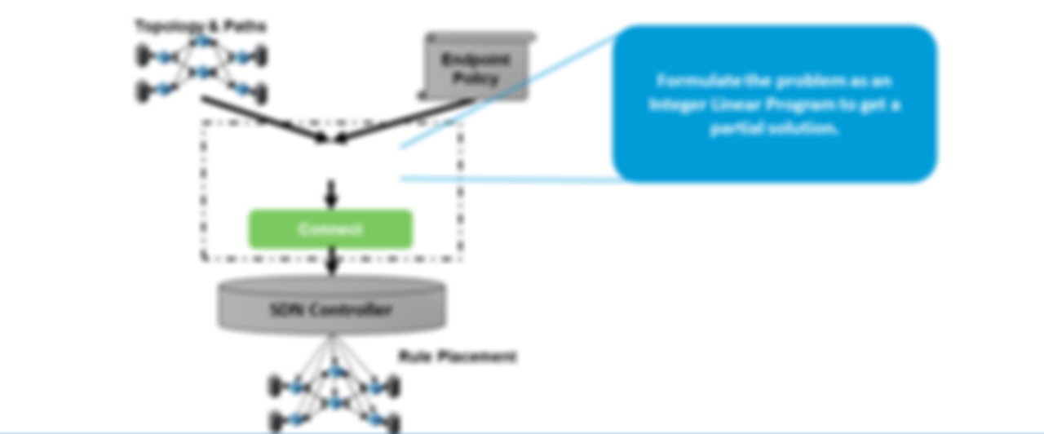
Raptor Overview
Topology & Paths
Formulate the problem as an Integer Linear Program to get a partial solution.
Endpoint Policy
Solve the Integer Linear Program without ordering constraint.
Diffuse
Connect
SDN Controller
Rule Placement
Raptor
Notes:
The First phase, diffuse, we solve the ILP without ordering constraint to get a partial solution.

Slide 26
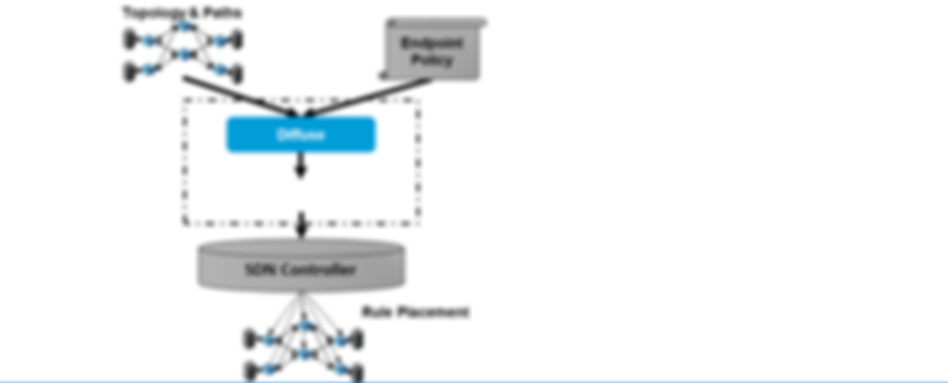
Raptor Overview
Topology & Paths
Endpoint Policy
Diffuse
Connect
Re-arrange the rules to maintain ordering
SDN Controller
Rule Placement
Raptor
Notes:
Let me now go into the solution,
Given the Topology(with the selected paths) and the endpoint policy.
We go through two phases.

Slide 27
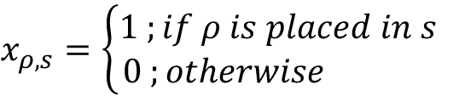
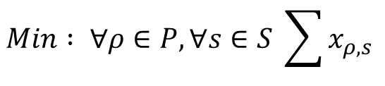
Diffuse
Model as Integer Linear Programming (ILP) problem
Allocation Matrix : Shared-Rules P vs Switches S
Minimize the total number of rules.
Objective :
$$Min : ∀ρ∈P,∀s∈S \sum{x_{ρ,s}}$$
$$x_{ρ,s}=\left\{\begin{aligned}1 ;if ρ is placed in s \\ 0 ;otherwise \end{aligned}\right.$$
Raptor

Slide 28
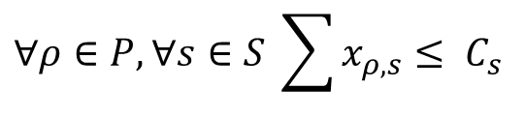
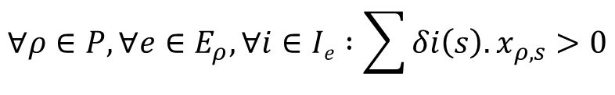
Diffuse
Constraints
1) Switch Capacity Constraints :
$$∀ρ∈P,∀s∈S \sum{x_{ρ,s}}≤ C_{s}$$
2) Path Coverage Constraints :
$$∀ρ∈P,∀e∈E_{ρ},∀i∈Ie :\sum{{δi\left(s\right).x}_{ρ,s}}>0$$
Each Path in I_{e} must have atleast one switch hosting the rule
Raptor
Notes:
First constraint, is the switch capacity constraint, to make sure we do not exceed beyond the limit of TCAM capacity in the switch.
Second is the path coverage constraint, which makes sure we place the rule on at least one switch to cover all the selected paths(Ie)
However, something we are missing, is the priority ordering of the constraint. We do not include priority constraint in LP.
We explain next, by formulating the constraint, and explaining its complexity ; which justifies why we do not want to do them using the constraint.
Equation can be explained

Slide 29
Raptor Overview
Topology & Paths
Formulate the problem as an Integer Linear Program to get a partial solution.
Endpoint Policy
Approximate solution w/o ordering
of shared rules where sharing is maximized.
Diffuse
Connect
SDN Controller
Rule Placement
Raptor

Slide 30
Raptor Overview
Topology & Paths
Endpoint Policy
Diffuse
Connect
Re-arrange the rules to maintain ordering
SDN Controller
Rule Placement
Raptor
Notes:
Let me now go into the solution,
Given the Topology(with the selected paths) and the endpoint policy.
We go through two phases.

Slide 31
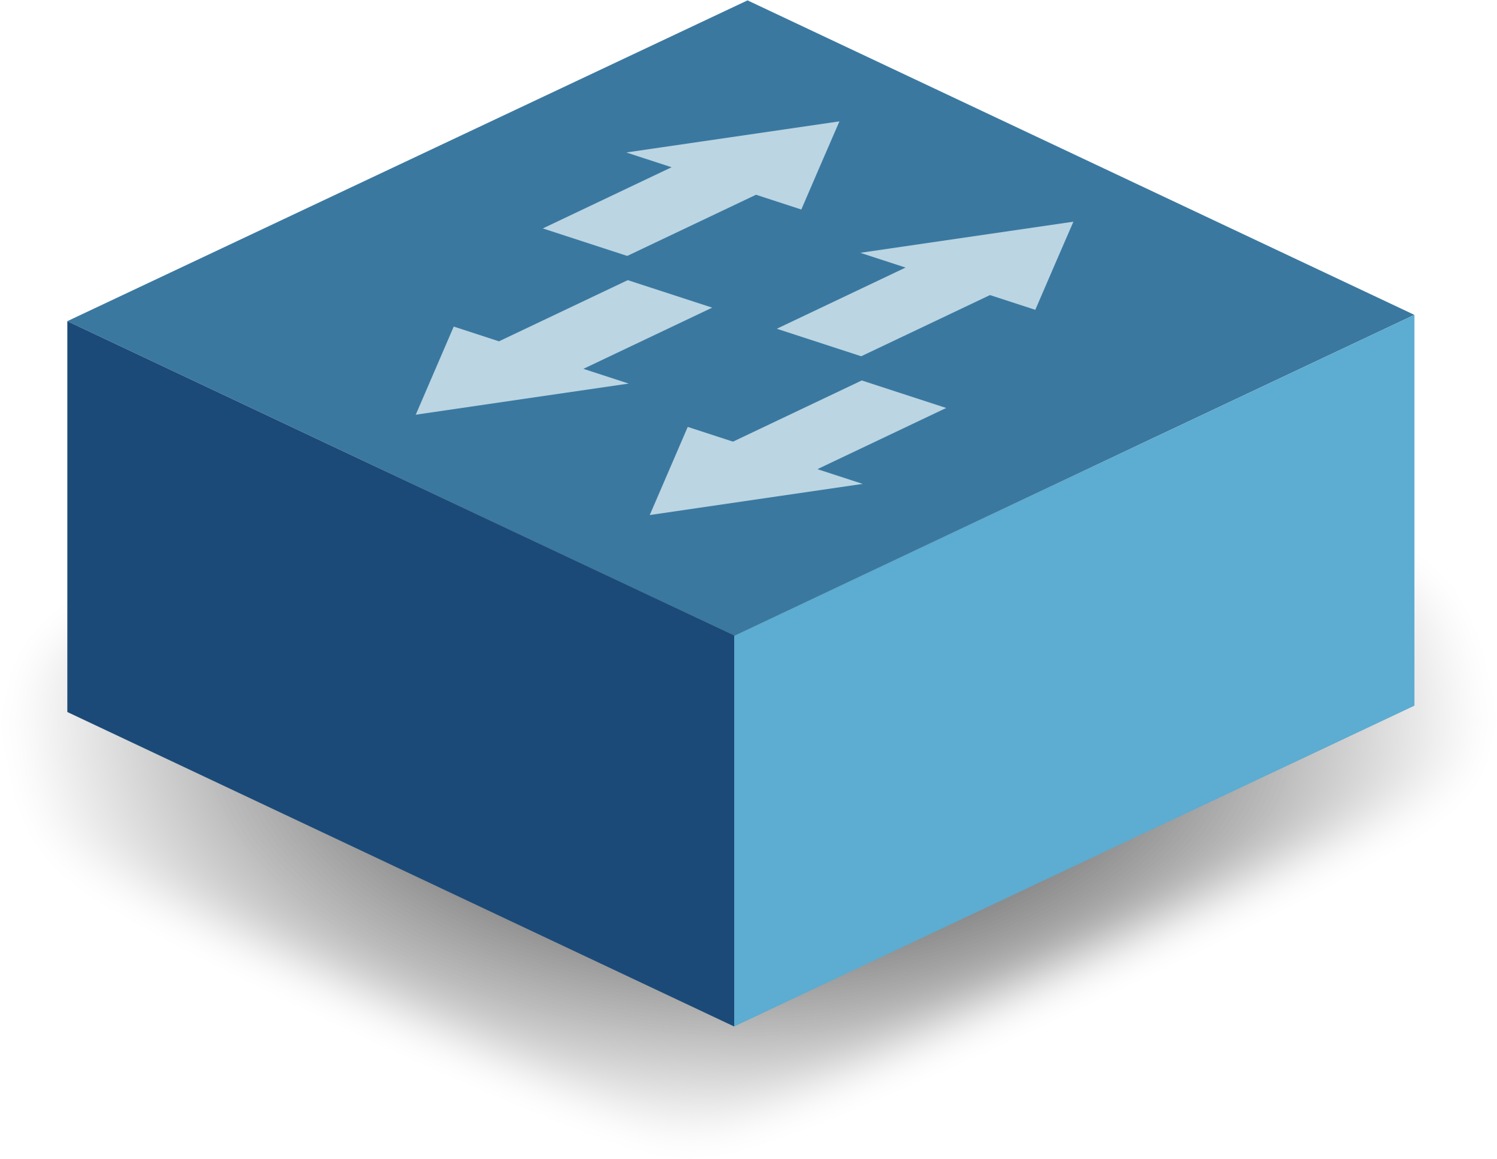
Connect
Construct Rule Graph for each Edge pairs based on dependency.
Place the Entire individual rule graph on a switch (pivot), with condition:
* Majority switch position of allocated shared rules (Diffuse).
Employ Graph Partitioning to spread the rules along the path, while maintain ordering.
S2
S3
S1
S6
4
5
S4
S5
3
2
1
Raptor
Notes:
We construct the Rule graph, which includes all the rules comprising the shared and edge pair rules, b/w a specific ingress-egress pair.
The entire rule-graph is placed on the pivot switch, identified as the one which can maximize sharing of rules.
Final step is to offload rules along the path, such that they maintain ordering.

Slide 32
Connect
Construct Rule Graph for each Edge pairs based on dependency.
Place the Entire individual rule graph on a switch (pivot), with condition:
* Majority switch position of allocated shared rules (Diffuse).
Employ Graph Partitioning to spread the rules along the path, while maintain ordering.
3
S2
S3
2
S1
S6
S4
S5
1
4
5
3
2
Raptor
Notes:
As earlier, we construct the Rule graph, which includes all the rules comprising the shared and edge pair rules, b/w a specific ingress-egress pair.
One slide for all the correction, and ordering.
Moves around the rules to maintain correctness.

Slide 33
Evaluation
Policies generated using Classbench. (10K- ~170K)
Implemented over Floodlight SDN Controller.
Evaluated using Virtual topologies.
Raptor
Notes:
We perform evaluation using policies generated using ClassBench tool,
We have implemented in floodlight SDN controller, and evaluated using 4 virtual topologies

Slide 34
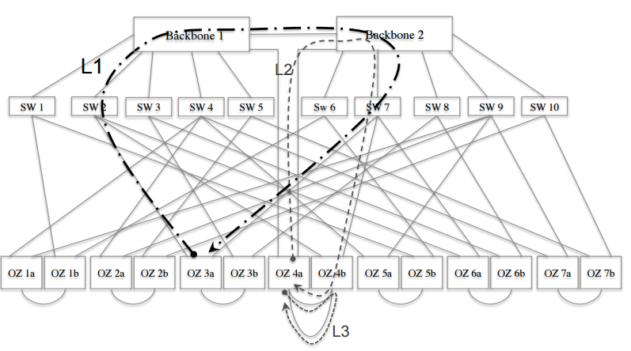
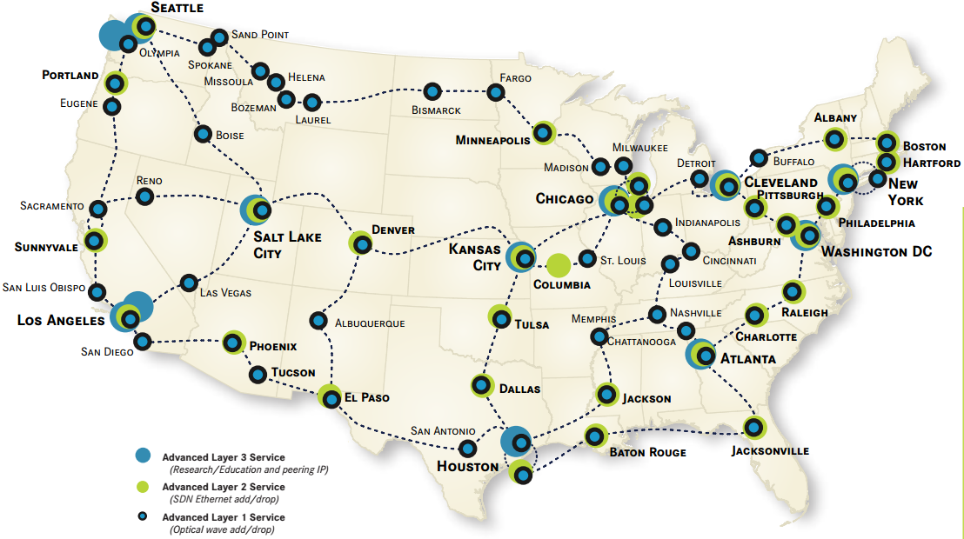
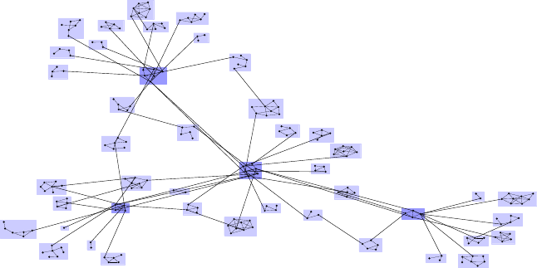
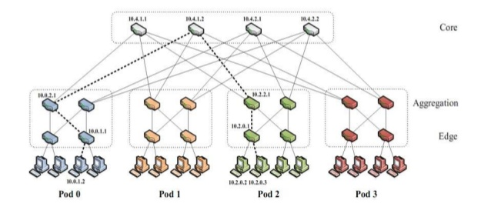
Evaluation
Topology | N(Switches)
FatTree8 | 80
GT-ITM Topologies | 100-600
Stanford Backbone | 25
Internet2 (Abilene) | 40
Raptor
Notes:
Fattree8, Transit stub topologies, Stanford backone and internet2 topology.

Slide 35
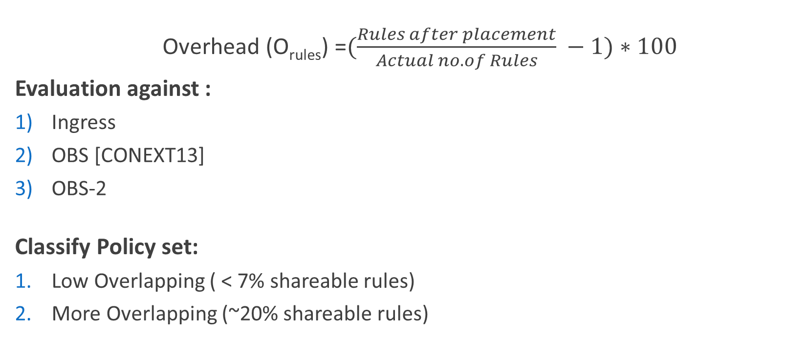
Evaluation – Overhead of Rules
Overhead (O_{rules}) =$(\frac{Rules after placement}{Actual no. of Rules} −1)∗100$
Evaluation against :
Ingress
OBS [CONEXT13]
OBS-2
Classify Policy set:
Low Overlapping ( < 7% shareable rules)
More Overlapping (~20% shareable rules)
OBS - Kang et.all, Optimizing the “One Big Switch” Abstraction in software Defined Networks, CoNext 2013
Raptor
Notes:
We evaluate the total overhead due for all the rule placement schemes
For comparison, we compare against, Ingress scheme, and OBS, one of the closely related work.

Slide 36
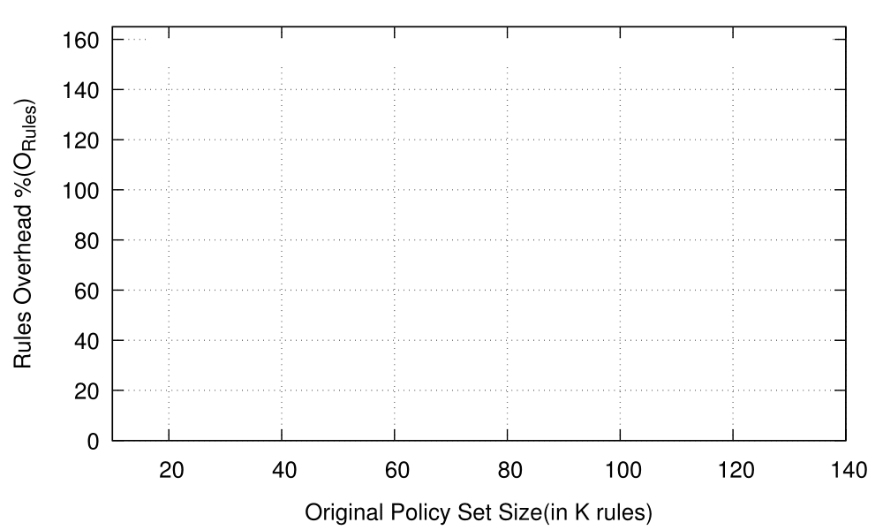
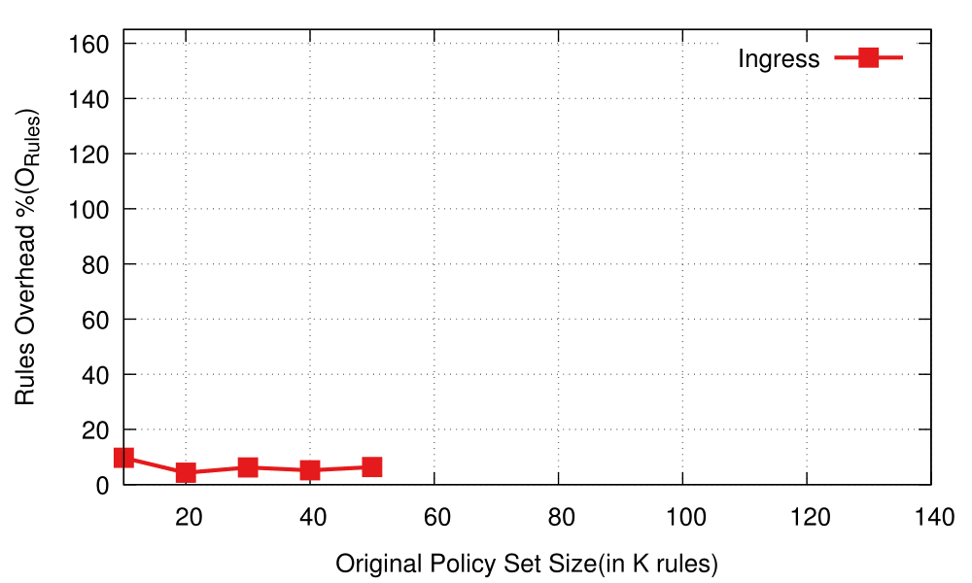
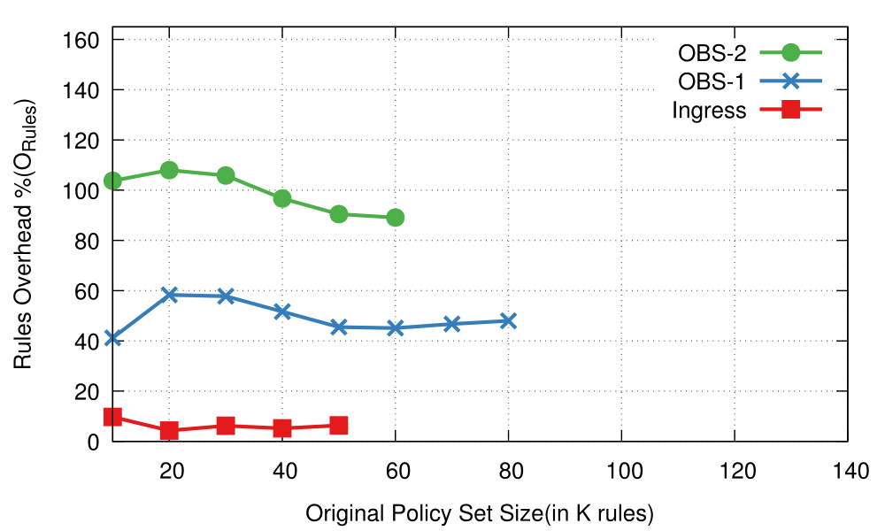
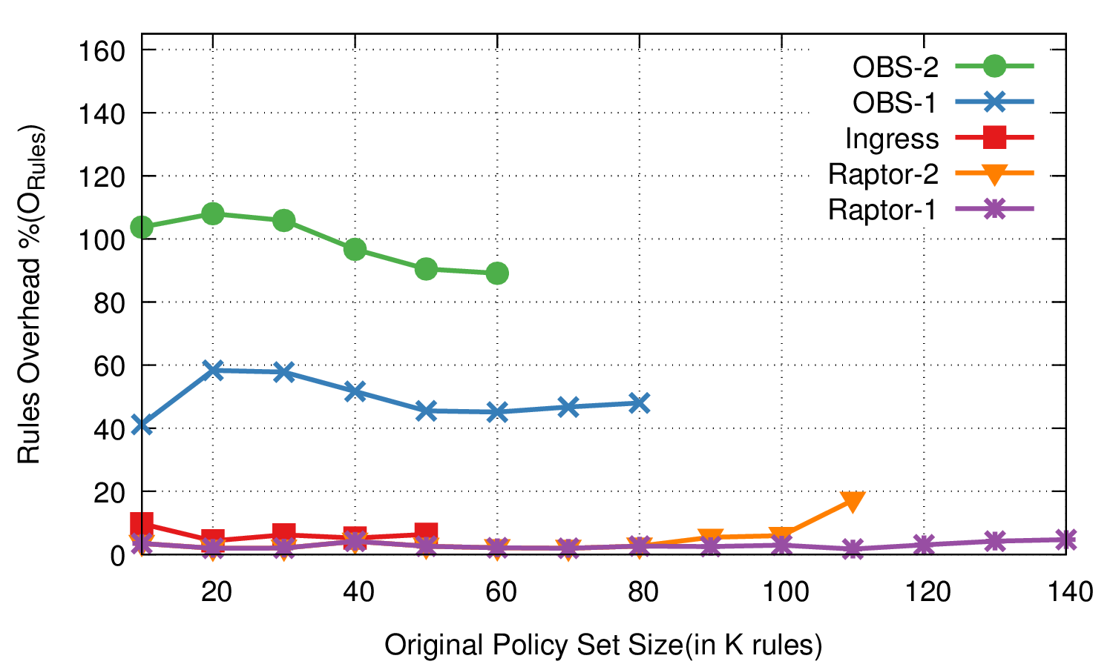
Scalability of Raptor
Fat-Tree-8 – Less Overlapping
Raptor
Notes:
In FatTree-8, we observe savings of 40-60% over OBS-1 for less overlapping policies.
Adding to that, we observe that we are able to accommodate larger policy-set for a given topology and switch tcam size.

Slide 37
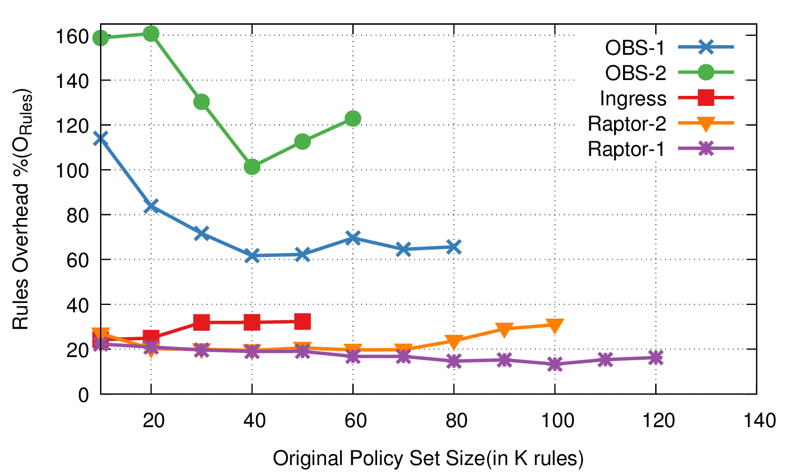
Scalability of Raptor
Fat-Tree-8 – More Overlapping
Raptor
Notes:
In FatTree-8, we observe savings of 40-60% over OBS-1 for less overlapping policies.
Adding to that, we observe that we are able to accommodate larger policy-set for a given topology and switch tcam size.

Slide 38
Overhead in various topologies
Fat-Tree-8 – Less Overlap
Fat-Tree-8 – More Overlap
Save 40-100% over OBS-1;
80-140% over OBS-2
Scales 3X over Ingress
1.75X over OBS
Raptor
Notes:
In FatTree-8, we observe savings of 40-60% over OBS-1 for less overlapping policies.
Adding to that, we observe that we are able to accommodate larger policy-set for a given topology and switch tcam size.

Slide 39
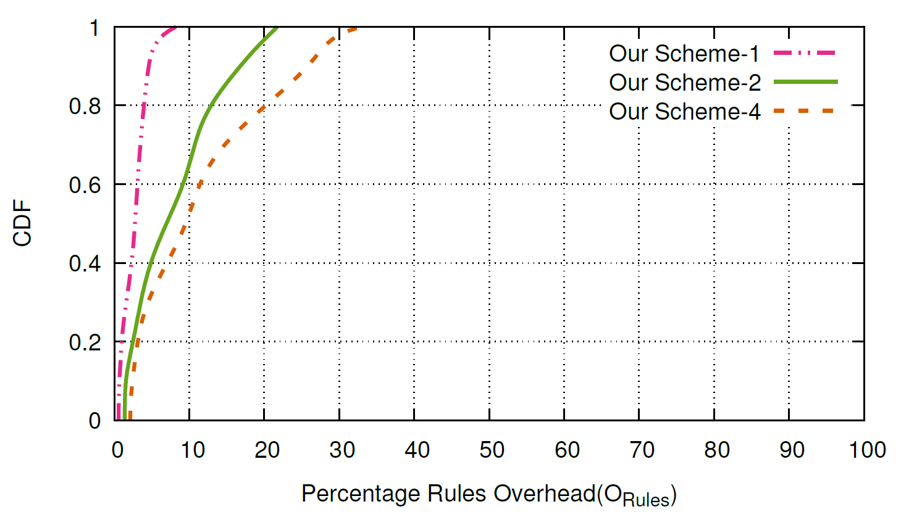
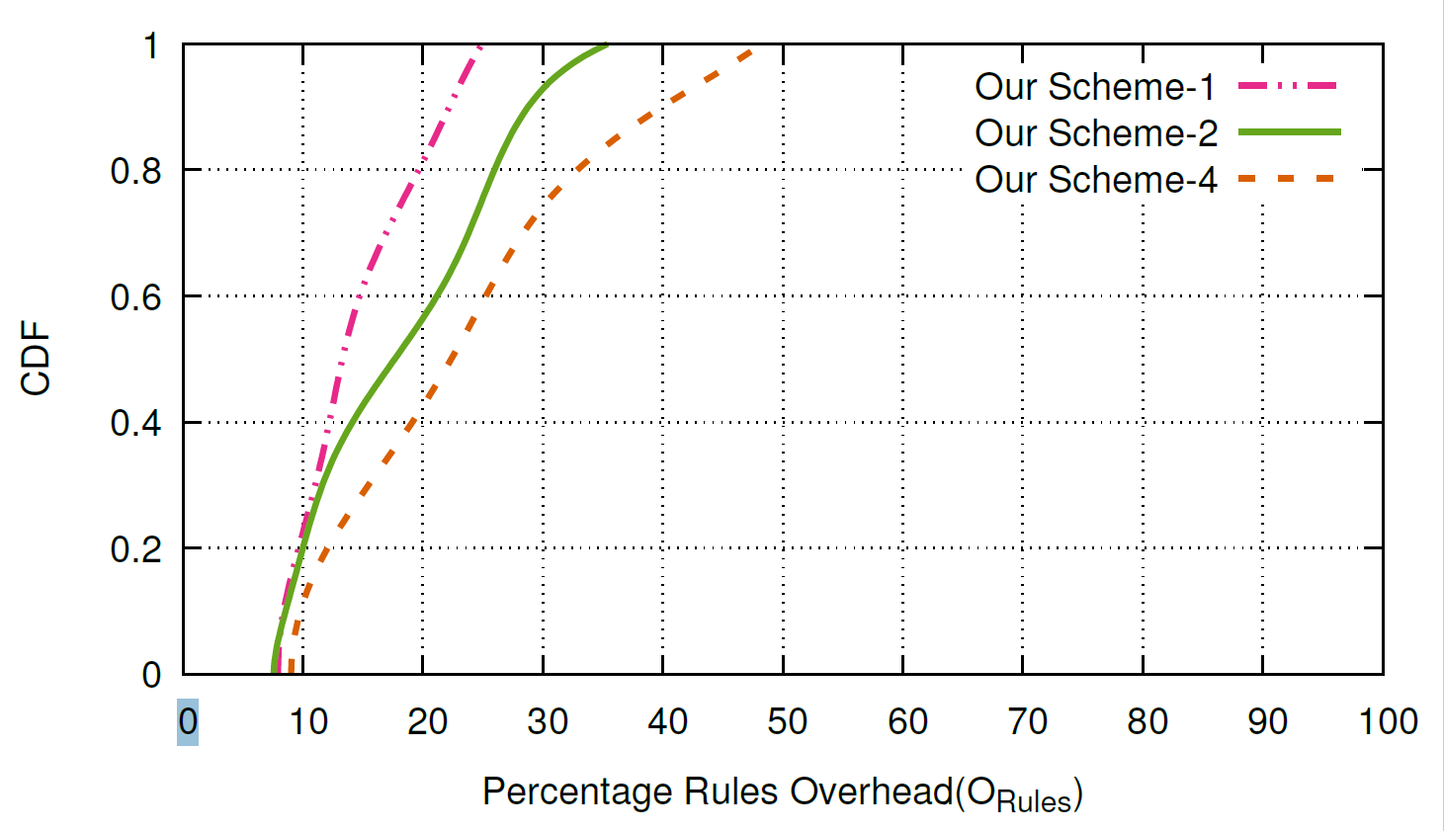
Increasing Paths for Rule Placement
Less Overlap
More Overlap
Raptor-1
Raptor-2
Raptor-4
Raptor-1
Raptor-2
Raptor-4
80th percentile :
1path = Overhead < 4%
2 path = Overhead <12%
4 path = Overhead < 21%
80th percentile :
1path = Overhead < 19%
2 path = Overhead <26%
4 path = Overhead < 30%
Raptor
Notes:
Add traffic inducing rules

Slide 40


Traffic Overhead (Side-effect of Raptor)
Movement of Rules down the path!!
S3
S6
ID | Source | Destination | Action
1 | H1(00) and tcp-port:80 | H3(10) and tcp-port:80 | Drop
2 | H2(01) | H3,H4(1*) and tcp-port:443 | Drop
3 | All(*) | H4(11) | Counter
4 | All(*) | All(*) and tcp-port :22 | Drop
H1 (00)
H3 (10)
1
4
3
4
S1
S5
S4
S7
H2 (01)
2
H4 (11)
S2
Notes:
One possible side-effect of Raptor is increase in traffic overhead. Since, packets may now traverse the network to eventually be dropped due to policies.

Slide 41
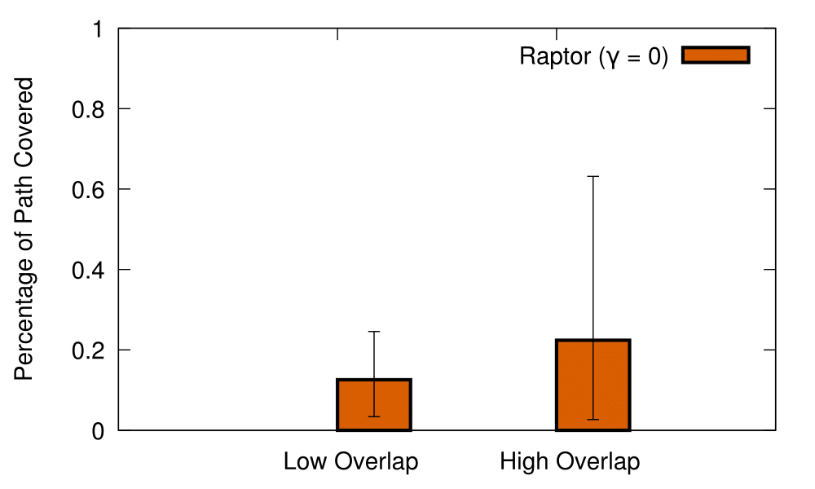
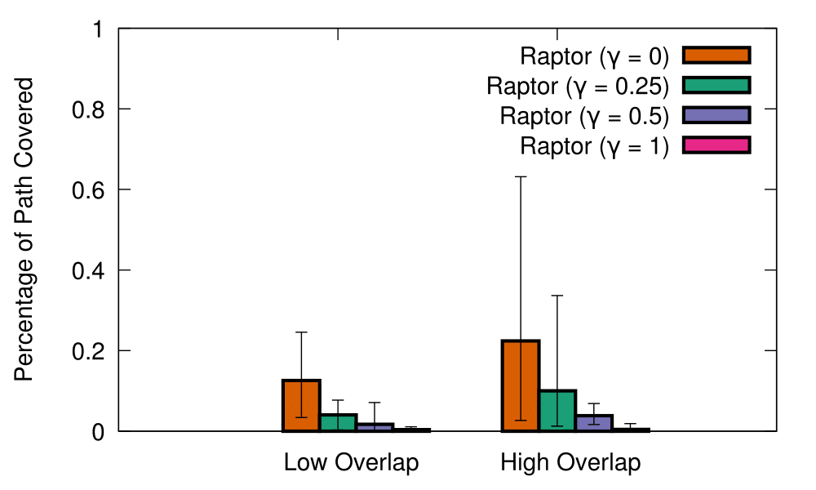
Tackling Traffic Overhead
Raptor
Solution : “Modify the ILP’s objective to consider Traffic Overhead too.”
Notes:
With our optimal placement we see 30% to 60% worst case traffic overhead scenarios, where the packet travels upto 60% of the network after its dropped.
To solve this problem, we modify the ILP’s objective to consider traffic overhead (which is gamma in our solution as the tuning parameter)
Hence, with this we can reduce traffic overhead to upto 0.04% while still saving on rules needed significantly.

Slide 42
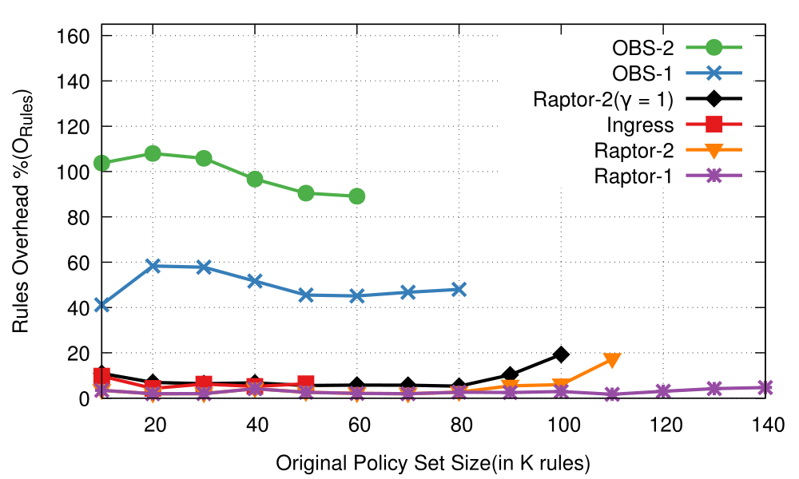
Scalability of Raptor
Fat-Tree-8 – Less Overlapping
Raptor
Notes:
In FatTree-8, we observe savings of 40-60% over OBS-1 for less overlapping policies.
Adding to that, we observe that we are able to accommodate larger policy-set for a given topology and switch tcam size.

Slide 43
Conclusion
Raptor, a scalable and efficient rule placement technique.
Supports multi-path traffic by minimal duplication of rules.
Implemented on Floodlight, and tested with various virtual topologies.
TCAM usage reduction of 42% to 92.7% compared to existing techniques.
Raptor
Notes:
To Conclude.
We demonstrate that rule-sharing can lead to effective savings in t

Slide 44
Thank You

Slide 45
Raptor : Scalable Rule Placement over Multiple Path in Software Defined Networks
Pravein Govindan Kannan, Chan Mun Choon, Richard T.B.Ma and Ee-Chien Chang

Slide 46
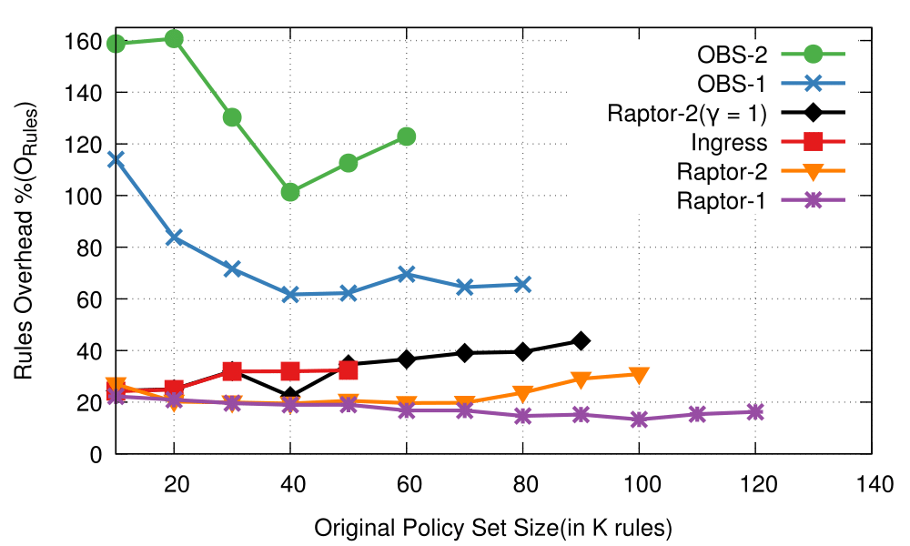
Overhead in various topologies
Fat-Tree-8 – Less Overlap
Fat-Tree-8 – More Overlap
Save 40-100% over OBS-1;
80-140% over OBS-2
Scales 3X over Igress
1.75X over OBS
Raptor
Notes:
In FatTree-8, we observe savings of 40-60% over OBS-1 for less overlapping policies.
Adding to that, we observe that we are able to accommodate larger policy-set for a given topology and switch tcam size.

Slide 47
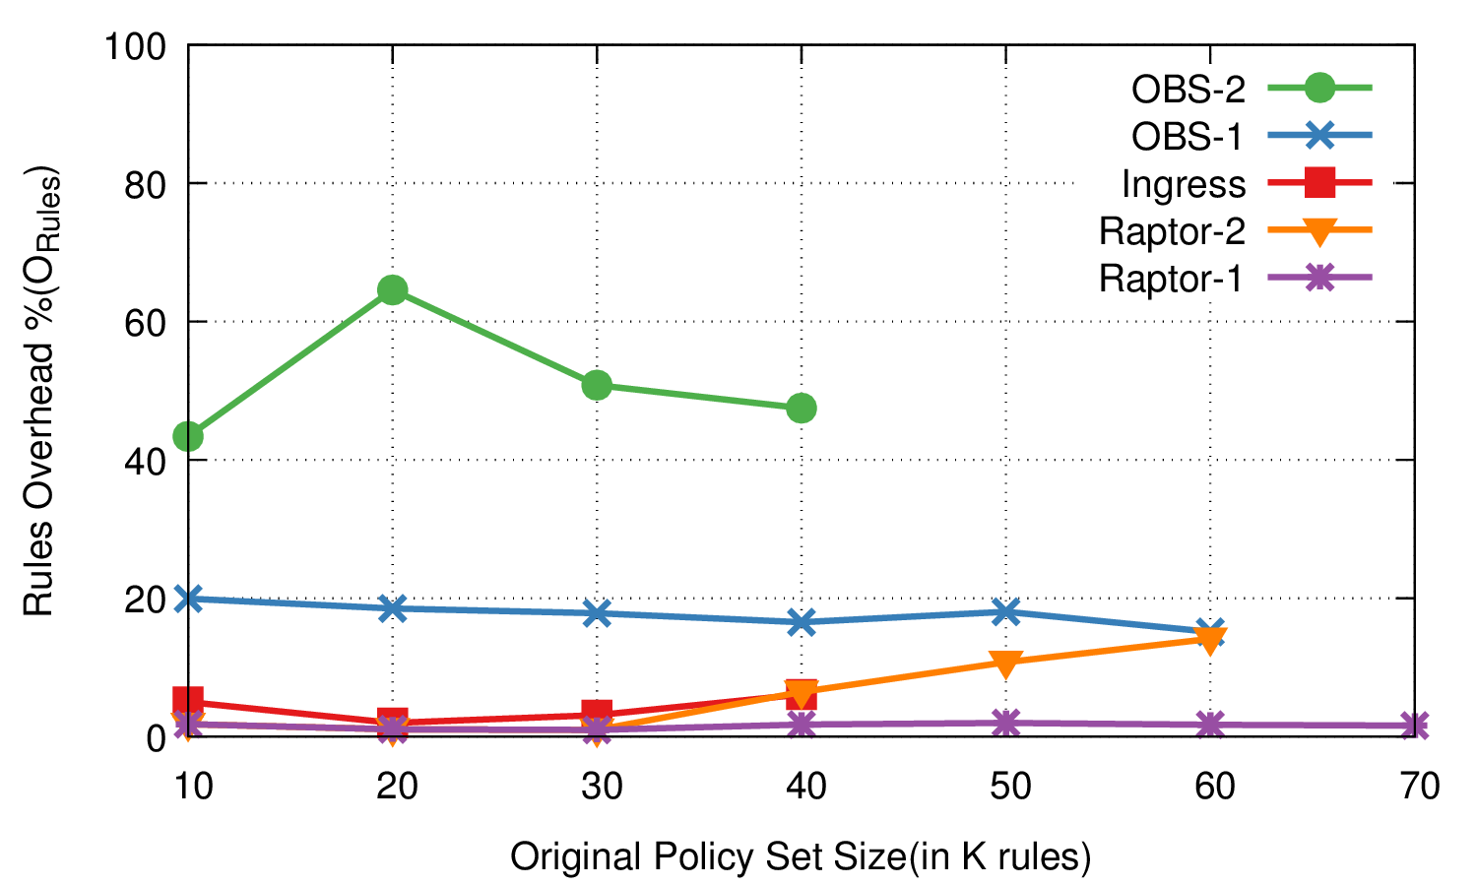
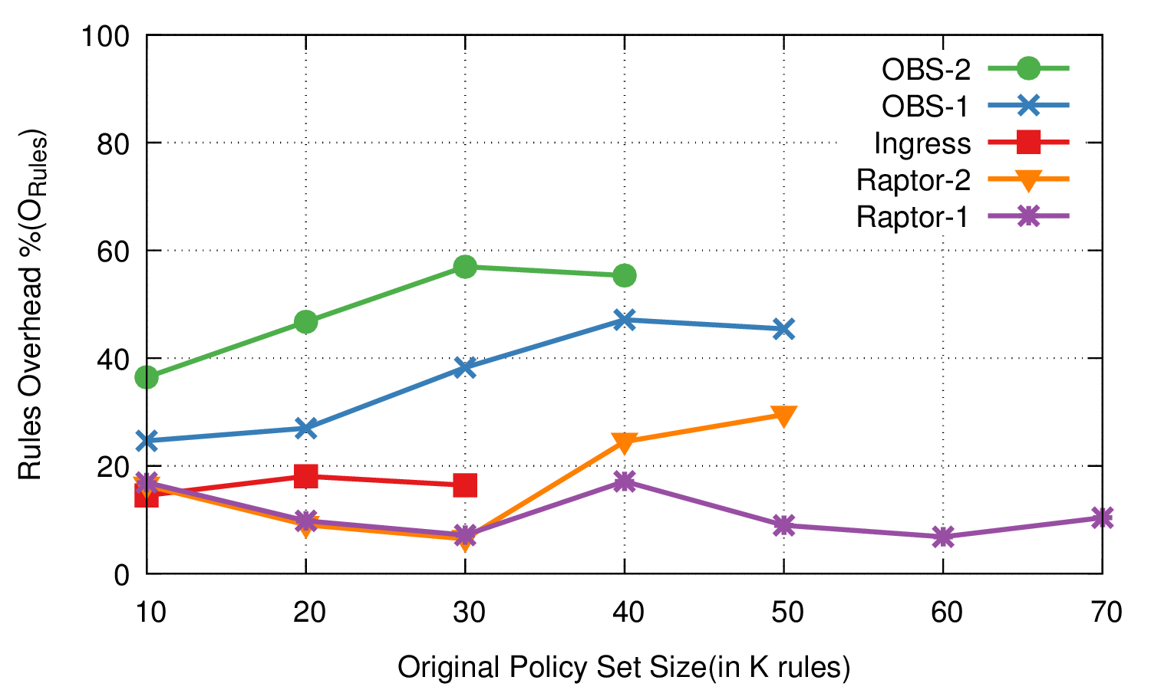
Overhead in various topologies
Stanford –Less Overlap
Stanford – More Overlap
Save 20-30% over OBS-1;
25-60% over OBS-2
Scales 2.5X over Ingress
1.5X over OBS
Raptor

Slide 48
Backup slides

Slide 49
Policy Management IN SDN
Policy Abstractions
(Frenetic[SIGPLAN11],Pyretic,PGA[SIGCOMM15],etc)
Policy Verification and Translations
(Netplumber, Veriflow, etc)
Rule Placement over Network
(OBS[CONEXT13], Palette[INFOCOM 13], Ingress, etc)
Notes:
Hence, research in policy management in Software defined networks can be classified into three major segments :
Providing Policy Abstractions, which provide new methods of expressing policies in a network.
Policy verfication, translations, compression etc, which works on the defined policy abstractions and produces a set of rules.
Rule placement, which has various strategies to place the set of rules in-order to enforce the entire network policy.

Slide 50
Policy Management IN SDN
Policy Abstractions
(Frenetic[SIGCOMM,Pyretic,PGA,etc)
Policy Verfication and Translations
(Netplumber, Veriflow, etc)
Rule Placement over Network
(OBS, Palette, Ingress, etc)
Notes:
Hence, research in policy management in Software defined networks can be classified into three major segments :
Providing Policy Abstractions, which provide new methods of expressing policies in a network.
Policy verfication, translations, compression etc, which works on the defined policy abstractions and produces a set of rules.
Rule placement, which has various strategies to place the set of rules in-order to enforce the entire network policy.

Slide 51
Rule Sharing
“Mining Policies From Enterprise Network Configuration”, IMC 2009
Policy Unit : Two end-points in a network belong to a policy unit if and only if the same set of reachability constraints apply to them when sending traffic to all network end-points.
A Policy unit spanned over 50% of routers of a network.
Many end-points of a network fall into same policy units.
Gives a potential for Rule Sharing

Slide 52
COMPRESS

Slide 53
Dynamic Policy Updates
Addition of New Rule
Rule applies to hosts in Multiple Edge Pairs
Rule applies to hosts in Multiple Edge Pairs
Diffuse Algorithm to determine best placement to maximize sharing
Run Connect, with the added rule to be policy graph.
Consider the new rule as a red-policy and validate the position.
Run Connect, with the added rule to be policy graph.
Consider the new rule as a black-policy and run : Allocate(P,Max(prev_Nodes),Min(next_Nodes),I_{e})

Slide 54
Dynamic Policy Updates
Removal of a Rule :
1) Remove rule from applicable switch(s).
2) Update Policy Graph(s).
Update of a Rule :
1) Remove existing rule.
2) Treat the update as another addition.
In case of Infeasibility : Run “Connect” Algorithm for the failed Edge Pair.

Slide 55
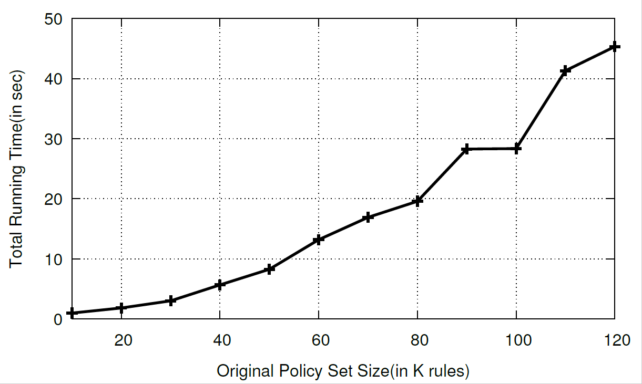
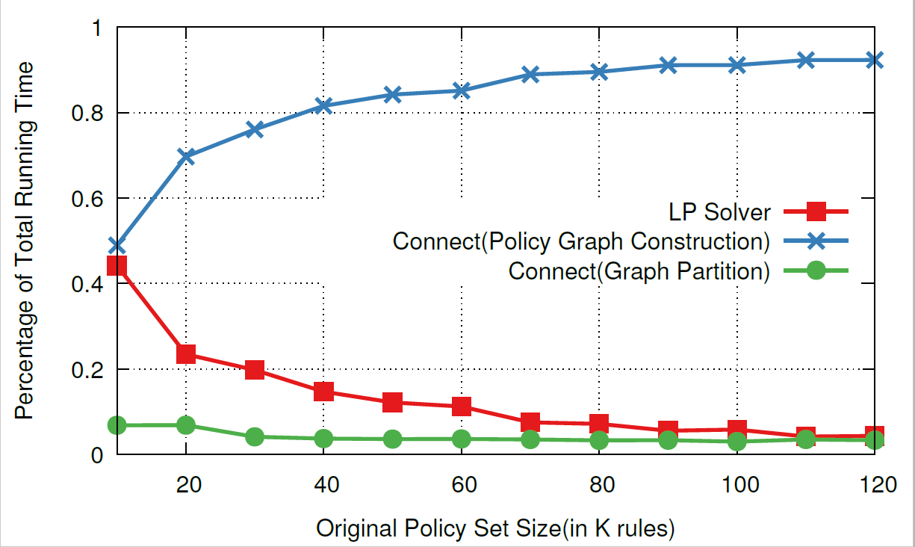
RUNNING TIME
Total Running Time in sec :
% Running Time of 3 major components :

Slide 56
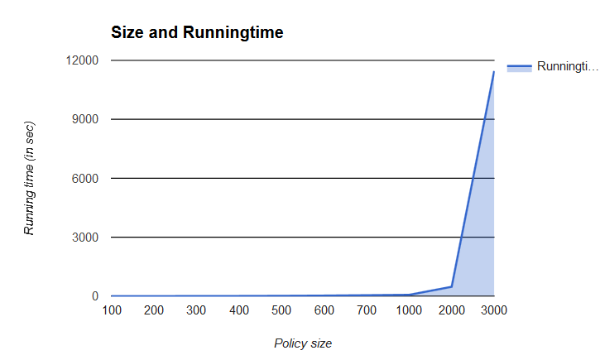
RUNNING TIME
Total Running Time in sec :

Slide 57
Complexity
Connect Complexity Analysis :
For Each Edge-pair :
Path Coverage : O(Ie.Se)
Policy Graph Construction : O(n²) , n is number of rules.
Connect Algorithm : O(n.N) , N is worst-case allocation for n rules.
N (Red Rule ) : O(1)
N (White Rule) : O(1)
N (Blue Rule) : O(m.k) , m is no. of blue rules in the graph, and k is no. of hops.

Slide 58
Connect
Step 3 : Identify “start” position
start Switch hosting the max shared rules.
FlowSpace
No Shared Policy
Shared Policy
Allocated From Ingress
Allocated From start

Slide 59
Limitations of Current Networks
Closed Systems :
Only Interface Configurability.
Non-Transparency.
Hardware-Centric :
Pros : Faster PacketSwitching.
Cons :
Loss of Flexibility.
Slows Innovation. (Due to backward Compatibilities).
Vendor-Specific Software :
Non-Standard Interface to SW
Re-inventing the wheel.

Slide 60
Limitations of Current Networks
Research Stagnation :
Huge costly equipment to be procured and networks to be set up by each team for research.
Networks have remained the same throughout years.
Difficult to Manage.
Feature1
FeatureN
Million of lines of source code
Many complex functions baked into infrastructure
OSPF, BGP, multicast, differentiated services, Traffic Engineering, NAT, firewalls, …
Operating System
Packet Fwd HW
Billions of gates

Slide 61
Existing works
1) Openstack, Floodlight controller(Ingress)
Partition Rules into Sets
2) DIFANE, Sigcomm 2010
3) vCRIB, NSDI 2013
4) Pallete, INFOCOM 2013
5) “One Big Switch”,Conext 2013
6) Joint Optimization of Rule Placement and Traffic Engineering for QoS provisioning in SDN, ToC 2015

Slide 62
Connect
Placement of the Blue Rules ( Edge Pair Rules)
1
2
3
4
5
Topological Sort
4
7
5
3
6
6
7
2
Blue Rule Graph G
Blue Rule List L
1
S2
S3
S1
S6
C = 4
C = 5
S4
S5
C = 1
C = 3
C = 5
C = 5
Partial Topology for Rule Placement
I_{e} = { {S1,S2,S3,S6}, {S1,S4,S5,S6} }
Allocate(L,S1,S6,I_{e})
Runs over several rounds

Slide 63
Connect
Round 1 :
Initial Position : Q , Direction of Placement :

Slide 64
Connect
Round 1 :
Initial Position : Q , Direction of Placement :
Allocate(L,S1,S6,I_{e})
Q selected if based on Cumulative vacancy along the direction
S2
S3
S1
S6
1
C = 4
C = 5
2
3
4
S4
S5
5
C = 1
6
C = 3
7
Policy List L
Q
C = 5
C = 5
Direction D = Forward
Cumulative Vacancy > 7 for both paths

Slide 65
Connect
Round 1 :
Initial Position : Q , Direction of Placement :
Allocate(L,S1,S6,I_{e})
Q selected if based on Cumulative vacancy along the direction
S2
S3
S1
S6
C = 4
C = 5
1
2
3
S4
S5
4
C = 1
5
C = 3
6
7
Policy List L
C = 5
C = 5
Q
Direction D = Forward
Cumulative Vacancy = 6 for both paths

Slide 66
Connect
Round 1 :
Allocate(L₁,S1,S6,I_{e})
S2
S3
S1
S6
C = 4
C = 5
2
3
S4
S5
4
C = 0
C = 3
5
6
1
7
Policy List L₁
C = 5
C = 5

Slide 67
Connect
Round 2 :
Allocate(L₁,S1,S6,I_{e})
S2
S3
S1
S6
C = 4
C = 5
2
3
S4
S5
4
C = 0
5
C = 3
6
1
7
Policy List L₁
C = 5
C = 5
Q
Direction D = Reverse
Cumulative Vacancy > 6

Slide 68
Connect
Round 3 :
Q
Cumulative Vacancy > 3
Allocate(L₂,S1,S6,I_{e})
S2
S3
S1
S6
C = 4
C = 5
2
3
S4
S5
4
C = 0
C = 0
Policy List L₂
1
5
6
C = 5
C = 5
7
Direction D = Reverse

Slide 69
Connect
Round 4 :
Allocate(L₂,S1,S6,I_{e} – {S1,S2,S3,S6})
2
3
4
S2
S3
S1
S6
C = 4
C = 2
2
3
S4
S5
4
C = 0
C = 0
Policy List L₂
1
5
6
C = 5
C = 5
7
Direction D = Reverse
Q
Cumulative Vacancy > 3

Slide 70
Connect
Final Allocation of Blue Rules :
2
3
4
S2
S3
S1
S6
S4
S5
1
5
6
7
2
3
4

Slide 71
Connect
Movement of Red Rule
(4)
R1
R2
Rule can be Moved, only if
R1 << R2 << Pivot
Red can be Moved, only if
R1 >> R2 >> Pivot
R2
R1
In both cases, in case of conflicting positions,
only the non-conflicts can be moved.
If Movement cannot be afforded,
Re-color(Red) -> White

Slide 72
Connect
Placement of Blue Rule
(4)
B
R
(or)
B
R
Allocate(B, source, Min(Pos(R), pivot)
(5)
R
B
(or)
B
R
Allocate(B, Max(Pos(R),pivot), dest)

Slide 73
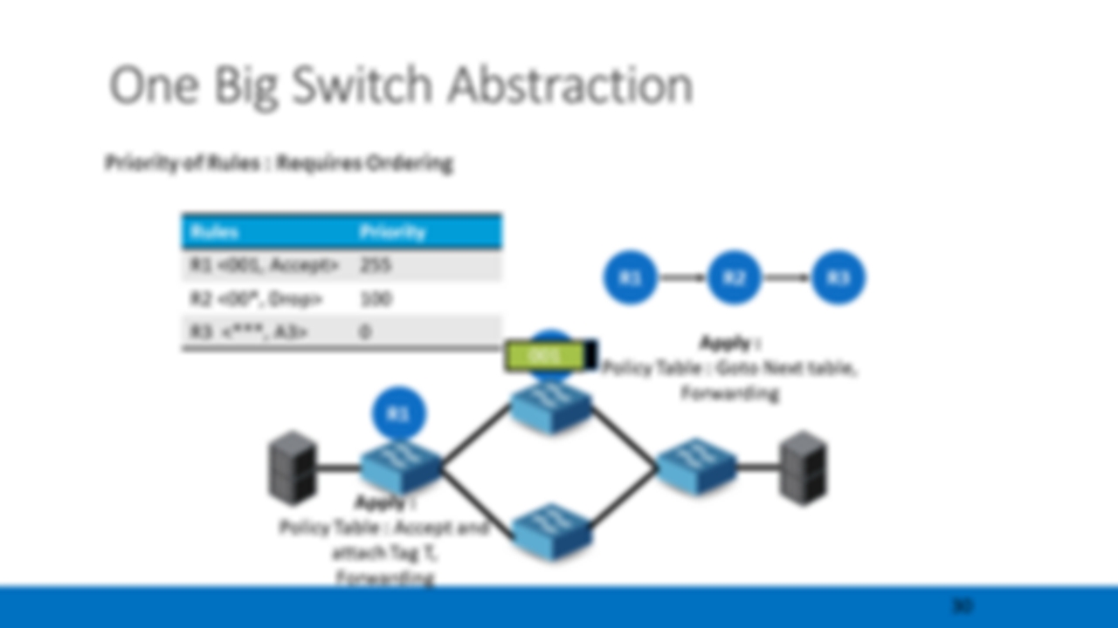
Rules behave as they are placed in a single switch
Raptor
Notes:
A placement where, R1 is placed ahead of R2 is a correct scenario

Slide 74
Rule Classification
Rules
Edge Pair Rules
Shared Rules
Raptor

Slide 75
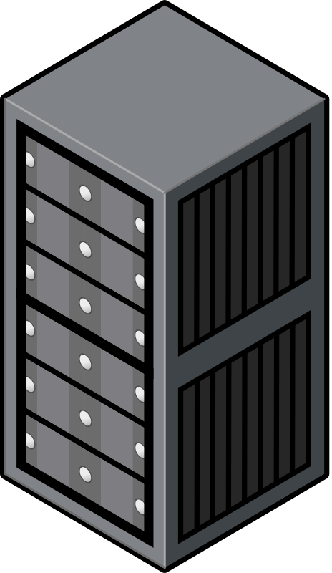
Edge Pair Rule
Edge Pair Rule
(ip_src = 01,ip_dst=10, tcp_port=xx, Accept)
01
10
SDN Controller
Raptor

Slide 76
Shared Rule
Shared Rule
tcp_port = 22, Deny
SDN Controller
Raptor

Slide 77
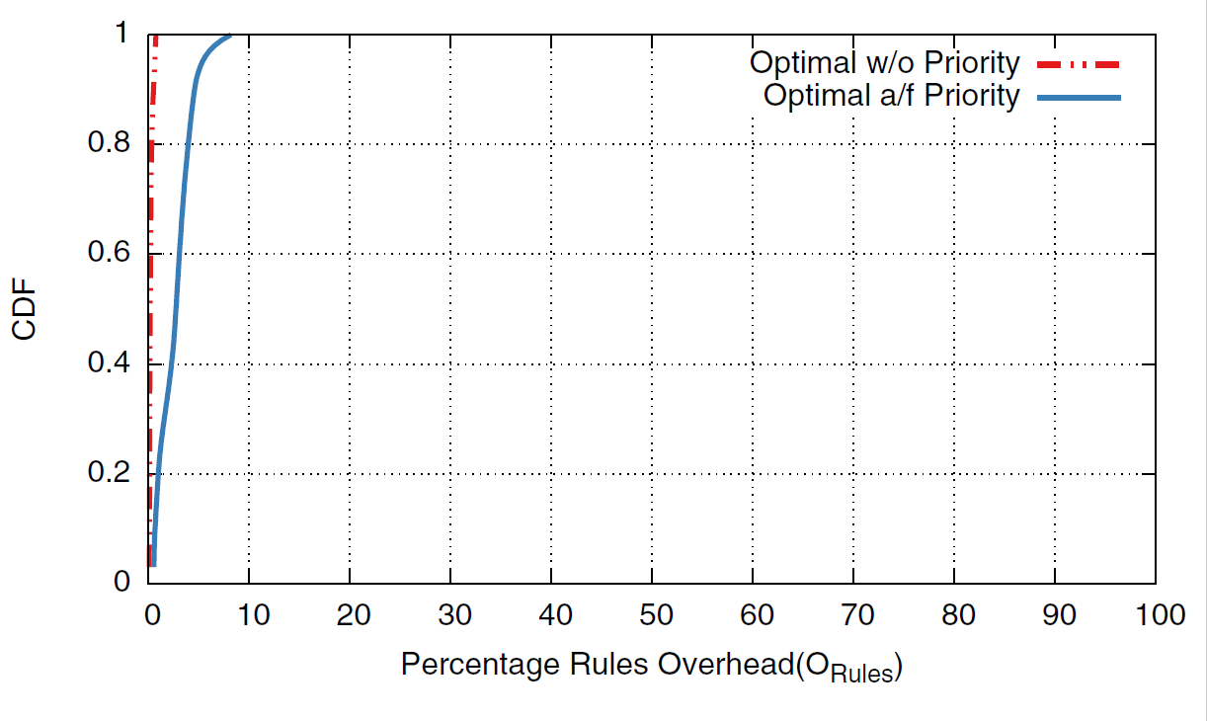
ILP vs Raptor

Slide 78
One Big Switch Abstraction
Priority of Rules : Requires Ordering
Rules | Priority
R1 <src:*, dest:001, A1> | High
R2 <src:00*, dest:*, A2>
R3 <src:*, dest:*, A3> | Low
R1
R2
R3
R2
Apply :
Policy Table : Goto Next table,
Forwarding
R1
001
Apply :
Policy Table : Accept and attach Tag T,
Forwarding
Raptor
Notes:
A placement where, R1 is placed ahead of R2 is a correct scenario

Slide 79
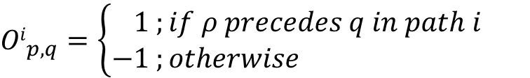
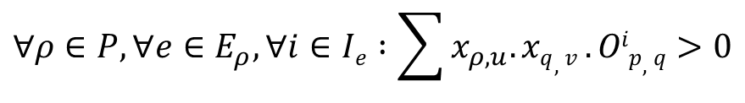
No Priority Constraint?
Maintaining the One Big Switch abstraction
$$∀ρ∈P,∀e∈E_{ρ},∀i∈Ie :\sum{x_{ρ,u}.xq,v}.Oip,q>0$$
$${Oi}_{p,q}=\left\{\begin{aligned}1 ;if ρ precedes q in path i \\ −1 ;otherwise \end{aligned}\right.$$
Constraint to make sure, for each Edge in Rule Graph, Ordering is maintained.
Complexity : I_{e}P².S²
Hence, need efficient heuristic to solve ordering problem
Raptor

Slide 80
Connect
Step 2 : Identify Independent Rule-sets
4
5
6
7
3
2
1
Independent rule-sets can be allocated independently.
Raptor
Notes:
Once the graph is constructed, we identify the disconnected pieces as subgraph/ flowspace islands.

Slide 81
Connect
Step 3 : Identify “pivot” position
pivot Switch hosting the max shared rules.
Assume , and are shared rules.
are allocated to S6 by Diffuse
is allocated to S1 by Diffuse
4
5
4
5
1
3
4
5
2
1
1
S2
S3
S1
S6
S4
S5
Raptor
Notes:
The next step is to identify the “pivot” position, where the entire rule-set subgraph will be assigned to.
The pivot position is chosen as the switch which has the most shared rules ( as per diffuse)
Lets take an example grph with 5 nodes, Let 4,5 and 1 be shared rules.
Consider, 4 and 5 are allocated to S6 by diffuse, and 1 is allocated to S1.
In that case, since S6 has the most shared rules, we allocate the entire sub-graph to S6.

Slide 82
Connect
Graph Partitioning
3
S2
S3
2
S1
S6
S4
S5
1
4
5
3
2
Please refer paper for algorithmic details and proofs.
Raptor

Slide 83
Connect
Overall Algorithm for each Edge Pair, and flowspace
Pick the Pivot Position
Allocate dependent edge pair Rules
Is Allocation Feasible?
No
Yes
Place Rules
Raptor
Notes:
Hence, to look at the overall connect Algorithm :
First we pick a pivot point to allocate the entire flowspace graph.
Next step, we decompose the graph, to allocate red, blue and white rules.
If the allocation turns out to be feasible w/o exceeding the capacity of the switches, then we end the algorithm, and perform the rule placement with the allocation matrix.
If the picked position is not feasible, then we need to try to identify the next best pivot position.
We repeat this until we find the right allocation. If allocation is not possible for any picked pivot position. Then, we stop the algorithm, and report that it is not feasible to incorporate all the policies.

Slide 84


