Slide 1

Ranuni Function
By: Matthew Miller

Slide 2
What is the Ranuni Function?
Ranuni stands for Random Uniform; the ranuni function is a pseudo random number generator (PRNG) that generates numbers in (0,1) seemingly randomly following a uniform distribution, meaning all values within the range (0, 1) are equally likely to get picked.
A PRNG is an algorithm that produces seemingly random numbers based off mathematical formulas and a given initial value, or seed state. They are periodic sequences of numbers, meaning at some point, the entire sequence will repeat (hence pseudorandomness).
PRNGs are useful for getting computers to behave by chance instead of set programming. As such, PRNGs including the ranuni function are most often used for simulation, sampling, and modeling applications, most notably simulating/modeling statistical distributions and the samples taken from the population.

Slide 3
Syntax of Ranuni Function
Ranuni(seed)
The seed may be any value such that 0 < seed < 2³¹−1
The same seed will always give the same sequence of pseudorandom values
If 0 is placed for the seed, the system time is used as the seed state, generating different values each go
The seed may be a function of other numeric values
May be transformed from (0, 1) range to (b, a+b) as follows:
a*Ranuni(Seed) + b

Slide 4
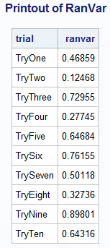
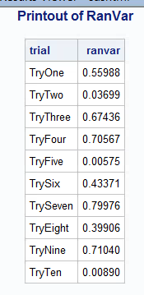
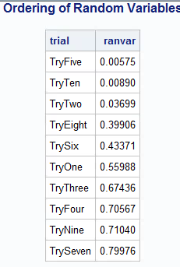
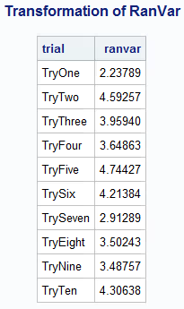
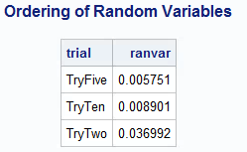
Examples of Output
Different First 10 Values
Generated Using
Ranuni(0) Twice
Ordering Via Ranuni
And Truncation of Population
To Take Sample of 3 From 10
Transforming Ranuni to Assign Values In (2, 5)
i.e. 2*Ranuni(0)+3

Slide 5
Fallbacks of Ranuni
Ranuni belongs to a family of functions, RanXXX, that generate random numbers according to the type of distribution specified.
Upon researching Ranuni, it was found to be mostly phased out in favor of the RAND function in current and future applications of SAS.
Rand function virtually eliminates the possibility of pseudorandoms completing a loop from start to end, number of terms is 4x10^6001 instead of 2^31
More distributions are supported by the Rand function than the RanXXX family
The syntax for Rand is consistent in different distributions, where RanXXX has separate functions for each.
Number sets generated by Rand more closely resemble sets of the given distribution and are therefore more accurate.
Ranuni is still used frequently in legacy systems and within older datasets, so there is a good chance of seeing it in a future career despite the transition to the Rand function.

Slide 6
References
This Youtube Video Goes Over the Example Problem in More Depth
https://www.youtube.com/watch?v=VrAQ9csjUlY
The SAS Documentation Center Provides Information on the Syntax and Applications of Randuni
https://go.documentation.sas.com/?cdcId=pgmsascdc&cdcVersion=9.4_3.4&docsetId=lefunctionsref&docsetTarget=p1fkiqt9ygapyxn1pd1w8manlpub.htm&locale=en

Slide 7
Thanks For
Listening!

