Slide 1
Shuttle-service-app-Techjutsu
Presenters:
Snetha Sivakumar – Team Lead (developer)
Aryan Raj – developer
Vijayasai Sanagaram – developer

Slide 2
Introduction
The app's concept is that workers are dropped off and boarded at Manyata Tech Park by a shuttle that circles the tech park. It is difficult to track and difficult to determine the shuttle's whereabouts. The application is intended to assist Manyata employees in locating the bus and determining its distance from the tech park's specified bus stops. With this app, employees will find it simple to leave the workplace whenever they want to. Instead of waiting around at the bus stop for a long time for the shuttle to arrive, they can check the shuttle's location and get going.

Slide 3
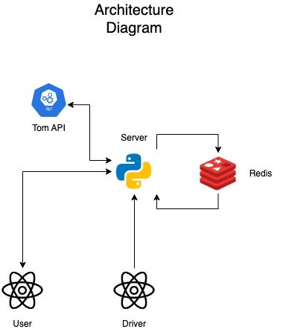
Architecture Diagram
In our architecture diagram, we have
React Native apps
Driver
User
Python Fast API backend
Server to calculate the distance.

Slide 4
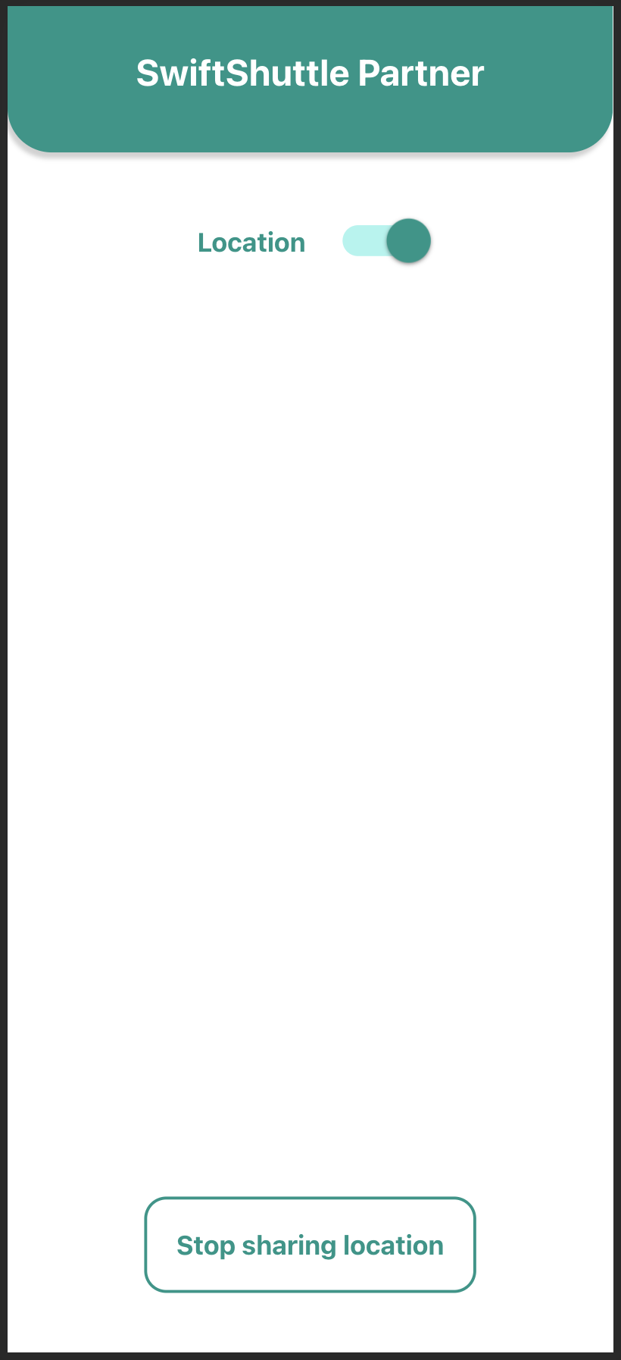
Driver App
Developed using react native
The button to enable location sharing is displayed.
We can turn off location using the same button.
Every 20 seconds, the driver app sends the coordinates to the server.

Slide 5
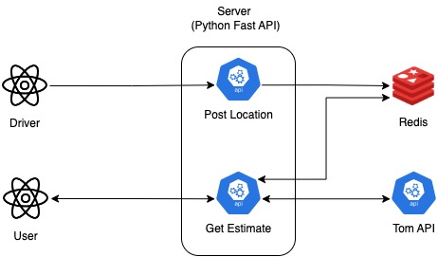
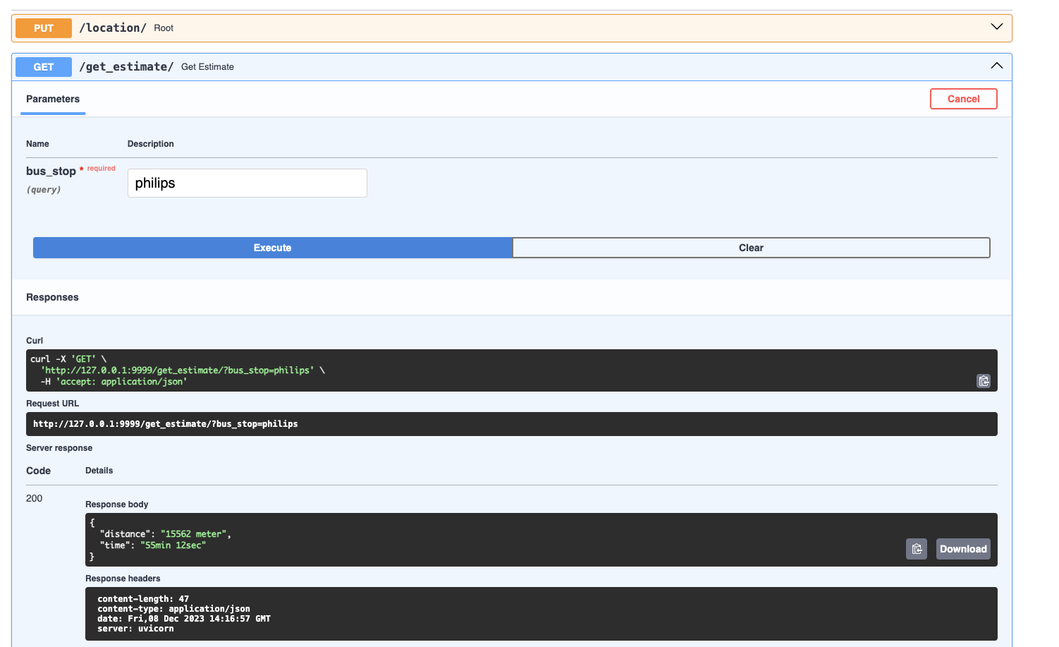
Server
Developed using python (FAST API)
APIs
Post Location
When the co-ordinates are received from the driver app, the details are kept in Redis tagging the bus id.
Get Estimate
When the user selects the bus stop from the dropdown, this API gets invoked, and takes the latest co-ordinates from redis and calculates the distance, time and returns it for particular bus stop.

Slide 6
User App
Developed using react native.
We have 3 parts on the screen
Map with marked locations of bus stops of Manyata and current user location.
Dropdown to select the bus stop
Placeholder to display the bus, bus stop, distance and time.
When you pick a bus stop from the drop-down menu, our server retrieves the distance and time from that bus stop (not your current location).

Slide 7
Approach
Planning
After we claim the idea, we had a call with our mentor to discuss the functional and non-functional requirements.
After collecting the requirements, we as a team discussed the structure of the project.
We split the modules among us for development.
Implementation
During the implementation phase, we developed driver, server and user application.
We connected all three modules and tested it.
The code structure
ShuttleDriver
ShuttleServer
ShuttleUser
Redis (docker-compose)
https://github.ibm.com/CIO-Ideathon-Q4-2023/Shuttle-service-app-Techjutsu
Submission
We used GitHub repo for our VCS.
We pushed our code to main branch of the provided GitHub Repo.

Slide 8
Enhancement scope
Tagging the driver devices to bus.
If we do that, we can improve our display of distance and time specific to the bus. Currently it is the current running bus.
Possibility of live tracking through the user app
We can enhance the design changes in the User and driver app.

Slide 9
Thank You

Slide 10
Demo and Questions

