Slide 1

Turning 3,900 purchases
into retail decisions
Customer Shopping Behavior Analysis | Data Analyst portfolio case study

Slide 2
THE BUSINESS QUESTION
The business question was simple: what drives value and repeat behavior?
Understand
Translate
Who spends, what sells, and where loyalty is forming
Transaction-level data into actions for subscriptions, promotions, products, and marketing

Slide 3
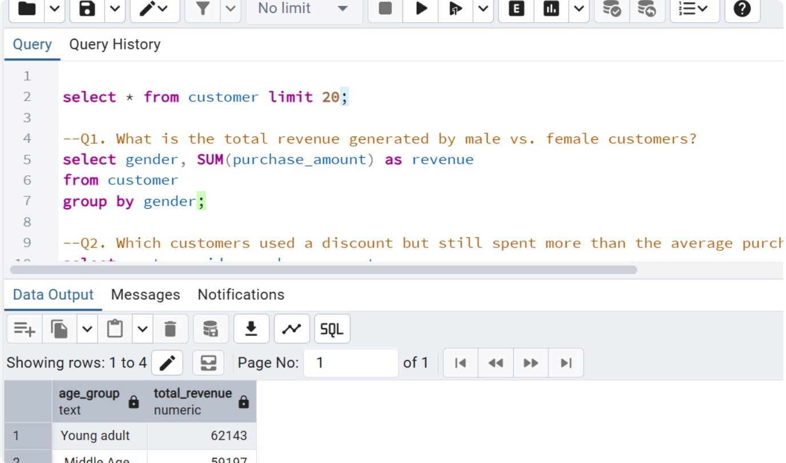
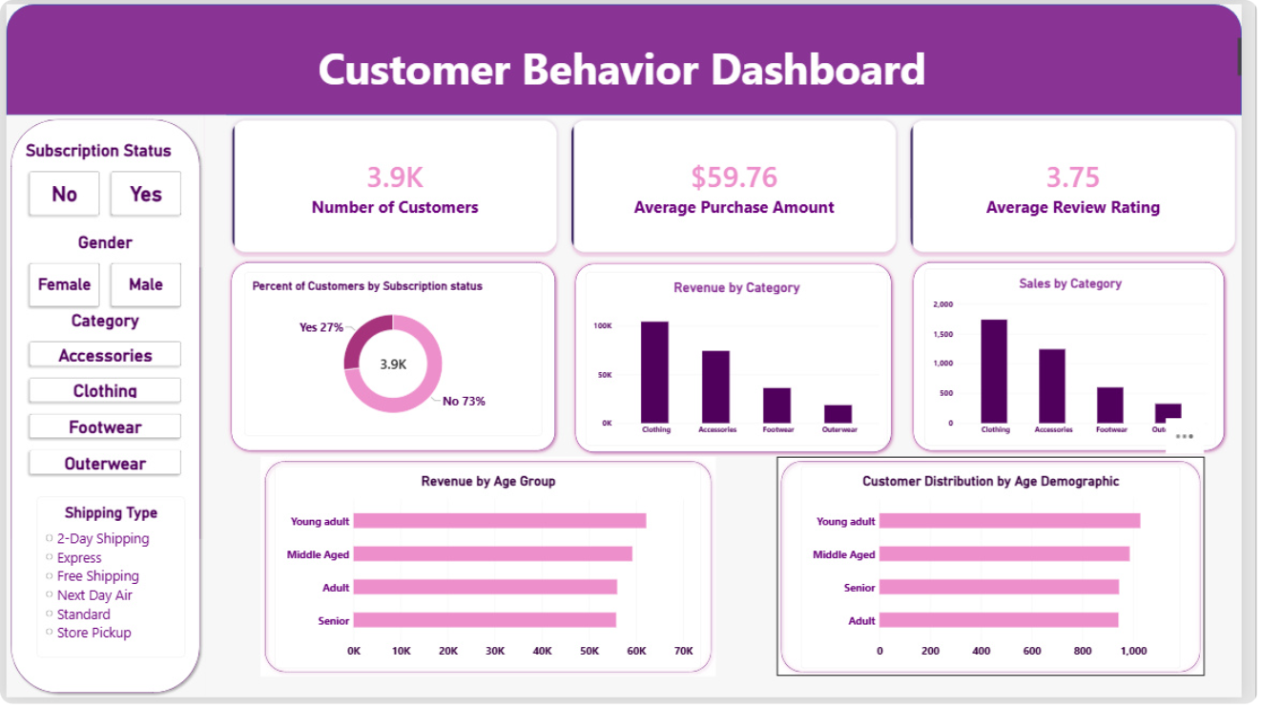
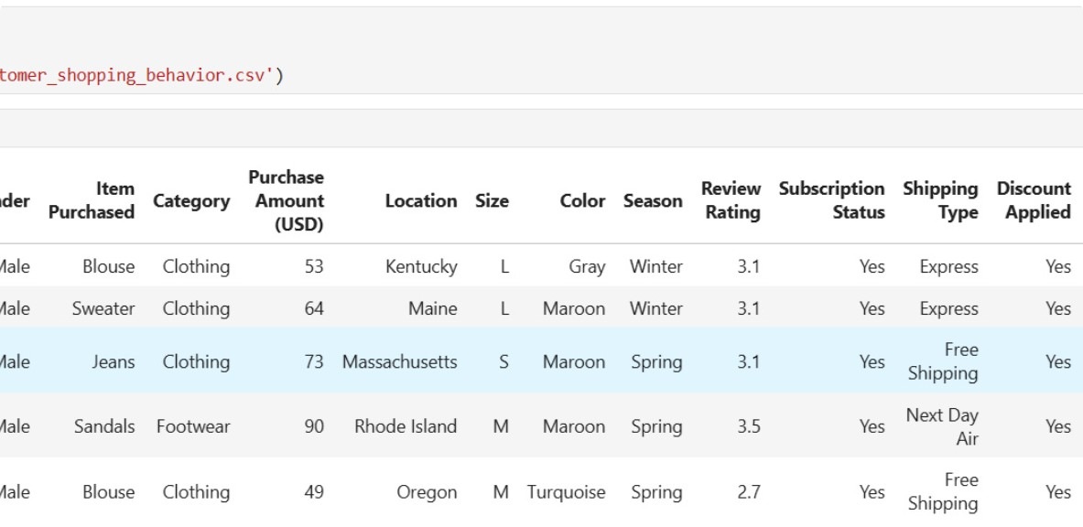
FROM RAW DATA TO DECISION
I built a clean path from raw data to decision-ready insight
01
02
03
Prepare
Query
Explain
Prepared and validated the data in Python with pandas
Loaded the cleaned dataset into PostgreSQL for business questions
Visualized the findings in an interactive Power BI dashboard

Slide 4
THE DATASET
The data was broad enough to connect customer, product, and service behavior
3,900
Behavior connected
37
Customer demographics, purchase details, discounts, shipping, ratings, and purchase frequency
purchases
missing review ratings
Across 18 columns and 25 products
Handled with category-level median imputation

Slide 5
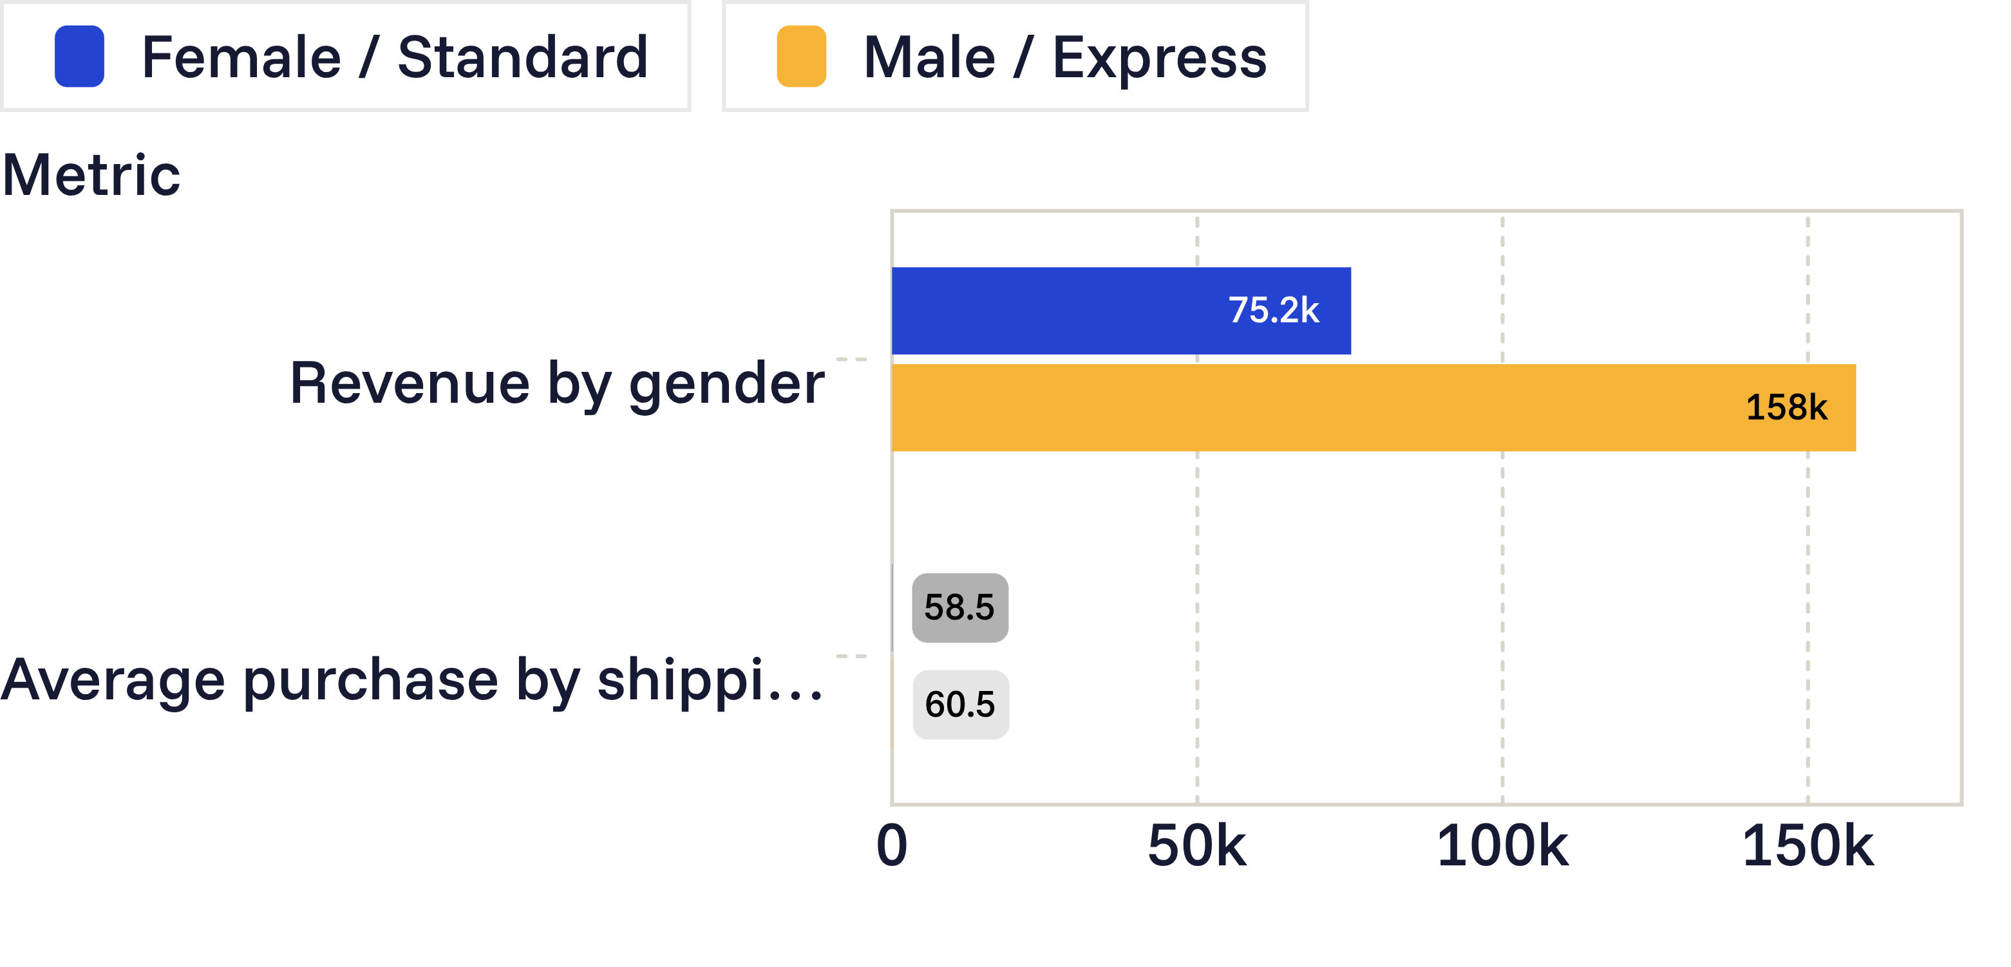
COMMERCIAL SIGNALS
The strongest commercial signal was concentrated in a few customer behaviors
Revenue is concentrated among male customers, while express shipping is associated with a modestly higher average purchase.
839
customers used discounts while still spending above the average purchase amount

Slide 6
LOYALTY AND SUBSCRIPTION
Loyalty is present, but subscription value is not yet proven
Loyalty mix
Subscription comparison
3,116 Loyal
701 Returning
83 New
Subscribers averaged $59.49 versus $59.87 for non-subscribers.
Non-subscribers generated $170,436 in revenue versus $62,645 from subscribers.
Among repeat buyers, 958 subscribed and 2,518 did not.

Slide 7
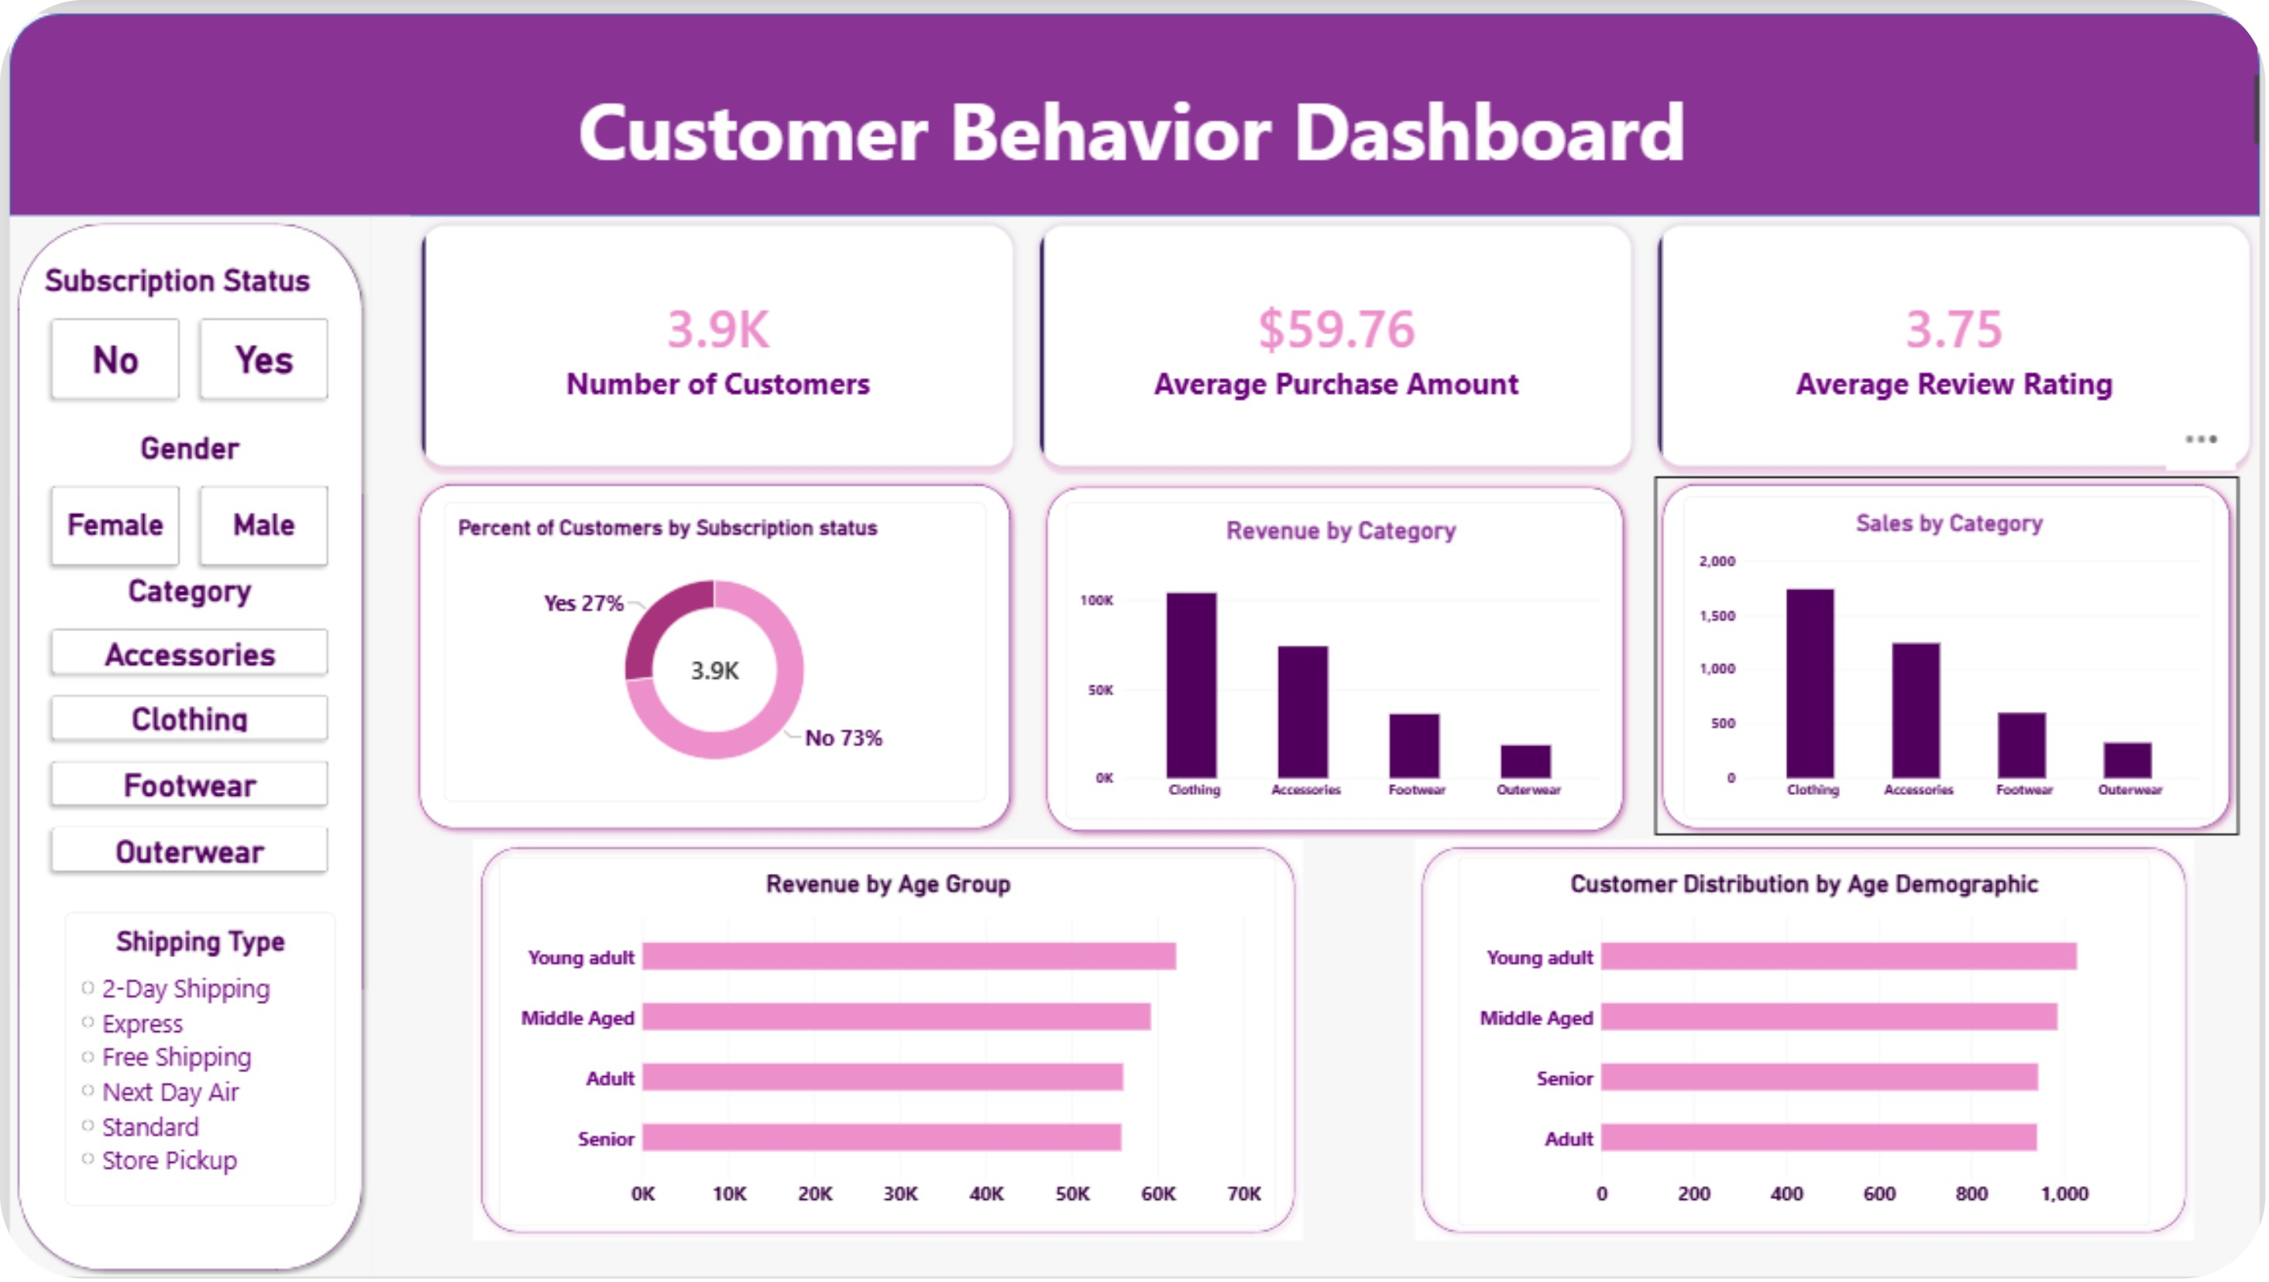
THE EXPLORATION LAYER
The dashboard made the story easy to explore and explain
Interactive views connected subscription status, category, shipping type, customer count, purchase amount, ratings, revenue, and sales by age group.

Slide 8
PRODUCT AND CATEGORY SIGNALS
Product and category signals point to focused merchandising moves
~$100K
Top-rated products
50.00%
Gloves at 3.86
Sandals at 3.84
Boots at 3.82
Clothing led category revenue
discounted-purchase rate
Hats led, followed by Sneakers, Coats, Sweaters, and Pants.
Accessories followed at about $75K.

Slide 9
FROM ANALYSIS TO ACTION
My recommendations turn the analysis into a testable growth plan
01
Test subscriber-only benefits and measure conversion among repeat buyers
02
Reward repeat purchasing to move customers from Returning to Loyal
03
Review discount depth by product to protect margin while preserving demand
04
Feature top-rated products and high-revenue categories in campaigns
05
Target high-revenue age groups and customers who choose express shipping

