Slide 1
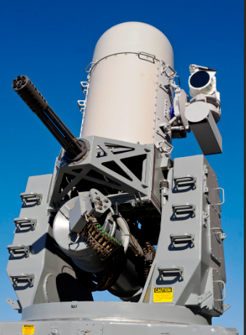
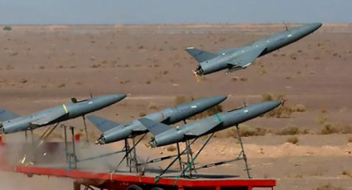
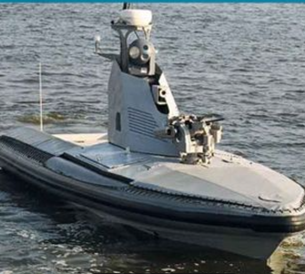
Sensor Upgrade for the fielded Phalanx Block 1A Close-In Weapon System (CIWS) Preliminary Design Review
The Goals to build sensor detection software to target non-radar to detect a threat from Iranian drone and protect the U.S. Navy ship

Slide 2
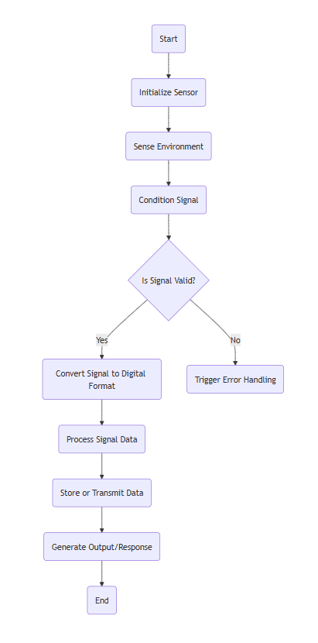
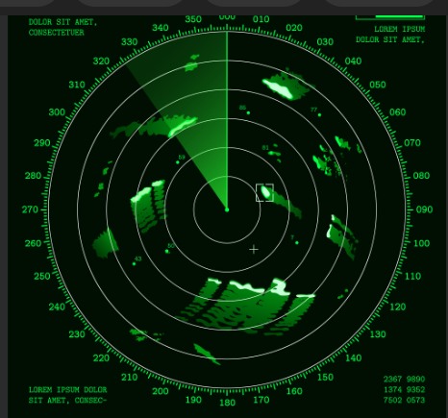
Functional Flow Block Diagram of Sensor

Slide 3
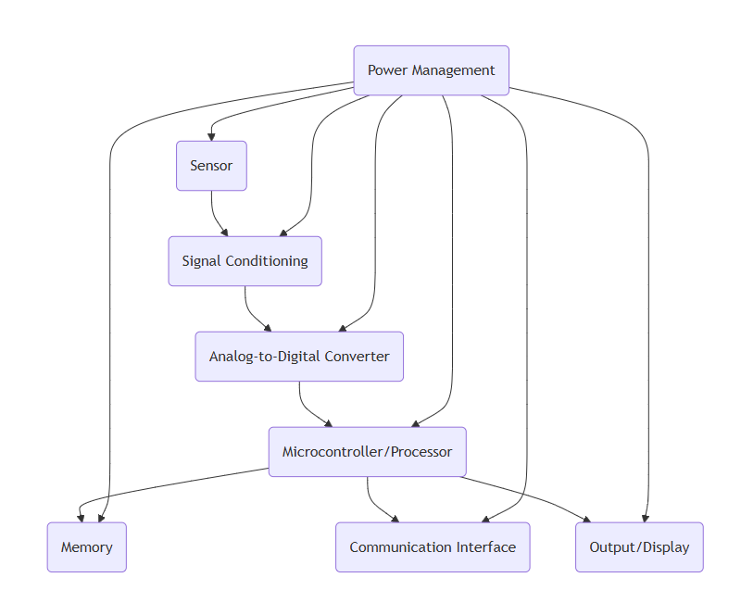

System Block Diagram of Sensor Radar

Slide 4

Allocate requirements to subsystems
Sensor Unit Detect, track, and identify targets in day and night conditions. Detect targets at 25 nautical miles (nm) range.Track targets at 20 nm range. Identify targets described on slide 7 at 10 nm range.
Signal Processing UnitProvide azimuth and elevation to the tracked target with an accuracy greater than or equal to 0.1 milliradians. Process cues from the ship’s MRTDT system for enhanced detection and tracking.
Environmental and Structural Design Ensure operation in tropical maritime conditions as defined in MIL-STD-810G.
Enable below-deck system operation in temperatures from 0-50 degrees Celsius.
Ensure below-deck and above-deck systems comply with the specified vibration profile.
Communication and Control Interface Accept cues from the ship’s MRTDT system. Facilitate seamless integration with shipboard systems.

Slide 5
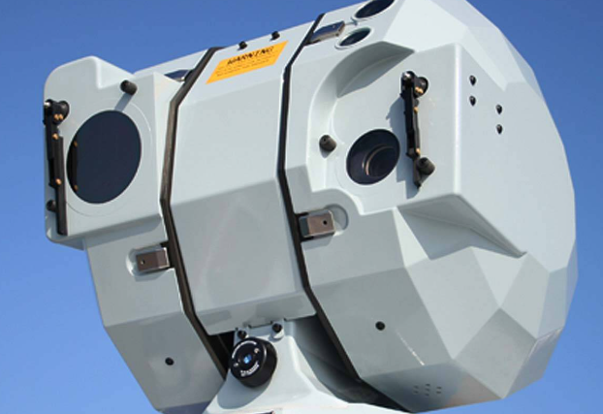
Allocate requirements to subsystems
Subsystem: Above-Deck Unit Operate in temperatures from -20 to 60 degrees Celsius. Be impervious to moisture penetration. Provide range to target accurate to within 1 meter. Provide range rate accuracy to within 0.1 meters per second. Fit within a volume of 1 foot x 1 foot x 2.5 feet. Weigh no more than 35 pounds. Require no more than 150 Watts of power.
Subsystem: Below-Deck Unit Fit within a volume of 3 feet x 3 feet x 3 feet (excluding cables or displays). Weigh no more than 80 pounds. Require no more than 100 Watts of power.
Subsystem: Display and User Interface Displays shall be no larger than 27 inches diagonally.
Subsystem: Power Management Operate on 270 Volt DC power.
Subsystem: Communication and Networking Integrate with the ship’s Local Area Network to distribute sensor images in real time. Integrate with the ship's GPS navigation system to provide absolute target location.

Slide 6
Specification Compliance Matrix: Upgraded Sensors Hardware
Requirement ID | Requirement Description | Sensor Type | Compliance Status | Comments
RQ-01 | Operate in -20°C to 60°C | Environmental Sensor | ✅ Compliant | Tested and verified under standard operating conditions.
RQ-02 | Detect vibration with sensitivity < 0.01g | Accelerometer | ⚠ Partial Compliance | Sensitivity slightly above threshold in high-noise environments.
RQ-03 | Noise filtering with SNR > 40 dB | Data Processing Unit | ✅ Compliant | Meets standard signal-to-noise ratio requirements after preprocessing.
RQ-04 | Compatible with 12V/24V DC power supply | Power Supply Interface | ✅ Compliant | Fully compatible with legacy system power interfaces.
RQ-05 | Transmit data securely over Wi-Fi | Communication Module | ✅ Compliant | Supports AES-256 encryption and tested under various network conditions.
RQ-06 | Response time < 2ms | Data Processing Unit | ✅ Compliant | Verified during integration tests.
RQ-07 | Detect objects within 1-meter range | Proximity Sensor | ❌ Non-Compliant | Current sensor limited to a 0.8-meter detection range.
RQ-08 | Log data for at least 30 days | User Interface/Storage | ✅ Compliant | Sufficient onboard storage and optimized for data retention.
RQ-09 | Operate in 90% relative humidity | Environmental Sensor | ✅ Compliant | Tested in high-humidity test chamber.
RQ-10 | Support remote firmware updates | Communication Module | ⚠ Partial Compliance | Firmware updates require manual intervention under certain conditions.

Slide 7
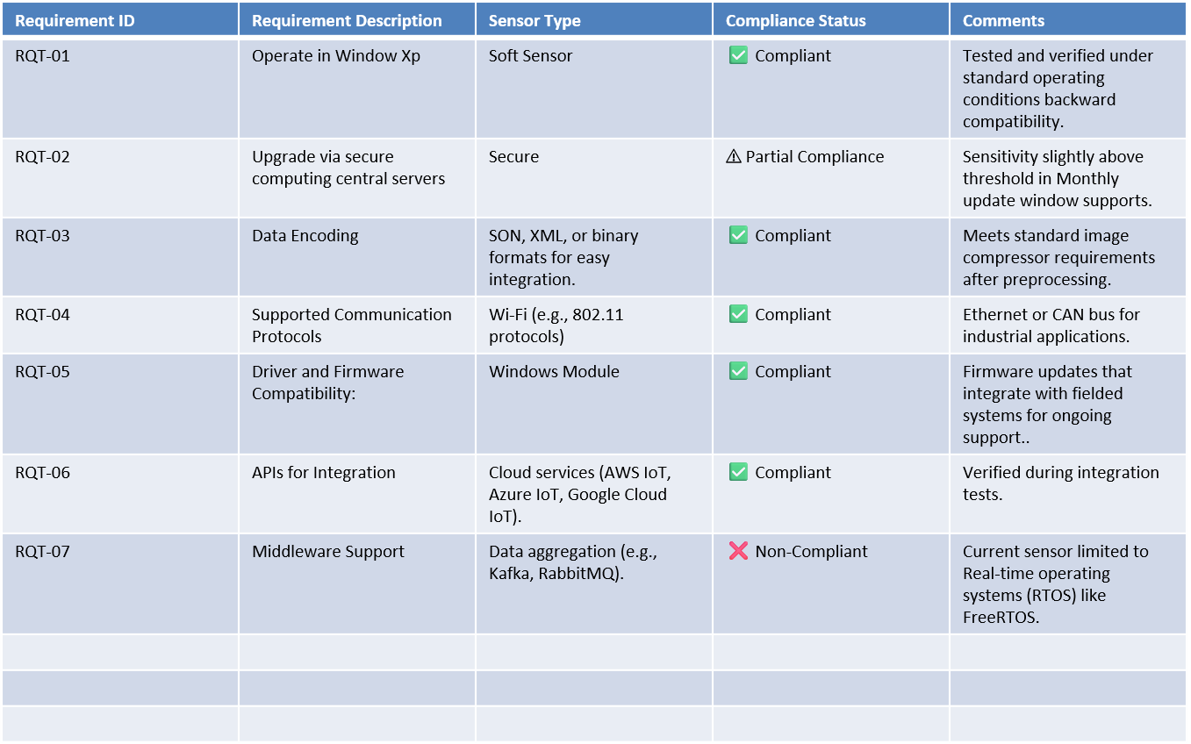
Specification Compliance Matrix Upgraded Sensors Software

Slide 8
Technology Readiness Assessment: Sensor Upgrade
Subsystem | Current TRL | Description | Challenges | Recommended Actions
Cable Sensor Unit | TRL 6: Prototype | Tested for sensitivity and accuracy in relevant conditions. | Sensitivity to noise; durability in extreme conditions. | Perform field tests and refine noise reduction.
Data Processing Unit | TRL 7: Operational Prototype | Real-time filtering and preprocessing demonstrated. | High power consumption during processing loads. | Optimize firmware and adopt low-power algorithms.
Communication Module | TRL 5: Laboratory Validation | Secure data transmission validated over Wi-Fi and ZigBee. | Limited testing on long-range protocols; interference in urban areas. | Expand testing to remote areas and improve protocol interoperability.
Power Supply Interface | TRL 8: Fully Integrated | Tested with existing field power systems. | Insufficient support for alternative energy sources. | Incorporate solar/battery backup options.
Firmware Update System | TRL 5: Laboratory Validation | Secure OTA updates demonstrated in lab settings. | Compatibility issues with legacy systems. | Conduct field testing and simplify update mechanisms.
Environmental Sensor | TRL 6: Prototype | Validated in simulated environmental conditions. | Limited testing in high-humidity or corrosive environments. | Perform extended tests in extreme environments.
User Interface (UI) | TRL 6: Prototype | Provides real-time visualization and alerts. | Scalability for multiple sensors and diverse data streams. | Develop a cloud-based scalable architecture.

Slide 9
Technology Readiness Assessment: Sensor Upgrade
Subsystem | Current TRL | Description | Challenges | Recommended Actions
thermistors Sensor Unit | TRL 6: Prototype | Measure ambient or object temperature (e.g., thermistors, thermocouples, RTDs). | Temperature moisture levels in the air (e.g., capacitive or resistive humidity sensors). | Perform field tests and refine noise reduction.
Acoustic Sensors: | TRL 7: Operational Prototype | Detect sound waves, vibrations, or ultrasonic signals. | Acoustic sensors are highly sensitive to background noise, which can affect their accuracy in detecting specific signals. | Optimize firmware and adopt low-power algorithms.
Infrared Sensors Module | TRL 5: Laboratory Validation | Detect thermal radiation or measure distances (used in remote controls or heat imaging). | The effective range of IR sensors is limited compared to other sensing technologies like radar or LIDAR, particularly in open spaces. | Use protective enclosures or filters to mitigate interference from dust, smoke, or fog.
Vibration Sensors | TRL 8: Fully Integrated | Monitor machinery health by measuring vibrations (e.g., piezoelectric sensors). | Difficulty in integrating with advanced monitoring systems or legacy equipment due to protocol or compatibility issues. | Provide detailed guidelines and tools to simplify installation and ensure optimal sensor placement.
Hall Effect Sensors: | TRL 5: Laboratory Validation | Detect magnetic fields (used for position or speed sensing). | Improper alignment of the sensor with the magnetic source can lead to measurement errors or reduced sensitivity. | Incorporate high-sensitivity Hall Effect sensors for applications requiring the detection of weak or distant magnetic fields.
Electromagnetic Field Sensors: | TRL 6: Prototype | Monitor electromagnetic interference or wireless signals. | Sensor performance can vary with temperature changes, impacting accuracy and reliability. | Use directional EMF sensors or filtering algorithms to focus on specific sources of electromagnetic fields.
Conductivity Sensors | TRL 6: Prototype | Measure electrical conductivity of materials or solutions. | Difficulty in integrating conductivity sensors with existing monitoring systems due to communication protocol mismatches or lack of standardization. | Adopt industry-standard communication protocols compatibility with modern systems.

Slide 10
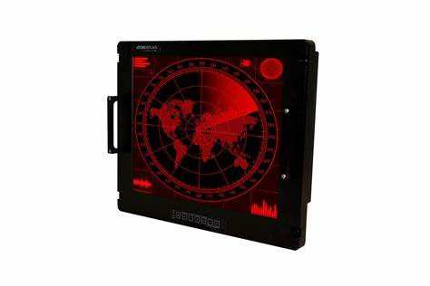
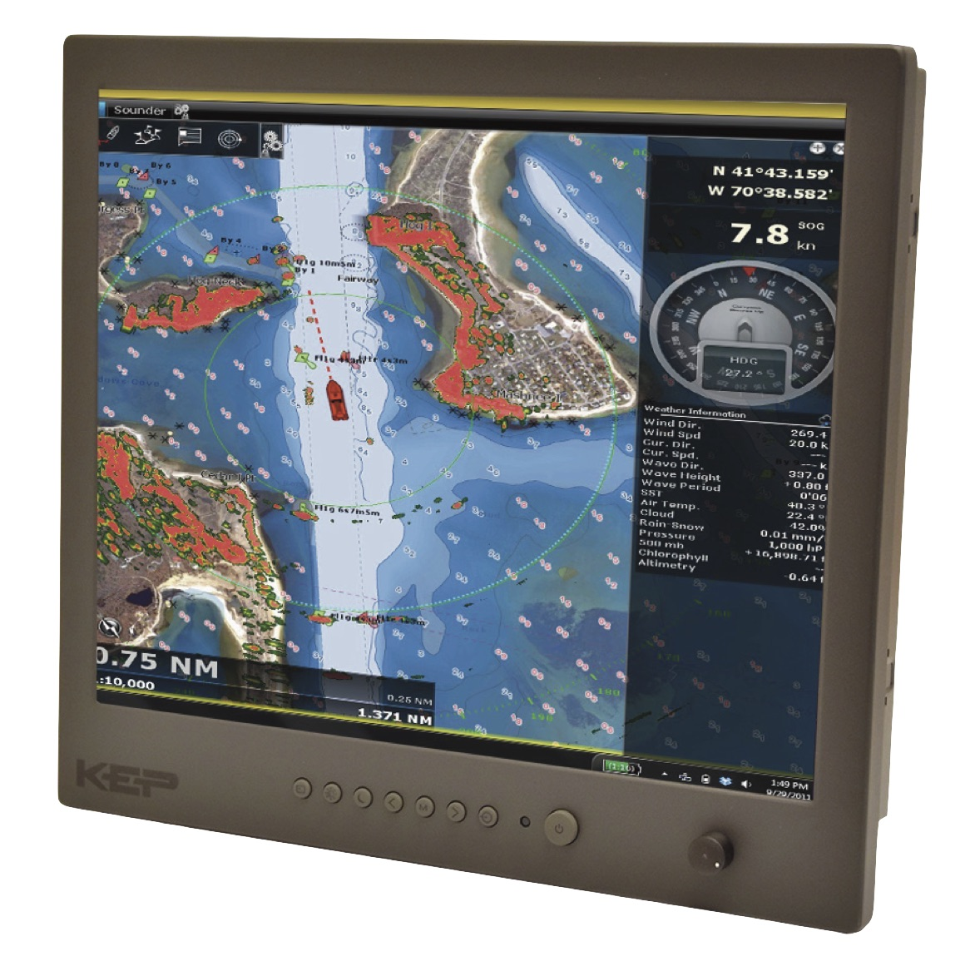
Trade Study Displays
Aydin Displays 19" Rugged COTS Smart Display
Designed for shipboard, airborne, and ground mobile environments.
Optional 28 VDC power and fiber Ethernet.

Slide 11
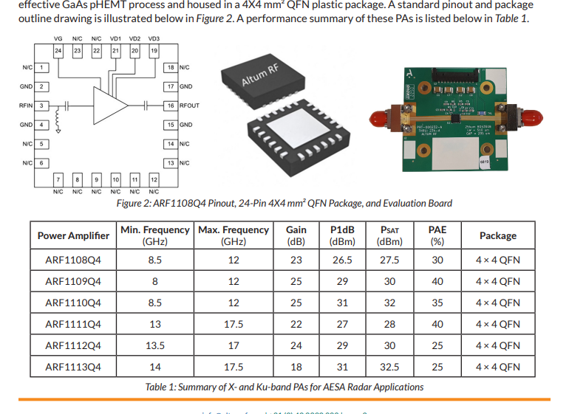
Trade Study AESA radar
Altum RF has developed a family of PAs for AESA radar at X-band (8 to 12 GHz) and Ku-band (13.5 to 17.5 GHz) with saturated output power in the 0.5W to 2W range. These PAs are highly effcient and meet the thermal and ruggedness requirements for AESA radar applications. These PAs are fabricated using a high-performance, costeffective GaAs pHEMT process and housed in a 4X4 mm² QFN plastic package. A standard pinout and package outline drawing is illustrated below in Figure 2. A performance summary of these PAs is listed below in Table 1

Slide 12
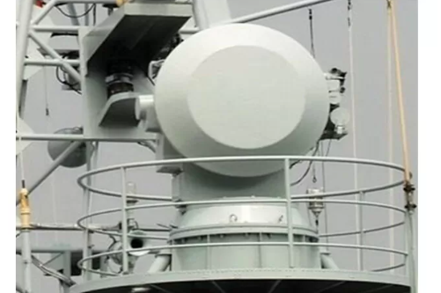
Trade Study / Ground Based Radar Systems
Monopulse Automatic Tracking Surveillance Maritime / Ground Based Radar Systems
Auto detection and tracking sea-surface or air targets
Auto switch to multi-sensors tracking under electronic jamming
Precisely 3D tracking data
Mounted on any sea or ground platform for medium and short range air-defense

Slide 13
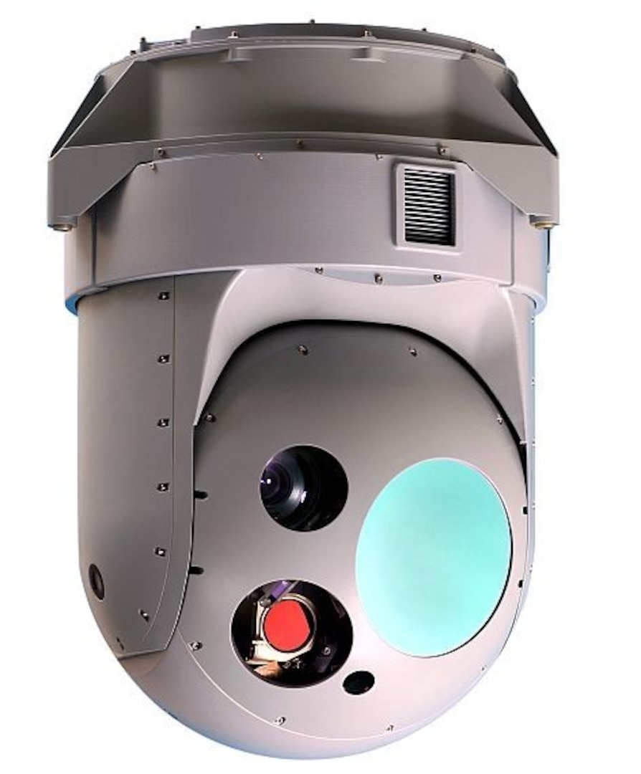
Trade Study Systems Airborne Infrared
JHS640-240P4 Eo Ir Systems Airborne Infrared Optical Multi - Sensor High Stability
Detection, Recognition and Recognition of Designated Targets Day and Night
Multiple Tracking Algorithms, Real-time Acquisition and Reporting of Target Location
High Precision Gyro Stabilization
Optional built-in IMU provides carrier-to-frame attitude
Wireless transmission

Slide 14
Technical Performance Measures (TPM)
TPM | Definition | Measurement Method | Use to Track Maturity | Status
Detection Range | Maximum distance for accurate detection | Lab and field tests | Prototype, mid-phase validation, final tests | In Progress
Accuracy | Match between measurements and reference values | Controlled test objects | Benchmark, refinement, operational validation | In Progress
Response Time | Time for detection and processing | Time-stamped events | Circuit validation, optimization, live testing | Achieved
Environmental Resilience | Functionality in harsh conditions | MIL-STD tests | Simulations, lab tests, field testing | Testing
Power Efficiency | Power usage during operation | Mode-based power measurement | Comparison, optimization, deployment validation | In Progress
False Positives/Negatives | Error rates in detection | Controlled scenarios | Algorithm validation, system integration | Testing
Integration Compatibility | Ease of integration with existing systems | Interface and protocol tests | Design, system integration, final validation | Planned
Reliability (MTBF) | Operational time between failures | Accelerated life testing | Component analysis, operational validation | Planned
SWaP | Size, weight, and power constraints | Physical measurement and analysis | Design, prototyping, operational testing | Achieved
Cost | Total development and operational cost | Budget tracking | Trade studies, prototyping, production validation | In Progress

Slide 15
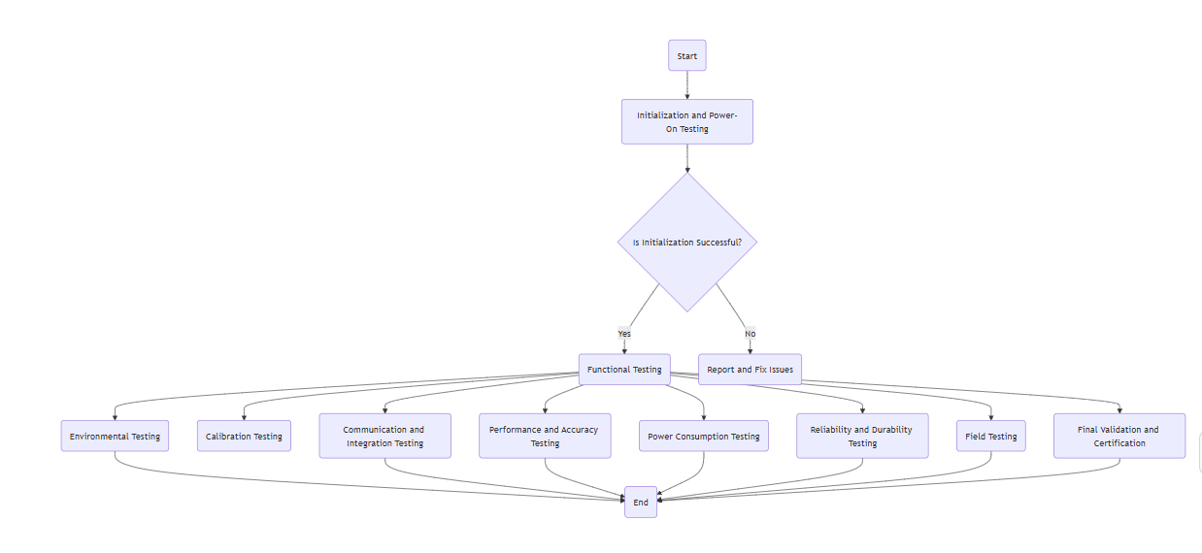
Test Flow Initialization and Power-On Testing

Slide 16
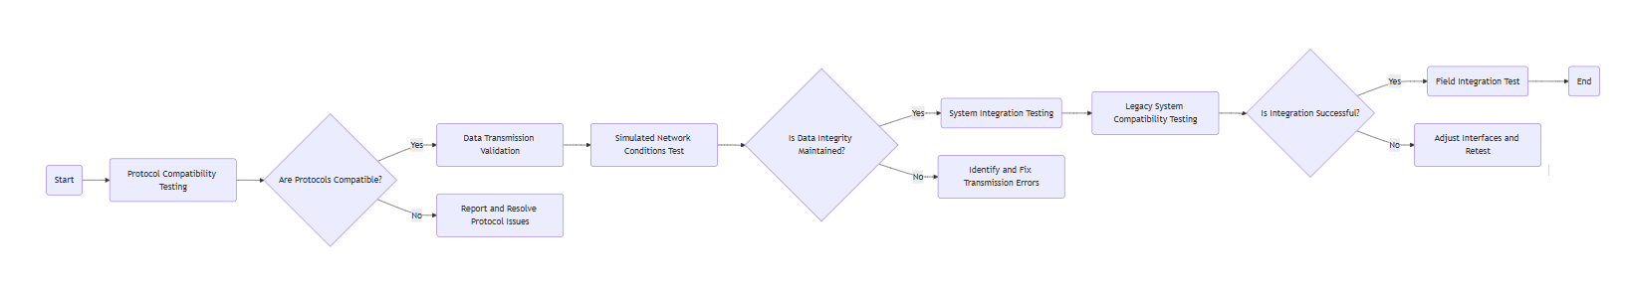
Test Flow Communication and Integration

Slide 17
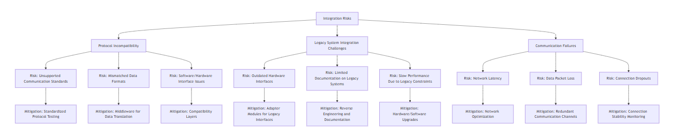
Risk Analysis in Integration Risks Sensor upgrade Integration

Slide 18
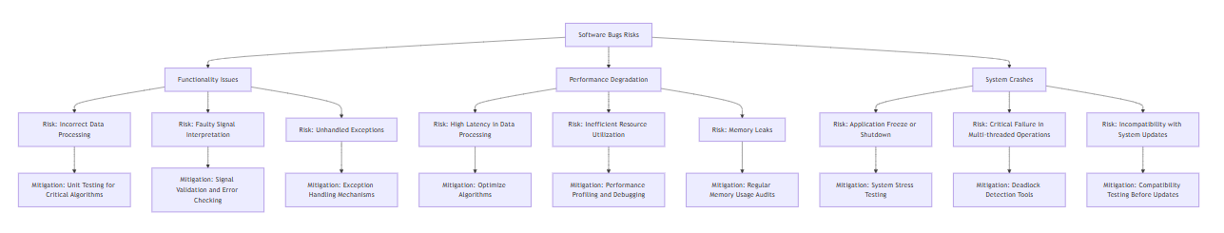
Risk Analysis Sensor Upgrade for Software Bugs

Slide 19
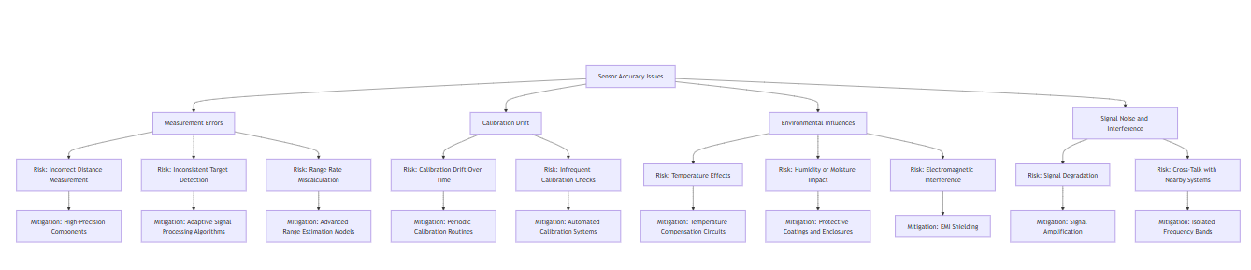
Risk Analysis Sensor Upgrade for Sensor Accuracy Issues

Slide 20
Program Schedule
Task ID | Task Name | Start Date | End Date | Duration (Days) | Milestone
1 | Project Initiation | 1/1/2025 | 1/14/2025 | 14 | Project Start
2 | Requirement Analysis | 1/15/2025 | 1/31/2025 | 16 | Requirements Finalized
3 | System Design | 2/1/2025 | 2/28/2025 | 28 | System Design Complete
4 | Sensor Prototype Development | 3/1/2025 | 3/31/2025 | 31 | Prototype Complete
5 | Initial Testing and Debugging | 4/1/2025 | 4/30/2025 | 30 | Initial Testing Complete
6 | Integration with Legacy Systems | 5/1/2025 | 5/31/2025 | 31 | Integration Ready
7 | Environmental and Stress Testing | 6/1/2025 | 6/30/2025 | 30 | Stress Testing Complete
8 | Final System Validation | 7/1/2025 | 7/31/2025 | 31 | System Validated
9 | Field Deployment | 8/1/2025 | 8/31/2025 | 30 | Deployed
10 | Project Closure | 9/1/2025 | 9/15/2025 | 15 | Project Complete

Slide 21
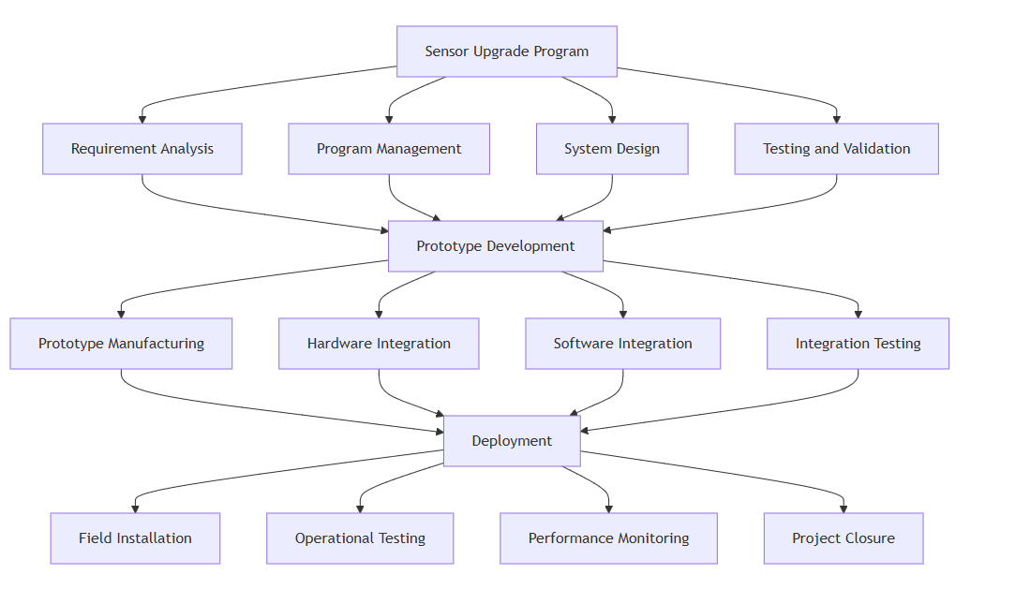
Work Breakdown Structure (WBS) for the Sensor Upgrade Software Program

Slide 22
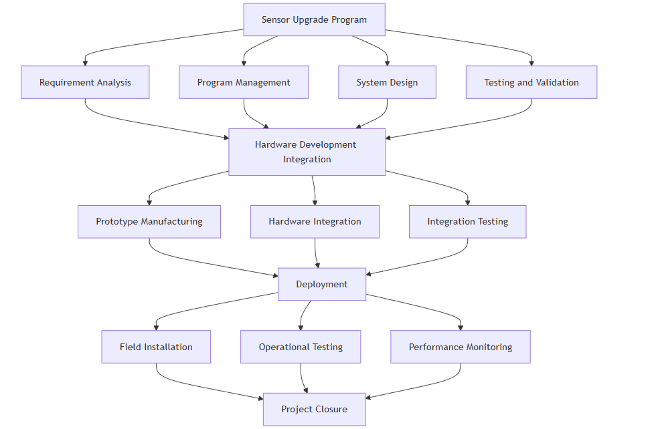
Work Breakdown Structure (WBS) for the Sensor Upgrade Hardware Program

