Slide 1
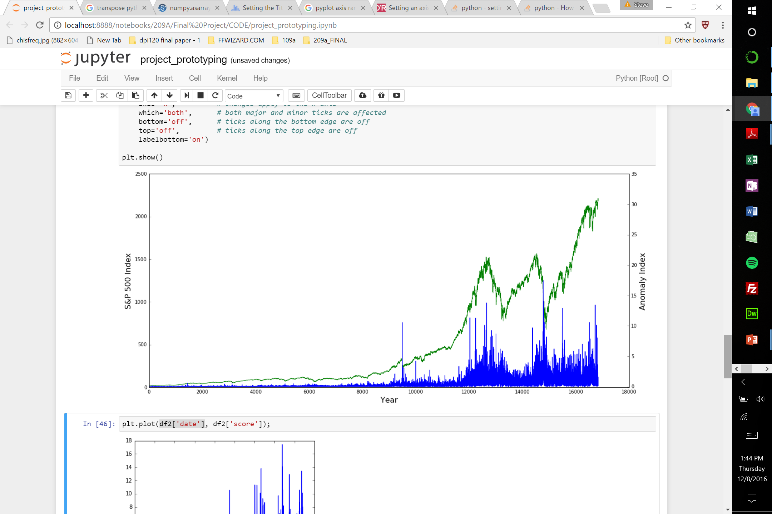
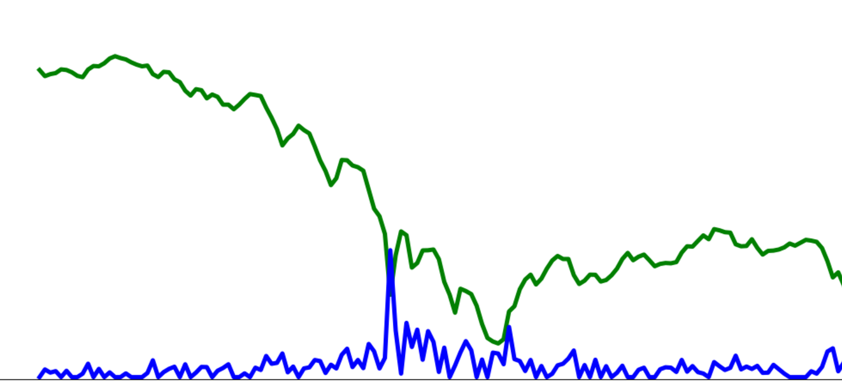
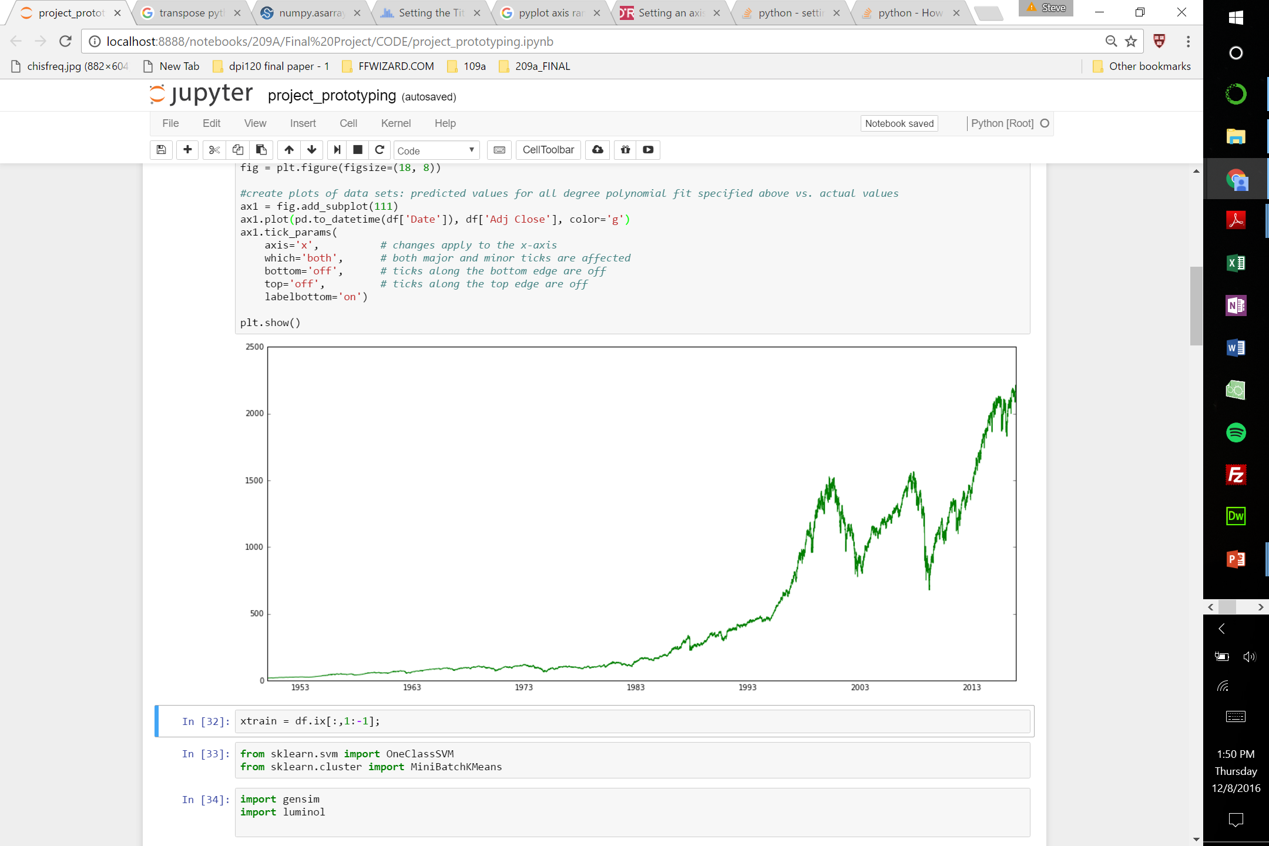
S&P Index and Anomaly Index over Time
Brexit
Great Recession
Dot-com Bubble
Cuban Missile Crisis
Crash of 1987
Year

