Slide 1

Cloud Wars Go Global!
MIS 6363 CLOUD COMPUTING FUNDAMENTALS
SHREENIDHI SRIRAM

Slide 2
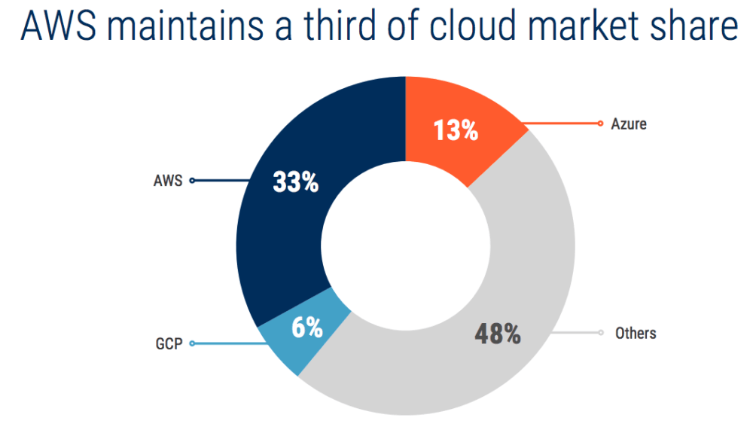
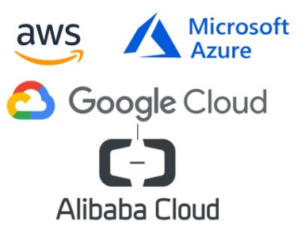
INTERESTING FACTS IN THE CASE!
AWS, the Early Winner of the race, has been dominating the Market Share, maintaining a third of the Market share since the birth of the Cloud Industry.
The Global Public Cloud Market is forecast to grow from $182.4 billion (in 2018) to $331.2 billion (in 2022), a compound annual growth rate of 12.6%.
Microsoft’s Strategy: Targeting all the Retailers (Walgreens, ASOS, Bemol, etc) who avoided Amazon and all its subsidiaries, as it was their “Competition in the Retail Sector.”
Analysts predicted that Google would gain share over time, with companies choosing GCP over AWS and Azure for its “Lower Pricing and Higher Speed of upto 10tbps.”

Slide 3
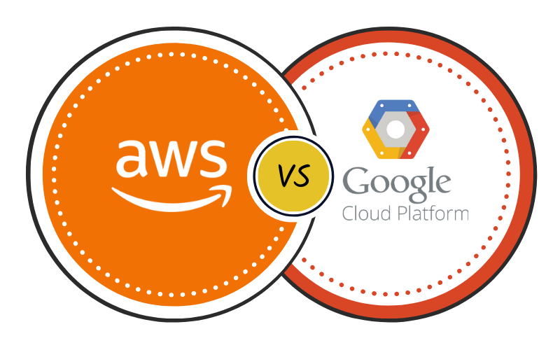
COMPETITIVE ADVANTAGES FOR EACH SERVICE PROVIDER
AWS
GCP
AWS storage’s greatest competitive advantage has become its capacity to cut storage expenses for its users through scale.
AWS is the market leader in the IaaS and PaaS categories, the highest growing segments in the cloud services industry.
The costs for developing and constantly updating cloud technologies and infrastructure form a barrier to entry for competitors, with even giants like Google struggling to keep the pace.
Dominant in many features like configuration, monitoring, security and others.
Extensive, mature offerings
Enterprise-friendly services
Global reach
Google is the master of big data and AI - If your use case involves really ridiculously large amounts of data, Google Cloud is the best place to run it.
Open source support and portability.
Discounts & flexible contracts - Google cloud beats AWS in its price and flexibility. Charges per minute, while others are for an hour.
DevOps expertise.

Slide 4
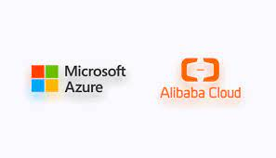
COMPETITIVE ADVANTAGES FOR EACH SERVICE PROVIDER
Microsoft Azure
Alibaba Cloud
Scalability - uitable for both small and established firms and easily scalable to match your IT requirements.
Security, compliance, and disaster recovery - Offers numerous compliance certifications, is a leading choice for cloud services in high-risk industries such as health care and government, has multi-factor authentication and advanced disaster recovery capabilities that can restore data in a matter of hours.
Integration Capabilities and Mobile Workforce - Apart from the Azure Active Directory (AD) as an access management system, the platform also provides advanced integrations with third-party solutions via an API (Application Programming Interface) and direct integration with Office365.
Location - China. China is by far the largest Internet market in the world, with 560 million users spending 20 hours a week online—twice the size of the US market. China, in particular, is eschewing traditional shopping in favor of e-commerce.
Economies of scope - Cost savings associated with a single firm selling multiple items using the same sales channels. Alibaba has two shopping sites: Taobao, which sells thousands of non-brand name products from unknown merchants, and Tmall, which sells brand name products.
Networking - Alibaba is a type of "collective entrepreneurship" that involves the corporation and thousands of merchants who join the network; Alibaba provides the platform, while the merchants provide the goods.
VS

Slide 5

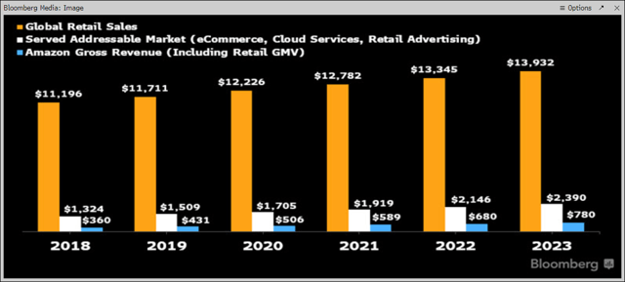
Which service provider will have the highest growth rate during the next two years? Why?
Amazon Web Services Revenue rose from around $35 billion in 2019 to about $62 billion in 2021. Trefis expects the metric to rise to over $80 billion in 2022 and to about $101 billion in 2023.
Over 165 fully featured services, over 40 of which were not available anywhere else.
Growth to be driven by rising demand for web services, as companies look to cut their IT infrastructure costs.
Moreover, growth in online media and e-commerce could also drive AWS revenues.

Slide 6
THANK YOU!

