Slide 1

MIS 6363 CLOUD COMPUTING FUNDAMENTALS
PING AN:
HOW A CHINESE FIRM BECAME A TECH GIANT
SHREENIDHI SRIRAM

Slide 2

Ping An’s Digital Technologies
~ Ping An : Banking & insurance Sectors - Offers small & medium sized loans for micro businesses ~
OneConnect (FinTech): Cloud-model based on a Modular Architecture - No need to redevelop systems for each client.
Facial Recognition (FR) Technology: Match each person with their photo and data from the biometric chip from Passport (99.8% Accuracy)
BlockChain Technology: Able to Automate Transactions.
Dedicated IT Team & Tech Capabilities: 50% of Staff Members being IT Experts.
RESULT: Raised $750 Million in Financing (2018), Listed on the New York Stock Exchange (2019), giving it a valuation of $7 Billion - 36.9% Shares of Ping An

Slide 3
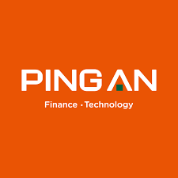
How Ping An differentiated itself from its competitors
Actively innovating outside of established business environments
Creating consumer experiences that are efficient, relevant, and consistent.
Deploying homegrown digital technique to achieve operational excellence

Slide 4


How Ping An's strategic assets differ from those of a Traditional Financial Institution
Ping An possessed strategic assets that differed from those of a typical banking institution since it was an early user of innovative technology.
Ping An started investing in cloud technology to provide standardized middleware such as cloud servers and storage and technology solutions for financial, medical, and governmental institutions.
Ping An's key assets supplied end-to-end solutions for security applications, like face recognition technology for authentication and blockchain technology for financial transaction automation.

Slide 5

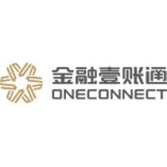
Would you declare OneConnect
a success?
In December 2015, a fintech offshoot was launched to address the underserved market.
The company had filed 4,327 patent applications as of June 30, 2020.
It provided services to 99 percent of the city's commercial banks and 53% of the insurance companies.
Employees at Ping An did not accept it at first, until OneConnect was listed on the stock exchange.
In less than a year, OneConnect had more than doubled its market capitalization.
Key elements of contribution
Facial Recognition Technology - Efficient with an accuracy rate of 99.8%
IT team - Established its own IT team and technological capabilities. By 2020, more than half of the company's employees constituted of IT professionals.
Blockchain Technology - Integrated into the financial systems of several of China's major manufacturers, allowing them to more efficiently automate transactions.

Slide 6

Role of Ping An's Senior Management Team
Expansion Strategy for Overseas Markets: Globally and plan of setting up in Southeast Asia, rather than the US.
Established its subsidiaries: Regions like Singapore, Indonesia, and Hong Kong (2019).
Successful Spinoffs: Brought outside investors in the early stages of new start-ups.
Financial Indicators: Made use of KPIs and own industry and company-specific management methods.

Slide 7
THANK YOU!

