Slide 1
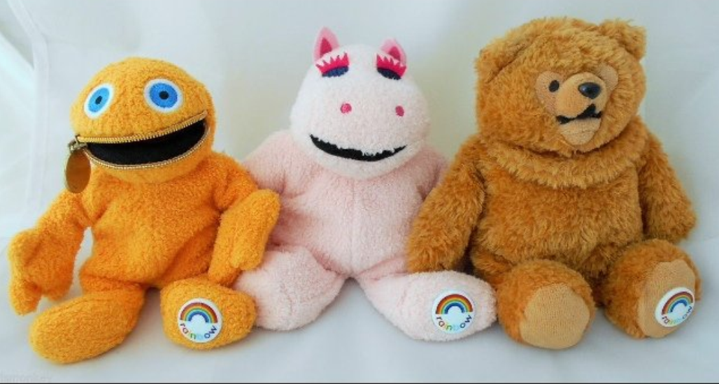
???
W3
???
32.
32.
N51

