Slide 1

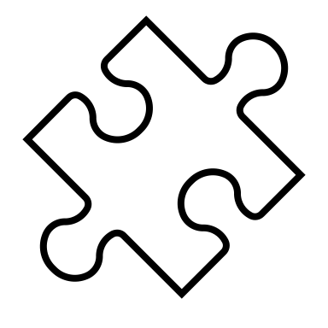
About AP Environmental Science
Take the Practice Test
View Units

