Slide 1
Generative AI and NLP: Evolution and Key Models Exploring the Journey from Naive Bayes to Transformers Sampann Nigam 13 Nov 2024

Slide 2
Introduction to Generative AI
What is Generative AI? Definition: Generative AI refers to algorithms that generate new content (text, images, videos) by learning patterns from existing data
Applications: Text generation (ChatGPT), image creation (DALL-E), music composition.
Significance: Revolutionizing industries like healthcare, entertainment, and education.

Slide 3
Evolution of Generative AI
Timeline of Key Milestones:
1950s–1960s: Rule-based systems like ELIZA (1966)
1990s–2000s: Probabilistic models, Bayesian networks
2010s–Present: Deep learning, GANs (2014), Transformer models (2017), GPT series (2018+)
2020s: Large-scale models like GPT-4 and diffusion models

Slide 4
Understanding Natural Language Processing
What is NLP?
Definition: NLP enables machines to understand, interpret, and generate human language.
Importance in AI: Powers applications like machine translation, chatbots, sentiment analysis.
NLP is foundational for LLMs (Large Language Models) and generative AI tools like ChatGPT

Slide 5
Key Concepts in NLP Evolution
Naive Bayes Classifier: Early statistical model for text classification.
Simple yet effective for tasks like spam detection.
Topic Modelling: Techniques like Latent Dirichlet Allocation (LDA) help discover hidden topics in large text datasets.
Word Embedding: Word2Vec introduced vector representations of words based on context, improving semantic understanding.
King – Man + Woman = Queen

Slide 6
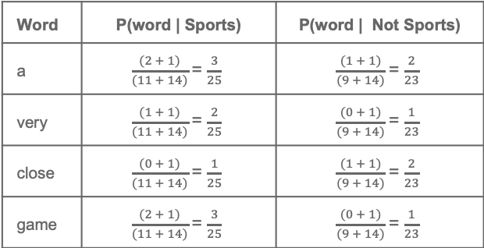
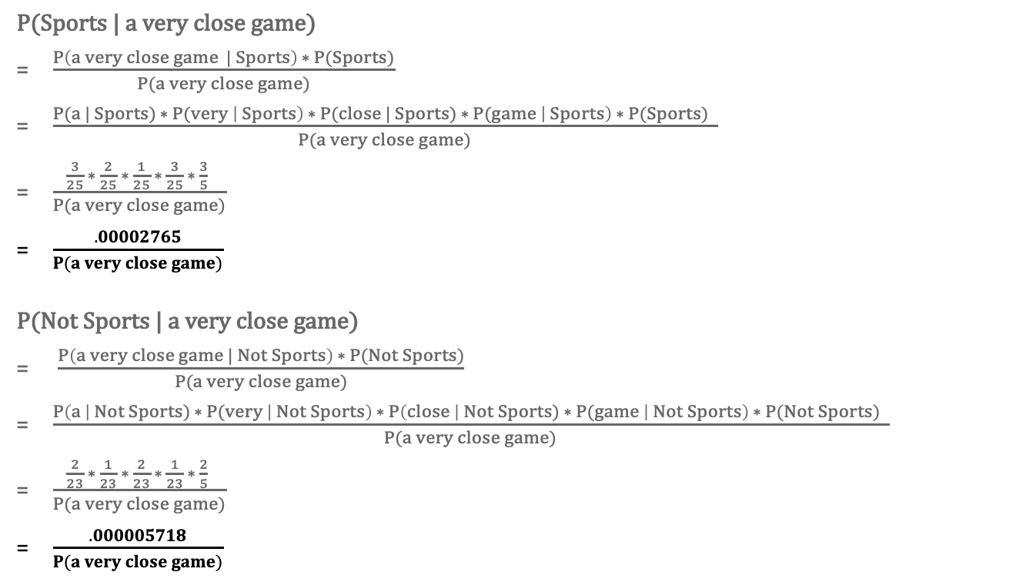
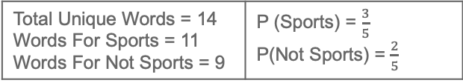
Naive Bayes Explanation
Training Data
Problem: Which Class this sentence belong? - “A very close game ”
Text | Class
“A great game” | Sports
“The election was over” | Not sports
“Very clean match” | Sports
“A clean but forgettable game” | Sports
“It was a close election” | Not sports
P(Sports | a very close game)
$\frac{P\left(a very close game | Sports\right) ∗ P(Sports)}{P(a very close game)}$
$\frac{P(a | Sports) ∗ P(very \left| Sports\right) ∗ P(close | Sports) ∗ P(game \left| Sports\right) ∗ P(Sports) }{P(a very close game)}$
$\frac{\frac{3}{25} ∗ \frac{2}{25} ∗ \frac{1}{25} ∗ \frac{3}{25} ∗ \frac{3}{5} }{P(a very close game)}$
$\frac{.00002765}{P(a very close game)}$
P(Not Sports | a very close game)
$\frac{P\left(a very close game | Not Sports\right) ∗ P(Not Sports)}{P(a very close game)}$
$\frac{P\left(a \right| Not Sports) ∗ P(very \left| Not Sports\right) ∗ P\left(close \right| Not Sports) ∗ P(game \left| Not Sports\right) ∗ P(Not Sports) }{P(a very close game)}$
$\frac{\frac{2}{23} ∗ \frac{1}{23} ∗ \frac{2}{23} ∗ \frac{1}{23} ∗ \frac{2}{5} }{P(a very close game)}$
$\frac{.000005718}{P(a very close game)}$
Total Unique Words = 14 Words For Sports = 11 Words For Not Sports = 9 | P (Sports) = $\frac{3}{5}$ P(Not Sports) = $\frac{2}{5}$
Word | P(word | Sports) | P(word | Not Sports)
a | $\frac{(2 + 1)}{(11 + 14)}$= $\frac{3}{25}$ | $\frac{(1 + 1)}{(9 + 14)}$= $\frac{2}{23}$
very | $\frac{(1 + 1)}{(11 + 14)}$= $\frac{2}{25}$ | $\frac{(0 + 1)}{(9 + 14)}$= $\frac{1}{23}$
close | $\frac{(0 + 1)}{(11 + 14)}$= $\frac{1}{25}$ | $\frac{(1 + 1)}{(9 + 14)}$= $\frac{2}{23}$
game | $\frac{(2 + 1)}{(11 + 14)}$= $\frac{3}{25}$ | $\frac{(0 + 1)}{(9 + 14)}$= $\frac{1}{23}$
Laplace Smoothing: 1 added into numerators and 14 into denominators, to avoid 0 probabilities
Prediction: “A very close game ” belongs to class Sports

Slide 7
From RNN to Transformer Models
RNN (Recurrent Neural Networks): Used for sequential data processing but limited by vanishing gradients
LSTM (Long Short-Term Memory): Improved RNN architecture to handle long-term dependencies in text sequences
Transformer Models (2017): Revolutionized NLP with self-attention mechanisms allowing parallel processing of words8

Slide 8
BERT – Bidirectional Encoder Representations from Transformers
What is BERT? A transformer-based model developed by Google in 2018
https://medium.com/analytics-vidhya/introduction-to-bert-f9aa4075cf4f
Key Features: Bidirectional understanding of text by considering both left and right contexts simultaneously.
Training Process: Pre-trained on large datasets using Masked Language Modeling (MLM) and Next Sentence Prediction (NSP)
Applications: Question answering, sentiment analysis, named entity recognition

Slide 9
ChatGPT – A Breakthrough in Conversational AI
What is ChatGPT? Developed by OpenAI, ChatGPT is a generative language model based on the GPT architecture
How it Works: Uses transformer architecture to predict next words in a sequence based on context.
Reinforcement Learning with Human Feedback (RLHF): Fine-tuned using human feedback to improve conversational accuracy and relevance
Applications: Customer service automation, content generation, tutoring systems.

Slide 10
Comparison of BERT vs. ChatGPT
Feature | BERT | ChatGPT
Purpose | Understanding language context | Generating human-like conversations
Training | Bidirectional with MLM & NSP | Autoregressive with RLHF
Applications | Sentiment analysis, NER, QA | Text generation, dialogue systems
Model Type | Encoder-only transformer | Decoder-focused transformer

Slide 11
Conclusion & Future Trends
Summary of Key Points: Generative AI has evolved from simple rule-based systems to advanced neural networks.
NLP has progressed from Naive Bayes classifiers to sophisticated transformer models like BERT and GPT.
Future Trends: Multimodal models combining text, image, and video generation.
More personalized AI interactions through memory features in tools like ChatGPT

Slide 12
QA with context (RAG)
PDF Docs
Text Chunks
Vector Database
Lang chain Splitter
Embeddings for text chunks
Question
Sentence Embeddings
User
Similarity Check
Question Embedding
Question
Relevant Text Chunks + Metadata
BERT (LLM)
Answer to the Question
Sources ( Relevant Text Chunk Metadata)

Slide 13
DEMO

