Slide 1

MINI PROJECT
PRESENTATION
2021-22
Department of Computer Engineering and Applications
GLA University, Mathura
Uttar Pradesh, India

Slide 2

Bookxholic
Submitted by-
Sahil Vishwakarma(191500693)
Snigdha Dhamija (191500816)

Slide 3

Contents
INTRODUCTION
- Motivation
- Main Idea
TECHNOLOGIES USED IN THIS PROJECT
- Kotlin
- XML
- Picasso
- Postman
CONTRIBUTION SUMMARY
LIVE DEMO SESSION
CONCLUSION

Slide 4

Introduction
Motivation Behind The Project:
In this cut throat competition, android app development is one of those fields that is experiencing great demand in every sector. It has gained a lot of scope in the topnotch industries.
For this, it is important to have practical knowledge of languages and build projects that can be utilized and worked upon in future and among such projects is “Bookxholic”.

Slide 5

Main Idea Behind the Project
In this digital era where people share their hobbies like dance, music etc, there comes a need to provide an open platform to all those readers who want to explore new book titles every day and share their aspects regarding a book.
This idea has led to building book-specific social media platform: Bookxholic, where people can connect over poetry, literature, blogs, articles, quotes, scriptures- writings that are worth sharing.

Slide 6
Technology
Used
Kotlin
XML
Postman
Picasso
Room

Slide 7
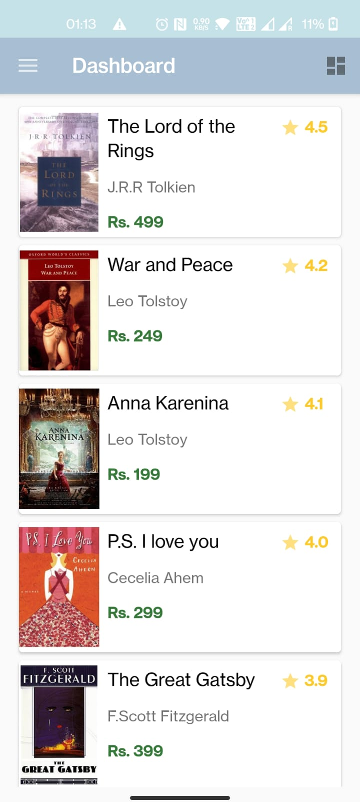
Dashboard
This is the Home Screen of the app. It contains all the list of books along with their respective details like – book name , book image, author, ratings and book price.
On the top right corner it has a sorting button , which sorts the books according to rating of the books .
On the top left corner is the hamburger menu button, which slides to open the menu drawer.

Slide 8
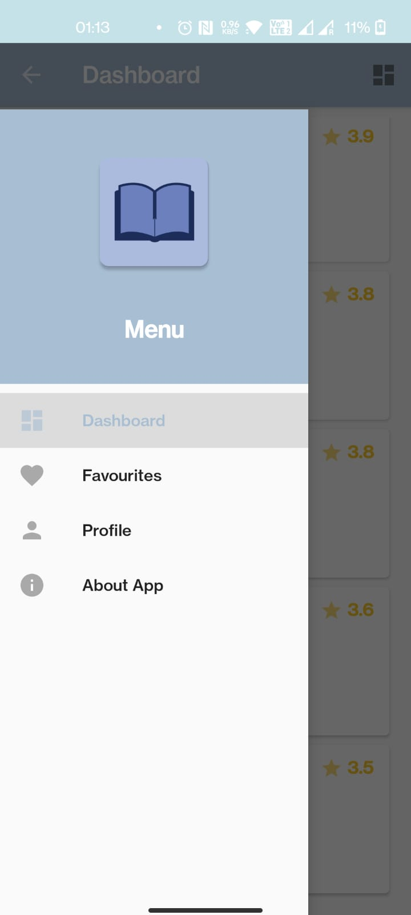
Menu Drawer
This is the menu drawer of the app which contains all the fragment like – Dashboard, Favourites, Profile and About App.
Fragments are responsible to store all the information about the user.
User can click on any of the fragments to go to the respective fragment.

Slide 9

Contribution Summary
Sahil Vishwakarma
1
Snigdha Dhamija
2

Slide 10

Conclusion
Bookxholic is a real time project which is useful for all the book lovers and readers as this helps in building a social media sort of platform where they get to explore new book titles. They can like such shareable posts and also share their own experience of reading a particular book. Classifying on a broader aspect, this platform is a hobby oriented social platform where users can discover new things in this so-called Bookxholic!

Slide 11

Thanks!
We are up for Questions!

