Slide 1

GLA University Mathura Mini Project Session – 2021-22
SW Medication

Slide 2
Developer
Tanya Agrawal
Univ. roll no. – 191500849
Shivansh Gupta
Univ. roll no. – 191500771

Slide 3
Technologies Used
HTML
CSS
JAVASCRIPT
BOOTSTRAP
Node.js
Mongodb
Figma
Font awesome

Slide 4
INTRODUCTION
Charity is an act of kindness, where a person who has financially more than enough of what he or she needs contributes a part of his or her surplus income for the fulfilment of the needs of those who are less capable. So, keeping this idea in mind we have designed this project in which we help needy to find supplies related to pharmacy products.
Getting donor is a very hard task, and sometime dealing with some donor’s conditions can be a big challenge for NGOs to fulfil it. This SW Medication (charity management system) will help to find donors easily. This system has three modules namely, Admin, Buyer and Donor.
Admin can login using credentials and manage the requests raised by buyer by approving or rejecting it. Approval will be done after verifying the buyer documents uploaded by buyer. Buyer can register and raise request by uploading their required specifications.
Once admin gets the approval, they can login using credentials. Donor can simply register and login using credentials.

Slide 5
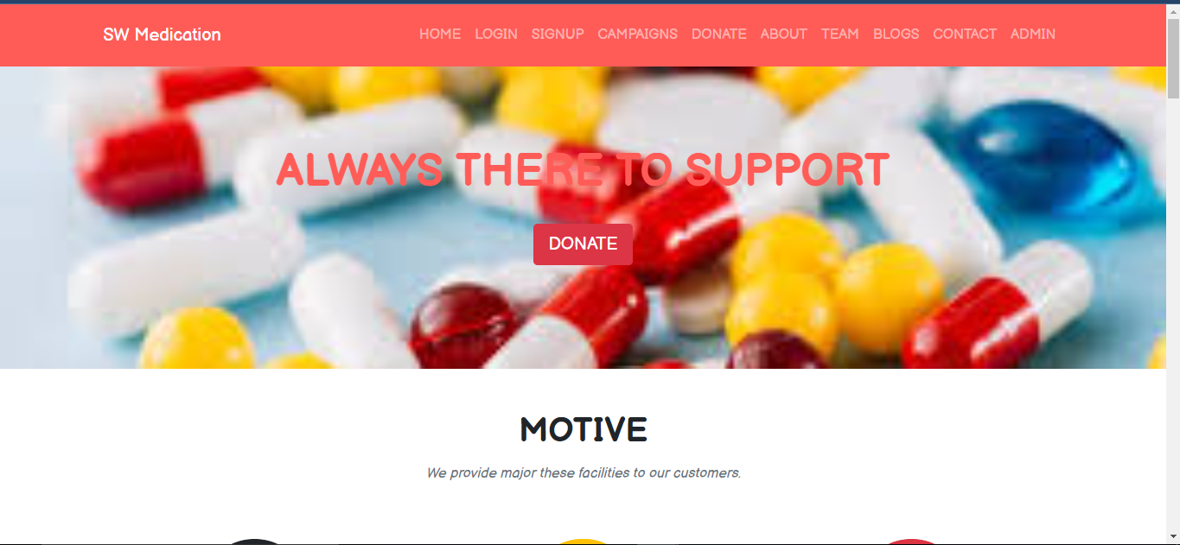
Few Glimpse

Slide 6
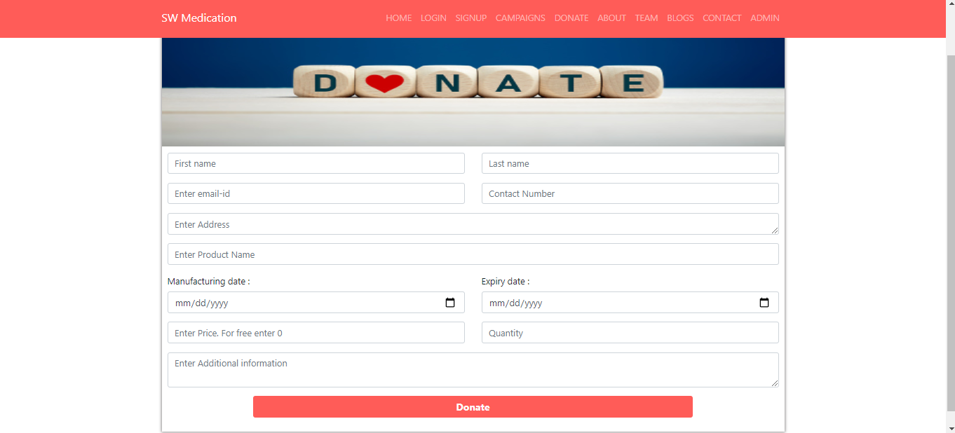
Donate page -

Slide 7
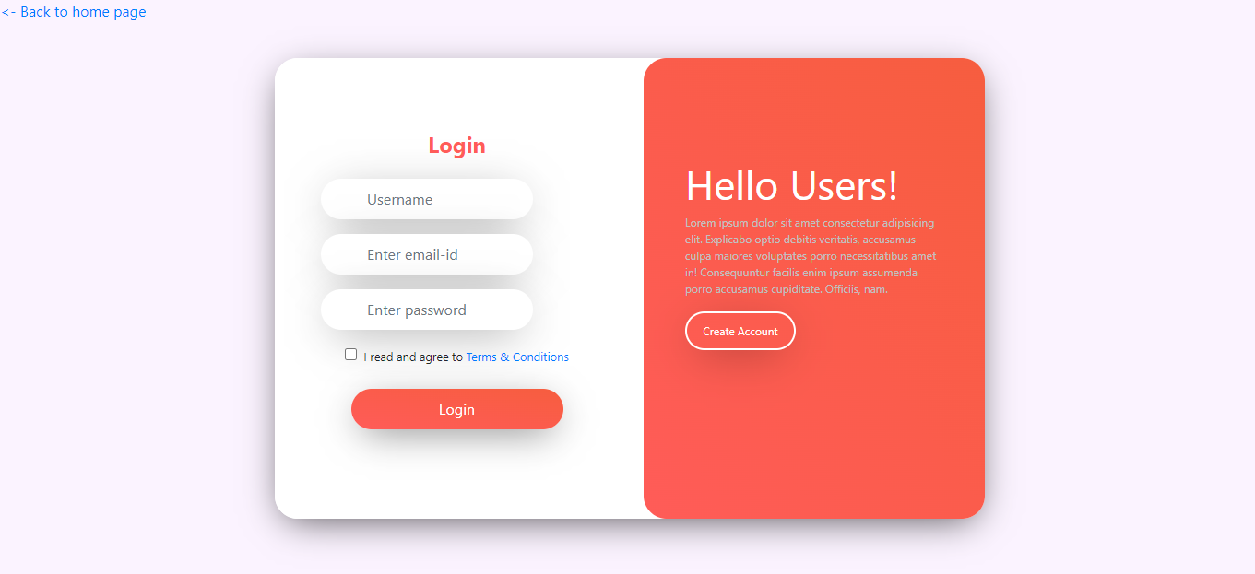
User LogIn

Slide 8
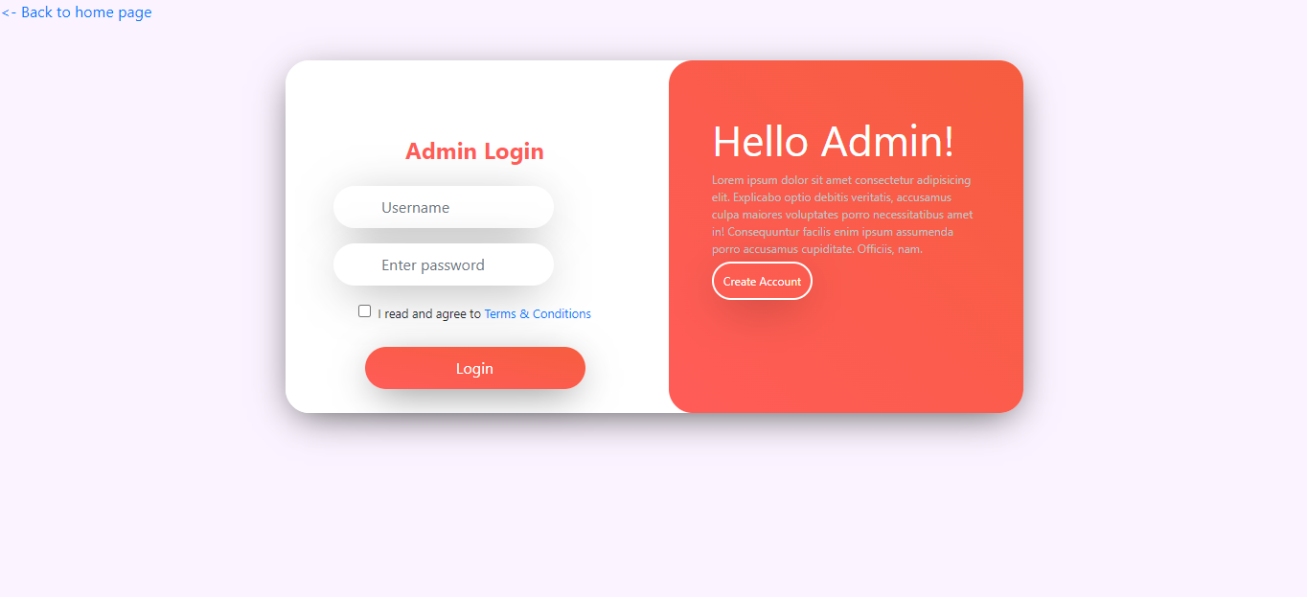
Admin login

Slide 9
Git Repository
Repository url -
https://github.com/TanyaMittal31/SW-Medication

Slide 10
Conclusion
Our website has a good range of scope in upcoming era as we have recently pass out the time of covid 19 most are the families are still affected and required the help of people who wan to donate for good , so for good of these people as website will act as helpful partner and also inspire the other people who want to help the needy ones but are hesitating in some way or other.
The further modification of the project is to create or expand in such way that it be used by everyone easily . It can be extended to more security using various levels of authentication and verification more security and privacy issues can be maintained by using various aspects .

Slide 11
References
www.beta-labs.in
https://www.w3schools.com
https://stackoverflow.com
Wikipedia
https://github.com/
udemy
YouTube

Slide 12
THANKYOU

