Slide 1
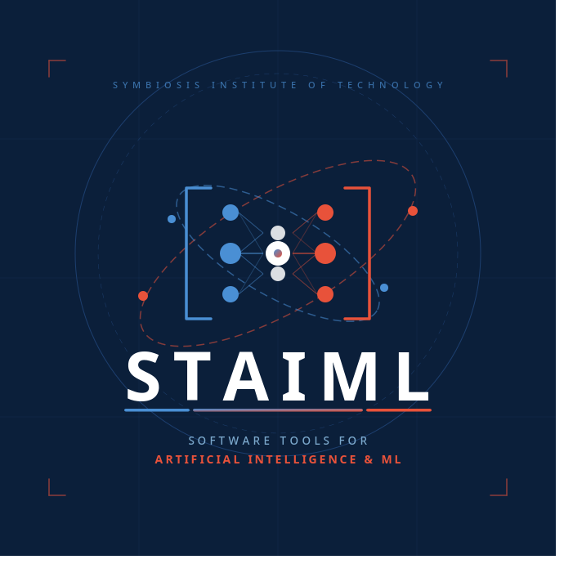
Synthetic Data Generation
and Evaluation
Using Machine Learning on the Pima Indians Diabetes Dataset
Software Tools for Artificial Intelligence and Machine Learning
Snigdha Singh · PRN: 25070126169
Shubhayu Bhattacharya · PRN: 25070126168
Shaury Tandon · PRN: 25070126162
Sohan Saha · PRN: 25070126170

Slide 2
01
Introduction
Problem motivation & objectives
Table of
Contents
Literature Survey
02
4 papers reviewed (2024–2025)
03
Methodology
8-step ML pipeline
04
Results & Visualization
Accuracy comparison & charts
STAIML Project
05
Conclusion
Key takeaways & future work
06
References
All citations & sources

Slide 3
The Problem
Healthcare data is privacy-sensitive and hard to share legally, blocking AI research.
Introduction
The Approach
Synthetic data: artificial patient records that preserve statistical patterns without exposing real individuals.
Dataset
Pima Indians Diabetes Dataset — 768 female patients, 8 clinical features, binary diabetes outcome.
Objectives
Central Question
Can a classifier train entirely on synthetic data match one trained on real patient records?
Tools
Python · pandas · numpy · scikit-learn · matplotlib · seaborn

Slide 4
Literature Survey
4 Papers Reviewed · 2024–2025
01
2024 · MDPI Electronics
02
2024 · arXiv
Systematic Review of SDG Using Generative AI
Comprehensive Exploration of SDG: A Survey
Reviewed 77 studies. GANs & LLMs most effective; privacy leakage remains a key challenge.
417 SDG models catalogued. GANs dominate for structured data; no universal evaluation metric.
03
2024 · arXiv
04
2024–25 · arXiv
Generative AI for SDG: Methods & Challenges
Machine Learning for Synthetic Data: A Review
LLMs match real data in low-resource settings; hallucination in tabular data is a critical risk.
GAN variants achieve highest fidelity. Privacy–utility tradeoff is the central unsolved problem.

Slide 5
Methodology — The 8-Step Pipeline
S1
Data Acquisition
S2
Missing Data Handling
pandas read_csv(); inspect column types & zeroes
Replace 0s with NaN in 5 columns; mean imputation
S3
Outlier Detection
S4
Univariate Analysis
IQR boxplots; Insulin shows extreme outliers (>600)
Histograms; most features right-skewed; Age 21–40
S5
Bivariate Analysis
S6
Label Encoding
Correlation heatmap; Glucose–Outcome r≈0.47; scatter
Outcome mapped to text then sklearn LabelEncoder
S7
Synthetic Data Gen.
S8
ML Training & Eval.
Gaussian sampling (μ,σ) per class; 500 rows; clipped
LR & RF trained on real vs synthetic; same test set

Slide 6
Dataset Description
Pima Indians Diabetes Dataset
768
268
500
8
Total Patients
Diabetic
Non-Diabetic
Clinical Features
Feature
Description
Normal Range
Pregnancies
Times the patient has been pregnant
0–17
Glucose
2-hour glucose tolerance test (mg/dL)
70–140
BloodPressure
Diastolic blood pressure (mm Hg)
60–80
SkinThickness
Tricep skinfold — proxy for body fat (mm)
10–40
Insulin
2-hour serum insulin (µU/ml)
16–166
BMI
Body Mass Index (kg/m²)
18.5–24.9
DiabetesPedigree
Genetic diabetes risk score
0.08–2.42
Age
Patient age (years)
21–81

Slide 7
Results & Visualizations
Outlier Detection (Boxplots)
Univariate Analysis (Histograms)
Insulin has extreme outliers (>600). DiabetesPedigreeFunction also clusters high. Other features are well-behaved.
Most features are right-skewed. Glucose closest to normal distribution. Age concentrated at 21–40.
Correlation Heatmap
Glucose vs BMI Scatter
Glucose has highest correlation with Outcome at r≈0.47. BMI and Age show moderate correlations (~0.29 and 0.24).
Diabetic patients (red) shift to upper-right. Higher glucose + higher BMI → higher diabetes risk. Classes overlap significantly.
Real vs Synthetic Distributions
Confusion Matrix — Random Forest
Strong overlap for Glucose & BloodPressure. Pregnancies matches well. SkinThickness shows a minor peak shift.
Better at identifying non-diabetic patients — expected with class imbalance (65% non-diabetic in dataset).

Slide 8
Model Accuracy: Real vs Synthetic Training Data
Logistic Regression
Real: 69.48% Synthetic: 70.13%
Nearly identical — linear patterns transferred cleanly from synthetic to real data.
Random Forest
Real: 77.92% Synthetic: 67.53%
~10 pt gap — RF captures fine-grained detail that Gaussian sampling smooths out.
Synthetic training beats random chance for both models!

Slide 9
Conclusion
01
Key Finding
Logistic Regression on synthetic data matched real-data performance. Random Forest retained a working classifier at 67.53% accuracy.
02
Method Insight
Simple Gaussian sampling — no deep learning, no specialised libraries — produced statistically valid synthetic healthcare data.
03
Practical Implication
Organisations can share statistical models instead of real patient records, enabling privacy-preserving AI research at scale.
04
Future Work
Apply CTGAN for tabular-aware synthesis · Add KL divergence & Wasserstein distance metrics · Test additional model architectures.

Slide 10
References
1
[1] N. Baowaly et al., "A Systematic Review of SDG Techniques Using Generative AI," Electronics, vol. 13, no. 17, p. 3509, MDPI, Sep. 2024.
2
[2] A. Bauer et al., "Comprehensive Exploration of Synthetic Data Generation: A Survey," arXiv:2401.02524, Feb. 2024.
3
[3] X. Guo & Y. Chen, "Generative AI for Synthetic Data Generation: Methods, Challenges and the Future," arXiv:2403.04190, Mar. 2024.
4
[4] Y. Lu et al., "Machine Learning for Synthetic Data Generation: A Review," arXiv:2302.04062, updated Apr. 2025.
5
[5] J. W. Smith et al., "Using the ADAP Learning Algorithm to Forecast Diabetes Mellitus," Proc. Symp. Comput. Appl. Med. Care, 1988, pp. 261–265.
Symbiosis Institute of Technology, Pune · STAIML Project 2025-26

Slide 11
Team
Thank
You
Snigdha Singh
Shubhayu Bhattacharya
Shaury Tandon
Sohan Saha
Under the supervision of
Dr. Priyanka Deshmukh
SIT Pune

