Slide 1
INFORMATION RETRIEVAL PROJECT
IR BASED CHATBOT
SNIGDHA-CS20MTECH11010
RAMYA B Y-CS20MTECH11008

Slide 2
PROBLEM STATEMENT
Designing IR Based Chatbot system
Given context and utterance, the task is to predict the relevant utterance for given context.

Slide 3
DESCRIPTION OF DATA
UBUNTU DIALOG CORPUS
Dataset is based on the chat logs of Ubuntu channels with each examples consisting of context and utterance.
Utterances are labeled either positive or negative.
The training data consists of 1,000,000 examples, 50% positive(label 1) and 50% negative labels(label 0).

Slide 4
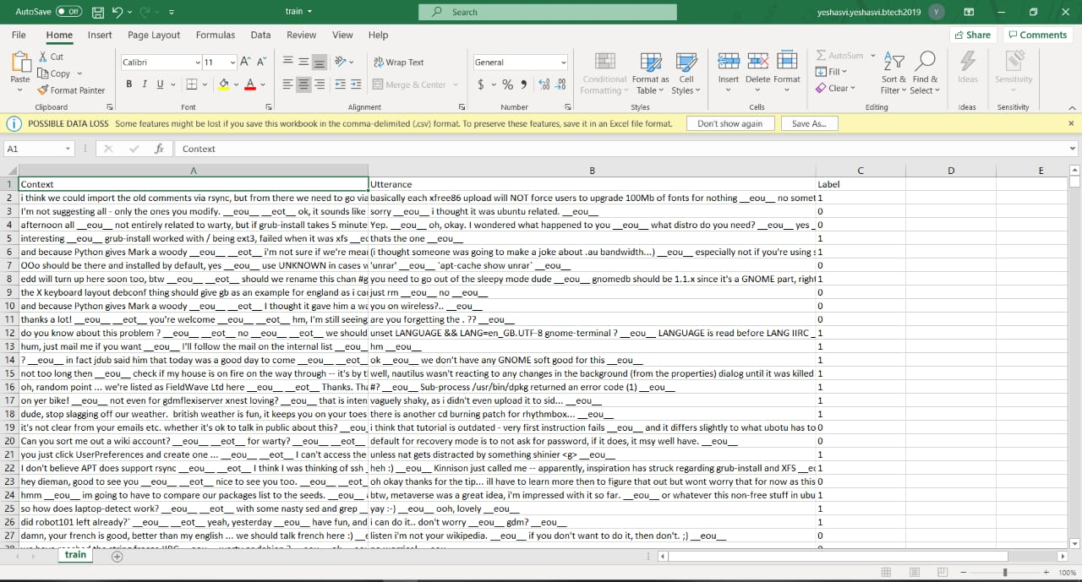
SNAPSHOTS

Slide 5
FLOWCHART
ENCODING: (Glove)
CREATING THE MODEL TO CLASSIFY DATA:(LSTM)
PREDICTION
EVALUATION

Slide 6
PRE PROCESSING
First of all to work with the given data preprocessing needs to be done.
The given data(Ubuntu Dialog corpus) was stemmed and lemmatized.
Further we removed the stopword from context and utterances.
In the later step we removed underscores and few meaningless words.

Slide 7
STEP 1: ENCODING
The context and responses are of different length so we make use of encoders to get the fixed size vector for context and utterance.
We tokenize both context and response .Here tokens represents words
Every word has to be converted into fixed size vectors.
We made use of Glove vectors to initialize the word embeddings of context and responses.
Now we have word embeddings for every word of context and responses

Slide 8
GLOVE
The basic idea behind the Glove word embedding is to derive the relationship between the words from statistics.
Its unsupervised learning algorithm to get vector representation of words.
It allows us to take a corpus of text to transform each word in the corpus to high dimension vector space

Slide 9
Step 2: Classification
Once we complete our step 1 of encoding we get output as vectors for every word of context and response.
These vector are used as input for classification.
For classification we used LSTM(Long Short Term Memory) model
Vector embedding(of words) are given as input to define the embedding layer.
This implementation of LSTM is done using Keras.

Slide 10
LSTM
The word embeddings of context and response are fed to LSTM network word by word.
Everytime we feed ,it learns the vector representation of entire text by updating the hidden layer.
At last we get two fixed length vectors of context(c) and response(r) respectively.
During training ,model will also learn matrix M.
We multiply c and M to get the predicted response.Then we concatenate the predicted response and actual response to get the similarity between them and later we applied sigmoid function to get the probability.

Slide 11
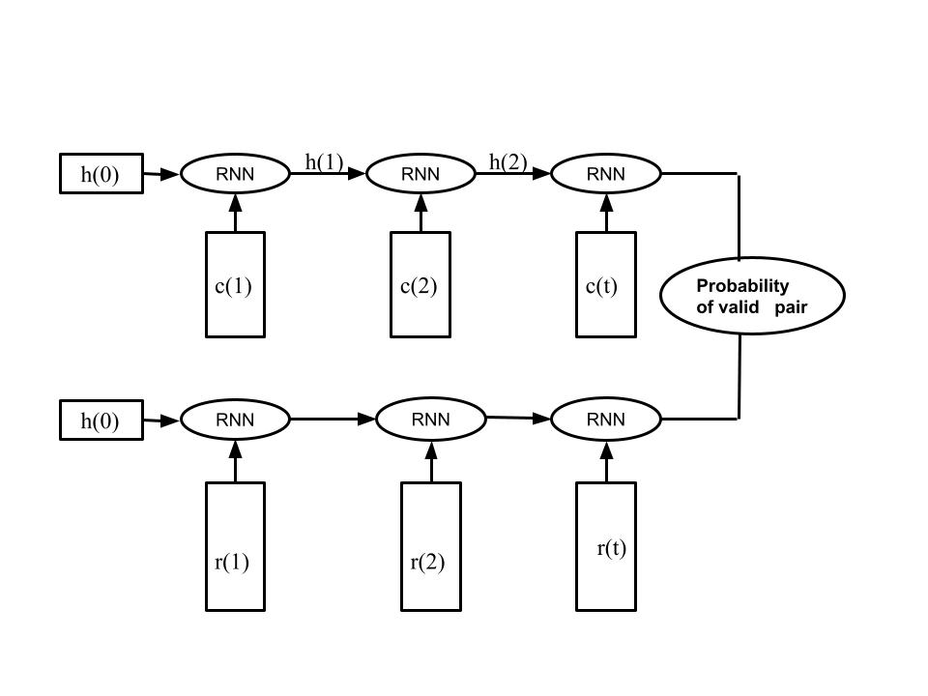
FLOWCHART OF LSTM

Slide 12
Implementation of LSTM using Keras
Its a sequential model.
First layer is the embedding layer initialized with word embedding matrix.
Next we add LSTM layer which gives context and response matrix
We concatenate the obtained matrix to find the similarity
Next we added dense layer with sigmoid activation function to get the probability.
We compiled the model with binary cross entropy loss and metrics like accuracy and recall.

Slide 13
Demo
Context | Response | Predicted Probablity
what you looking for linuxuz3r? __eou__ no i mean are you looking for a spefic program? __eou__ im not sure if there is anything better then sourceforge __eou__ __eot__ no particular program, anything that interest me then contribute to the source __eou__ i wanna learn how to read code __eou__ __eot__ | there is one that escapes me at the moment __eou__ most people use sourceforge __eou__ | 0.7910602
 | but, from what to what? Can I hook up a formerly raid'd drive via USB/SATA bridge like that? __eou__ | 0.3378635

Slide 14
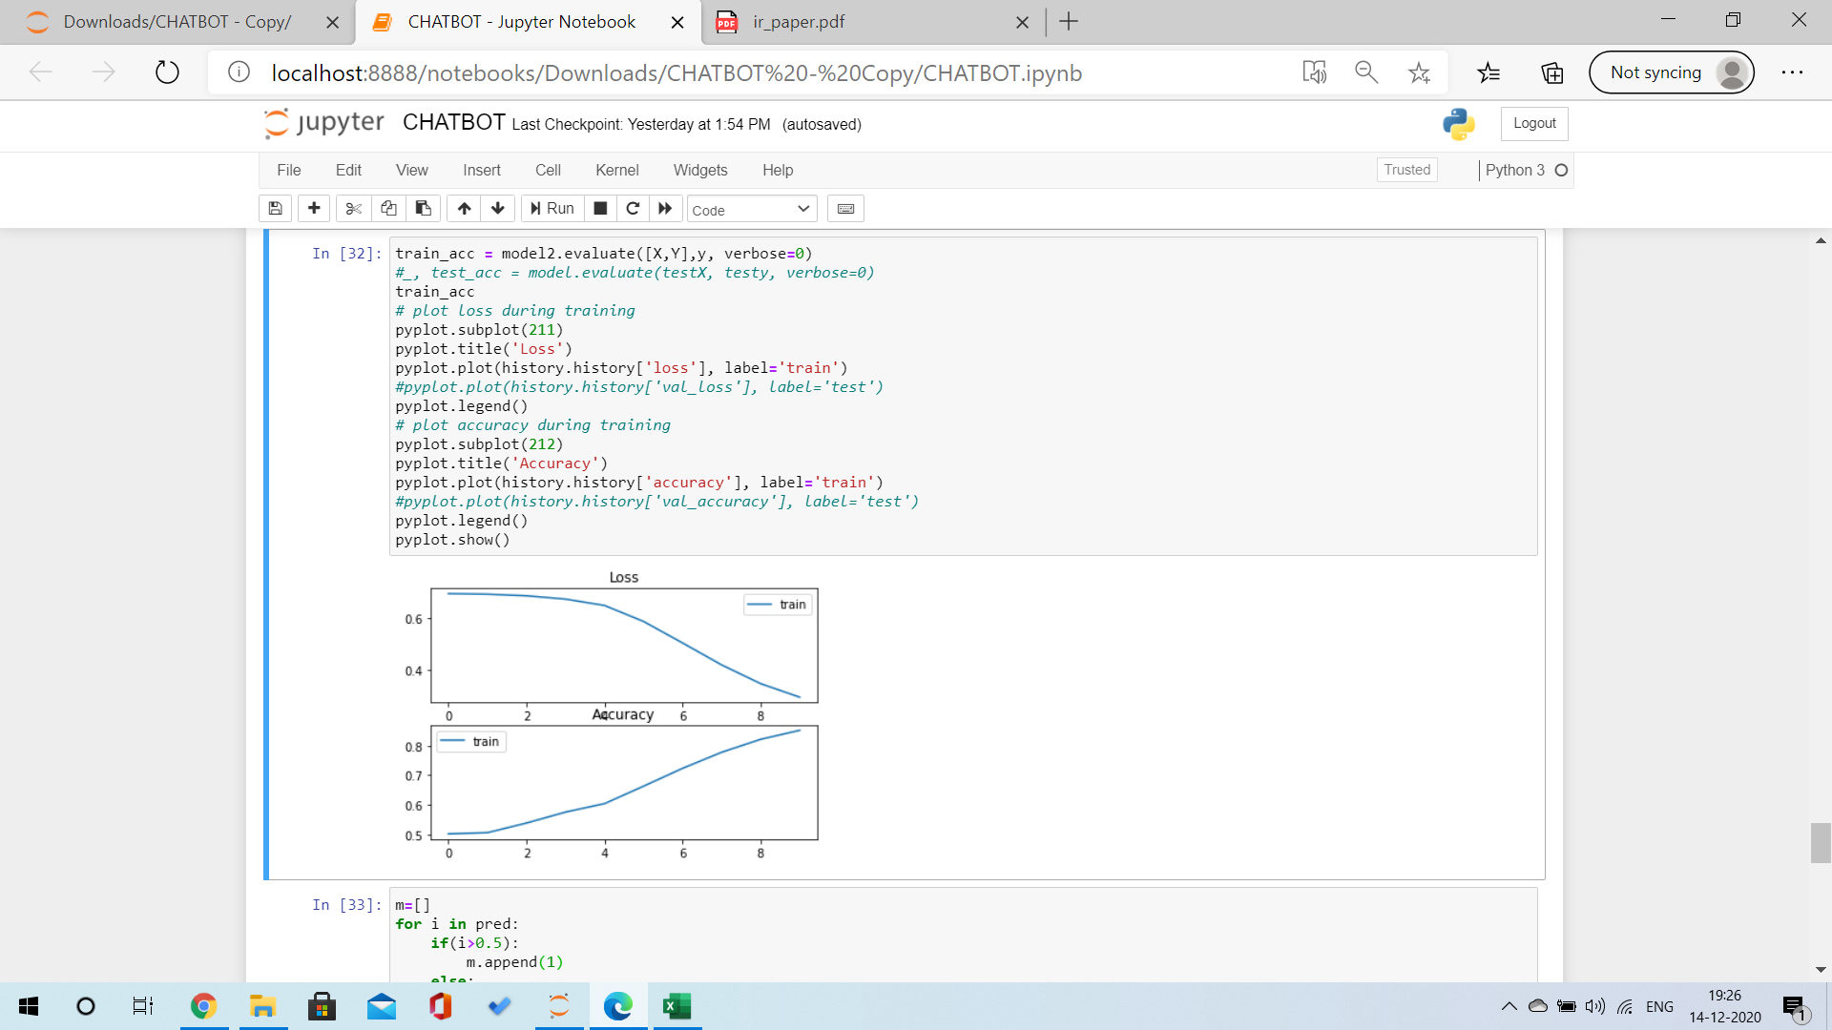
Results

Slide 15
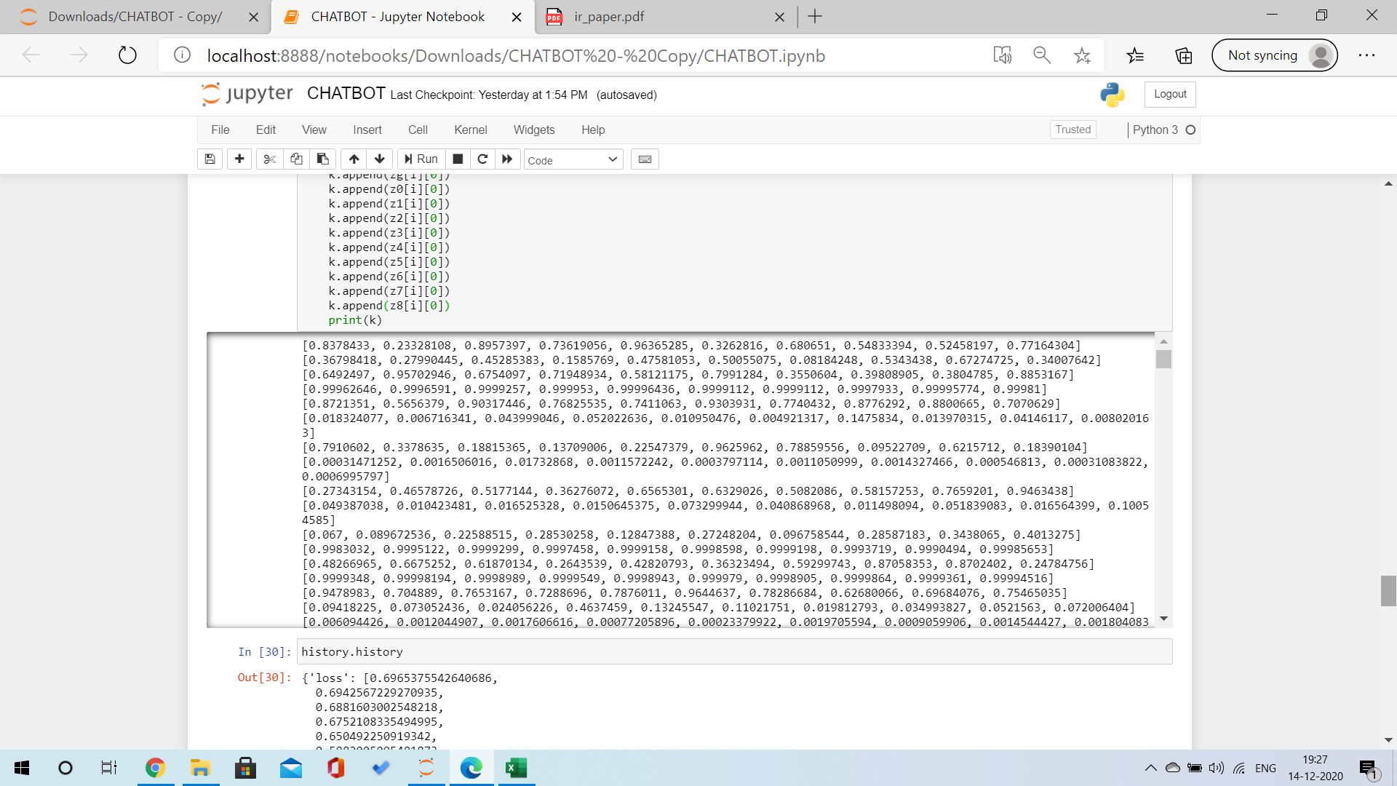

Slide 16
 | LSTM
1 in 10 R@5 | 0.49386138
1 in 10 R@6 | 0.5881188
1 in 10 R@7 | 0.6990099
1 in 10 R@8 | 0.8019802

Slide 17
REFERENCES
Research paper:An Information Retrieval-based Approach for Building Intuitive Chatbots for Large Knowledge Bases -Andreas Lommatzsch and Jonas Katins TU Berlin, DAI-Labor, Ernst-Reuter-Platz 7, D-10587 Berlin, Germany
Other references:
http://www.wildml.com/2016/07/deep-learning-for-chatbots-2-retrieval-based-model-tensorflow/

Slide 18
https://www.analyticsvidhya.com/blog/2020/03/pretrained-word-embeddings-nlp/
https://www.kaggle.com/sbongo/do-pretrained-embeddings-give-you-the-extra-edge
https://www.kaggle.com/lystdo/lstm-with-word2vec-embeddings
https://basmaboussaha.wordpress.com/2017/10/18/implementation-of-dual-encoder-using-keras/#comments
http://www.wildml.com/2016/07/deep-learning-for-chatbots-2-retrieval-based-model-tensorflow/
https://medium.com/analytics-vidhya/basics-of-using-pre-trained-glove-vectors-in-python-d38905f356db
https://towardsdatascience.com/understanding-lstm-and-its-quick-implementation-in-keras-for-sentiment-analysis-af410fd85b47
https://towardsdatascience.com/neural-network-embeddings-explained-4d028e6f0526

