Slide 1
DuoLink🔗
Snigdha Bose and Kshitij Srivastava

Slide 2
Motivation
Key Issues:
Unexpected Failures: Hardware faults, configuration errors, and security breaches.
Network Congestion: Traffic spikes leading to degraded performance.
Security Threats: Increasingly sophisticated attacks requiring swift action.
Reactive vs Predictive vs Proactive:
Reactive Management: Addresses issues after they occur, leading to downtime and user dissatisfaction.
Predictive Management: Forecasts issues but may not prevent them proactively.
Proactive Management: Anticipates and acts to prevent issues.

Slide 3
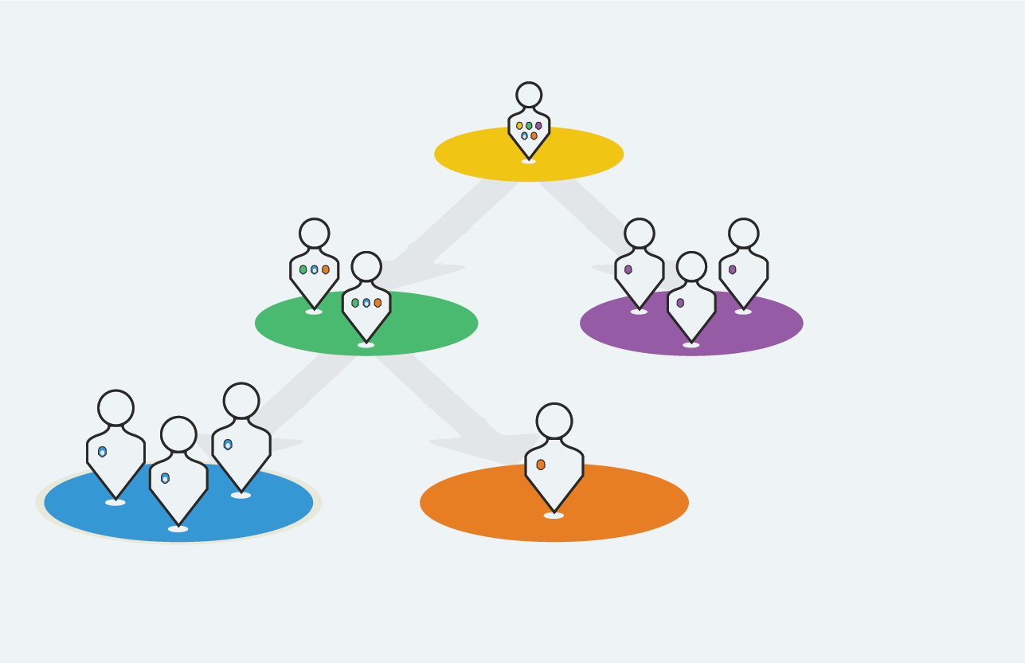
Who Benefits?
For Network Administrators:
Immediate insights into network health, with proactive alerts for potential issues.
Prevents service interruptions, ensuring connectivity and reliability for users.
For Businesses and Service Providers:
Protects against revenue loss from downtime and poor service quality.
Reduces manual interventions, allowing teams to focus on high-impact tasks.

Slide 4

Real-time problem solving
Imagine this scenario: As the network load surges, our system automatically reroutes traffic, adjusts bandwidth, and scales resources to maintain performance. An alert shows a predicted hardware failure, and the system reroutes critical traffic to avoid it—no downtime, no connectivity loss.
With this solution, users stay connected seamlessly, and network teams stay ahead of issues before they impact service.

Slide 5
Key features
Predictive Maintenance Alerts: Proactively warns of potential failures.
Dynamic Load Balancing: Smoothens traffic across the network.
Bandwidth Allocation Adjustments: Ensures priority traffic gets priority access.
Resource Scaling and Rerouting: Real-time resource adjustments to prevent congestion.
Interactive dashboard keeps everyone informed with visual insights and real-time notifications.

Slide 6
Our approach
Digital Twin
XGBoost Prediction
Reinforcement Learning Agent
Visualization and Testing
A real-time virtual network replica using NSL-KDD data to simulate traffic, failure points, and security scenarios.
Will analyze network data to predict potential failures and security threats based on historical patterns.
Using DQN RL Agent that adapts network parameters in real time by learning from both predicted and observed network states, making predictions, adjusting routes, bandwidth, and resource allocation.
Real-time monitoring and predictive insights in Dash display network status, failure predictions, and RL adjustments, evaluated by prediction accuracy, latency reduction, and minimized manual interventions.

Slide 7
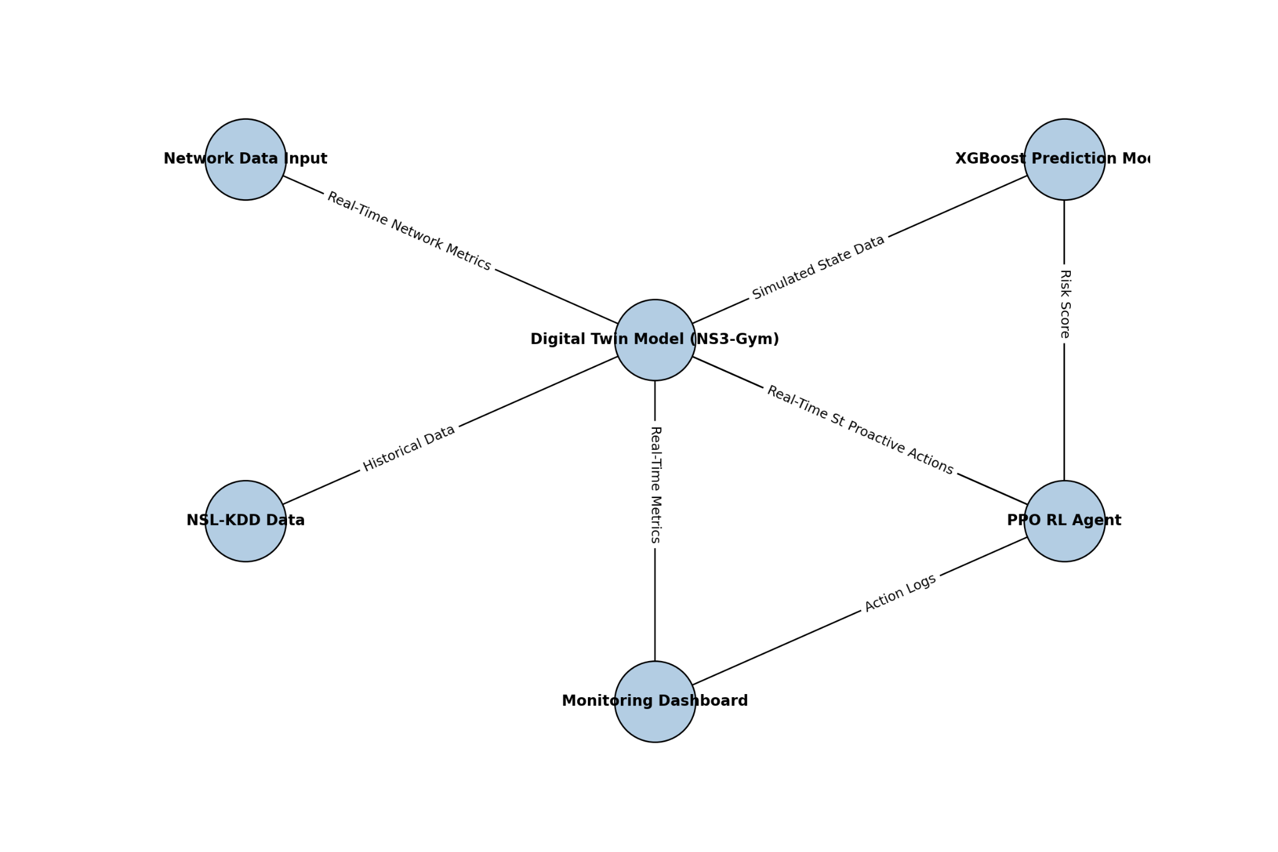
Architecture

Slide 8
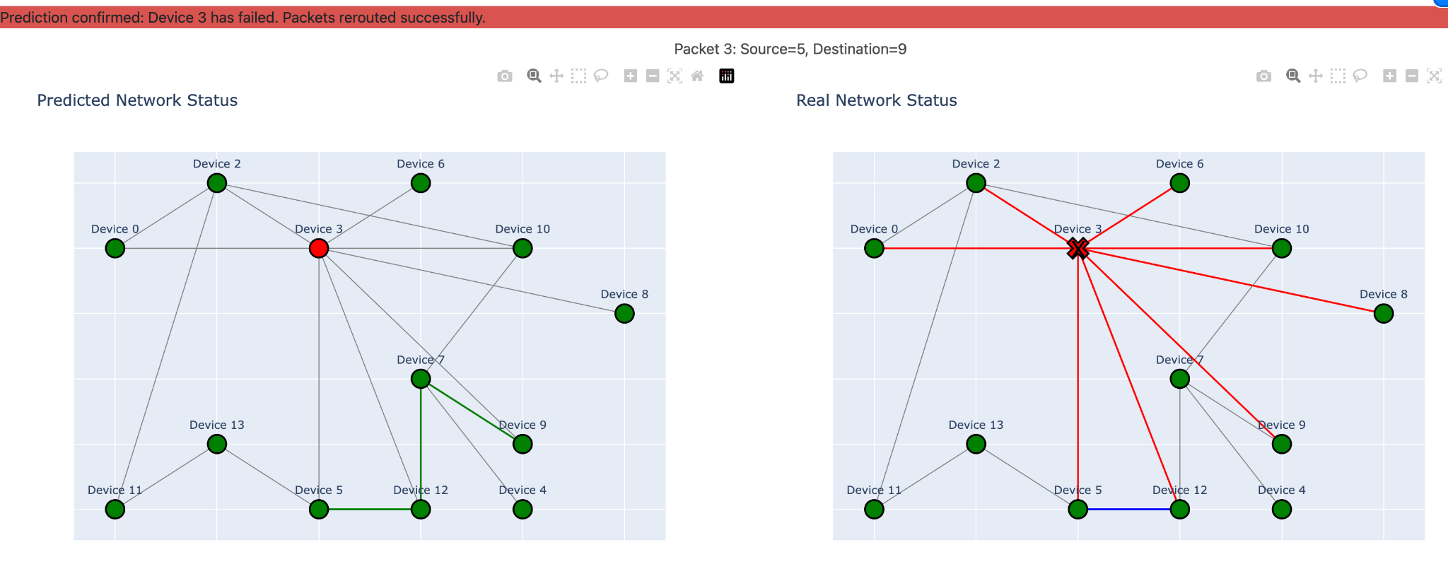
The Digital Twin Advantage
Real-time replica of network
Continuously synchronized with actual network
Allows for safe testing and predictive insights

Slide 9
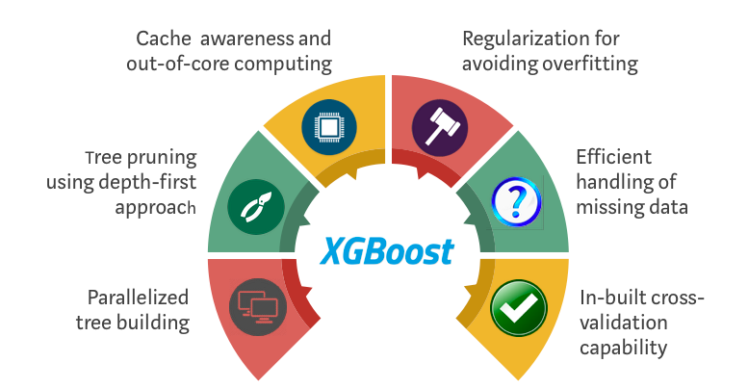
XGBoost Predictor
Trained on NSL-KDD Dataset
Provides real-time risk scores per node
Identifies anomalies and high-risk areas at 96% accuracy rate
Supplies a risk score to the RL agent

Slide 10
Reinforcement Learning (RL) Agent for proactive network management
What it is?
Using DQN (Deep Q-learning network) with Prioritized experience replay
Focuses on critical episodes(e.g., incidents leading to downtime) in our topology
What it can do?
Detects risk and congestion early
Automates resource allocation, rerouting
Learns and improves with each scenario
Load balancing
Rate limiting
Node isolation

Slide 11
Rewards structure for RL agent
Negative rewards (about -1000) for each instance of downtime or high-risk states not acted upon. (Hence the agent learns to avoid downtimes)
Positive rewards (about +1) for each timestep the connection is stable.
-1000
+1

Slide 12
Long-Term Impact
The RL agent could be trained to dynamically adjust firewall rules, implement rate limiting, or restrict access based on the type of detected threats.
We can use our agent to dynamically segment the network into virtual slices based on application needs (e.g., low-latency, high-bandwidth), with each slice optimized to meet specific service requirements.
We can have fully-automated decision making:
A hierarchical RL structure with multiple layers of agents: local agents manage individual nodes, regional agents handle clusters, and a top-level agent oversees the entire network.

Slide 13
DuoLink🔗
Thank you!

