Slide 1
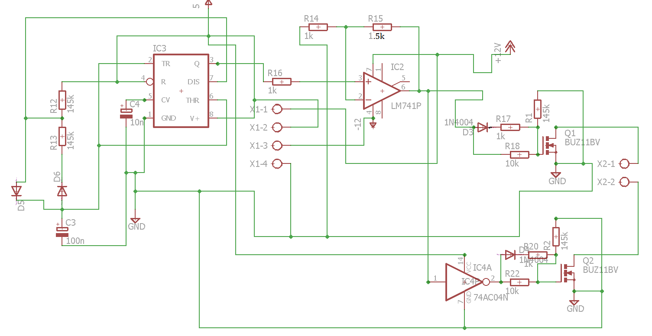
SCHEMATIC

Slide 2
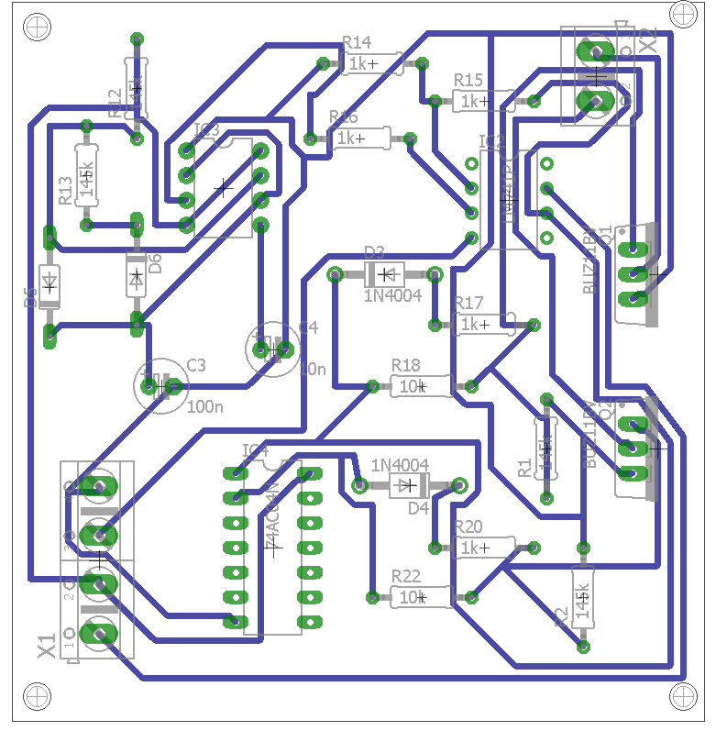
PRINTED CIRCUIT BOARD(PCB) DESIGN

Slide 3
TOLERANCE ANALYSIS
Tolerance is the permissible limit or limits of variation in a physical dimension, a measured value or physical property of a material manufactured object, system, etc.
Engineering tolerance is a machine's potential to cope with changes in the following elements of its surroundings and remain functioning.
A primary concern in the electronics circuits and systems is to determine how wide the tolerances may be without affecting other factors or the outcome of a process.
We know that all systems are designed in such a way that it is economical for the people producing them. However this should be done within the limits of allowable tolerance.

Slide 4
The following octave code is for the variation in gain of the opamp with change in the R1 value:
rf=1500;
reg=0.01*input('enter tolerance of r1:');
r1=1000;
deltar1=reg*r1;
r=r1-deltar1;
ar=1+rf/r1;
k=deltar1/1000;
x=0;
while(r<=(r1+deltar1))
x=x+1;
a(x)=1+rf/r;
r=r+k;
end
r=r1-deltar1:k:r1+deltar1;
percentager1=(r-r1)*100/r1;
percentagea2=(a-ar)*100/ar;
plot(percentager1,percentagea2)

Slide 5
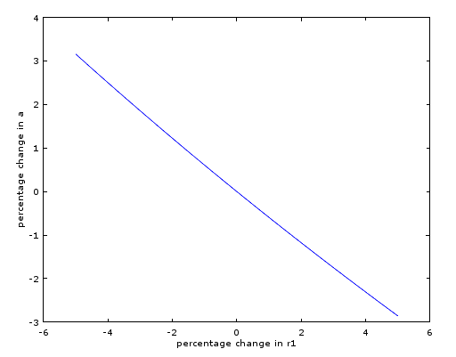
The variation in the gain for 5% variation in the value of R1 is around 3%.

Slide 6
The following octave code is for the variation in gain of the opamp with change in the Rf value:
r1=1000;
reg=0.01*input('enter the tolerance of rf:')
rf=1500;
deltarf=reg*rf;
r=rf-deltarf;
ar=1+rf/r1;
k=deltarf/1000;
x=0;
while(r<=(rf+deltarf))
x=x+1;
a(x)=1+r/r1;
r=r+k;
end
r=rf-deltarf:k:rf+deltarf;
percentagerf=(r-rf)*100/rf;
percentagea=(a-ar)*100/ar;
plot(percentagerf,percentagea)

Slide 7
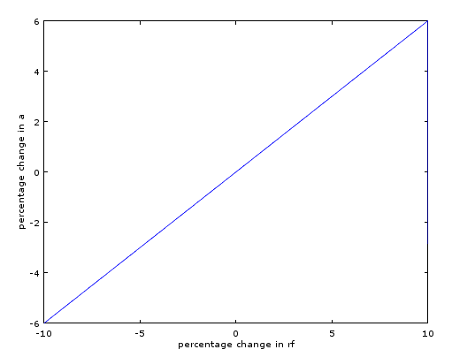
The variation in the gain for 10% variation in the value of Rf is around 6%.

