Slide 1

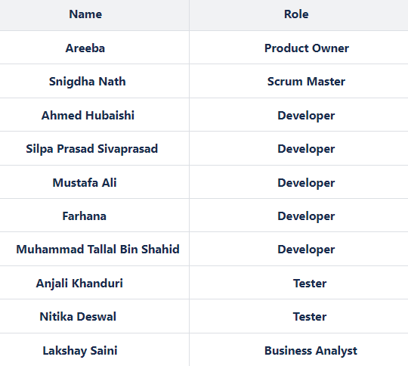
NrollXpert: Simple Application, Seamless Enrolment
App for continuous feedback in the enrolment process

Slide 2

Project Charter
Project Overview
Project Objectives
Scope
Stakeholder
Deliverables
Timeline
Budget
Risks
Quality Assurance

Slide 3

Project Plan:
Project Planning
Phase 1 (Pre-Planning )
Phase 2(Sprints Planning )
Phase 3(Sprints Development)
Phase 4(Testing)
Phase 5(Documentation & Deployment)
Resources
Budget
Communication Plan

Slide 4

Requirement Gatherings :
Product Vision statement
Product Name
Description
Product Scope
Target Audience
Purpose and Aspiration
Functional & Non - Functional Requirements

Slide 5
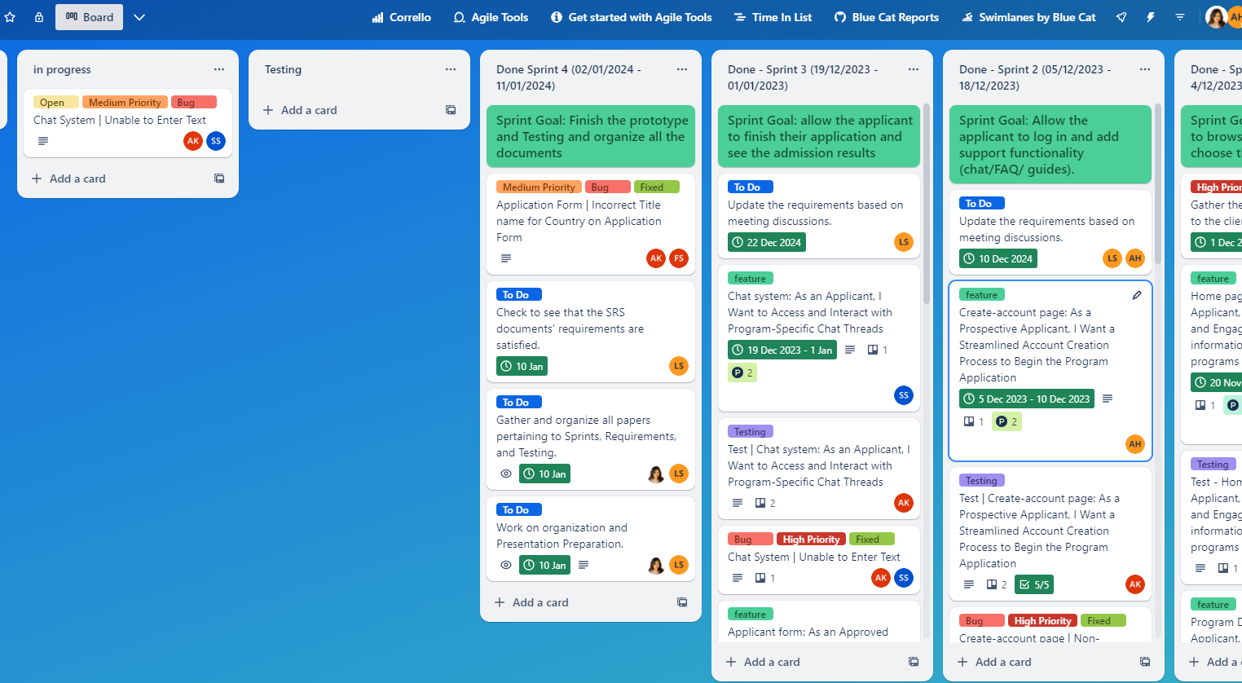
Trello Dashboard & Sprint Planning
1st Sprint (Nov 20th – Jan 4th):
Goal: Prioritized "BROWSING THE PROGRAMS" feature
Achievements: Completed 6 planned features on time
2nd Sprint (Dec 5th – Dec 18th):
Goal: Worked on "CHAT FAQ and GUIDE" feature
Achievements: Addressed requirement updates, resolved bugs
3rd Sprint(Dec 19th – Jan 1st):
Goal: Worked on "APPLICATION " feature
Achievements: Resolved bugs, completed all planned goals
4th Sprint (Jan 2nd – Jan 11th):
Goal: Organizing all project aspects
Achievements: Prototype finalization, documentation, stakeholder presentation preparation
Trello Board (Public)
https://trello.com/invite/b/J1fFnQQL/ATTIb10c885bd9aec6475735ea3165a20149F3308C0F/nrollxpert

Slide 6



Virtual Workplaces Used for the Project
Trello Board (Public)
https://trello.com/invite/b/J1fFnQQL/ATTIb10c885bd9aec6475735ea3165a20149F3308C0F/nrollxpert

Slide 7
Testing Process
Testing Scope
Test Closure
Test Planning
Test Preparation
Test Execution and Defect Reporting
Defect Closure Decision
Defect Closure
Sprint wise

Slide 8
Test Plan includes:
Test objective
Testing Scope
Level of Testing
Test Deliverables
Test Environment
Test Schedules
Resource Requirement
Risk Analysis
Testing Approach
Defect Management
Test Metrics

Slide 9
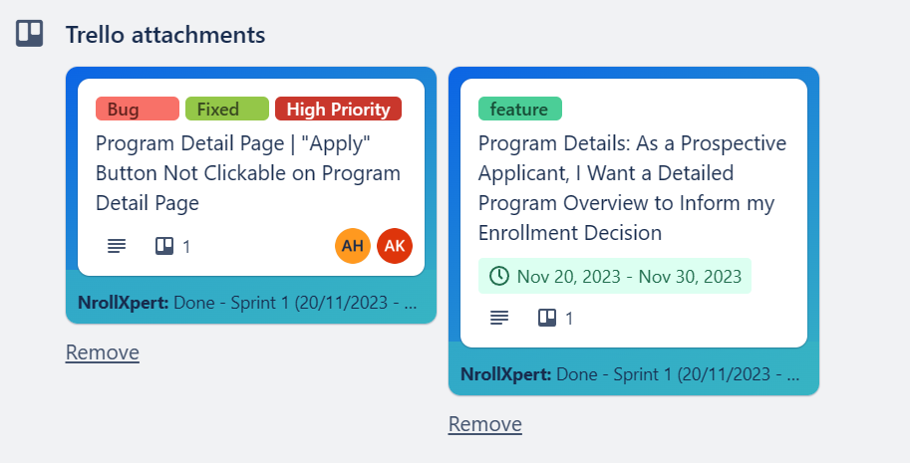
Test Preparation & Execution
Test Cases prepared based on Acceptance Criteria.
Development Story, Test cases and bugs linked for easy management.

Slide 10
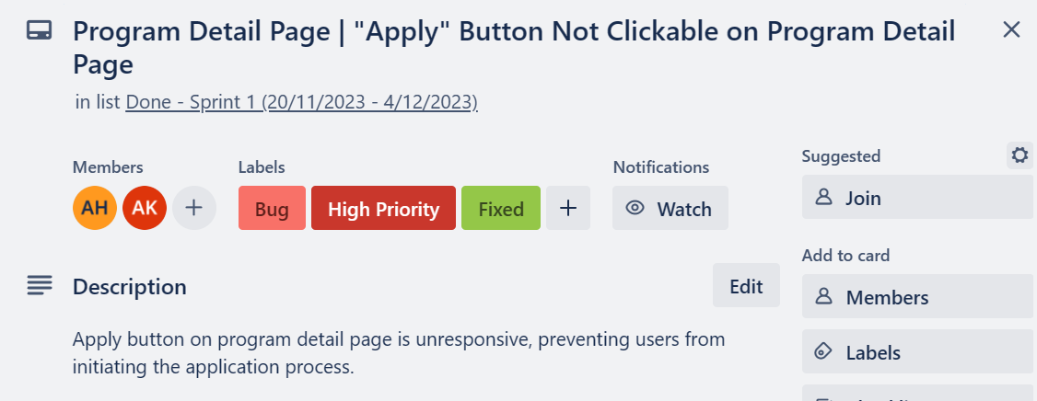
Test Stories and Defect outline:
Use of Labels
Test Stories include: Test Description, Test Steps, Expected Results
Test bugs Includes: Steps to Reproduce, Expected Behaviour and Actual Behaviour

Slide 11
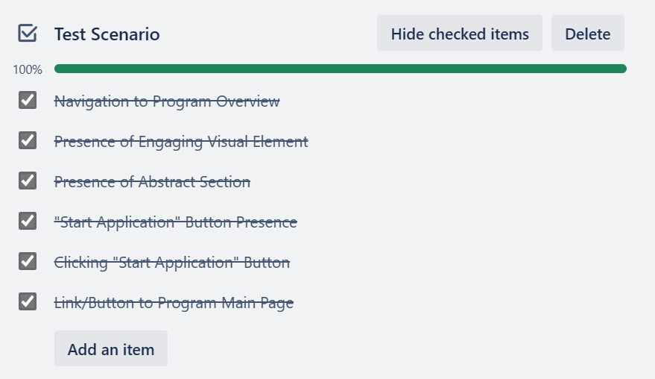
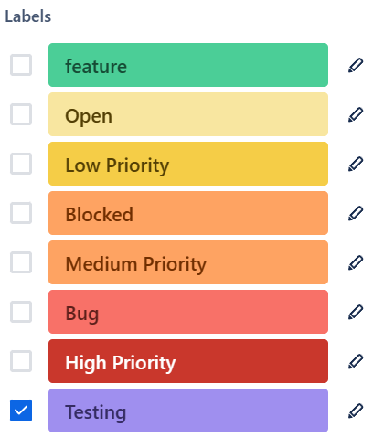
Test Stories and Defect outline- cont..
Test Checklist
Use of Labels

Slide 12

Reporting
Sprint Wise : Test Summary Report
Sign-Off Report

Slide 13
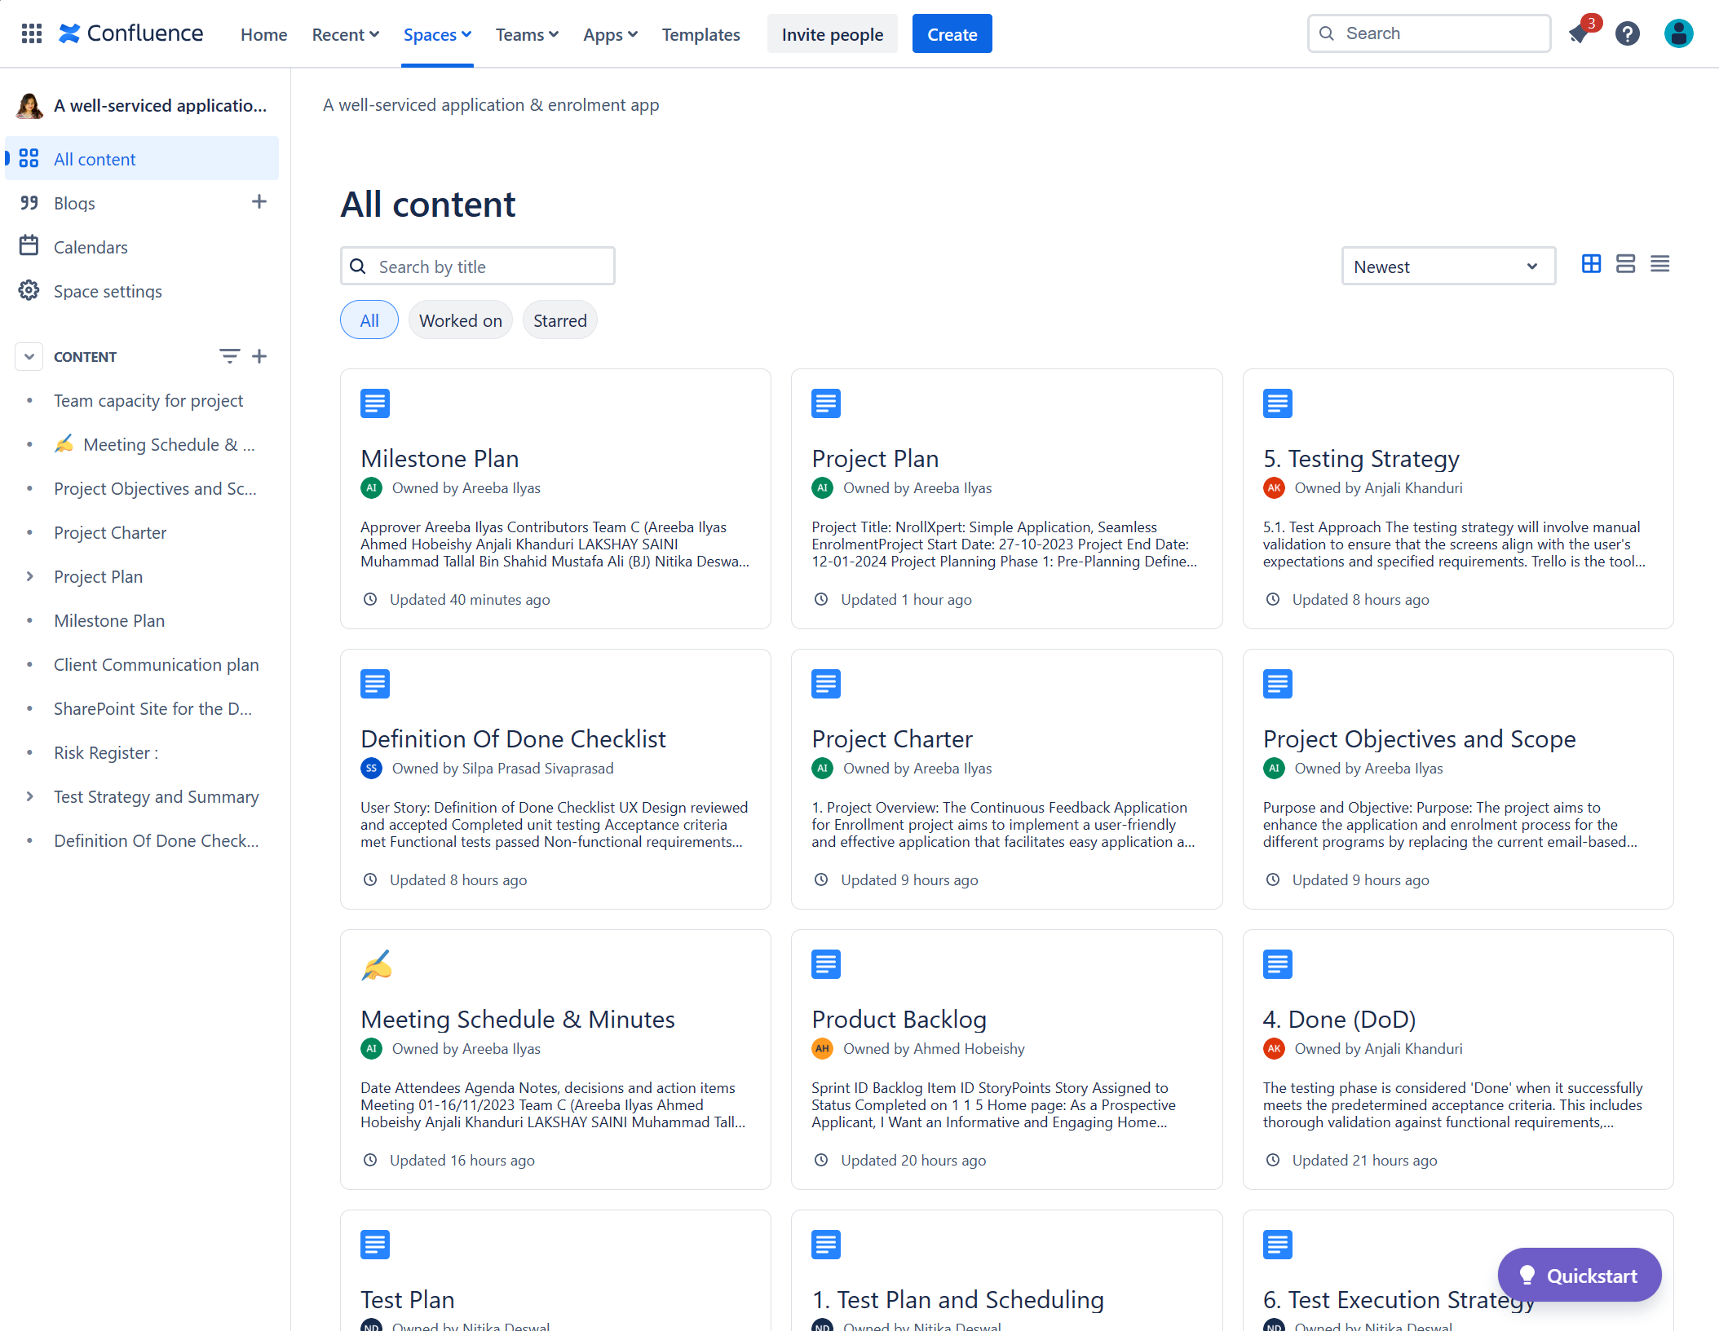
Confluence
Confluence (We attached pdf but we can also add to space upon request)
https://snigdhanath.atlassian.net/wiki/x/VgAB

Slide 14
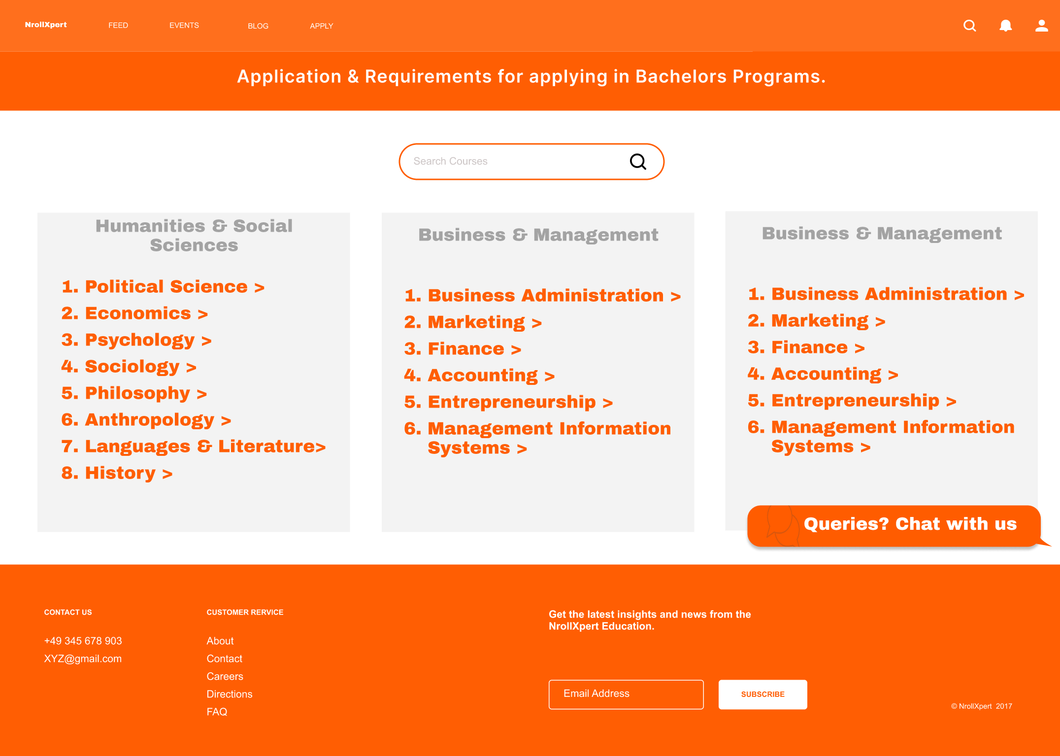
Prototype (UI/UX)
Please check this Figma (public) file: https://www.figma.com/proto/3ZQTKfJclc5S4uHLxblpX2/NrollXpert?type=design&node-id=639-3794&t=72q2TQA7IHLTn43W-1&scaling=scale-down&page-id=323%3A3507&starting-point-node-id=639%3A4013&mode=design

Slide 15
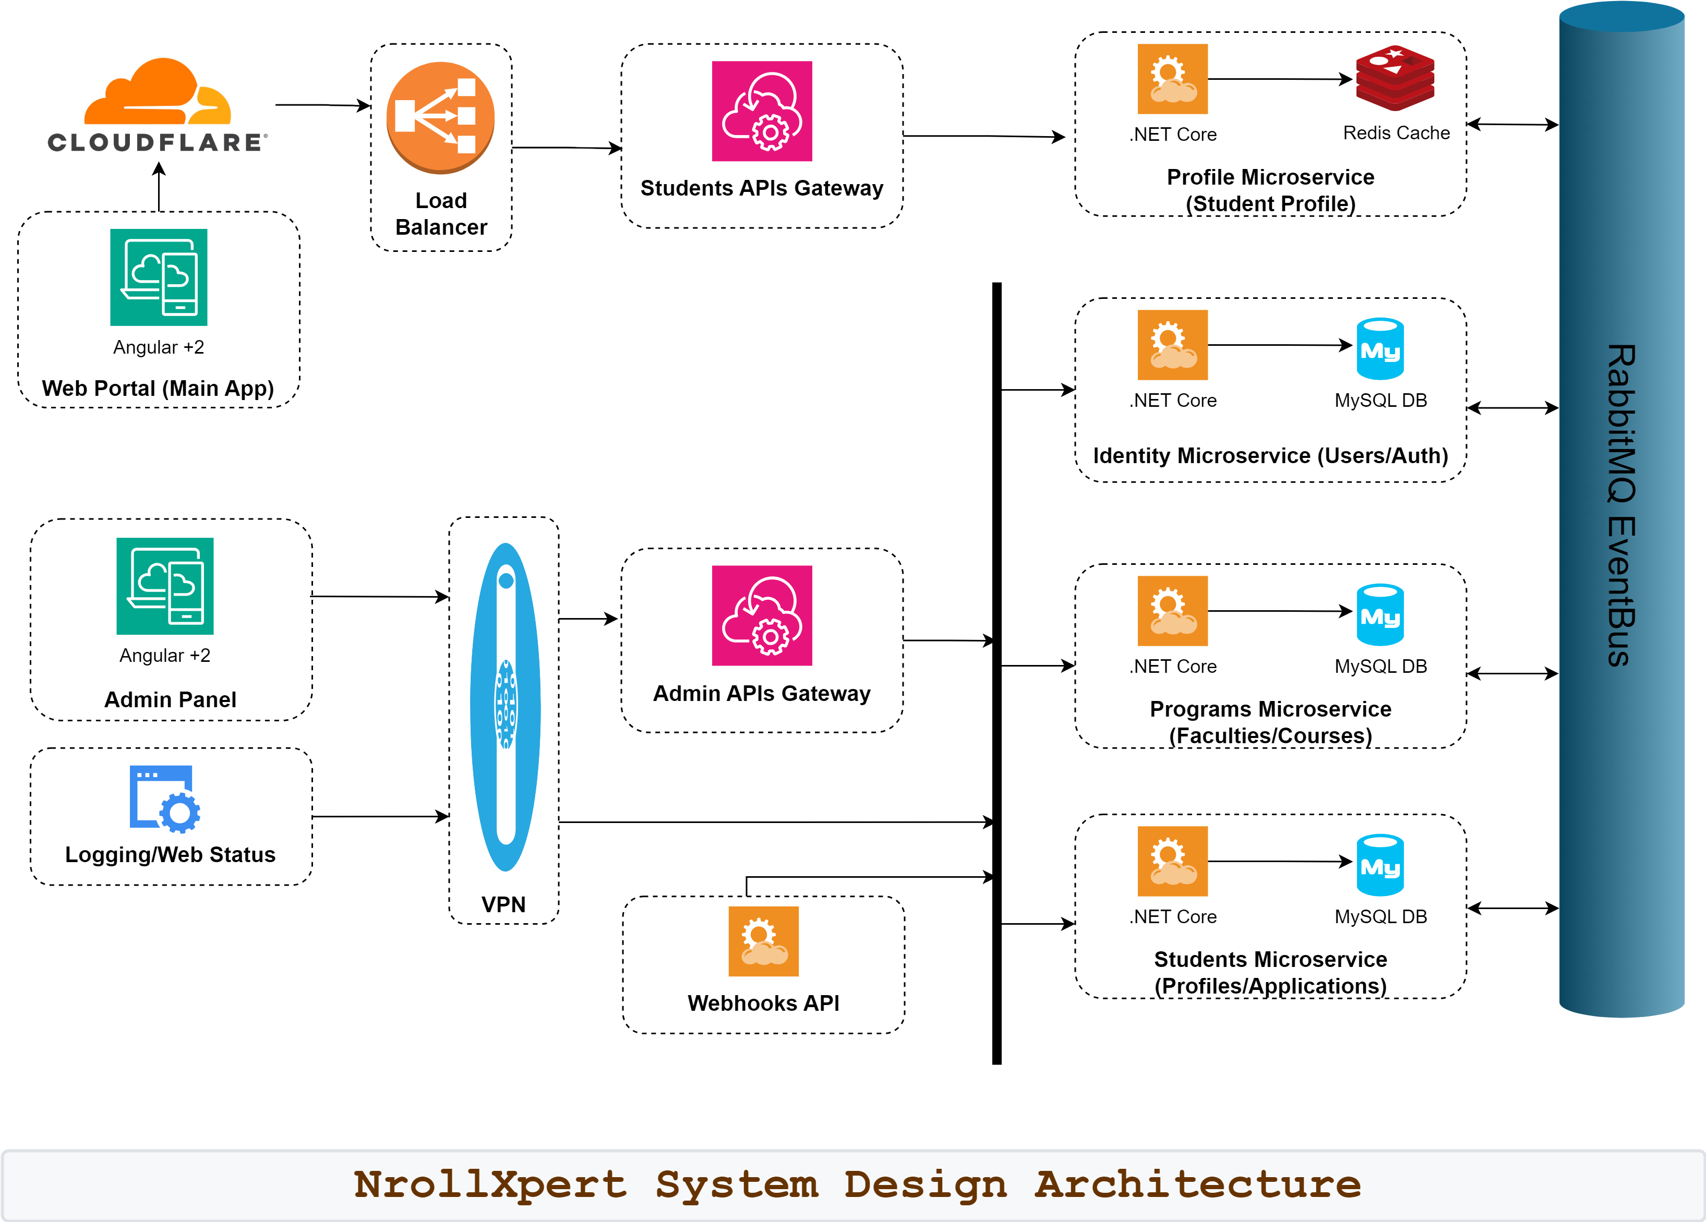

Slide 16
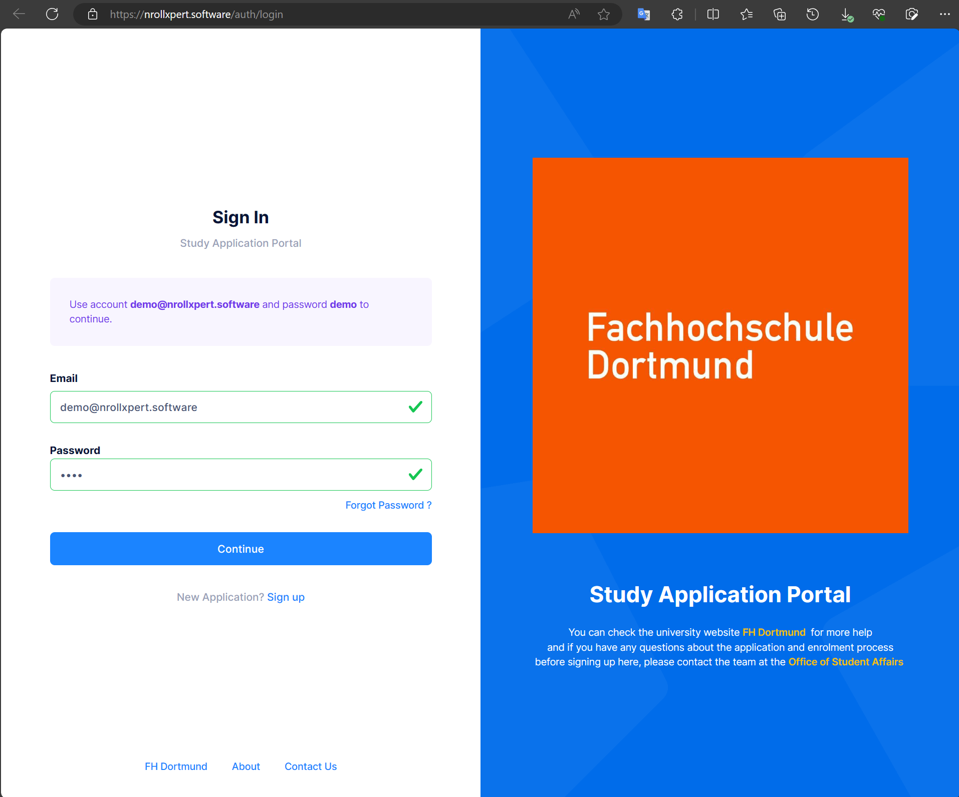
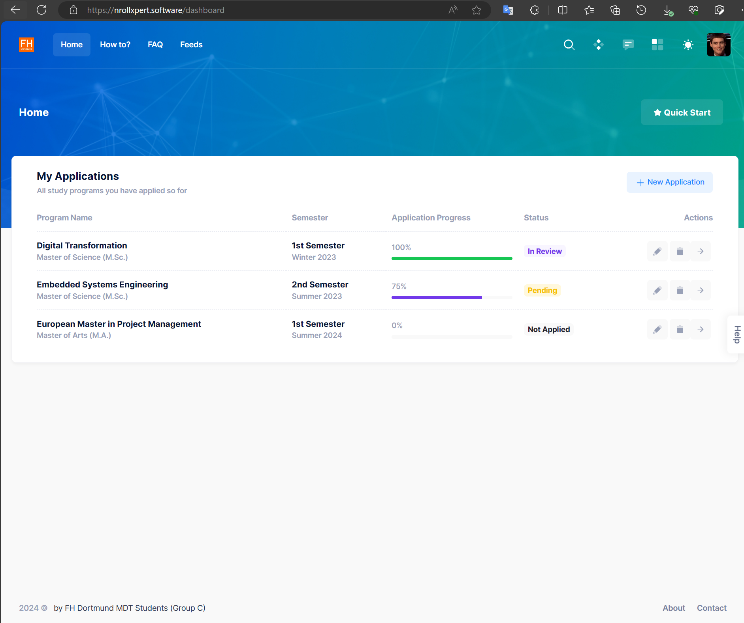
MVP for Main APP
https://nrollxpert.software

Slide 17

Thank You
Please feel free to ask your question !!

