Slide 1



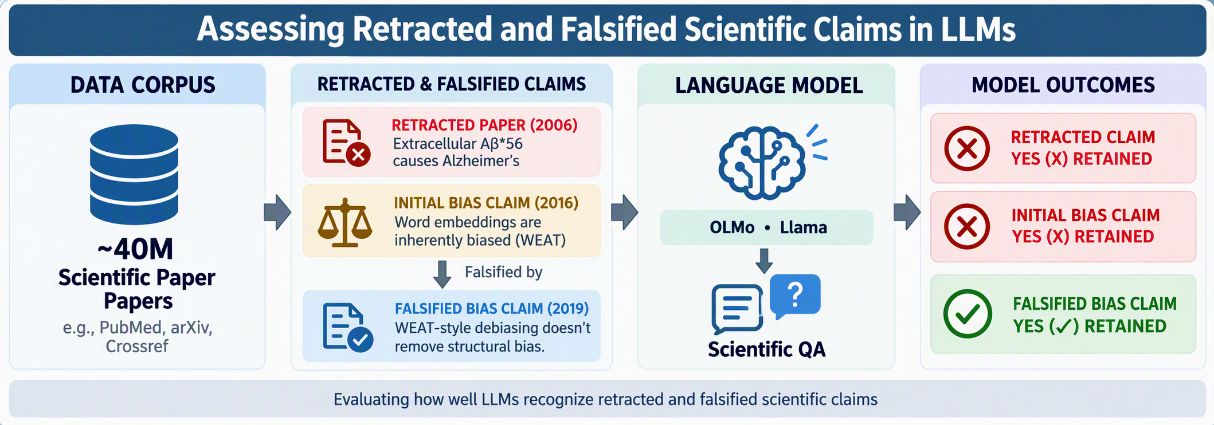
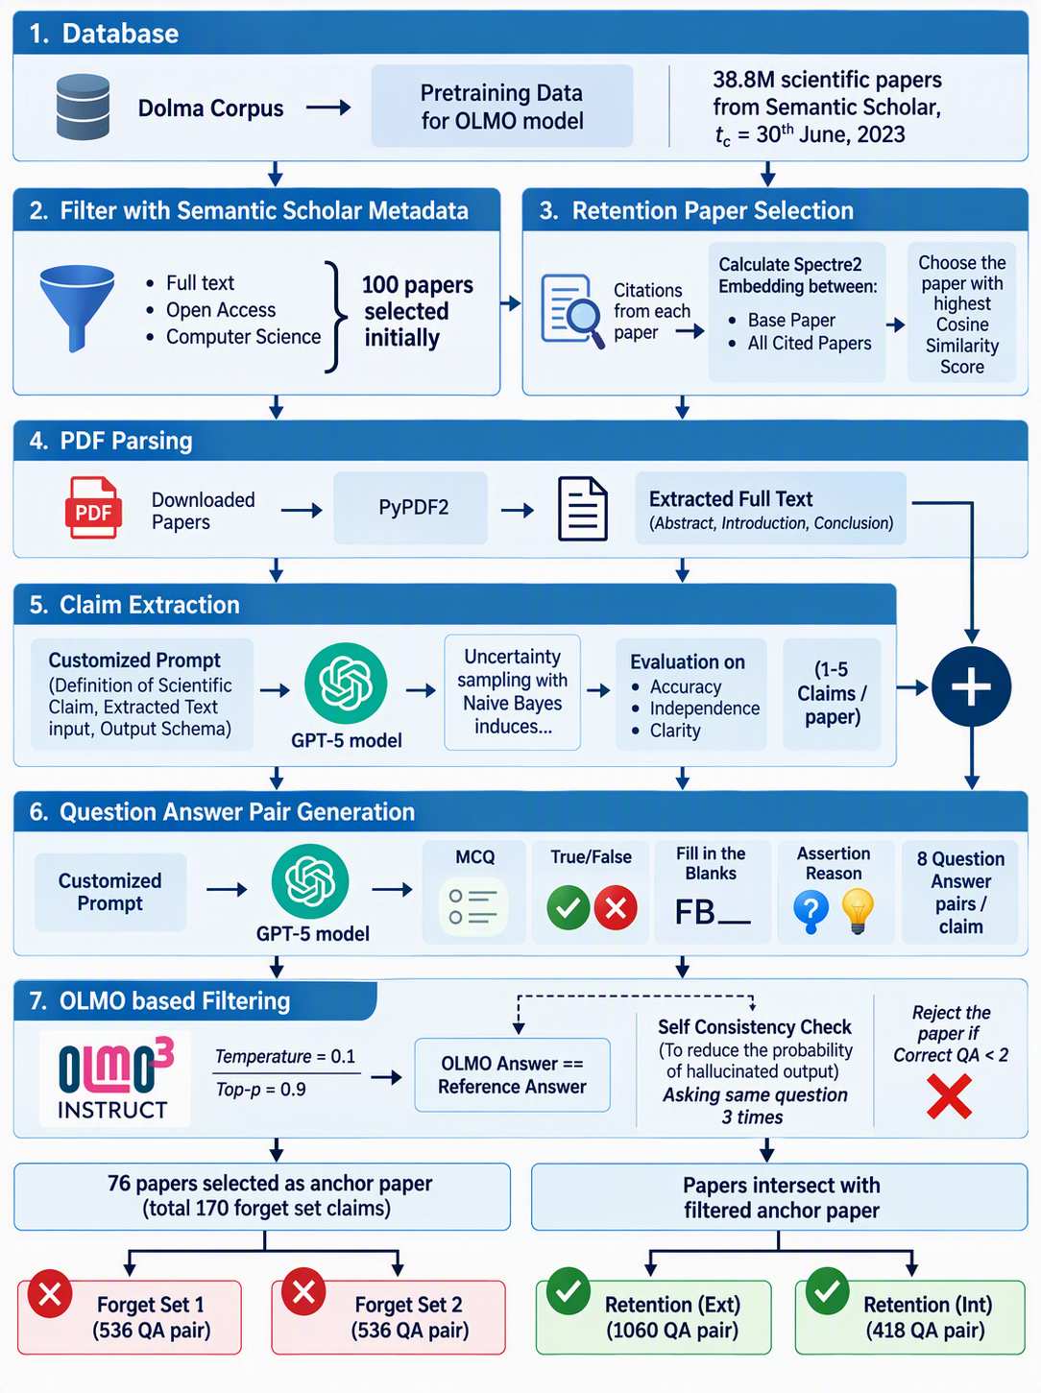


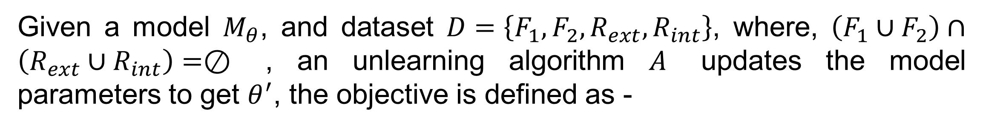
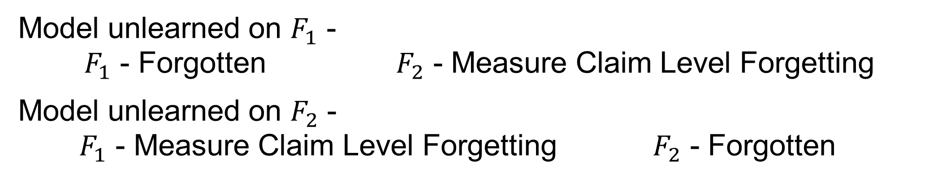
Can Scientific Claims Be Removed from Large Language Models? A Systematic Evaluation of Claim-Level Unlearning
Snigdha Paul Manasi Patwardhan Arman Cohan
MOTIVATION
DATASET CREATION
PROBLEM FORMULATION
Given a model $M_{θ}$, and dataset $D=\left\{F_{1}, F_{2}, R_{ext}, R_{int}\right\}$, where, $\left(F_{1}∪F_{2}\right)∩\left(R_{ext}∪R_{int}\right)=⊘$ , an unlearning algorithm $A$ updates the model parameters to get $θ^{′}$, the objective is defined as -
$$\min_{θ^{′}}{𝔼_{\left(q,a\right)∈F_{i}}\left[l_{f}\left(a|q;θ^{′}\right)\right]+λ𝔼_{\left(q,a\right)∈R}\left[l_{r}\left(a|q;θ^{′}\right)\right]}$$
Forget
Retain
Where, $\left(q,a\right)$ is the QA pair and $λ$ balances forgetting and retention loss.
Objective (Validation of Claim Unlearning):
Model unlearned on $F_{1}$ -
$F_{1}$ - Forgotten $F_{2}$ - Measure Claim Level Forgetting
Model unlearned on $F_{2}$ -
$F_{1}$ - Measure Claim Level Forgetting $F_{2}$ - Forgotten
EVALUATION PROTOCOL
Forget: exact match and ROUGE-L F1 on F₁ and F₂.
Retain: unrelated information from cited papers and source papers.
General utility: MMLU, ARC-Challenge and HellaSwag.
MIA: compare direct and semantic members with unrelated non-members.
Min-K% (k = 20%) AUC near 0.5 indicates indistinguishability.
Larger RefScore (L_unlearned − L_base) indicates stronger forgetting.
Dataset | Papers | Claims | F₁ | F₂ | R_{ext} | R_{int}
Computer science | 76 | 170 | 536 | 536 | 1060 | 418
Medical | 78 | 127 | 508 | 508 | 908 | 543
Retracted | 91 | 141 | 390 | 390 | 884 | 671
ALGORITHMS USED
Gradient Difference (GD), Negative Preference Optimization (NPO), Simplified NPO (SimNPO), NPO with retain set (NPO+RT), SimNPO with retain set (SimNPO+RT).
RESULTS AND DISCUSSION
HUMAN VALIDATION
Model | Method | Forget Set 1 ↓ |  | Forget Set 2 ↓ |  | Retain (Ext) ↑ |  | Retain (Int) ↑ |  | General Benchmarks
 |  | R-F1 | EM | R-F1 | EM | R-F1 | EM | R-F1 | EM | MMLU | Arc-C | HellaSwag
OLMo | Base Model | 97.54 | 94.21 | 93.92 | 89.17 | 95.40 | 90.75 | 92.44 | 83.49 | 58.75 | 54.35 | 76.02
 | GD (F₁) | 71.70 | 58.20 | 93.51 | 88.24 | 93.66 | 84.15 | 90.53 | 72.00 | 56.44 | 50.08 | 70.13
 | NPO+RT (F₁) | 88.81 | 81.52 | 93.67 | 89.55 | 92.44 | 86.13 | 90.66 | 82.05 | 58.28 | 49.91 | 69.89
 | GD (F₂) | 91.65 | 78.35 | 89.60 | 83.58 | 93.27 | 84.52 | 91.02 | 77.03 | 57.54 | 49.57 | 70.93
 | NPO+RT (F₂) | 96.14 | 89.92 | 86.78 | 82.27 | 91.47 | 85.18 | 91.60 | 81.81 | 57.39 | 50.51 | 73.02
LLaMA | Base Model | 96.61 | 93.65 | 87.37 | 77.61 | 91.86 | 86.03 | 90.07 | 83.25 | 64.74 | 75.58 | 55.88
 | GD (F₁) | 78.33 | 74.06 | 88.32 | 80.03 | 85.45 | 80.37 | 89.00 | 83.25 | 63.01 | 73.91 | 46.67
 | NPO+RT (F₁) | 73.56 | 70.33 | 90.91 | 86.38 | 86.53 | 83.01 | 90.35 | 83.73 | 63.35 | 75.28 | 53.41
 | GD (F₂) | 93.31 | 88.80 | 59.18 | 37.87 | 76.78 | 65.47 | 81.31 | 73.20 | 60.93 | 74.30 | 47.69
 | NPO+RT (F₂) | 96.08 | 93.09 | 78.59 | 66.23 | 87.36 | 78.86 | 85.14 | 77.27 | 64.44 | 75.01 | 55.37
Experts reviewed 75 claims from 50 papers. Human–LLM agreement on quality criteria reached Gwet’s AC2 of 0.84–0.91.
Accuracy: Claims and answers match the source evidence.
Independence: Each item is self-contained and needs no unstated context.
Clarity: Wording is clear and unambiguous.
KEY TAKEAWAYS
Table 1. LORA based unlearning results for OLMo and LLaMA. (Only on top performing algorithms)
Can LLMs truly forget scientific claims?
Existing methods do not achieve true claim level forgetting, only some papers not deeply rooted in the pretraining corpus can transfer the unlearning behaviour to the complementary forget set.
Model | Method | Forget Set 1 ↓ |  | Forget Set 2 ↓ |  | Retain (Ext) ↑ |  | Retain (Int) ↑ |  | General Benchmarks
 |  | R-F1 | EM | R-F1 | EM | R-F1 | EM | R-F1 | EM | MMLU | Arc-C | HellaSwag
OLMo | Base Model | 92.16 | 78.59 | 84.59 | 65.96 | 87.74 | 71.14 | 92.49 | 81.95 | 58.76 | 54.35 | 76.02
 | GD (F₁) | 58.20 | 35.78 | 75.40 | 61.05 | 86.78 | 73.78 | 92.77 | 84.34 | 57.24 | 52.47 | 71.07
 | NPO+RT (F₁) | 83.09 | 67.36 | 83.93 | 68.07 | 89.69 | 74.77 | 92.49 | 85.63 | 59.50 | 52.73 | 75.30
 | GD (F₂) | 83.80 | 68.77 | 55.59 | 32.28 | 88.97 | 74.77 | 93.95 | 86.37 | 56.43 | 51.70 | 72.50
 | NPO+RT (F₂) | 92.52 | 85.64 | 73.89 | 81.53 | 91.96 | 85.06 | 94.79 | 88.07 | 59.14 | 53.41 | 73.54
LLaMA | Base Model | 86.23 | 71.92 | 76.64 | 56.49 | 80.39 | 63.32 | 90.24 | 82.68 | 64.75 | 75.58 | 55.88
 | GD (F₁) | 70.08 | 55.78 | 73.70 | 56.14 | 81.61 | 65.96 | 93.81 | 88.21 | 63.87 | 75.39 | 52.99
 | NPO+RT (F₁) | 41.70 | 26.66 | 41.70 | 15.43 | 87.18 | 70.15 | 97.83 | 94.47 | 47.29 | 74.97 | 54.18
 | GD (F₂) | 83.32 | 68.77 | 68.34 | 48.77 | 82.94 | 67.62 | 93.90 | 88.39 | 63.10 | 75.29 | 52.82
 | NPO+RT (F₂) | 45.98 | 30.18 | 32.79 | 7.37 | 88.86 | 79.07 | 96.06 | 93.00 | 43.20 | 74.48 | 49.57
What else is needed for true Claim Level Unlearning?
Table 2. Full parameter unlearning results for OLMo and LLaMA. (Only on top performing algorithms)
To read the full paper scan the QR code here:
Notes:
[Sources]
MIA evaluation: user-supplied arXiv:2608.20960v1, Appendix J and Table 7. Direct members are targeted forget QA pairs, semantic members are complementary forget QA pairs, and non-members are unrelated external QA pairs. Min-K uses bottom 20% least-confident output tokens. RefScore = L_unlearned - L_base.
[/Sources]
[Sources]
Dataset statistics: user-provided image.png. Transcribed all columns: Papers, Claims, F1, F2, R_ext, R_int.
[/Sources]

