Slide 1
Enterprise Banking Microservices
A scalable and secure distributed banking backend
Course project — Database Systems Engineering & Distributed Backend Development
Team: Snigdha — 2520090160
Koumudi — 2520090161
Sumanjali — 2520090190
React.js → FastAPI → MySQL | JWT | Fraud Detection
1

Slide 2
Problem Statement
Traditional banking systems struggle with growth, security, and operational complexity.
• Scaling for high transaction volumes
• Secure authentication and authorization
• Consistent, reliable transaction processing
• Managing payments and account state across services
• Detecting suspicious/fraudulent behavior in real time
Project goal: build a secure, modular microservices platform managing customers, accounts, transactions, and fraud detection.
2

Slide 3
Project Objectives
Secure Architecture — Implement authentication, authorization, and secure REST APIs.
Scalability — Microservices design to scale individual capabilities independently.
Transaction Integrity — Consistent account balances and reliable transaction logging.
Fraud Detection — Identify suspicious patterns and flag high-risk activities.
User Experience — Clean frontend: registration, dashboard, transfers, and forms.
3

Slide 4
Literature Survey — Summary
Microservices Architecture — Improves modularity and scale; introduces distributed communication and consistency challenges.
Secure Authentication — Token-based auth and role-based access control are effective but need careful token lifecycle management.
Banking Transaction Systems — ACID semantics support correctness; scaling requires careful partitioning and compensating transactions.
Fraud Detection — Pattern-based and ML approaches detect anomalies; accuracy depends on data richness and labeled examples.
Research gap: Few works integrate scalable microservices, strong transactional guarantees, and inline fraud detection in a single platform.
4

Slide 5
Proposed System — Overview
We propose a microservices-based banking platform exposing secure REST APIs.
• Customer management and registration
• Authentication & authorization (token-based)
• Account and balance management
• Secure money transfers and payment recording
• Transaction ledger and audit trails
• Real-time fraud detection and alerting
Technology stack: React.js → FastAPI microservices → MySQL
5

Slide 6
System Architecture — Flow
Frontend (React) handles UI and client validation.
FastAPI services implement business logic per bounded context: auth, accounts, payments, and fraud.
Services communicate over REST (HTTP) and use MySQL for persistent state.
Fraud service subscribes to transaction events for near-real-time scoring.
6

Slide 7
Modules & Responsibilities
Customer Management — Profile CRUD, KYC fields, linkage to user accounts.
Authentication & Authorization — JWT tokens, refresh tokens, RBAC for operations.
Account Management — Account types, balance updates, overdraft rules.
Transfer & Payments — Atomic transfer flows with idempotency and audit logs.
Transaction Management — Durable transaction ledger and reconciliation endpoints.
Fraud Detection — Rule-based scoring and anomaly flags; alerts + quarantine actions.
Banking Dashboard — Aggregate views: balances, recent activity, alerts, KPIs.
7

Slide 8
Database Design — Conceptual
MySQL relational schema — main tables and key relationships:
• customers (customer_id, name, KYC, contact_info)
• users (user_id, customer_id, username, password_hash, roles)
• accounts (account_id, customer_id, balance, currency, status)
• transactions (tx_id, from_account, to_account, amount, status, timestamp)
• payments (payment_id, account_id, payee, amount, method, status)
Relationships: customers→users (1:N), customers→accounts (1:N), accounts→transactions (1:N).
Use indexes on account_id, customer_id, and transaction timestamps for performance.
10

Slide 9
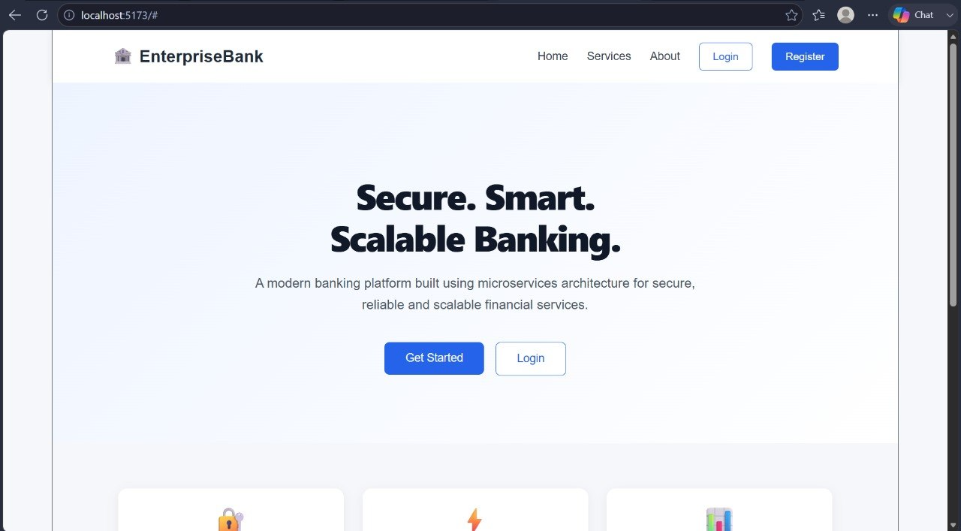
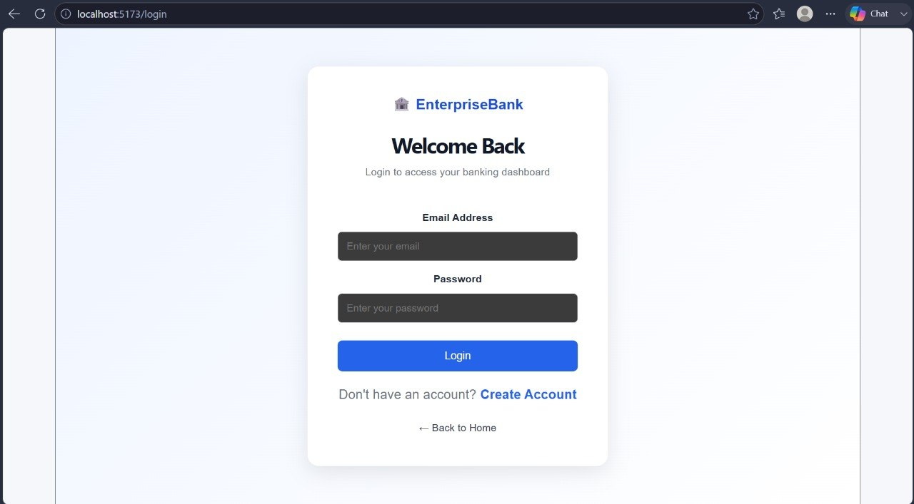
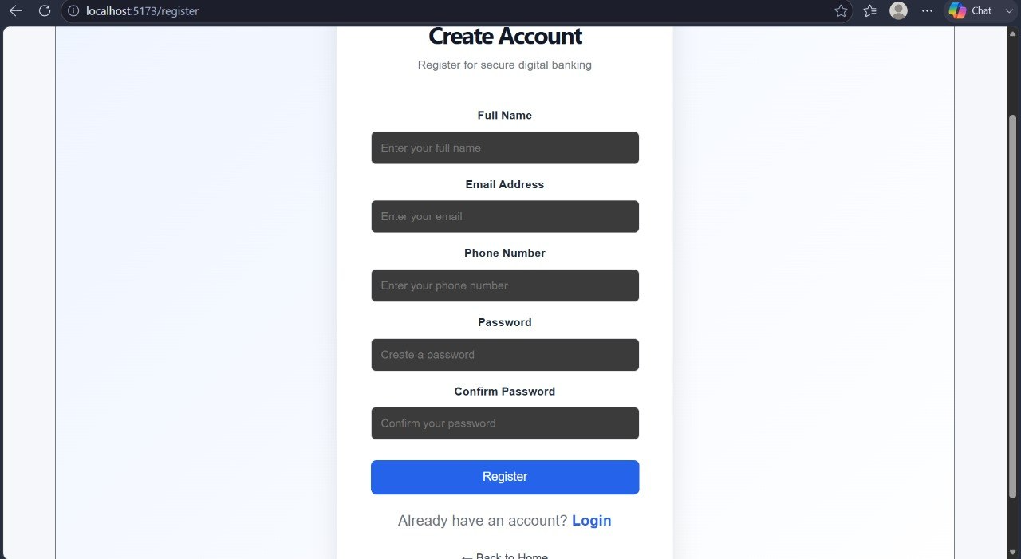
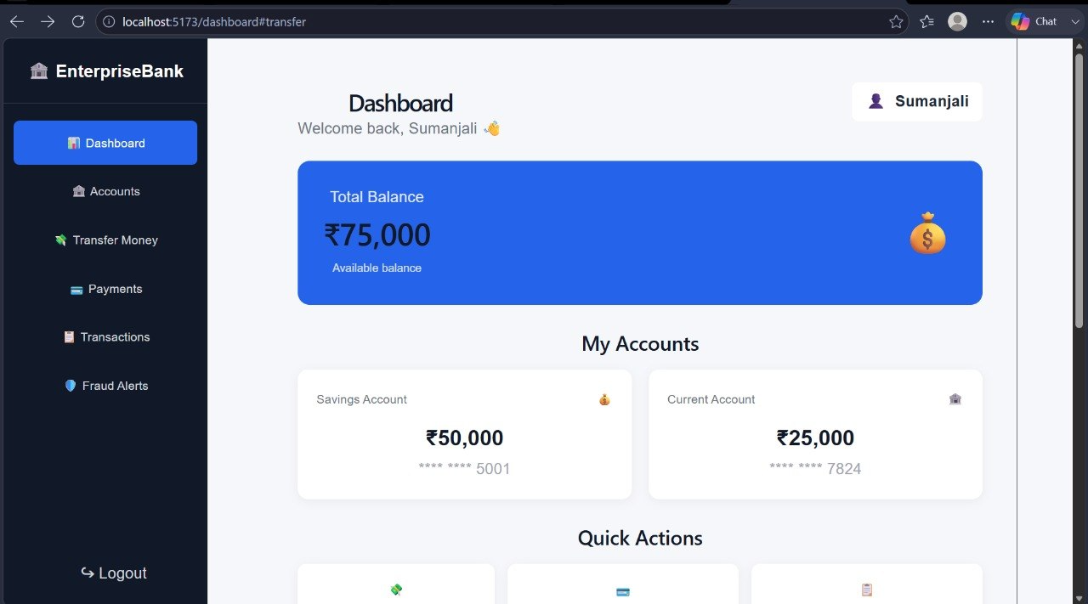
WEBSITE
10

Slide 10
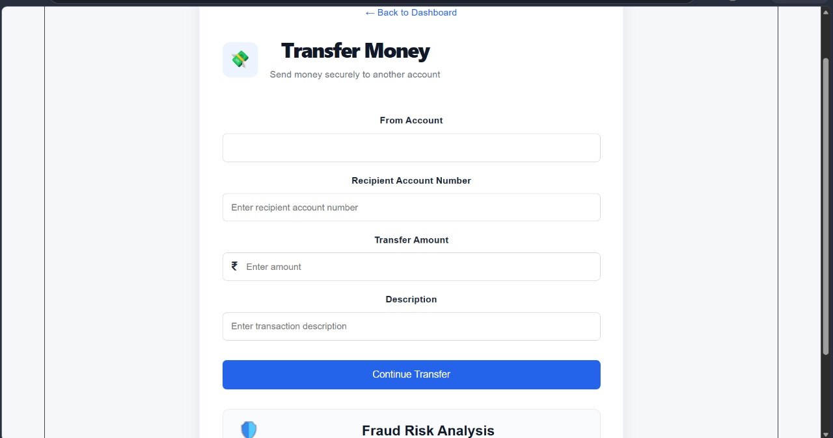
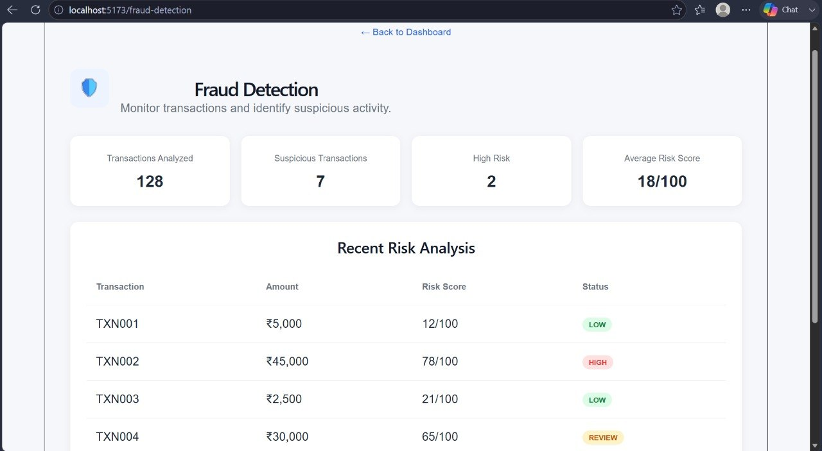
10

