Slide 1

  Hospital Patient Care Analytics

Slide 2
About me
I am Snigdha Reddy, B.Tech – Computer Science Engineering (2026)
Aspiring Data Analyst
Learning SQL, Python, Pandas and Data Analytics
Project focus: Hospital Patient Care Analytics using SQL
LinkedIn: www.linkedin.com/in/snigdha-reddy-anumandla-8abb90339
GitHub: https://github.com/snigdhareddyanumandla

Slide 3
INTRODUCTION
Hospital Patient Care Analytics
SQL-based healthcare data analysis project
Analyzed patients, appointments, treatments, doctors, and rooms
Studied patient demand, appointment behaviour, treatment outcomes, waiting time, and operational performance
Project Objective:
To use SQL to analyze hospital operational data, identify important patterns and problems, and generate actionable business insights to support better scheduling, resource allocation, and patient care.

Slide 4
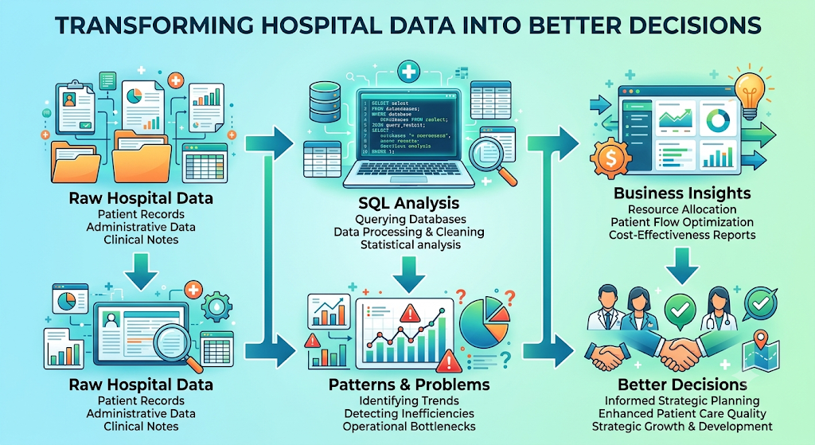
WHY THIS PROJECT?
Why Hospital Patient Care Analytics?
Hospitals generate large volumes of patient, appointment, treatment, doctor, and room data
Without proper analysis, it can be difficult to identify demand patterns and operational problems
SQL helps transform raw healthcare data into meaningful information
Analysis can support better scheduling, resource utilization, patient care, and operational decision-making

Slide 5
DATASET INFORMATION
Dataset: CarePlus Hospital Operations Data
Healthcare dataset representing CarePlus Hospital operations
Contains data related to patients, appointments, treatments, doctors, and rooms
Data was provided in CSV format and imported into MySQL
Used the dataset to perform SQL-based analysis and business insights
👤 Patients | 📅 Appointments | 🩺 Treatments | 👨‍⚕️ Doctors | 🏥 Rooms

Slide 6
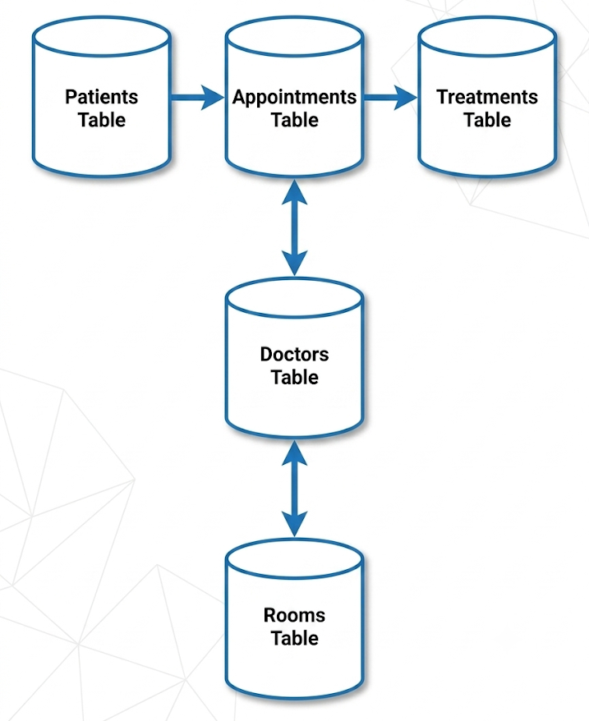
DATABASE and TABLES OVERVIEW
Table | Purpose
Patients | Stores patient details and demographic information
Appointments | Stores appointment booking and service-related information
Treatments | Stores treatment attempts, status, waiting time and duration
Doctors | Stores doctor information and availability/details
Rooms | Stores room information and room-related details

Slide 7
TABLE STRUCTURE
Patients
Stores patient demographics, city, patient type, preferred time slot, and registration details.
Doctors
Stores doctor name, specialty, rating, employment type, hire date, and active status.
Rooms
Stores room type, floor, equipment, capacity, maintenance date, and availability.
Appointments
Stores appointment date, patient, doctor, service type, priority, estimated cost, and booking channel.
Treatments
Stores treatment status, attempts, duration, waiting time, cost, and links to appointments, doctors, and rooms

Slide 8
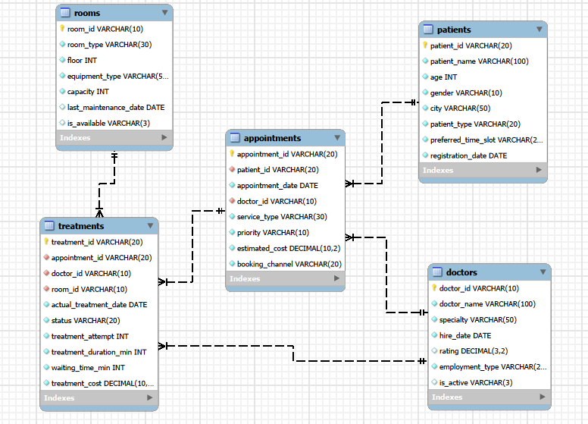
ER DIAGRAM AND TABLE RELATIONSHIPS
Key Relationships
One Patient → Many Appointments
One Doctor → Many Appointments
One Appointment → Multiple Treatments
One Doctor → Multiple Treatments
One Room → Multiple Treatments over time
Primary Keys uniquely identify each record.
Foreign Keys connect related tables and enable SQL JOIN operations.

Slide 9
PROBLEM STATEMENT
Hospital Operations Problem
Understand patient demand and appointment behaviour.
Analyze treatment outcomes, waiting time, and treatment performance.
Identify appointment problems such as cancellations, no-shows, and rescheduling.
Evaluate doctor, room, service, and priority-level performance.
Convert hospital data into actionable operational insights for better planning.

Slide 10
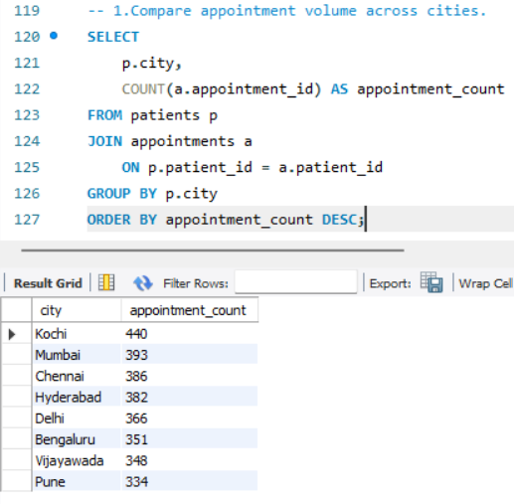
PATIENT & APPOINTMENT DEMAND
Key Questions Analysed
Which cities have the highest appointment activity?
Which patient types have higher appointment volume?
Which patient segments generate higher appointment value?
How does appointment demand vary geographically?
Business Metrics Used
Patient count
Appointment count
City
Patient type
Estimated appointment value
Average appointment value
Appointment volume

Slide 11
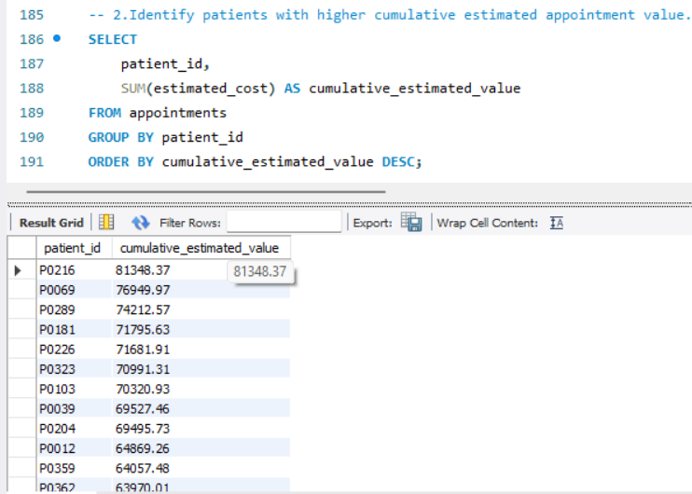
PATIENT APPOINTMENT BEHAVIOUR
Key Questions Analysed
Which patients have higher appointment activity?
Which patients have the highest cumulative estimated value?
Which cities have higher active patient counts?
How does booking behaviour change over time?
Which patient segments contribute higher appointment value?
Business Metrics Used
Patient activity
Appointment count
Cumulative estimated value
City
Patient type
Monthly appointment count
Number of appointments
Total estimated appointment value

Slide 12
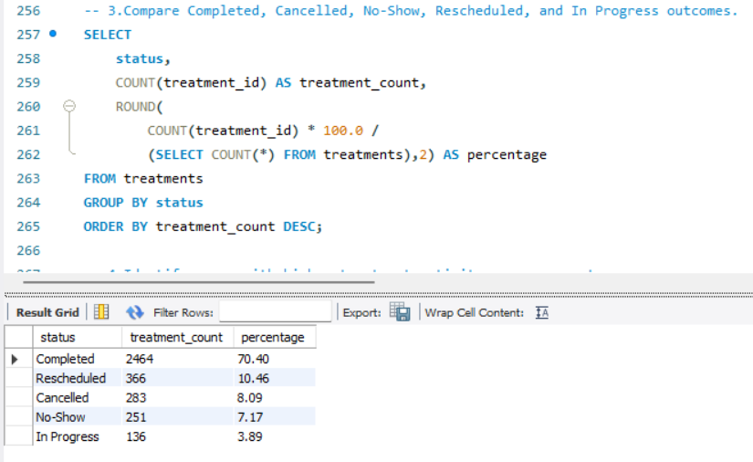
TREATMENT PERFORMANCE
Key Question
What percentage of treatments fall under each treatment status?
How do treatment duration and waiting time vary across service types?
Which cities have higher treatment activity?
Which service types have longer treatment duration?
Which cities have higher poor outcomes?
Business Metrics Used
Treatment status
Treatment count
Percentage of total treatments
Service type
Average treatment duration
Average waiting time

Slide 13
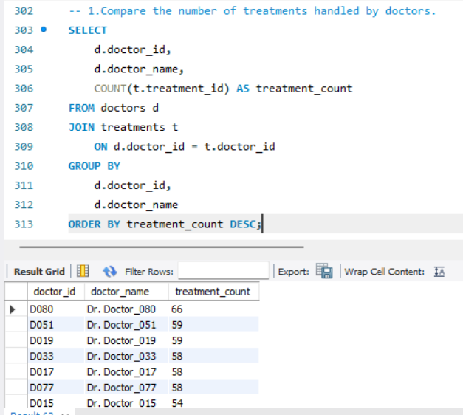
DOCTOR & ROOM PERFORMANCE
Key Questions Analysed
Which doctors handle the highest number of treatments?
How is treatment workload distributed among doctors?
Which doctors have higher treatment activity?
What types of rooms are available?
How can doctor and room utilization be evaluated?
Business Metrics Used
Doctor
Specialty
Treatment count
Treatment status
Doctor rating
Room type
Room availability
Room capacity
Treatment activity

Slide 14
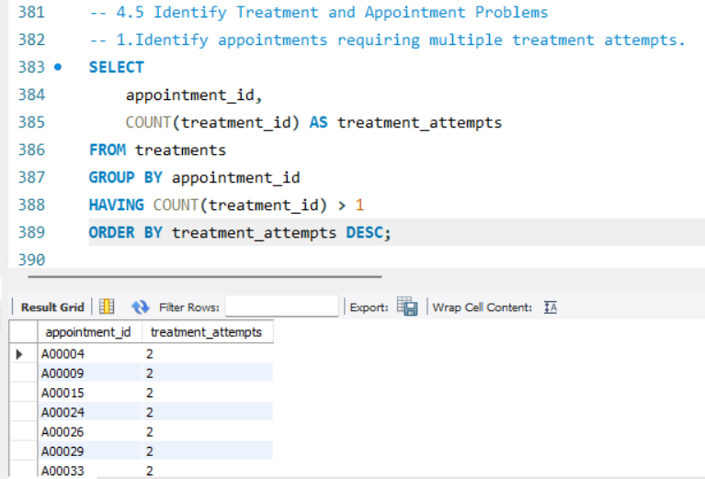
TREATMENT & APPOINTMENT PROBLEMS
Key Questions Analysed
Which appointments require multiple treatment attempts?
Is waiting time higher for appointments requiring repeated attempts?
How can treatment delays be identified?
Which operational cases require additional attention?
How can hospital treatment processes be improved?
Business Metrics Used
Appointment ID
Treatment attempts
Average waiting time
Treatment duration
Treatment status
Treatment count
Appointment priority

Slide 15
KEY BUSINESS INSIGHTS , CONCLUSION& RECOMMENDATIONS
INSIGHTS (BUSINESS UNDERSTANDING)
Kochi has the highest appointment activity with 440 appointments, indicating higher patient demand. P0216 has the highest cumulative estimated appointment value of approximately 81,348. 70.40% of treatments are completed, while the remaining treatments include rescheduled, cancelled, no-show and in-progress cases. Dr. Doctor_080 handles the highest treatment workload with 66 treatments, indicating higher doctor workload. Multiple treatment attempts are present for several appointments, highlighting cases that may require additional operational attention.
RECOMMENDATIONS
• Optimize staff allocation based on treatment workload and patient demand. • Improve appointment scheduling and patient communication to reduce cancellations and no-shows. • Monitor waiting times and treatment outcomes regularly. • Investigate repeated treatment cases to identify operational issues and improve patient care
INSIGHTS SUMMARY
• Successfully analyzed hospital operations data using SQL. • Studied patient and appointment demand across different dimensions. • Evaluated treatment performance, waiting time, and treatment outcomes. • Analyzed doctor workload and operational performance. • Identified appointment and treatment-related problems, including repeated treatment attempts. • Converted SQL analysis into meaningful business insights and recommendations

Slide 16

THANK YOU

