Slide 1


Personal Key Indicators of Heart Disease
C KAUSTUBH
SME : RAKSHITH RAMPRASAD
(THE MESSIAH )

Slide 2


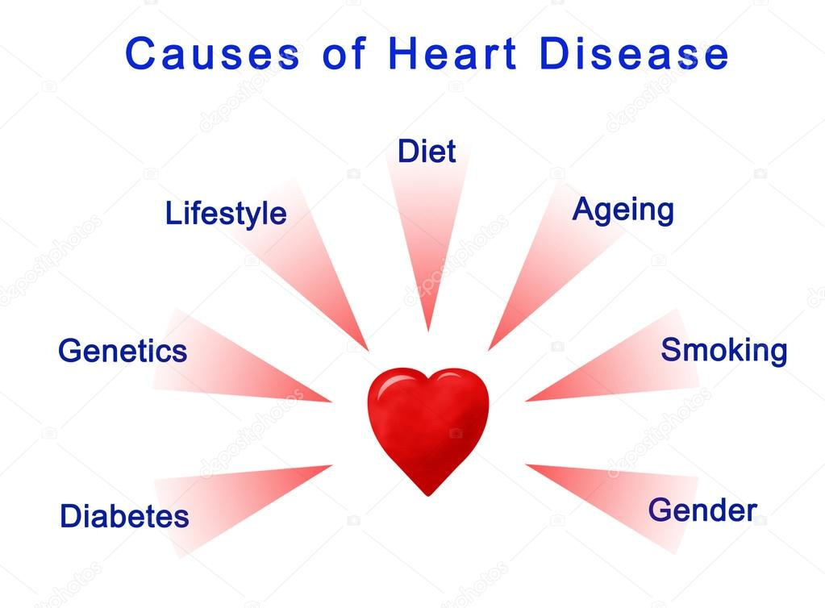
What is the Topic of this Project?
According to the CDC, heart disease is one of the leading causes of death for people of most races in the US (African Americans, American Indians and Alaska Natives, and white people).
About half of all Americans (47%) have at least 1 of 3 key risk factors for heart disease: high blood pressure, high cholesterol, and smoking.
Other key indicator include diabetic status, obesity (high BMI), not getting enough physical activity or drinking too much alcohol.
Detecting and preventing the factors that have the greatest impact on heart disease is very important in healthcare.
sum

Slide 3
Our Goal
Indicate the key variables that have a direct correlation and significant effect on the likelihood of Heart Disease.

Slide 4
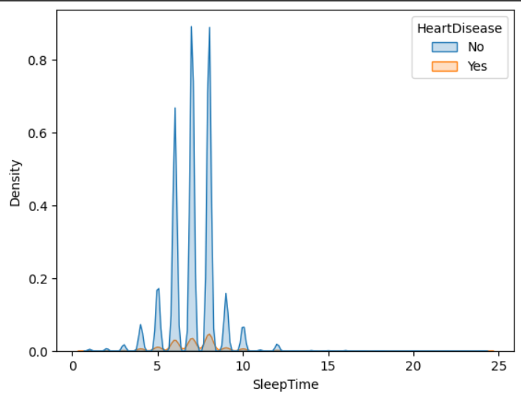
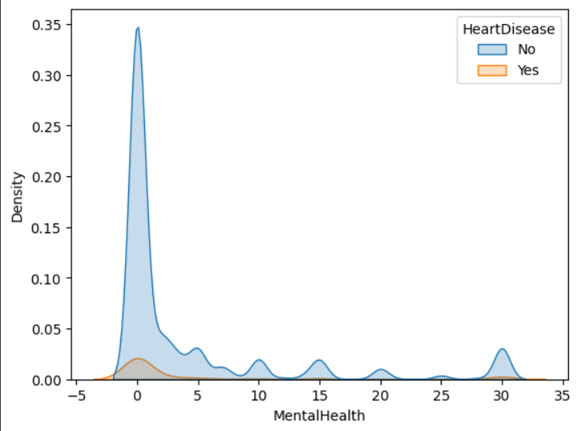
How Different Variables are related to Heart Disease.

Slide 5
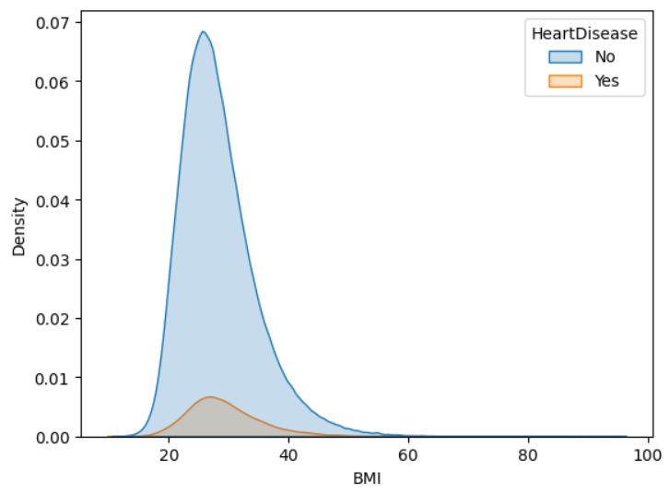
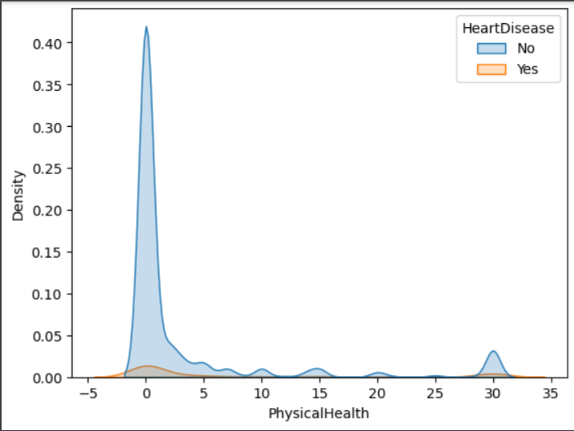
How Different Variables are related to Heart Disease.

Slide 6
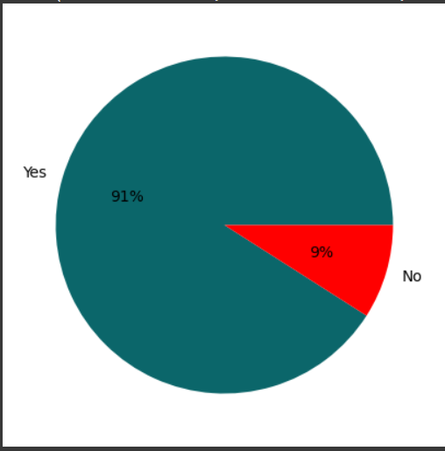
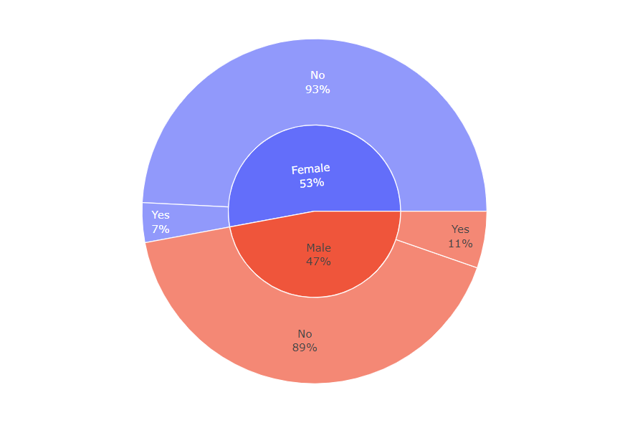
Ratio of People with and without Heart Disease
Ratio of Sex and Heart Disease.

Slide 7
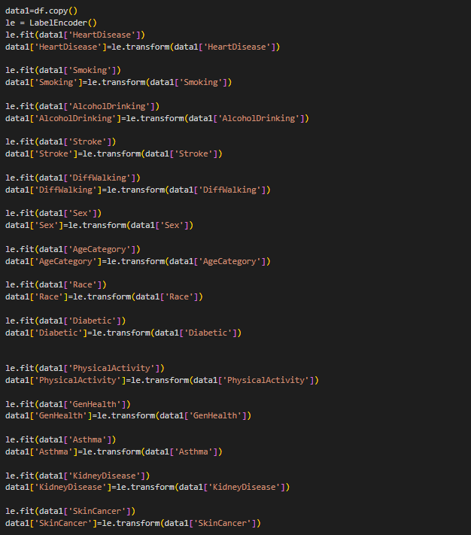
Labelling Each class Categorically

Slide 8
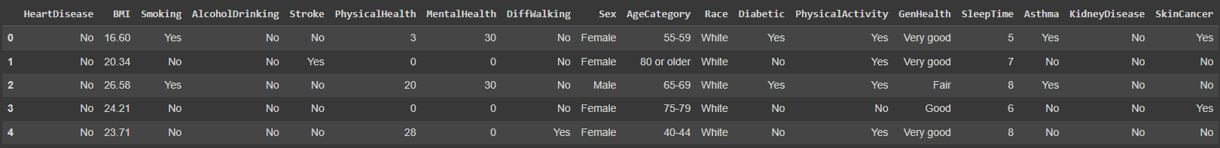
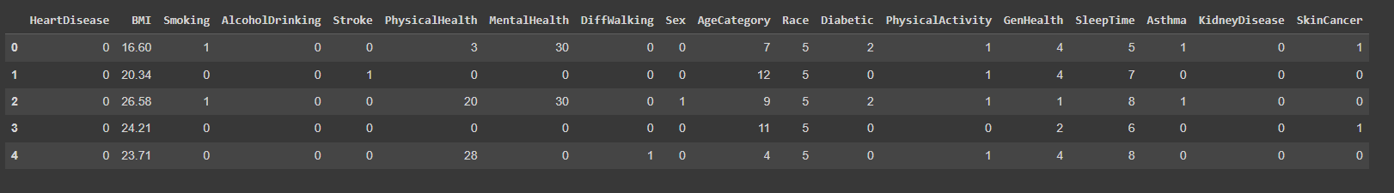
Data Post Encoding
Data Pre-Encoding

Slide 9
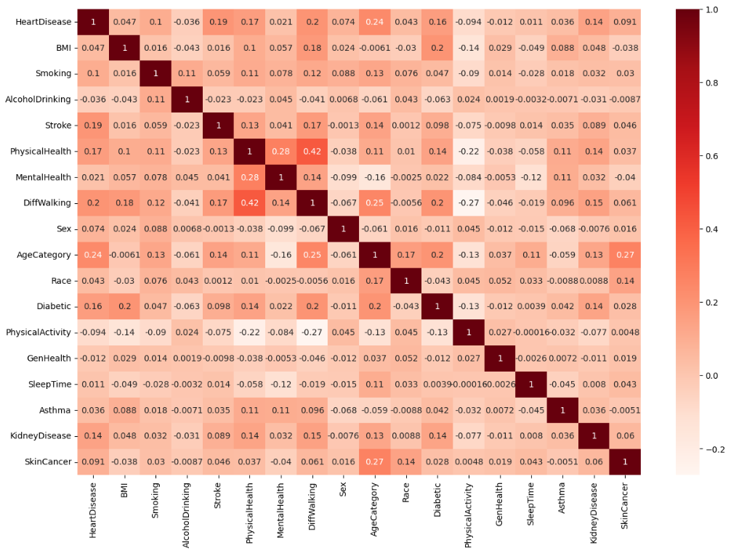
Correlation Between Each Variable

Slide 10
Process
RandomForestClassifier: Using GridSearchCv(with Hyperparameter Tuning)
(Without Handling Imbalance):
0.909800 using {'max_depth': 4, 'max_features': 5}
We used two machine learning models , Decision Tree Classifier and Random Forest Classifier.
We prepared two variations for the models, with and without class imbalance handling.
The Results were as follows.
RandomForestClassifier: (without Hyperparameter Tuning)(With Class Imbalance Handling):
Train Score : 0.9979304515113534 Test Score : 0.9671276998863205 accuracy : 96.71276998863205 (411684, 17) (411684,)
DecisionTreeClassifier (without Hyperparameter Tuning)(With Class Imbalance Handling):
Train Score : 0.9979304515113534 Test Score : 0.9506441834028041 accuracy : 95.06441834028041 (411684, 17) (411684,)

Slide 11
Conclusion
We were able to predict the possibility of a person having Heart Disease with close to 97% accuracy(using RandomForestClassifier).

Slide 12
THANK YOU!!!

