Slide 1


UE23AM441A – Capstone Project Phase – 3
Project Progress Review # 1
Project Title : Whose Indian Accent? A Significance-Tested Subgroup Audit of Indian and Frontier ASR Systems
Project ID : PW25_BJD_05
Project Guide : Dr. Bhaskarjyoti Das
Project Team : Aditya Sharma, Adithya V Holla, C Kaustubh, Aditi Mangala Udaya

Slide 2
ASR Fairness Audit
Outline
• Abstract and Scope of the Project
• Recap: Capstone Project Phase – 2
– The evaluation pipeline (ΔDP, ΔEO, Poisson significance)
– GRL failed; GRPO/FR-CISPO on whisper-tiny — no publication-valid win yet
– August: the pivot trigger — Sarvam Saaras V3 encroaches our thesis
• List of Tasks/Modules with Individual Contribution
• Design of overall Architecture
• Demonstration: the six-system Svarah fairness audit
• References

Slide 3
ASR Fairness Audit
Abstract and Scope
Indian-accented ASR systems look fine on aggregate Word Error Rate, but nobody checks whether the errors fall evenly across accents, or whether an observed gap is real structure versus statistical noise. Phase 2 built an evaluation protocol for exactly this on Svarah (19 accents → 3 language families), pairing every gap with a Poisson significance test.
In August, we found Sarvam's flagship Saaras V3 had been evaluated on our exact benchmark — shipped by a funded lab, with only an aggregate WER, no subgroup breakdown and no significance test. Rather than race a training result we cannot out-resource, Phase 3 points our own protocol at every ASR system we can reach: the open Whisper family, Saaras V3, and Qwen3-ASR. Six systems, one frozen decode and scoring path, six statistically significant per-family gaps.

Slide 4
ASR Fairness Audit
Summary of Work Done in Phase – 2, and Why We Pivoted
• Built a Svarah evaluation pipeline: ΔDP, ΔEO, per-family noise-robustness, Poisson drop-in-deviance p-value
• GRL (Wav2Vec2 + LoRA) adversarial de-biasing WIDENED the accent gap — SPIRE-SIES has zero Sino-Tibetan speakers, so the adversary cannot reverse a gradient for a group it never sees
• Pivoted to GRPO / FR-CISPO RL post-training on whisper-tiny — safety-gated (per-token KL, ratio caps): H0 (300-cycle run at 3 learning rates) refuted, H6 replication failed at seed 2028; no publication-valid result yet on Svarah (authoritative speaker IDs unobtainable)
• One banked, real result: the SPIRE-SIES cross-corpus ladder — 29.89% → 24.79% overall WER, worst-20%-speaker WER ‒23.87 pp (4.7× the average gain) — but the explicit fairness term is provably inert
• August literature pass (63 records → 12 kept): Sarvam's Saaras V3 was validated on our exact Svarah benchmark; ASR-FAIRBENCH already publishes our Poisson-test idea; a Nov-2025 paper shows third-party ASR audits get through review
• → Pivot: stop competing on a training result, ship the audit our own pipeline was always capable of

Slide 5
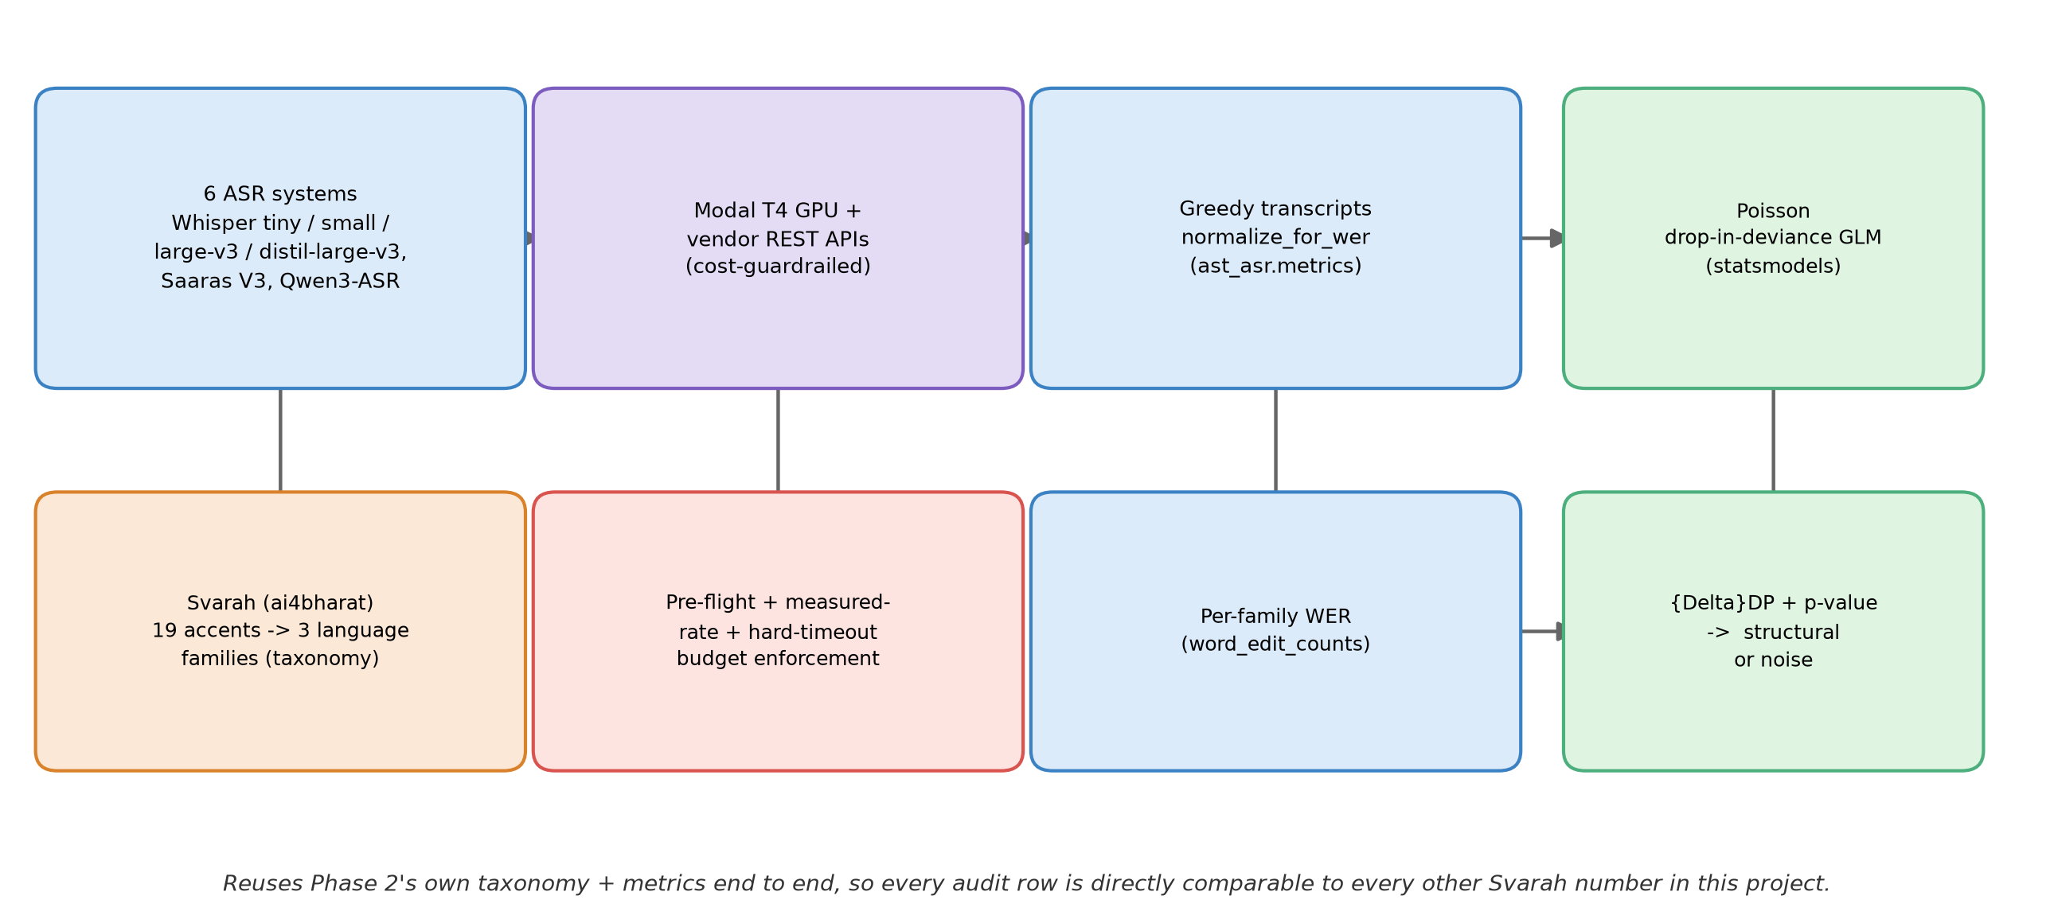
ASR Fairness Audit
Architecture
One frozen pipeline, six systems: acquire → transcribe → score → test → verdict

Slide 6
ASR Fairness Audit
List of Tasks/Modules
• Data module — Svarah loader (ai4bharat/svarah), 19-accent → 3-family taxonomy, per-family stratified sampling
• Whisper-family audit module — whisper-tiny / small / large-v3 / distil-large-v3 on Modal T4 GPUs, 2,500 clips each
• External-API module — Sarvam Saaras V3 REST client (cached, rate-limited) and Qwen3-ASR-0.6B via Transformers
• Scoring module — ast_asr.metrics.normalize_for_wer / word_edit_counts, reused unchanged from Phase 2
• Statistics module — Poisson drop-in-deviance GLM (statsmodels) → ΔDP + p-value + structural/noise verdict
• Cost-guardrail module — pre-flight estimate, in-run measured-rate re-plan, hard Modal timeout on every job
• Results-assembly module — schema-hard-fail assembler (9/9 pytest green) that recomputes every reported number straight from the per-utterance CSVs and cross-checks it against each summary JSON
• Side-quest module — on-policy distillation (whisper-tiny ← whisper-large-v3) PoC on Modal, parked as a future direction
• Tools / tech: Modal (serverless GPU), PyTorch + Transformers, HF Datasets/torchcodec, statsmodels, Sarvam Saaras V3 API, Qwen3-ASR — all open-source or free-tier API access

Slide 7
ASR Fairness Audit
Individual Contribution
Member | Task / Module | Contribution | Status
Aditya Sharma | Whisper-family fleet | Ported Phase 2's eval pipeline to Modal; whisper-tiny/small/large-v3/distil-large-v3, 2,500 clips each | Complete
Adithya V Holla | External systems | Sarvam Saaras V3 client (cache + backoff) and Qwen3-ASR-0.6B feasibility + run | Complete
Aditi Mangala Udaya | Assembly & receipts | Schema-hard-fail results assembler (9/9 tests green, reproduces all 6 rows exactly); 3-source receipts pack (PDF); fixed the HuBERT-row and [17]-citation report bugs | Complete
C Kaustubh | Pivot lead + audit | Literature search, pivot memo, blockers A/B, on-policy distillation side-quest (whispr-nano), and ran all six audit systems end-to-end to hit this review's deadline | Complete
Note: given the review deadline, Kaustubh personally ran all six audit systems (including the Whisper-family and external-API tracks) and completed the assembler/receipts/report-fix tasks on Modal + the vendor APIs; ownership above reflects the planned task split and hand-off documentation, which the team is now reconciling in parallel.

Slide 8
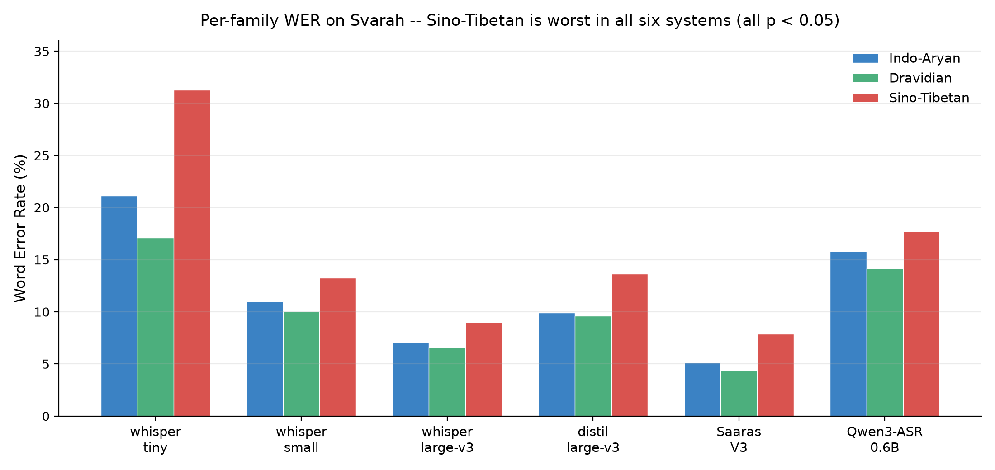
ASR Fairness Audit
Demonstration: the Six-System Svarah Fairness Audit
System | Overall WER | Worst family | ΔDP (pp) | Poisson p | n | Cost
whisper-tiny | 20.60% | Sino-Tibetan | 14.19 | 3.3e-24 | 2,500 | $0.034
whisper-small | 10.88% | Sino-Tibetan | 3.18 | 0.0045 | 2,500 | $0.095
whisper-large-v3 | 7.04% | Sino-Tibetan | 2.38 | 0.0152 | 2,500 | $0.411
distil-large-v3 | 10.03% | Sino-Tibetan | 4.02 | 0.00025 | 2,500 | $0.285
Saaras V3 | 5.81% (best) | Sino-Tibetan | 3.45 | 0.00023 | 450 | $0.226
Qwen3-ASR-0.6B | 15.49% | Sino-Tibetan | 3.57 | 0.0013 | 2,500 | $0.142
All six systems: Sino-Tibetan worst, all p < 0.05 (structural). Total cost across all six: $1.193. Best overall WER (Saaras V3) does not close the fairness gap — aggregate WER hides subgroup movement.
Bonus — whispr-nano (side-quest, $0.16):
On-policy WER: 10.09% → 7.89%
On-policy KL: 0.633 → 0.496
Off-policy WER: 10.09% → 7.57%
Off-policy KL: 0.633 → 0.524
On-policy wins on calibration — matches the LLM-distillation literature (GKD).

Slide 9
ASR Fairness Audit
References
[1] A. Radford, J. W. Kim, T. Xu, G. Brockman, C. McLeavey, and I. Sutskever, “Robust Speech Recognition via Large-Scale Weak Supervision,” arXiv:2212.04356, 2022.
[2] T. Javed et al., “Svarah: Evaluating English ASR Systems on Indian Accents,” in Proc. INTERSPEECH 2023, pp. 5087–5091, 2023.
[3] A. K. Rai, S. Rahangdale, U. Anand, and A. Mukherjee, “ASR-FAIRBENCH: Measuring and Benchmarking Equity Across Speech Recognition Systems,” in Proc. INTERSPEECH 2025, 2025.
[4] S. Kumar et al., “ASR Under the Stethoscope: Evaluating Biases in Clinical Speech Recognition across Indian Languages,” arXiv:2512.10967, 2025.
[5] A. Koenecke et al., “Racial disparities in automated speech recognition,” Proc. Natl. Acad. Sci., vol. 117, no. 14, pp. 7684–7689, 2020.
[6] Z. Liu, I.-E. Veliche, and F. Peng, “Model-Based Approach for Measuring the Fairness in ASR,” in Proc. ICASSP, pp. 6532–6536, 2022.
[7] S. Sagawa, P. W. Koh, T. B. Hashimoto, and P. Liang, “Distributionally Robust Neural Networks for Group Shifts,” arXiv:1911.08731, 2020.
[8] P. G. Shivakumar, Y. Gu, A. Gandhe, and I. Bulyko, “Group Relative Policy Optimization for Speech Recognition,” in Proc. IEEE ASRU, 2025.
[9] R. Agarwal et al., “On-Policy Distillation of Language Models: Learning from Self-Generated Mistakes,” in Proc. ICLR, 2024.
[10] Thinking Machines Lab, “On-Policy Distillation,” Company blog, 2025.
[11] S. Gandhi, P. von Platen, and A. M. Rush, “Distil-Whisper: Robust Knowledge Distillation via Large-Scale Pseudo Labelling,” arXiv:2311.00430, 2023.
[12] Sarvam AI, “Introducing Saaras V3,” Company blog, Feb. 2026. [Online]. Available: sarvam.ai/blogs/asr

Slide 10
Thank You

