Slide 1

International Conference on Innovative Research in Science and Technology (IRST-2023), May 23-25, 2023
Systems And Methods to Implement Smart Roof
Authors
Prof. Priyanka Bhatele
Soham Nimale
Sneha Jain
Sneha Bhat
Soham Gargote
Tanuj Somani
Somnath Ghadge
Session ID: S-115
Paper ID: IRST-2023-0176
Presented by:
Sneha Jain
Soham Nimale (Corresponding Author)
DEPARTMENT OF ENGINEERING SCIENCES AND HUMANITIES (DESH)
VISHWAKARMA INSTITUTE OF TECHNOLOGY, PUNE
[Sneha Jain] [Vishwakarma Institute of Technology] [Session ID: X] [Paper ID: IRST-2023-0176]

Slide 2
Table of Contents
Systems And Methods to Implement Smart Roof
Introduction
Problem Statement and Objectives
Literature Review
Methodology
Algorithms
Prototype
Results
Conclusion
References
[Sneha Jain] [Vishwakarma Institute of Technology] [Session ID: X] [Paper ID: IRST-2023-0176]

Slide 3
Introduction
Systems And Methods to Implement Smart Roof
NATURE provides us with valuable resources like sunlight and rainfall.
But, an excess amount of both can degrade the plant quality.
Too many hours of sunlight can cause bleached foliage.
Excess rainfall can destroy nursery bed herbs, plants, and various ornamental flowers.
Problems like soil erosion, water logging, and so forth are also caused by heavy rainfall.
We propose the development of a smart roofing system that cost-effectively, and efficiently manages rain and sunlight and thus, protects the plants.
[Sneha Jain] [Vishwakarma Institute of Technology] [Session ID: X] [Paper ID: IRST-2023-0176]

Slide 4
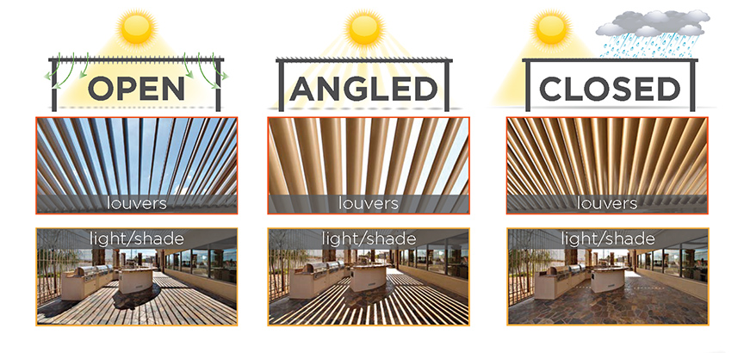
Problem Statement and Objectives
Systems And Methods to Implement Smart Roof
To create a system to help control the impact of heavy rainfall and harmful intensities of sunlight on plants.
To create smart automated roofing system for vehicle parking areas, farms, lawns, etc.
To collect local weather data for weather prediction and analysis.
Image [1] Outdoor Louvered Roof in three different weather conditions.
[Sneha Jain] [Vishwakarma Institute of Technology] [Session ID: X] [Paper ID: IRST-2023-0176]

Slide 5
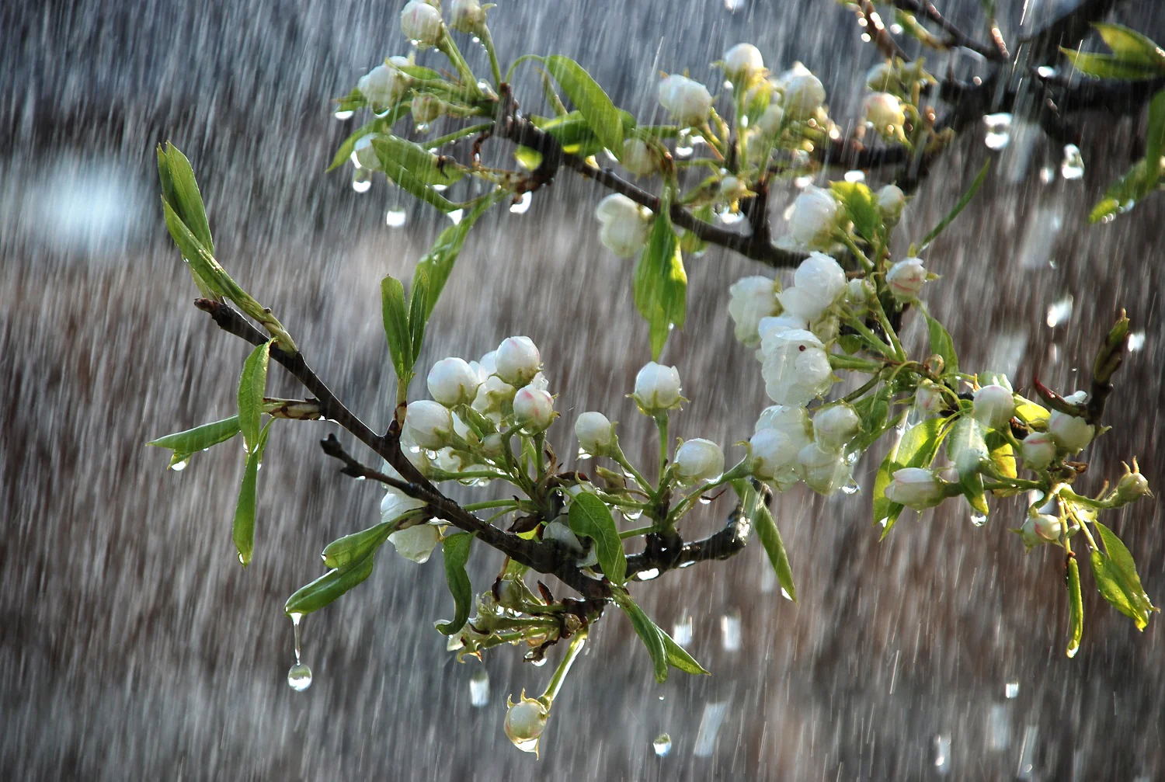
Literature Review
Systems And Methods to Implement Smart Roof
Some important points from Literature Review:
Rain detection using Arduino uno and rain sensors.
Light dependent resistance sensors.
Relation between plants and water.
Different purpose roofs.
Working of Servo Motors.
Image [2]. Affects of heavy rain on plants
[Sneha Jain] [Vishwakarma Institute of Technology] [Session ID: X] [Paper ID: IRST-2023-0176]

Slide 6
Methodology
Systems And Methods to Implement Smart Roof
Sensors
Raindrop sensor & LDR -
Sense rain and light
Power
Supply
Microcontroller
Arduino Uno -
Brain of system
Actuator
Servo motor
Roof open/close
[Sneha Jain] [Vishwakarma Institute of Technology] [Session ID: X] [Paper ID: IRST-2023-0176]

Slide 7
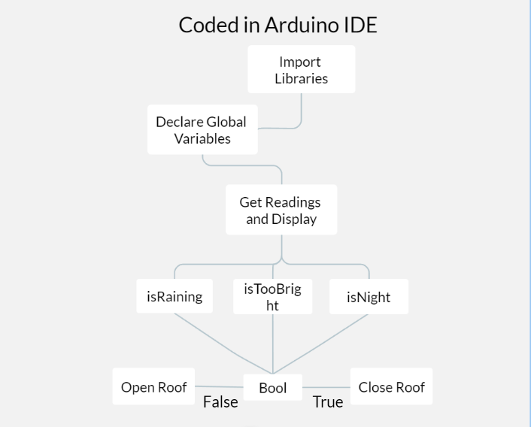
Systems And Methods to Implement Smart Roof
Algorithm
&
Flowchart
[Soham Nimale] [Vishwakarma Institute of Technology] [Session ID: X] [Paper ID: IRST-2023-0176]

Slide 8
Prototype
Systems And Methods to Implement Smart Roof
Arduino UNO based circuit with Servo Motor for high Torque.
Automation system runs on 10-12 V. (DC)
Servo Motor needs external power supply (15kWh)
Collected data is stored in external storage via Arduino UNO.
[Soham Nimale] [Vishwakarma Institute of Technology] [Session ID: X] [Paper ID: IRST-2023-0176]

Slide 9
Results
Systems And Methods to Implement Smart Roof
Figure 1: sunlight intensity vs time
Data collected from LDR shows the drop of sunlight intensity approximately from reading 500 to 1500.
Figure 2: rain intensity vs time
Data collected shows the rain sensor detected rain approximately from reading number 500 to 1500.
[Soham Nimale] [Vishwakarma Institute of Technology] [Session ID: X] [Paper ID: IRST-2023-0176]

Slide 10
Conclusion and Future Scope
Systems And Methods to Implement Smart Roof
Conclusion:
Cost-effective and efficient system
Protection of plants.
Improvement in the quality and quantity of the harvest.
(specifically in floriculture sector)
Easily accessible to the farmers.
Customization of functionality.
Future Scope:
Solar energy and rainwater harvesting.
(The slope of the roof should be about 30 to 45 degrees from the horizontal for optimal rainwater harvesting).
Use of AIML/similar technology for weather prediction using collected data.
[Soham Nimale] [Vishwakarma Institute of Technology] [Session ID: X] [Paper ID: IRST-2023-0176]

Slide 11
References
Systems And Methods to Implement Smart Roof
Image [1]. https://www.johnroccosales.com/equinox-louvered-roof
Image [2]. ugaoo.com/blogs/garden-maintenance/how-to-protect-plants-from-rain
[Soham Nimale] [Vishwakarma Institute of Technology] [Session ID: X] [Paper ID: IRST-2023-0176]

Slide 12
Systems And Methods to Implement Smart Roof
Thank You
[Soham Nimale] [Vishwakarma Institute of Technology] [Session ID: X] [Paper ID: IRST-2023-0176]

