Slide 1

Advanced Data Structures
Course Project
Title: Multi-stage Matching for EDAI Guides
Allocation using Gale-Shapley algorithm
Project Guide: Dr. Girija Limaye and Dr. Pushkar Joglekar
Group Members:
Sarthak Pithe 1
Hrishikesh Potnis 2
Soham Nimale 44
Madhur Vaidya 61
Group ID: SY-34

Slide 2



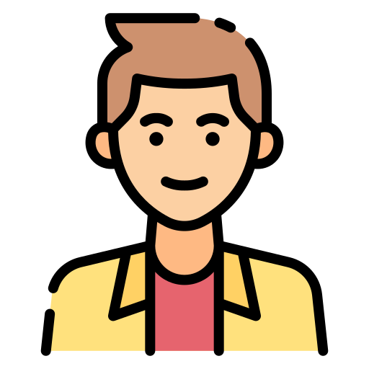


Introduction
What do we mean by “Matching”?
Generation of best possible pairs in a given scenario

Slide 3






Why are matchings so powerful?
JoSAA
Students to hostels
Resource Allocation
PG seat allocations
Game Theory

Slide 4
Setup of a Matching Problem
Two separate sides (Bipartite)
Each element of one side tries to match with some element of the other side
Each element on one side gives preferences of the elements on the other side
The matchings must be optimized in one or the other way

Slide 5
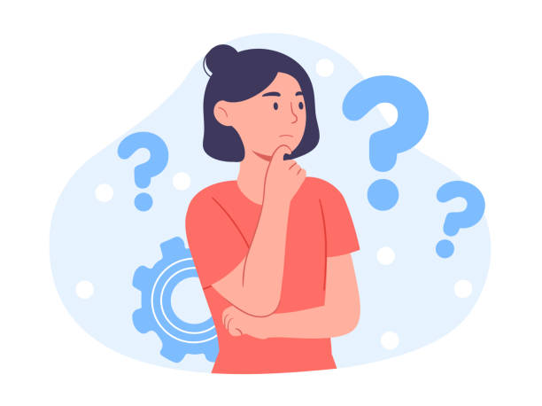
Problem Statement
To develop an optimal EDAI guide matching algorithm based on Gale-Shapley algorithm.

Slide 6
Challenges
Preferences of both sides matter
No preference given
Many to one matching
Variable Capacity of Guides
Conventional matchings not possible

Slide 7

Our Proposed Solution
Multi-staged approach
For each stage, Gale- Shapley based matchings
‘Capacity’ for guides
For last stage - take all preferences (complete graph)

Slide 8

Video Example & Explanation

Slide 9
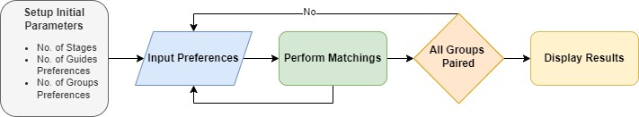
System Flow

Slide 10
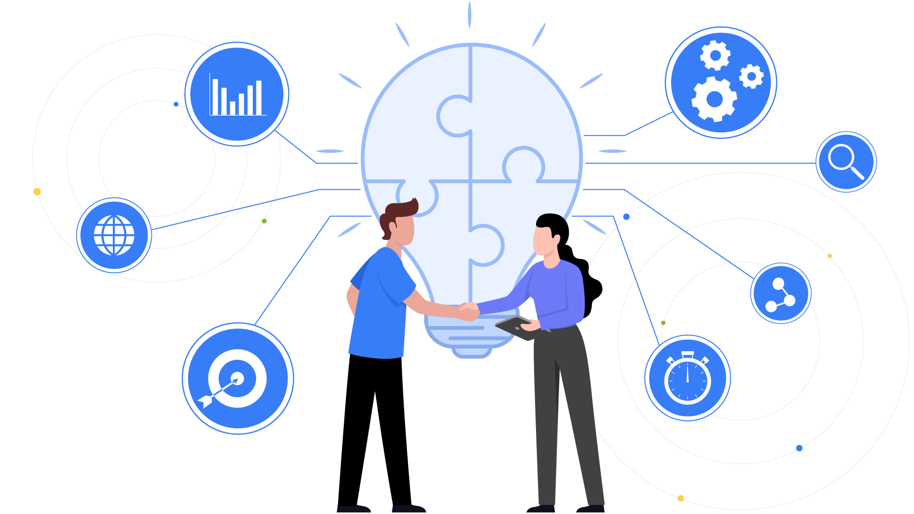
Mathematical Proof of Concept

Slide 11
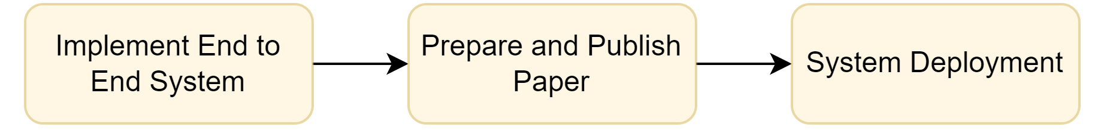
Roadmap

Slide 12
Comparison With Existing Solution
Existing Solution | Our Solution
Time Consuming | Efficient and Optimal
Manual Work | Automated Work
Preferences not matter | Preferences matter
Not standardized | Standardized

Slide 13
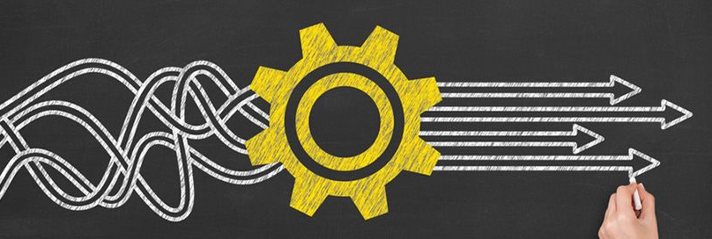
Conclusion
Efficient & Pragmatic Solution
Preferences Matter
Standardization of System
Novel Solution

Slide 14
THANK YOU!

Slide 15
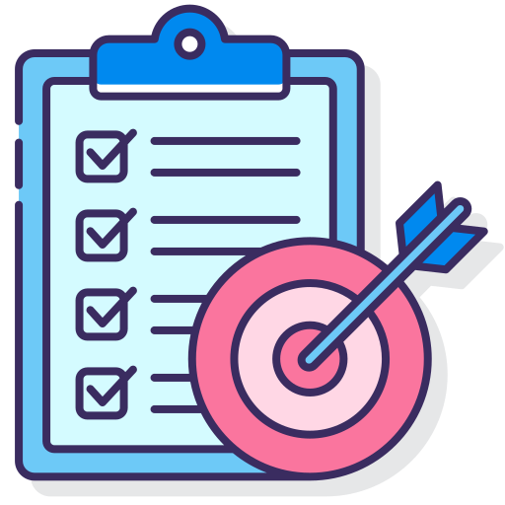
Objectives
Each group should be allocated to guides such that there should be no such pairs of guides and groups that would both prefer each other over their current matchings making the matching stable.
The algorithm should be multi-staged but all stages should be stable so that groups can make preferences to the guides in multiple rounds so that they get the best match.
There should a two way preference.

