Slide 1

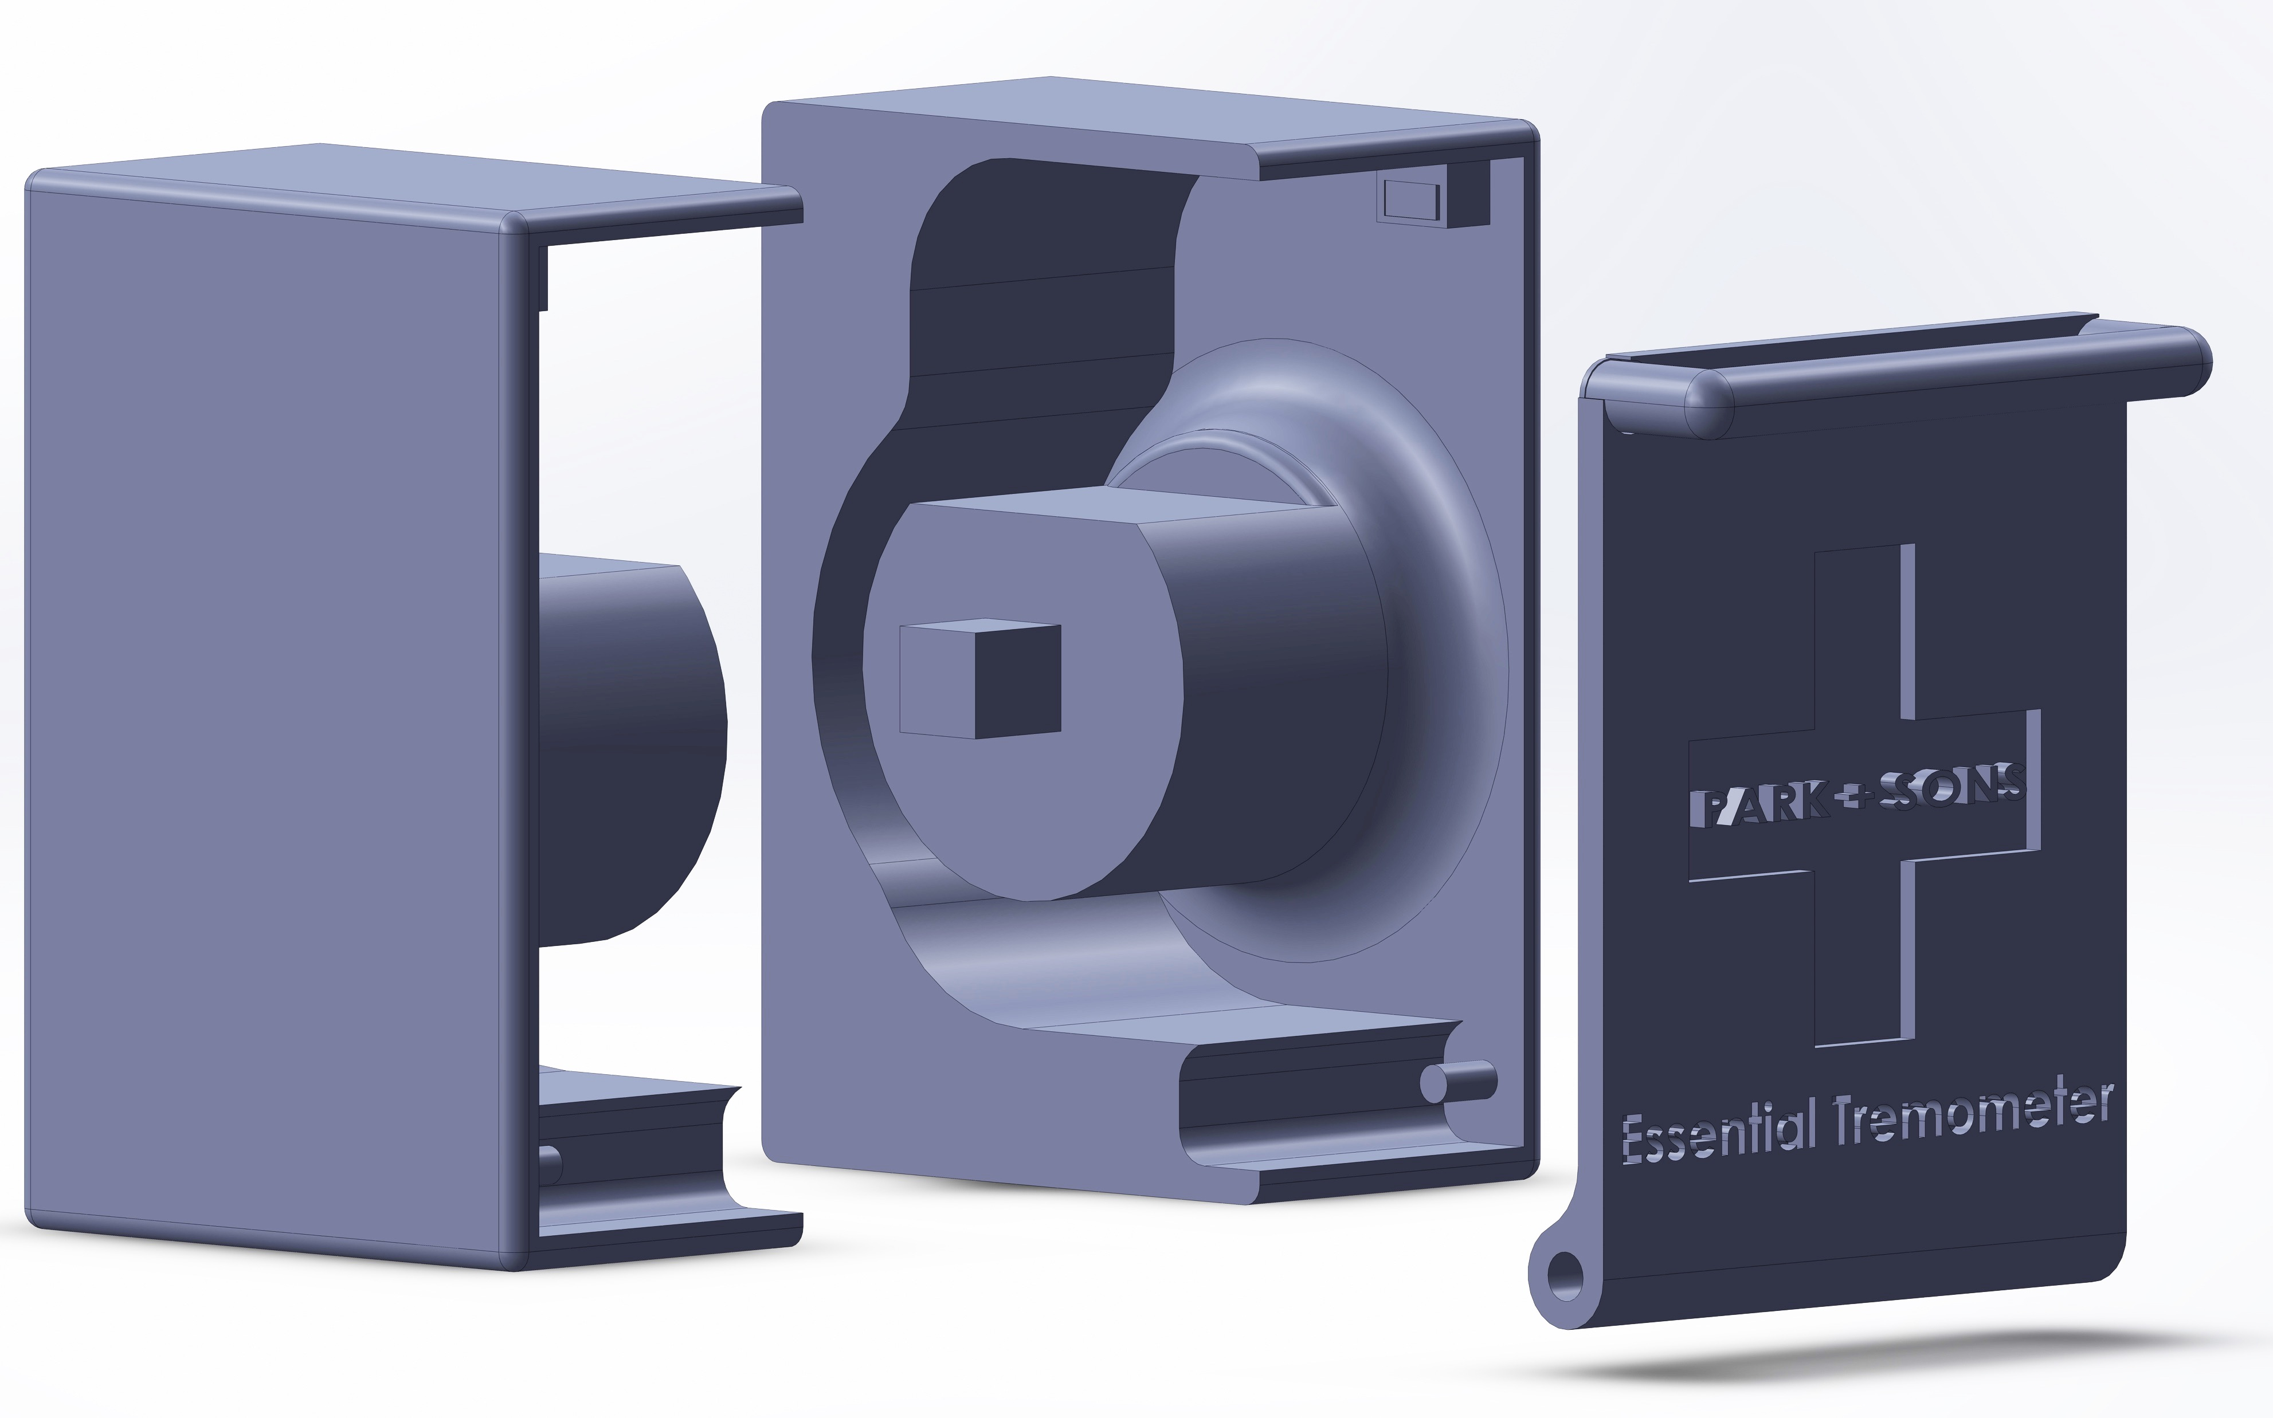
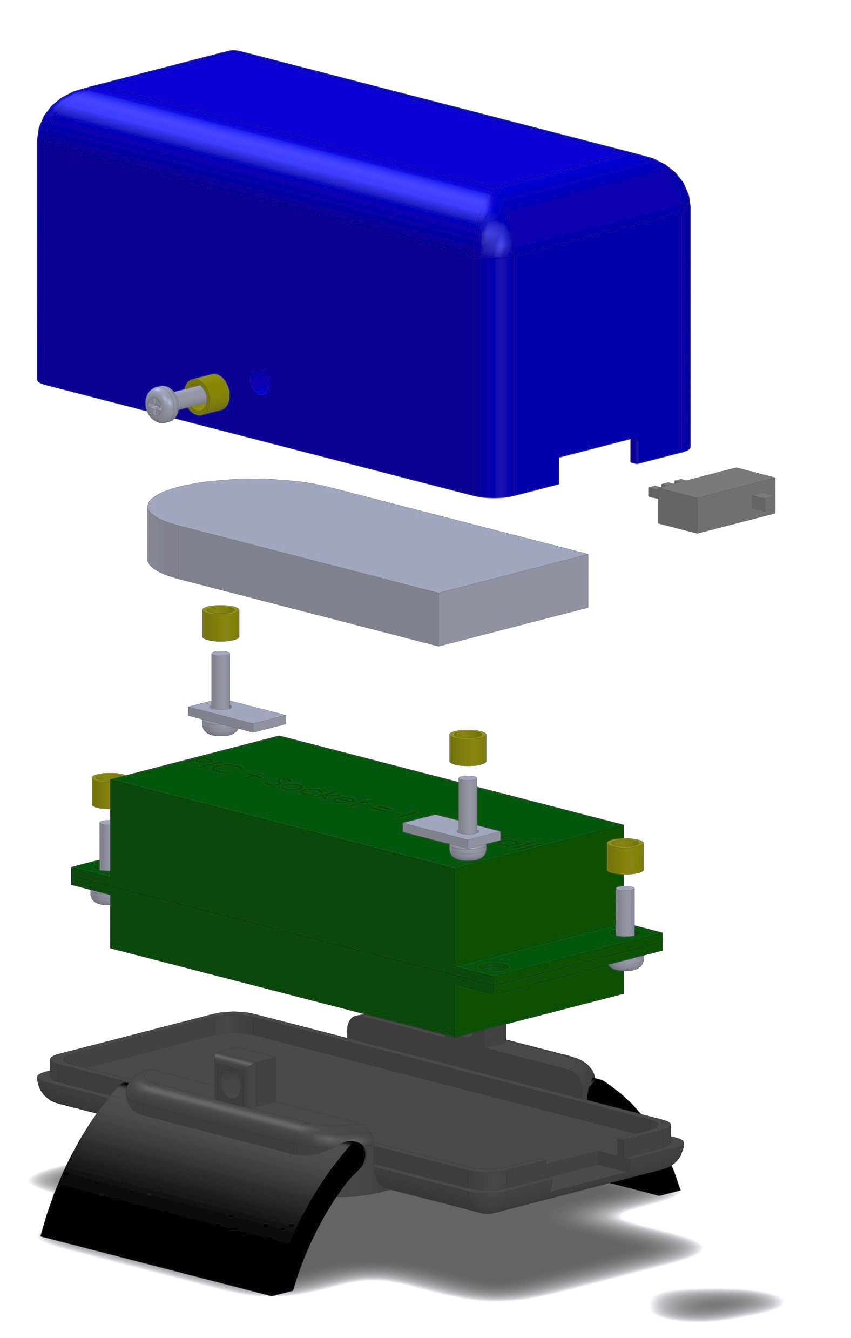
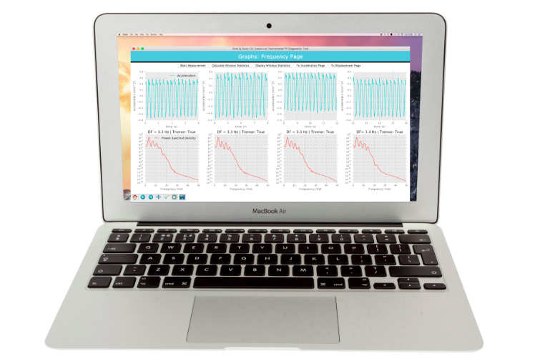
Quantification of Parkinsonian Tremor and Essential Tremor Using a Novel Bluetooth-Integrated, Accelerometer-Based System Caroline Kittle, Sai N. Nimmagadda, Eric Musselman, David Whisler Department of Biomedical Engineering, Duke University – BME464L – Patrick Wolf, Ph.D
Introduction
A
C
B
Figure 4: The Essential Tremometer Diagnostic System
Conclusions & Next Steps
Abstract
Figure 1: Sample analysis of signals from device with and without tremor
(A) Filtered, gravity compensated acceleration signal of subject with tremor (left) and no tremor (right). (B) Calculation of displacement
Figure 1: Sample analysis of signals from device with and without tremor
(A) Filtered, gravity compensated acceleration signal of subject with tremor (left) and no tremor (right). (B)
A
B
Acknowledgments
Figure 1: Sample analysis of signals from device with and without tremor
(A) Filtered, gravity compensated acceleration signal of subject with tremor (left) and no tremor (right). (B)

