Slide 1
Graduate Rotational Internship Program
Computer Vision and IoT
Animesh Sarkar Tusher
Computer Vision and IoT intern at “The Spark Foundation”
October 2022

Slide 2
Task 1 - Optical Character Recognition
Level - Beginner

Slide 3
Let’s Try with the First Image

Slide 4
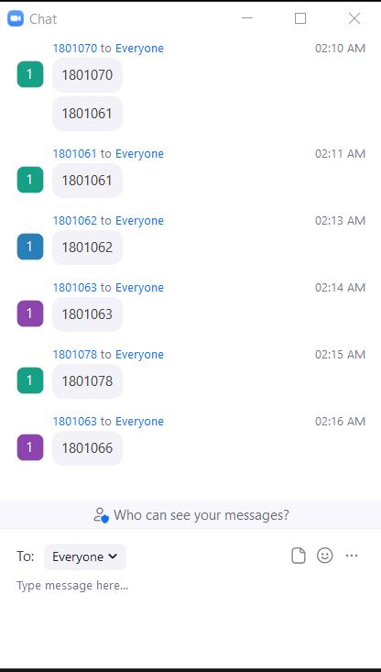
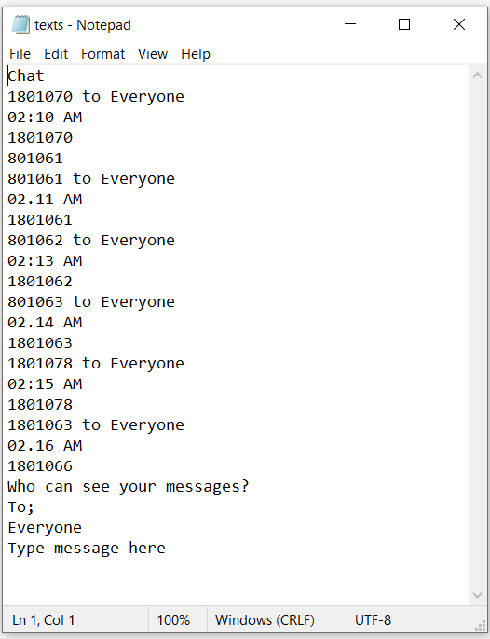
Input Image
Text File

Slide 5
Let’s Try with the Second Image

Slide 6
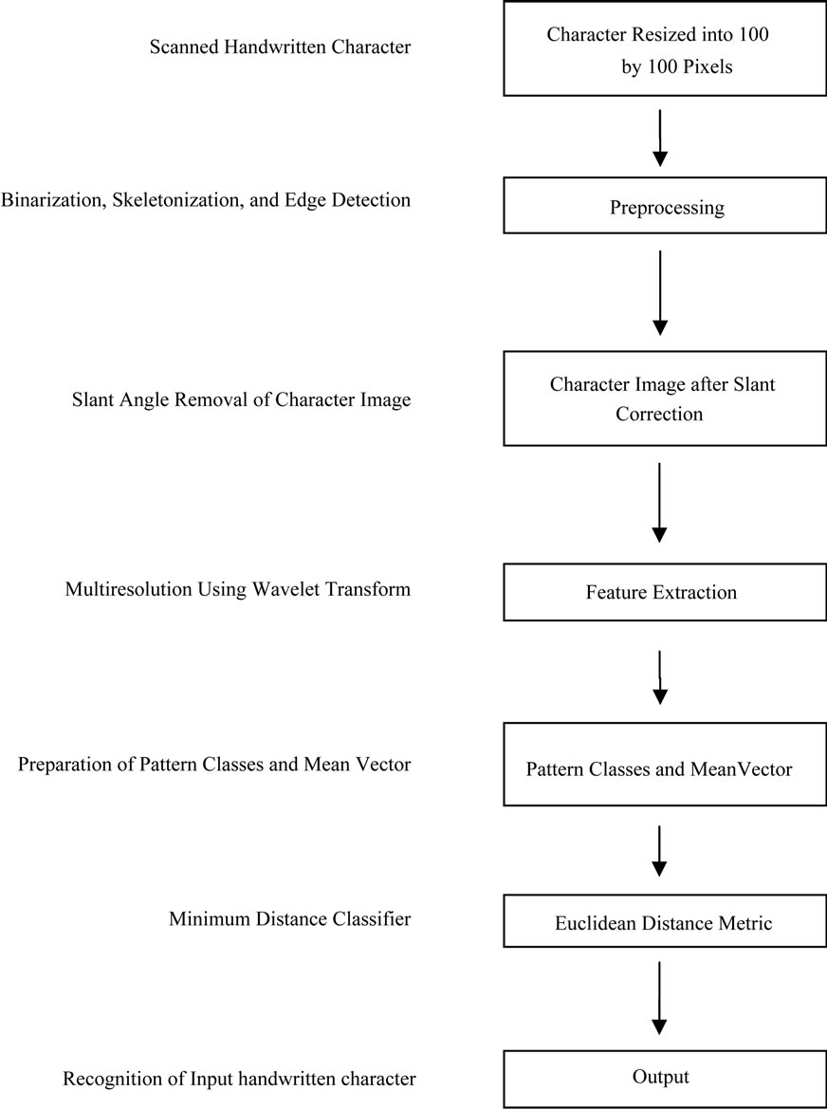
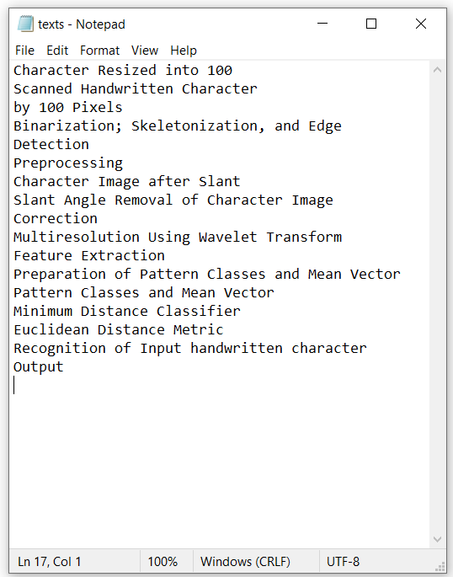
Input Image
Text File

Slide 7
Thanks to “The Spark Foundation” for
giving me this opportunity.

