Slide 1
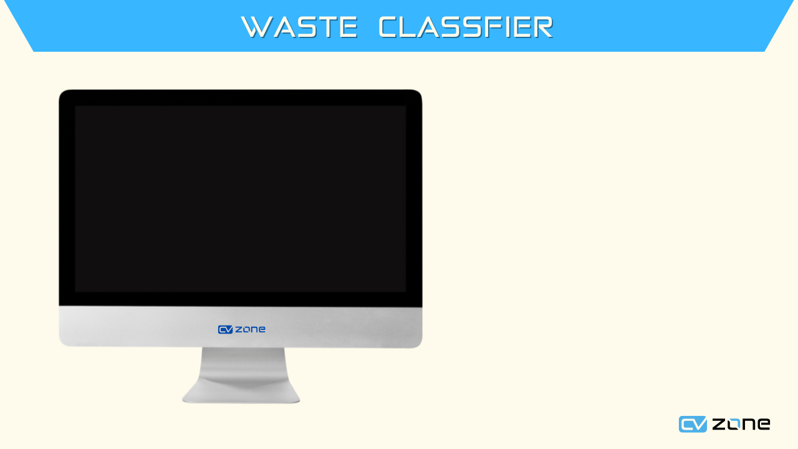
WASTE CLASSIFIER
AS

Slide 2







Slide 3



