Slide 1
Clojure On Aws lambda
Use clojuer & aws lambda to build tweet bot

Slide 2
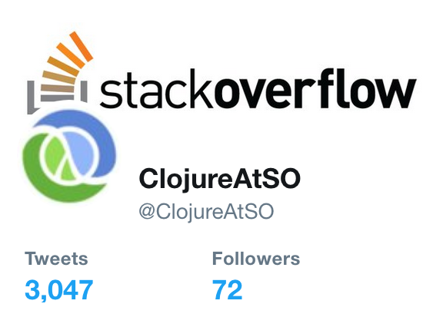

Slide 3
Background
Tweet bot which publishes clojure/clojurescript questions on stackoverflow
Original architecture
Hosted on Digital Ocean
Crob job run every 2 hours
Economically
$20/mo instance hosted both my blogs and the bot

Slide 4

Change

Slide 5

On aws lambda

Slide 6
Solutions
Java interop and AOT
Use S3 to persistent
Use the Environment Variable to save credentials
Setup AMI for cloud access
Setup AWS CloudWatch to schedule the job

Slide 7

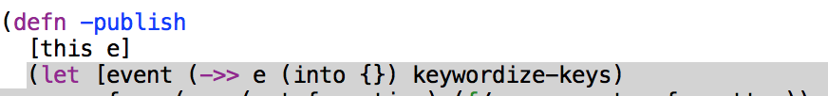
Java interop & AOT
(gen-class): create named classes for direct use as Java classes
Naming the generated class
Declaring additional methods

Slide 8
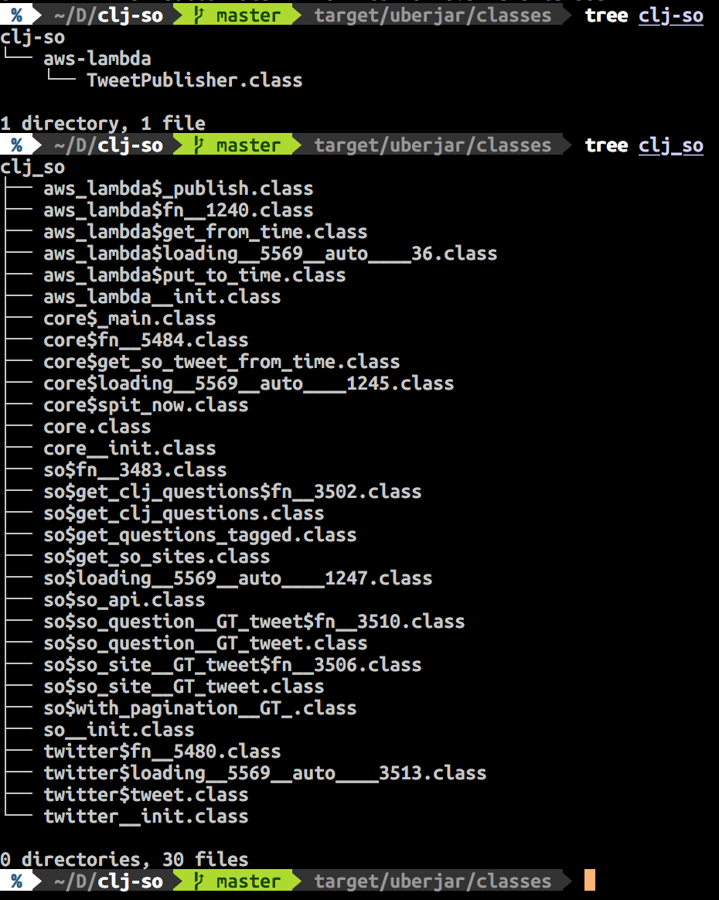
Aot
Ahead of Time Compilation

Slide 9
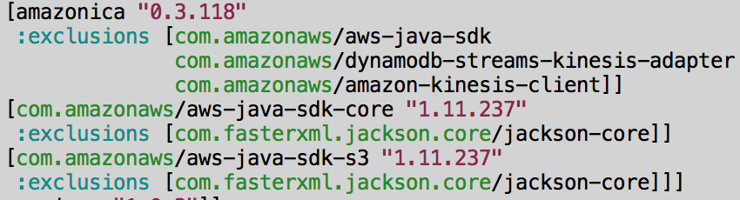
S3 Access
S3 is used to persistent the last updated time
[amazonica] is a great lib to access AWS
How to minimize the dependencies from amazonica

Slide 10
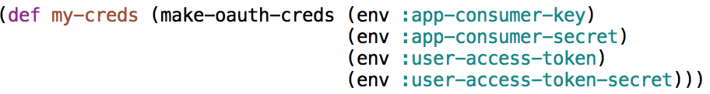
credentials
Tweet api credentials are exported by AWS Lambda as environment variables
(require ‘[environ.core :refer [env])

Slide 11
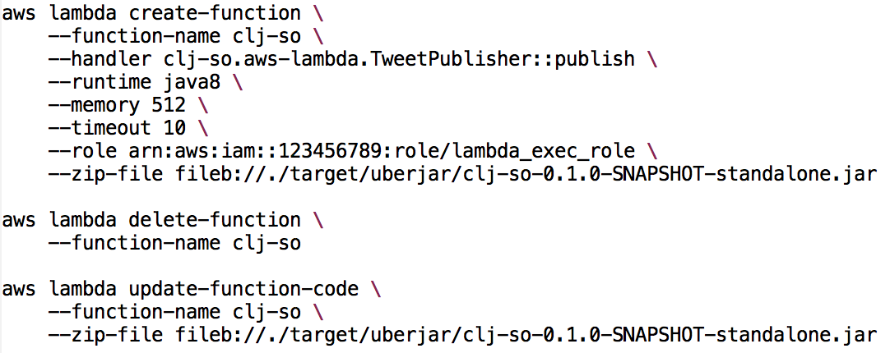
AWS Lambda

Slide 12
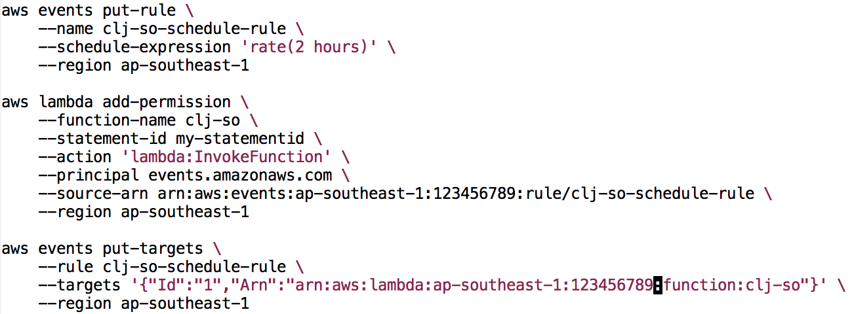
AWS Cloudwatch

Slide 13
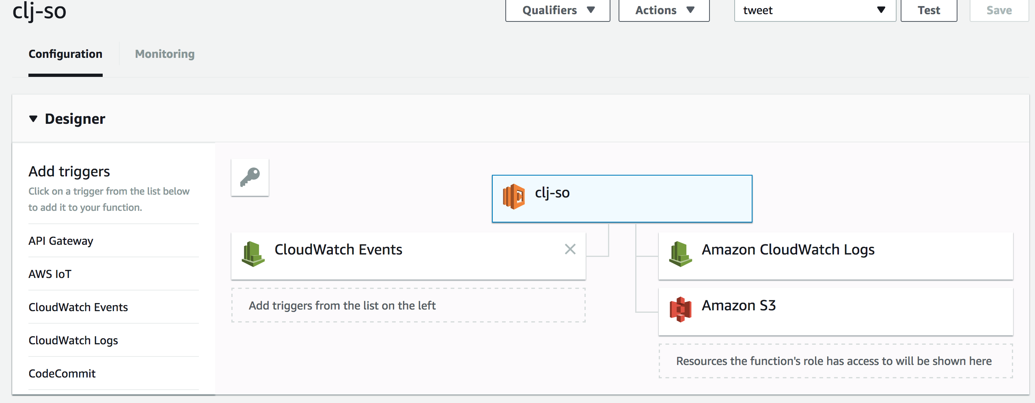
Benifits
I pay $0/mo
Nice AWS lambda console

Slide 14
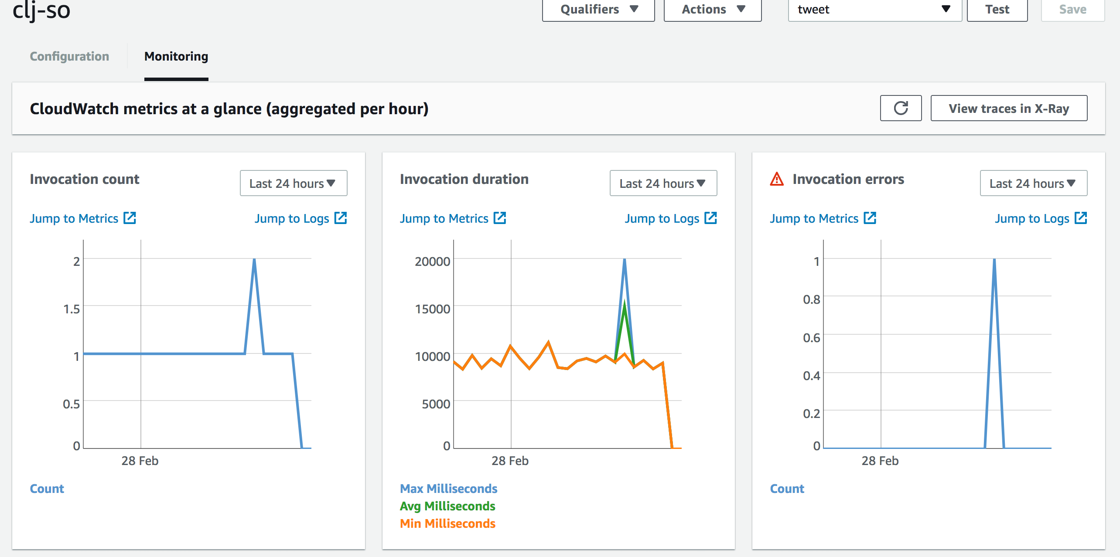
Benifits
Nice AWS CloudWatch monitoring dashboard

