Slide 1

Artificial learning and Machine learning Semester-IV (batch-2022)
Air-craft prediction system
Supervised by-
Sachin sir

Slide 2
Table of content
Introduction
Problem definition and requirement
Methodology
Result

Slide 3
Introduction
Aviation innovation at its peak, blending technology and precision engineering.
Focus: Utilizing advanced camera systems for aircraft type identification.
Method: Harnessing machine learning algorithms for real-time data processing.
Goal: Seamless detection and categorization of aircraft within camera frames.
Impact: Enhancing surveillance, airspace management, and security.
Vision: Redefining aerial identification for increased efficiency and safety.

Slide 4
Problem definition and requirement
Problem:
- Difficulty in accurately identifying and categorizing aircraft using traditional methods.
- Inefficient surveillance systems leading to potential security risks.
- Challenges in effective airspace management due to limited real-time data processing capabilities.
Solution:
- Implement advanced camera systems equipped with machine learning algorithms.
- Enable real-time data processing for swift and accurate aircraft identification.
- Enhance surveillance capabilities to mitigate security risks.
- Improve airspace management through enhanced detection and classification of aircraft types.

Slide 5
System requirement
Software Requirements:
1. **Camera System Integration:**
- Compatibility with various camera models for seamless integration.
- Support for high-definition video capture to ensure clear imagery.
2. **Machine Learning Framework:**
- Implementation of machine learning libraries (e.g., TensorFlow, PyTorch) for aircraft classification.
- Compatibility with deep learning models for accurate identification.
3. **Real-time Data Processing:**
- Ability to process streaming video data in real-time for timely aircraft detection.
- Efficient algorithms for rapid analysis and classification of captured frames.
4. **Compatibility and Scalability:**
- Compatibility with various operating systems (e.g., Windows, Linux) for widespread use.
- Scalability to accommodate increasing data volume and processing demands.

Slide 6
Methodology(Tensorflow)
TensorFlow: An open-source machine learning framework for building and deploying deep learning models. Utilize TensorFlow to implement deep learning models for aircraft classification, leveraging its extensive functionalities for training and inference.

Slide 7
Methodology(opencv)
OpenCV (Open Source Computer Vision Library): A library of programming functions mainly aimed at real-time computer vision, providing tools for image processing and analysis. Integrate OpenCV for real-time video processing, enabling tasks such as frame extraction, image manipulation, and feature detection to enhance aircraft identification.

Slide 8
Methodology(NumPy)
is a Python library for numerical computing, providing support for large, multi-dimensional arrays and matrices, along with a collection of mathematical functions to operate on these arrays efficiently.
Leverage NumPy for efficient handling of multi-dimensional arrays representing image data, facilitating operations such as data preprocessing, feature extraction, and mathematical computations within the aircraft classification pipeline.

Slide 9
Methodology(Keras)
Keras: A high-level neural networks API, running on top of TensorFlow, designed for fast experimentation and prototyping. Employ Keras, a high-level neural networks API running on top of TensorFlow, to easily build and deploy deep learning models for aircraft classification tasks.

Slide 10
Result
Dataset Generation:
A synthetic dataset of aircraft and fighter jets was generated using random data for attributes such as type, manufacturer, model, year, max speed, range, and payload.
Exploratory Data Analysis (EDA):
EDA involves examining and visualizing the dataset to understand its characteristics and relationships between variables.
EDA techniques such as histograms, boxplots, scatter plots, and summary statistics can be used to explore the dataset.
Model Building:
A Convolutional Neural Network (CNN) model was built using TensorFlow and Keras for aircraft classification.
The model architecture included convolutional layers, max pooling layers, a flatten layer, dense layers, and a dropout layer.
The model was compiled with appropriate loss function ('categorical_crossentropy'), optimizer ('adam'), and evaluation metric ('accuracy').

Slide 11
Data Preprocessing:
Image data augmentation techniques were applied using ImageDataGenerator to increase the diversity of training images and improve model generalization.
The training and testing data were loaded using ImageDataGenerator, specifying parameters such as rescaling, rotation, width/height shift, shear, zoom, and horizontal flip.
Model Training:
The model was trained using the training data generator with a specified number of epochs.
Training progress was monitored using validation data generator, and training metrics such as loss and accuracy were recorded.
Model Evaluation:
The trained model was evaluated using the testing data generator to assess its performance on unseen data.
Evaluation metrics such as accuracy, precision, recall, and F1-score can be calculated to measure the model's performance.

Slide 12
Prediction:
The trained model was used to make predictions on new images to classify them as either aircraft or fighter jets.
Image preprocessing techniques such as loading, resizing, and normalization were applied before making predictions.
Visualization:
Seaborn library was used for visualizing data distributions and relationships between variables using histograms, boxplots, scatter plots, etc.
Visualization aids in understanding the data distribution, identifying patterns, and gaining insights into the dataset.
Best Practices:
Best practices such as excluding row names (index) when saving DataFrame to CSV (index=False) and customizing visualization parameters (e.g., color palette) were followed for better data management and visualization.

Slide 13
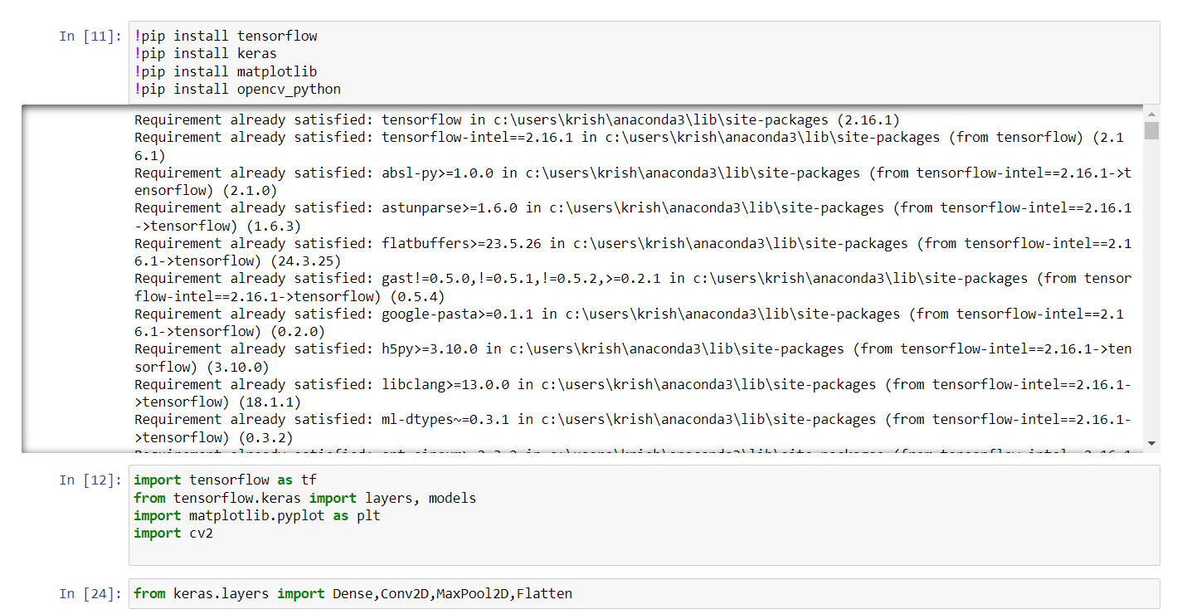
Fig 1.1
Importing models

Slide 14
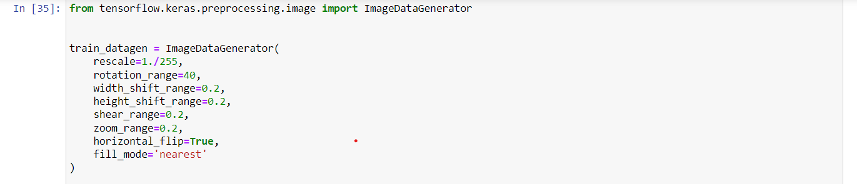
Fig 1.2
Importing models from keras to generate image

Slide 15
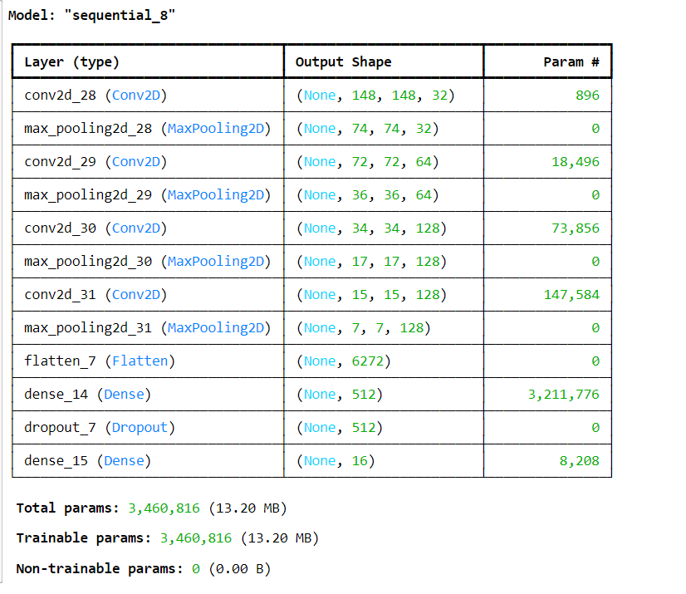
Fig 1.3
Total parameters

Slide 16
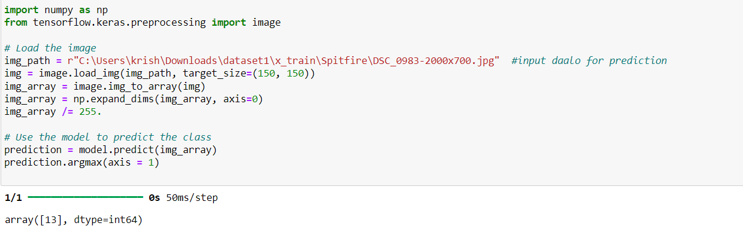
Fig 1.4 Final prediction

Slide 17
Thankyou
2210991802 Khushvir Singh Maan
2210991809 Krishna
2210991833 Kushagra
2210991829 Kunwardeep

