Slide 1
JULY 2026
MONTHLY MAINTENANCE WORKSHOP
Best Practice Sharing & Repetitive Problem Resolution

Slide 2
Workshop agenda
★
▲
📈
🏢
BEST PRACTICES
SHARING
REPETITIVE / CHRONIC
PROBLEM
DISCUSSION
ACTION REVIEW &
KPI TRENDS
HORIZONTAL
DEPLOYMENT

Slide 3
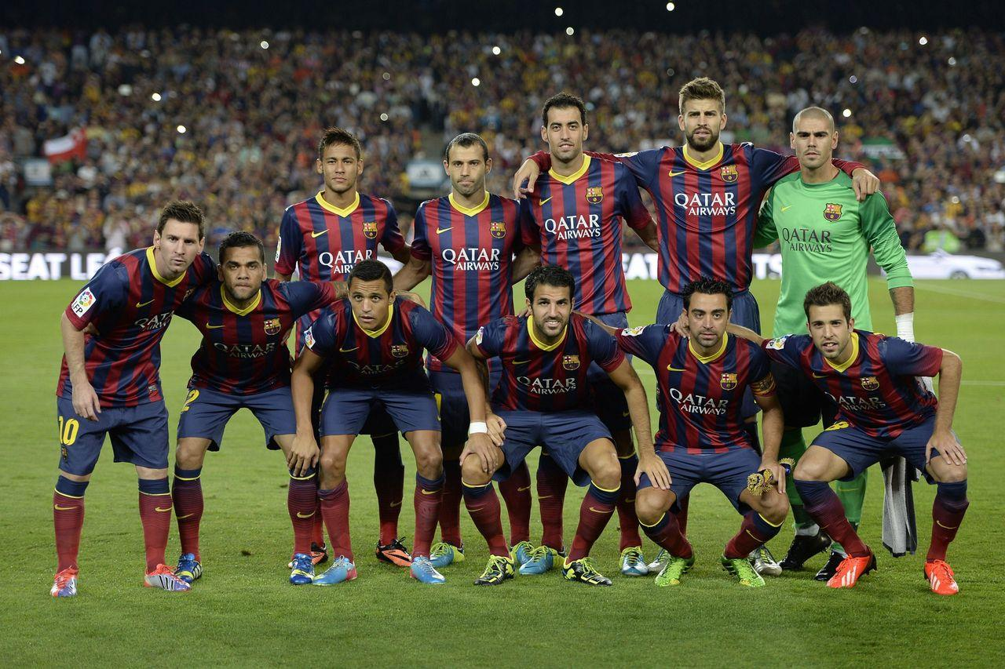
Department: Mechanical
BEST PRACTICE: blade
OBJECTIVE / PURPOSE
blade
PROBLEM ADDRESSED
bladeblade
PHOTOS & EVIDENCE
MISSING BEFORE
BEFORE
MISSING AFTER
METHODOLOGY / INNOVATION
AFTER
SUPPORTING
blade
IMPACT / SAVING
Cost Impact: Approx Rs. 123 Lakhs.

Slide 4
Department: Mechanical
SUPPORTING : Supporting Doc: blade
CUSTOM TABLE
Header 1 | Header 2 | Header 3
Data 1 | Data 2 | Data 3

Slide 5
Tracker
Monthly Maintenance Workshop
Category | Total Nos. of Entries | Nos. of entries for Action | Remarks
Best Practice | 01 | 01 | -
Repetitive Problem | 00 | 00 | -

Slide 6
Best Practice: Monthly Maintenance Workshop
Horizontal Deployment Tracker:
Department | Best Practice Title | Area/ Department to be Implemented | Deadline | Remarks
Mechanical | blade | - | - | -

Slide 7
Repetitive Problem: Monthly Maintenance Workshop
Suggestion Tracker:
Dept. | Equipment Details | Problem Statement | Discussion/ Initial Suggestion during workshop | Suggester Name | Team name for Analyse the problem | Analysis Target Date | Remarks
No Repetitive Problems recorded yet.

Slide 8
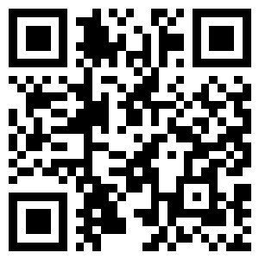
We Want Your Feedback!
Scan the QR Code to submit your suggestions live.

