Slide 1
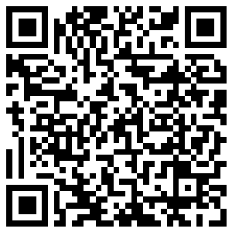
JULY 2026
MONTHLY MAINTENANCE WORKSHOP
Best Practice Sharing & Repetitive Problem Resolution
Click or Scan QR

Slide 2
Workshop agenda
★
▲
📈
🏢
BEST PRACTICES
SHARING
REPETITIVE / CHRONIC
PROBLEM
DISCUSSION
ACTION REVIEW &
KPI TRENDS
HORIZONTAL
DEPLOYMENT
Click or Scan QR

Slide 3
Tracker
Monthly Maintenance Workshop
Category | Total Nos. of Entries | Nos. of entries for Action | Remarks
Best Practice | 00 | 00 | -
Repetitive Problem | 00 | 00 | -
Click or Scan QR

Slide 4
Best Practice: Monthly Maintenance Workshop
Horizontal Deployment Tracker:
Department | Best Practice Title | Area/ Department to be Implemented | Deadline | Remarks
No Best Practices recorded yet.
Click or Scan QR

Slide 5
Repetitive Problem: Monthly Maintenance Workshop
Suggestion Tracker:
Dept. | Equipment Details | Problem Statement | Discussion/ Initial Suggestion during workshop | Suggester Name | Team name for Analyse the problem | Analysis Target Date | Remarks
No Repetitive Problems recorded yet.
Click or Scan QR

Slide 6
OUTSTANDING SUGGESTIONS
"Hajiajz"
— 0 (Maintenance & Engineering Dept)
"OopNb"
— Ysh (Power Plant Dept)
Click or Scan QR

Slide 7
We Want Your Feedback!
Scan the QR Code to submit your suggestions live.

